Slide 1
Wrap up on perfSONAR-Lite_TSS and Network Troubleshooting
Mario Reale GARR / IGI
EGI Network Support Coordination
mario.reale@garr.it

Slide 2
A little bit of history
During EGEE III a task of the SA2 activity was dedicated to the provisioning of a network monitoring solution for EGEE
The task emphasis drifted
from “monitoring” to “troubleshooting”,
from “scheduled measurements” to “on-demand”,
.. and to light deployment
DFN (RRZN Erlangen) designed a tool based on the widely known/used PerfSONAR framework

Slide 3
PerfSONAR-Lite_TSS
The idea was to provide a light weighted tool, acting on-demand, to provide network troubleshooting for Grid sites
Based on the PerfSONAR Web Services protocol
Key concept:
Few very basic network troubleshooting tests
To identify possible issues impacting on the provided functionality by the middleware
A few basic network tests/measurements:
Ping
Traceroute
Reverse DNS lookup
Port Scan
BWCTL (IPERF) bandwidth test
The tool has been developed by DFN/RRZE and validated by GARR, RENATER and NDGF

Slide 4
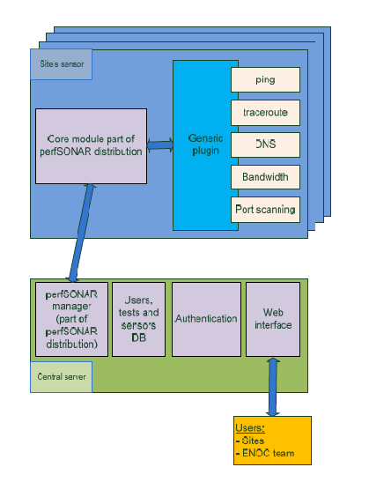
PerfSONAR-Lite_TSS Architecture
Central Web Server to access measurement results
A light-weighted sensor probe in each Grid site
Basic functionality provided by perfSONAR plugins
Two categories of users:
Sites
Network Coordination team

Slide 5
PerfSONAR-Lite TSS Architecture
Network troubleshooting tool
Runs tests on demand from a Grid site, managed by a central team or a grid site administrator:
ping, traceroute, DNS lookup, port scan e bandwith
1
Network Coordination, ROC or site administrator
2
6
3
ENOC
5
administrator
4
Grid site B
Grid site A
Local site light PerfSONAR’s sensor
Central Network Coordination monitoring server
5
Notes:
5

Slide 6
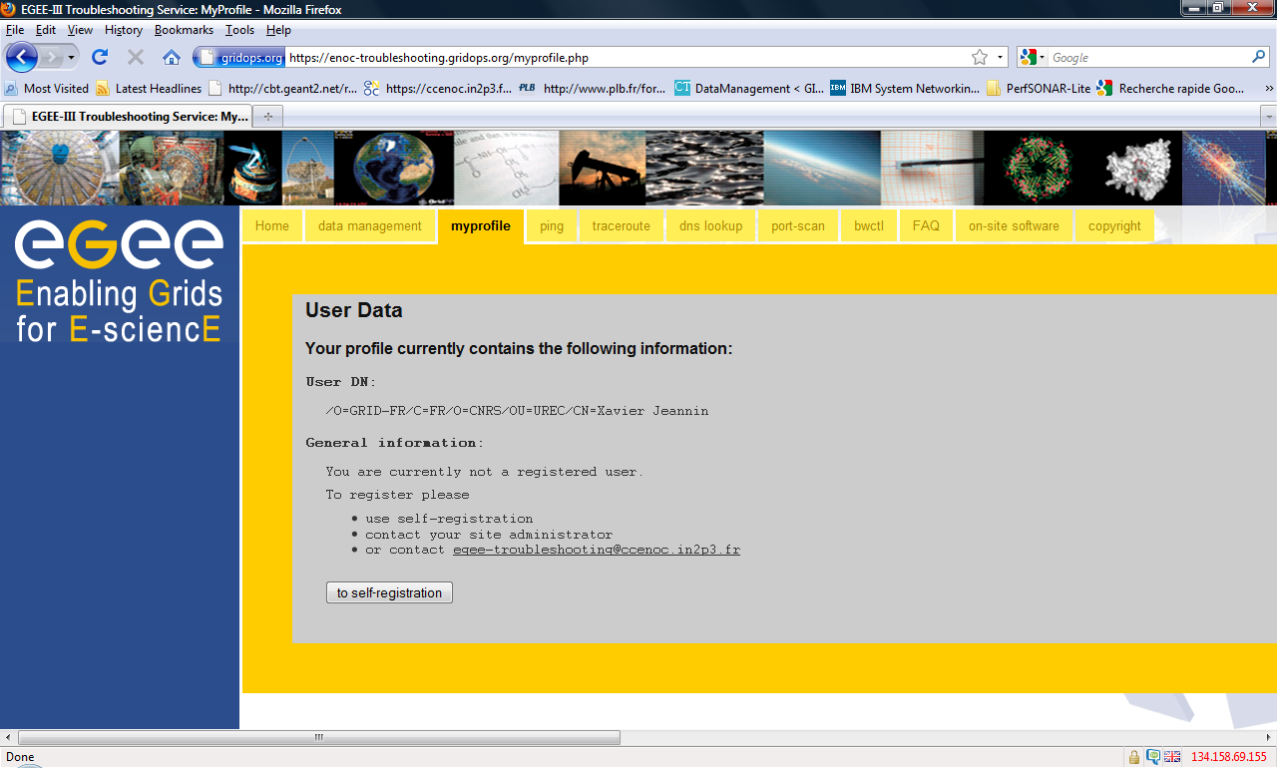
AuthN based on X.509 certificates

Slide 7
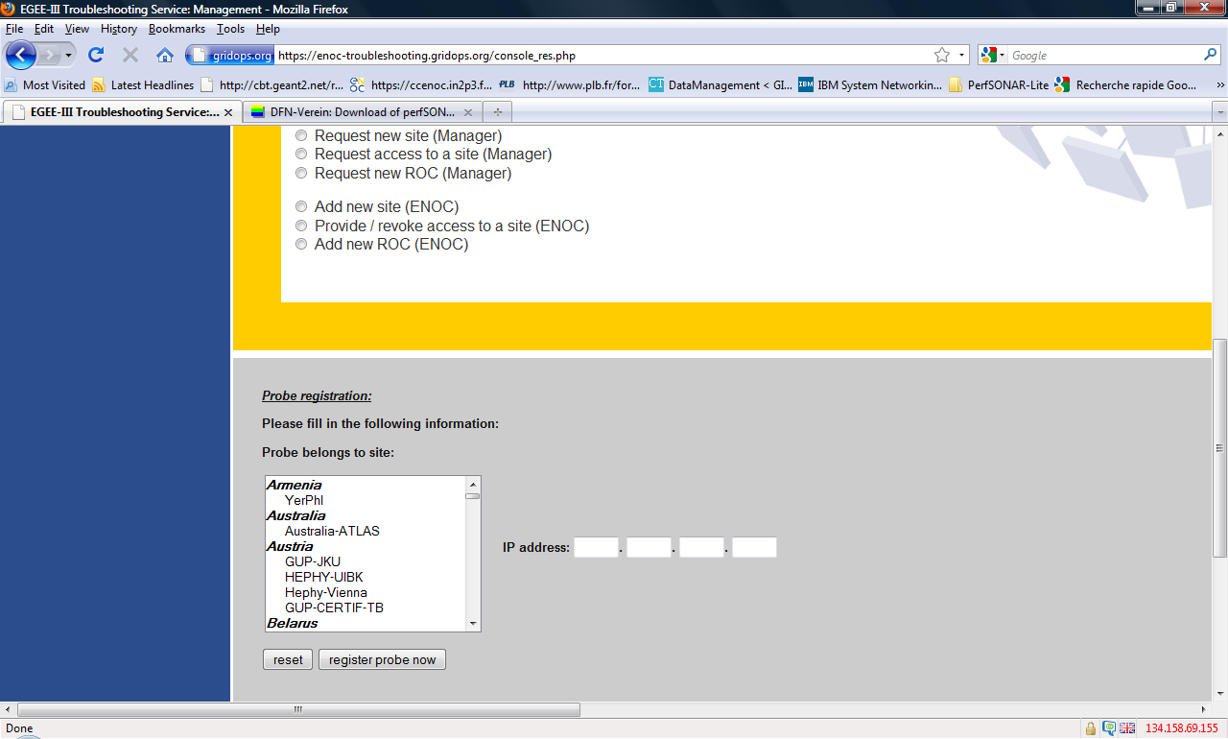
Registering a new probe

Slide 8
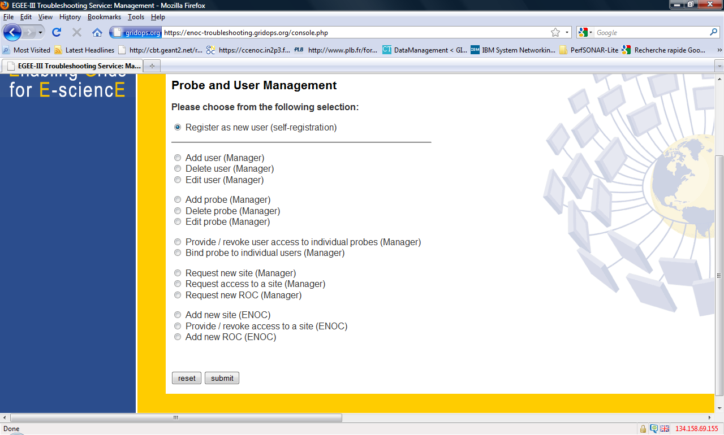
Probe and User Data Management

Slide 9
Traceroute Test
9
9
Notes:
9

Slide 10
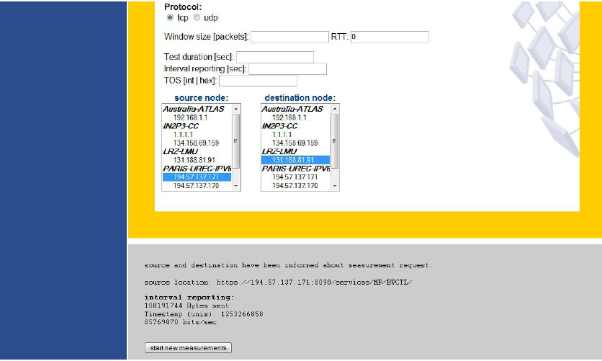
BWCTL Test

Slide 11
Advantages / Nice features
Focuses on an effective aspect like troubleshooting
It’s on demand
Foresees 2 different user profiles ( Coordinator, Grid Site)
Relatively light in deployment
Based on a widely used and reliable set of web services protocols (PerfSONAR)

Slide 12
Limitations / Issues
Some issues related to the security of the BWCTLD (too accessible to launch test)
Partially corrected in the last months of EGEE (specifying allowed IP addresses)
User Interface / Web forms a bit heavy / non particularly user friendly
Limited test campaign / validation
Tightly coupled/ too bounded to the GOC-DB structure
Some issues with probe registration / actually available probes

Slide 13
Summary on the tool
Hit the target of Troubleshooting on demand
It did not reach full production quality
Room for improvement in
Security
Web Interface for users
Would however be a pity to drop it ☹
….and the nice news is that we won’t waste the experience and effort around it ☺
http://www.dfn.de/win/quality-of-service/download-von-perfsonar-lite-tss/

