Slide 1

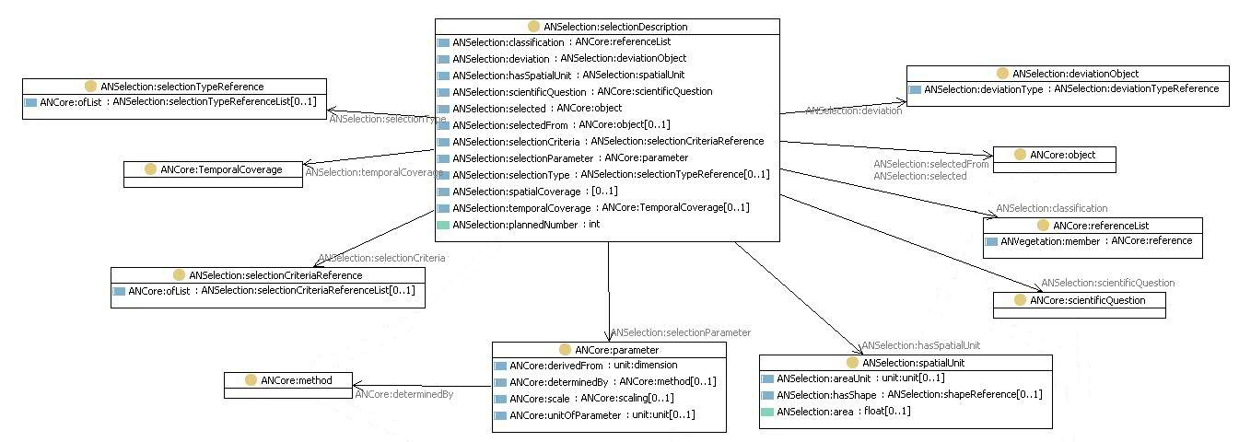


Biodiversity and C-Sequestration
LifeWatch use case: Pre-processing
ILTER
European Grid Infrastructure, EGI, Amsterdam,
15th Sept 2010
Michael Mirtl
(EAA, Austria)
Notes:
Key question: does biodiv influence sequestration of C – and to what extent

Slide 2
C-household in general
Notes:
a bit of textbook knowledge
to make data requirements understandeable

Slide 3
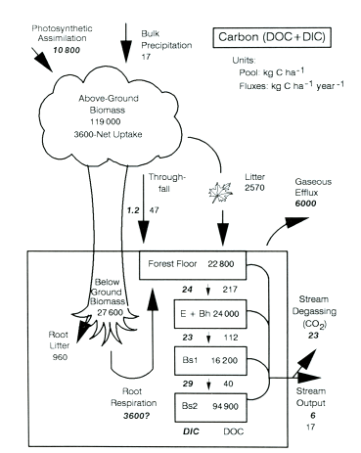
C-household in forests
Hubbard Brook C-budget model
Notes:
forests: biggest part of C in standing biomass, but substantial part in forest soil with 3 different pools (numbers show share)
critical: there is hardly any monitoring of soil biodiversity

Slide 4
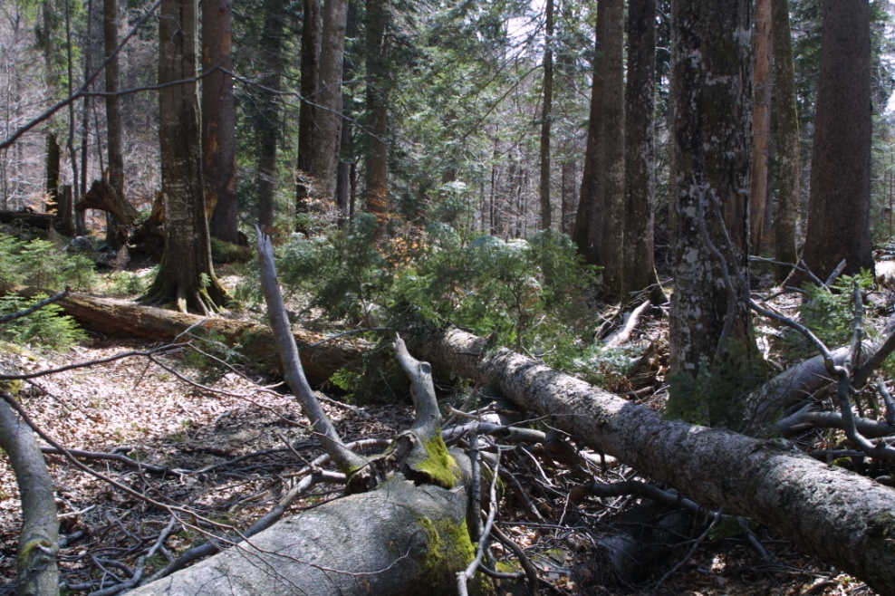
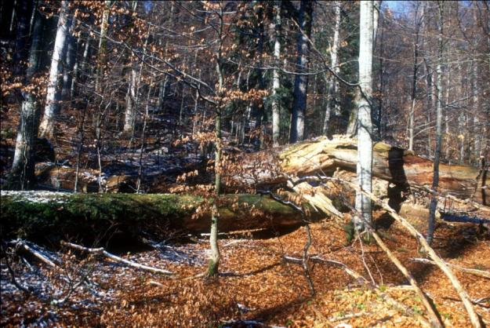

Slide 5
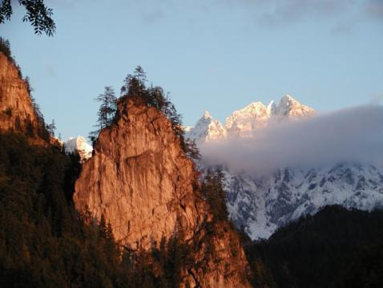
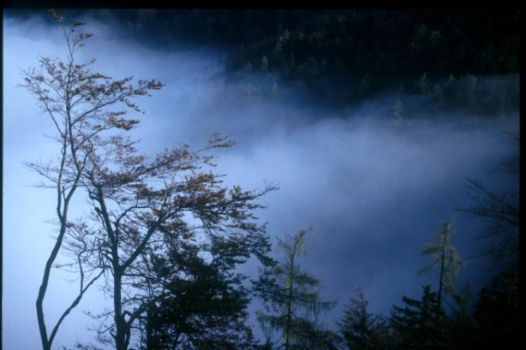
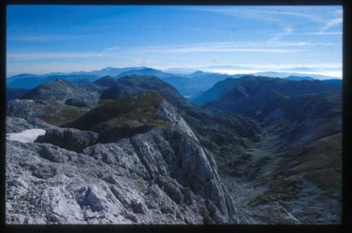
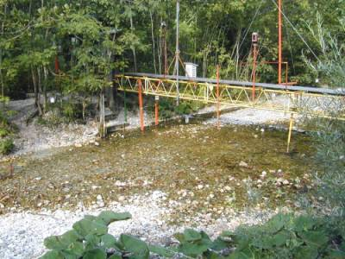

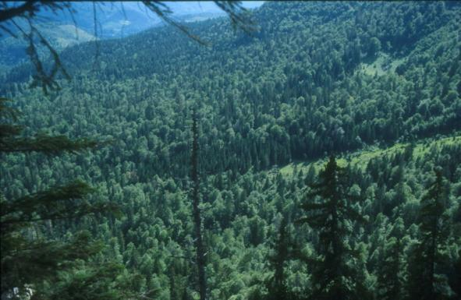
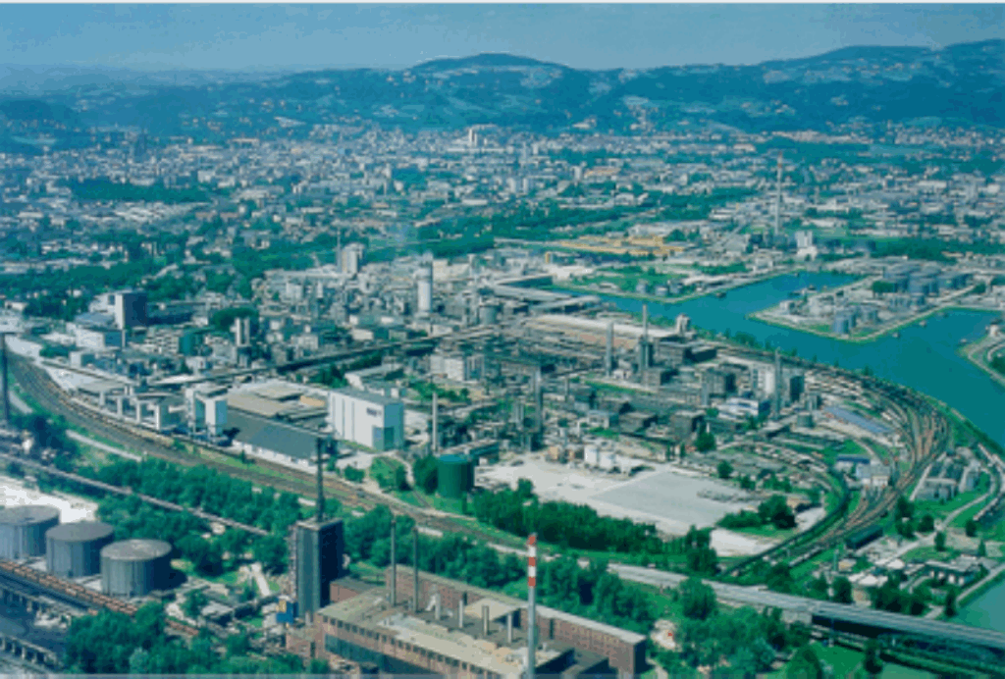
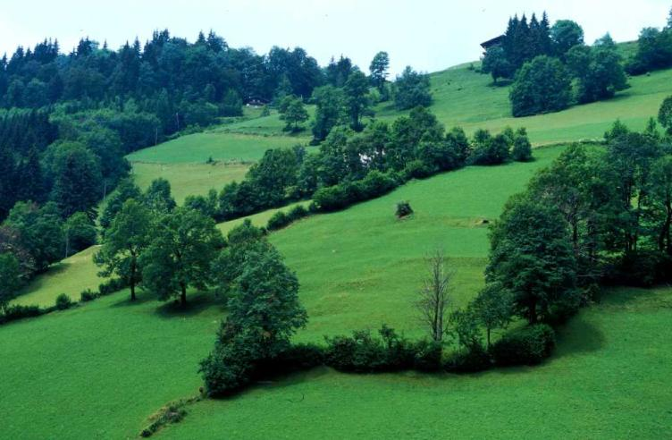
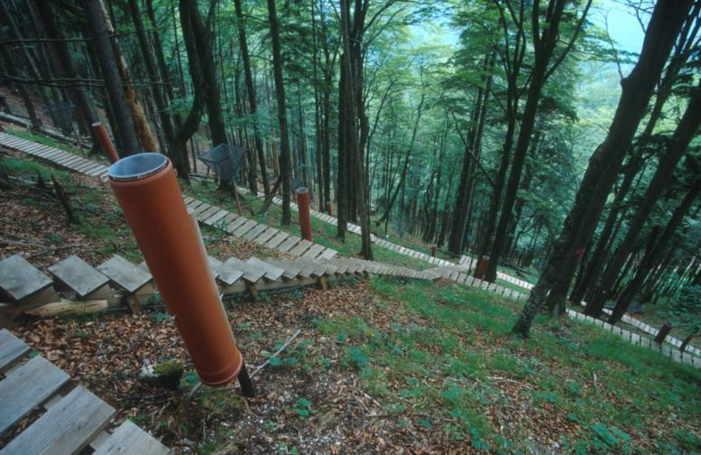



Pristine Forest „Rothwald“
main
Notes:
across different stand, soil types and management practices

Slide 6
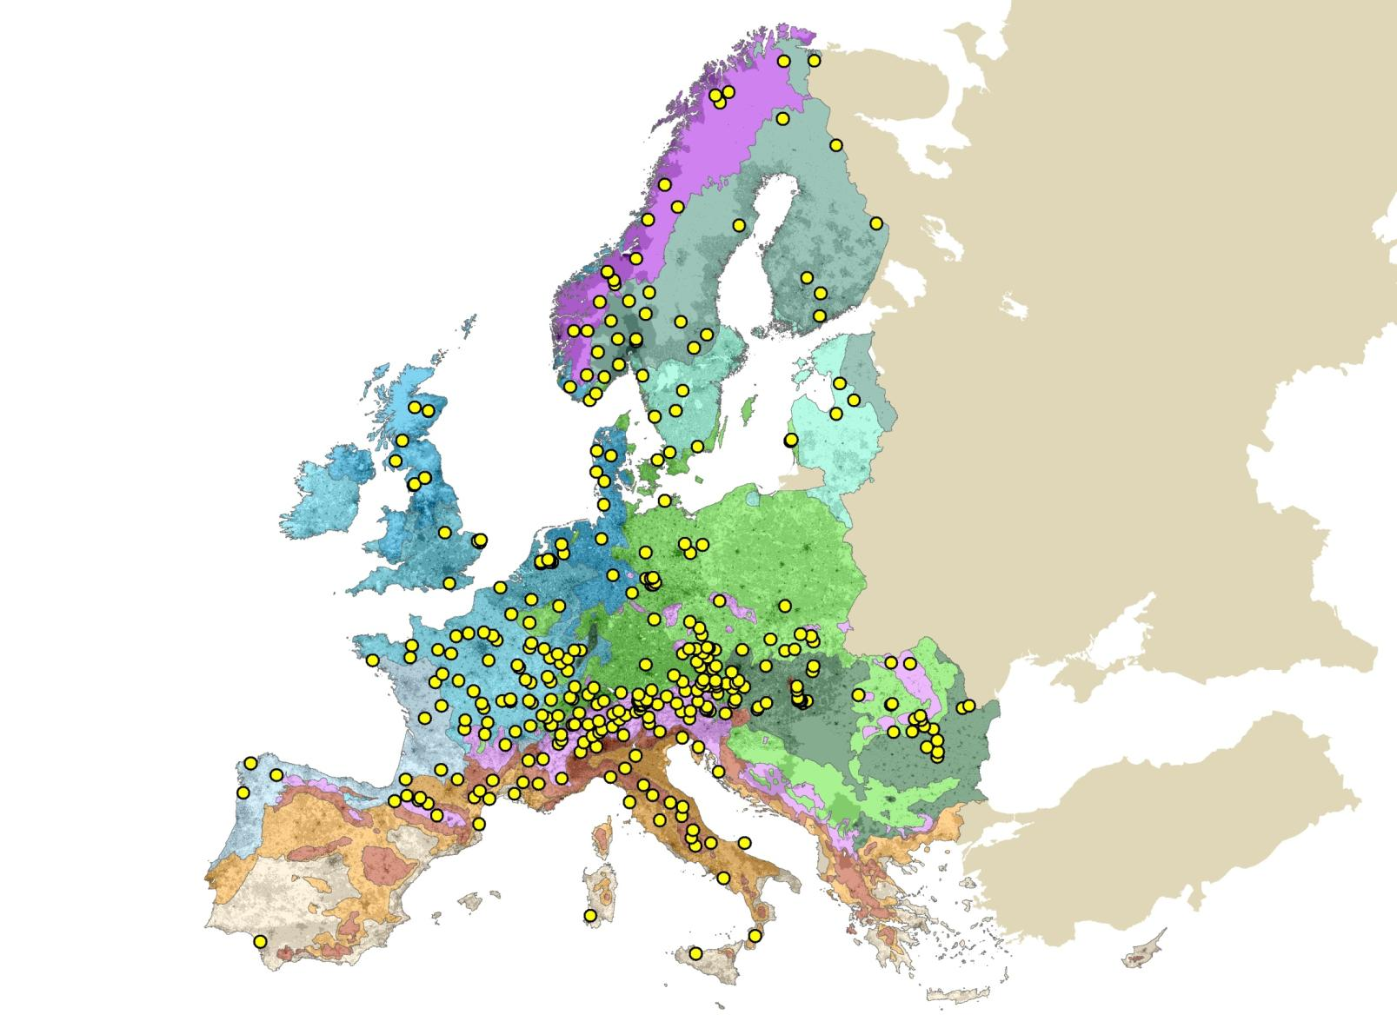
Sites with minimum meta-data (EU27)
LTER Sites (EU27)
406 declared sites (with meta data)
Notes:
continental environmental gradients

Slide 7
3 Variants of the use case, reflecting different...
spatial scales
data requirements (number of parameters, resolution)
data availabilities
time horizons for implementation (2-10 yrs)

Slide 8
3 Variants of the use case
Forest stand biodiversity and C-sequestration across Europe (based on long-term monitoring data)
Forest ecosystem biodiversity and C-sequestration (at research sites)
Interactions of biodiversity and short-term pulses (selected landscape patches and top sites)

Slide 9
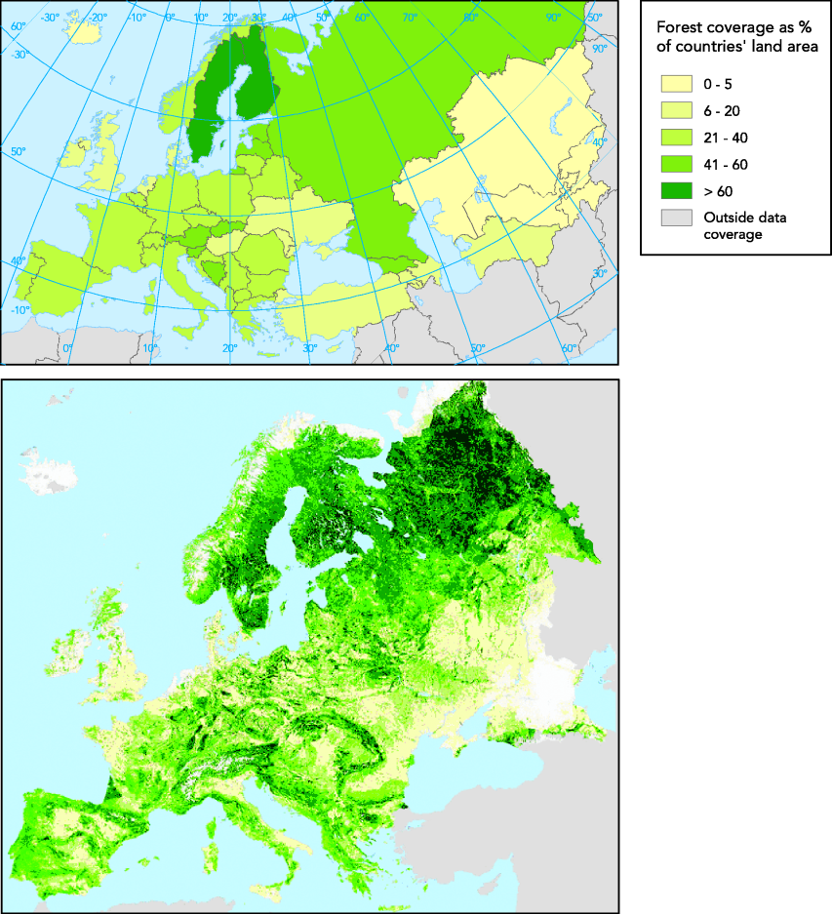
Variant 1: Forest stand biodiv & C
Notes:
in most European countries: forest has substantial share

Slide 10
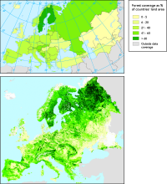
Var 1/ Hypotheses
Provisional working hypotheses:
tree species composition of forest stands across Europe influence C sequestration of forest ecosystems
data used for the Kyoto protcol calculations implicitly consider some biodiversity effects
Background Info:
calculated biomass contains empirical knowledge on interrelation between biodiversity and production (tree species specific root-shoot rations etc.)
calculation of C pools and fluxes based on these data contains this biodiversity signal
BUT: so far no systematic backwards check, if biodiverse systems do show better carbon sequestration (or more stable carbon sequestration)

Slide 11
Var 1/ Data and data sources
Data (scale: national forest inventories plots; resolution: 5-10yrs)
tree species compostion,
biomass (canopy, partly calculated depending on species composition)
soil type
soil carbon
litterfall (calculated production depending on species composition)
Data (scale: countries, continent; resolution: 5-10 yrs)
standing biomass
remote sensing data on species composition of forests (finer than CORINE classes)
remote sensing data for standing biomass
soil carbon modelling from IPCC (grid cell size?)
Databases/Holders
national Kyoto focal points
national forest inventories
CORINE
GMES
IPCC

Slide 12
Variant 2: Total biodiv & C
Notes:
in most European countries: forest has substantial share

Slide 13
Var 2/ Hypotheses
Provisional working hypotheses:
total biodiversity of forested ecosystems influences C sequestration
high Biodiversity reduces C fluctuations in time (mid- to long-term)
Assumptions:
most sites don´t have both, biodiv and C pools/fluxes (at least not for all compartments)
therefore C-household model (pools and fluxes) required for the site level (rather plot than micro-catchement level) in order to model lacking elements
supersites with complete measurements can be used for model development and testing
surrogates/indicators for total system biodiverstiy can be identified (e.g. vascular plants and plant communities of groundlayer vegetation, microbiological diverstiy in soils)

Slide 14
Var 2/ Workflow
identifcation of data requirements and decision on biodiversity surrogates for system biodiversity (might vary across forest types and environmental zones)
Europe-wide search for suitable sites based on site metadata
collation/comparison of available parameters and methods (classification & semantic mapping to secure interoperability)
evaluation of sites in terms of coverage of ecosystem compartments (C pools), fluxes and site specific models
development of a general C-household model
parameterisation of the general C-houshould model for about 100 sites
access distributed data sources (data portal, WEB interfaces, WFS for data harvesting)
correlative testing of C-storage trends against total biodiversity & biodiv trends
ITERATIVE PROCESS: implementation of identified biodiversity related C-household alterations in the C-household model itself
Notes:
in addition:
identification of sites with special combinations of information for specific research questions related to further improvements of the C-household model
example: existing data on soil biodiversity (collembola, isopods...)
example: sites with genetic information (genetic variability of trees, genotypes....)

Slide 15
Var 2/ Data and data sources
Data (spatial scale: plot, site)
biodiversity data (surrogates for biodiversity in main system compartments)
ev. functional traits
Soil type
Soil physical data
C pools (forest type/ ecozone specific main pools: above & below ground biomass, soil C)
C fluxes (measured directly, indirectly)
Meteorological data (in situ): Temp, precipitation
Databases/Holders
ICP Forest metadatabase and database
LTER-Europe metadatabase
100-200 distributed site holders databases
Databases of individual research teams and researchers
EML data worldwide/ in Europe
ICOS meta/database (ecosystem site component)
National meteorologtical institutes
Notes:
Plus
information on ecosystem processes, cause-effect relationships
quentification of drivers of C-sequestration
development and validation of general C-householde models
Minus
short signals can´t be detected (-> dynamics in time)
weak link with ICOS as atmoshperic CO2 levels don´t systematically vary on the continental level (no gradient that could be used to test C-sequestration dependancy of comparable ecosystems across a CO2 gradient)

Slide 16
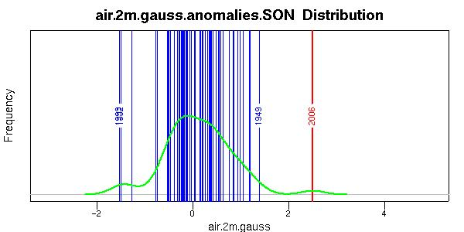
Unprecedented conditions already recently encountered (seasonal scale)
Fall 2006 (Europe)
Cattiaux et al 2008
Summer 2003
(Switzerland)
Schär et al 2005

Slide 17
Impacts on carbon balance
Peylin et al., 2008
Ciais et al. (2005)
Reichstein et al (2006)

Slide 18
Historical and recent stand dynamics
Splechtna, B.E., Gratzer, G., Black, B. subm.
Gratzer, G., Splechtna, B.E. and Rudel, B.subm.
Notes:
Effects of climate effects on increments less pronounced than growth response to release-events

Slide 19
Var 3/ Hypotheses
Working hypothses:
With high biodiversity C-sequestration is less affected by short term pulses (disturbances, extreme events such as drought...)
Assumptions:
There is a treshhold size for ecosystems beyond which C-metabolism can be detected by ICOS (forested areas of a certain size or bigger)
A number of landscape patches bigger than the treshold are available with comparable environmental and site parameters, but differing in biodiversity
C-pools and fluxes in such patches can be examplarily investigated with a seasonal time resolution at top sites

Slide 20
Var 3/ Data and data sources
Data
information on C-sequestration/release on the landscape level on a daily basis
biodiversity of landscape patches (surrogates): combination of terrestrial surveys and remote sensing
seasonal monitoring of C-pools and –fluxes at sites (soil, litter, canopy)
consideration of fast/medium/slow C-pools (soil: MO bound C to clay mineral bound)
biodiversity data for key compartments (canopy, soil)
Databases/ Holders
ICOS meta/database (ecosystem site component)
LTER-Europe metadatabase
100-200 distributed site holders databases
Databases of individual research teams and researchers
EML data worldwide/ in Europe
National meteorologtical institutes
CORINE
GMES
? EBONE

Slide 21
Overview: Who uses what?
Var 1: Research uses monitoring data from broad scale monitoring schemes
Var 2: Research uses small scale monitoring data and research data from permanent research infrastructures across dozens of sites (broad scale in terms of continental gradients)
Var 3: Research uses broad scale monitoring data in a new context, plus site specific and sub-regional monitoring and research data

Slide 22
Pre-processing: Data user perspective

Slide 23
Pre-processing: Data provider perspective

Slide 24
Key messages
Distinction between support for data access and data provisioning
Research is both, user and provider
Aerial monitoring data less critical than data gathered in a research context across Europe (standards, reporting obligations & resources for reporting)
Metadata importance increases with variability and complexity of design, i.e. closeness to a research context
Semantic annotation must be consistent and supported by simple tools for the data providing end user
Research data are primarily held in decentral data storages (all centralized approaches have failed over decades)
Role of European „research infrastructures“ as high tech long-term monitoring networks vs. infrastructure for linked short-term research projects to be considered

Slide 25




The vision as developed by ALTER-Net
Seamless access to meta information and data
Distributed data sources
Ecosystem, biodiversity and socio-ecological data
Where, what, how, etc.
Distributed Datamining
with local tools
Legend
Ontology
Semamtic orientied
data storage
Portal
Data storage
End user
Application
Semantic oriented
SearchEngine
and Portal
SERONTO

Slide 26

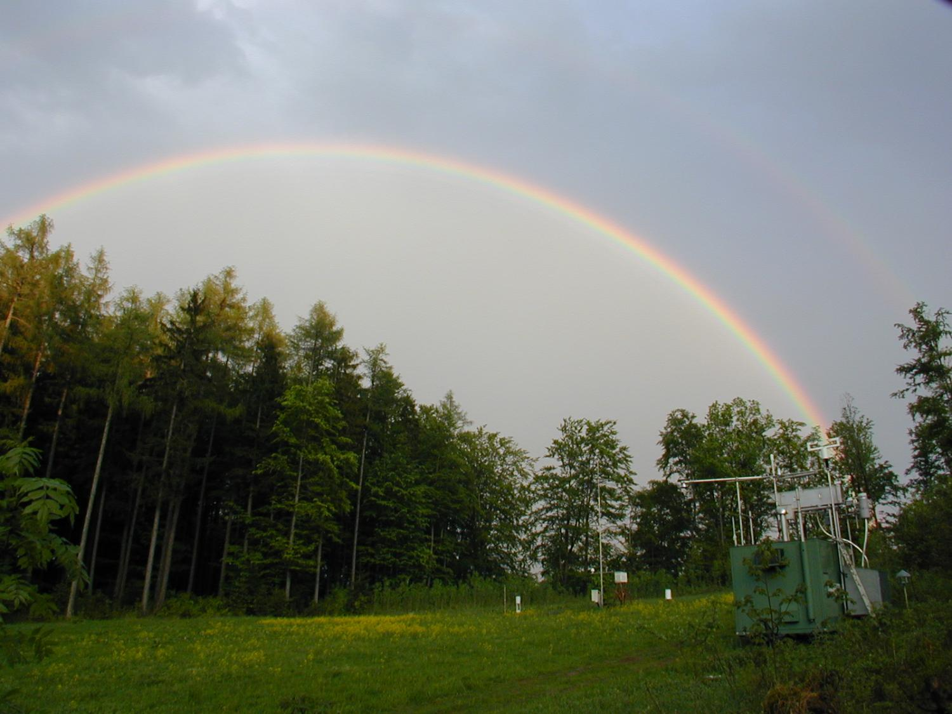
deck

Slide 27
Pristine Forest „Rothwald“
main
Notes:
Aiming at a comprehensive understanding ov the dynamics of natural mixed spruce-fir-beech forests:
Quantification of the effects of several natural disturbances on stand dynamics
Identification and characterisation of mechanisms allowing for the co-existance of dominant tree species
Description of the spatio-temporal development of the observed forest stands on permanent plots
Extending permanent plots to improve further monitoring

Slide 28
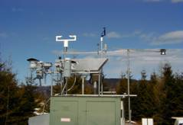
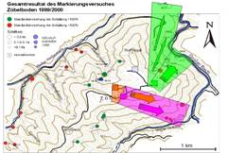
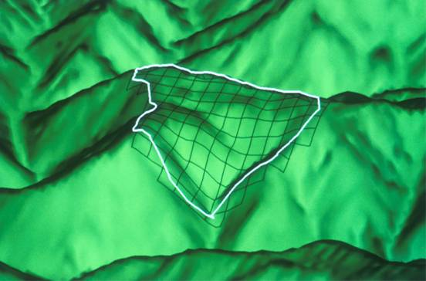
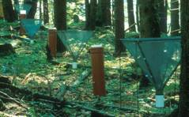
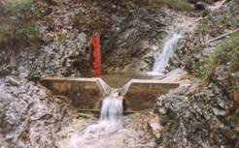
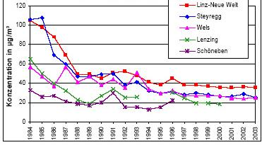
Environmental monitoring schemes
Input
Ecosystem Change
Output
Trends
Hydrology
Experiments
Atmosphere
Notes:
TO START WITH THE DESIGN:
to understand LTER we´ve to know about its history and past objectives
Let me recall the model of Integrated Monitoring.
We take a catchment, measure input and output of substances and investigate ecosystem changes.
Although gross commonalities exist of the measurement of parameters, this basic model calls for specific design optimations in each of the IM sites. In my presentation I will focus particularily on this specificities which are due to the nature of the investigated system.
After a short overview I will touch on each of the benchmarks Michael explained:
I will comment on the peculiar cross-scale variability of the site
I will give examples on how we merge many disciplines into one design
Since quality assurance is a core focus I will also tackle this topic
and last I will show how our project is embedded in the broader research and monitoring activities in the region, in Austria and internationally

Slide 29
LTER-Europe in the LifeWatch context

Slide 30
1) USERS: Environmental Research
Projects/ Networks requiring in-situ components and infrastructure
Examples:
- NOHA
- ANAEE
- ICOS
- LTER projects
- EBONE
2) REQUIREMENTS Identification
= „site profiles“
Attributes (examples)
- power supply
- access
- technical maintanence
- location, elevation
- trend data (monitoring)
- preceding scientific projects
- local expertise
RESULT:
Environmental Research in the ERA building and multiply using a distributed research infrastructure and its data
YES
YES
PLATFORM:
ESFRI/ ?LifeWatch
Discussion, Negotiation
Selection/Decision
NO
3) Attributes of request covered?
5) Feedback
Potential facilities
- site X
- site Y
- site Z
YES
NO
NO
4) SEARCH
LTER-Europe INFOBASE
Inquiry of additional metainformation on LTER-facilities from National LTER networks and LTER site/platform coordinators
NO
Attributes of request covered?

