Slide 1
Virtual Use Cases
the gap between Humanities and GRID
Dirk Roorda, coordinator infrastructure
http://www.dans.knaw.nl
Notes:
is there a gap?
When you look at the texts of ESFRI projects CLARIN, DARIAH, CESSDA, there is mention of GRID technology, in positive or even very positive terms.
A framework for collaboration, a source of sustainability, a potential for new research.
And from the side of the GRID initiatives there have been many invitations to come and talk and layout the use cases.
But, lately there has not been much news on the humanities front, and GRID is not mentioned that often, and where are the success stories?
So, what is happening? What is the dynamics?

Slide 2
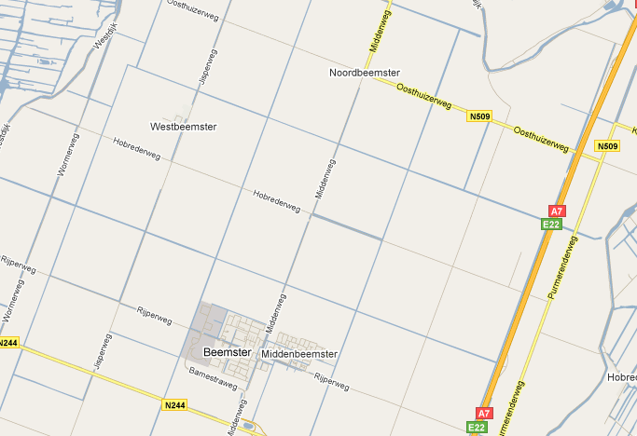
Prologue
GRID: The rationalist’s paradise
Notes:
1925 Aldous Huxley Along the Road Views of Holland
my love for plane geometry prepared me to feel a special affection for Holland.
For the Dutch landscape has all the qualities that make geometry so delightful. ...
In the interminable polders, the dykes and ditches intersect another at right angles, a criss-cross of perfect parallels. ...
No wonder Descartes preferred the Dutch landscape to any other scene.
It’s the rationalist’s paradise. ...
One feels that the universe is a simple affair that can be explained in terms of physics and mechanics, that all men are equally endowed with reason and that it is only a question of putting the right arguments before them ... to inaugurate the reign of justice and common sense.

Slide 3
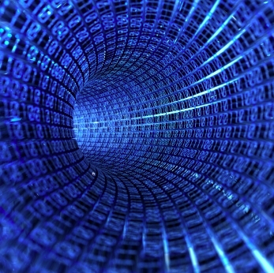
SSH and
ICT
an accelerating
story
in 3 gears
so far ...
Notes:
Yes, there is a lot of dynamics indeed.
Reckoning from where the humanities and social sciences come, and reckoning from where GRID is coming.
ICT can be seen as an engine that powers industry, technology, science and scholarship in general.
In the non-technical, interpretative sciences, the data is not produced by instruments in endless streams, but data is found as relics of times long passed, or as expressions of people doing very human things such as thinking, understanding, creating, enjoying, deciding.
All this data used to find its first expression on analogue media, such as stone, paper, vinyl disks, audio tapes. Multiplication was expensive, there was much traveling to and from the remaining copies by people that wanted to study them.

Slide 4
first gear:
online acces to sources
...
for people
Notes:
But then ICT came along. One by one all types of analogue expressions of sources became subject to digitisation.
And digital sources are easy to copy and to distribute.
It was a great improvement to have online access to sources, it opened up a wealth of material to individual researchers.
We are still in first gear. Not everything has been digitised, and online access is far from streamlined.
Yet, part of the enterprise is shifting to second gear.

Slide 5
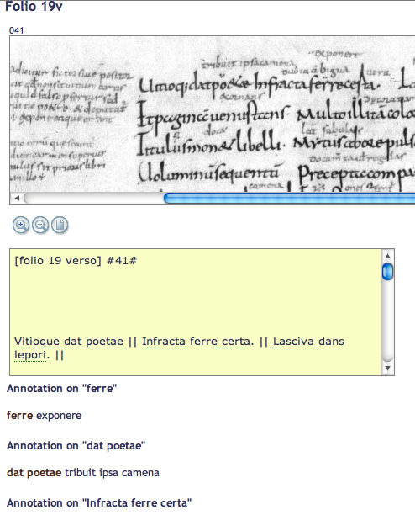
second gear:
collaborate
in
annotating
and
enriched
publications
Notes:
With so many sources now in the scope of the individual scholar, something has to be done.
The traditional way of working: close reading, interpreting, solving puzzles cannot cope with the amount of material available.
We need teams or even crowds of people doing small but intelligent things to the sources: making annotations.
And then: making editions, beautiful works with a rich set of ideas incorporated in it, around the old and new products of the human mind.
It is kind of an Industrial Revolution taking place.
This is not a trivial step. The sources have to be findable, referable, metadata must be normalised and added, results must be collected and be made available as resources themselves. Last but not least, access rights must be regulated. The international scale and improved technological accessibility of resources requires us to give the concept of trust a new meaning.
This second gear is where we can position the ESFRI projects, especially DARIAH for the humanities and cultural heritage, CLARIN for language resources and tools, and CESSDA for the social sciences.
And while these projects are by no means finished, they all are trying to shift to third gear.

Slide 6
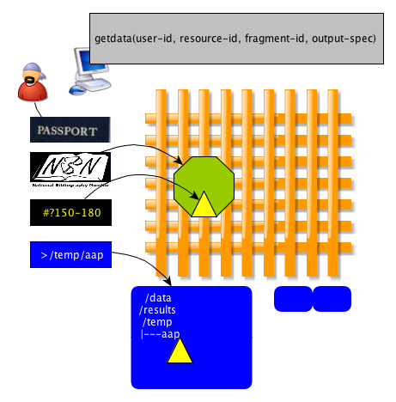
third gear:
resources
subject
to
intensive
computing
Notes:
There is something in the word GRID that suggests: solidity, rationality, efficiency, straightforwardness.
And in a sense the third gear is a straightforward step: leave the paradigm of downloading your sources to your pc, run local programs, upload your results, and publish on the outcomes.
If your resources are already out there, in cyberspace, and if, in cyberspace, you can tap unlimited computing resources, why force your processing through the bottleneck of your own pc?
This is really compelling given the increasing volume of data, and the second reason is that the algorithms that you want to run require more and more computing power.
There is, however, a but: it is not yet practical. For some disciplines, for some tasks, GRID performs well, but for the humanities and the social sciences it just has not materialized, yet.
Let us see how DARIAH, CLARIN and CESSDA position themselves with respect to high performance computing.

Slide 7
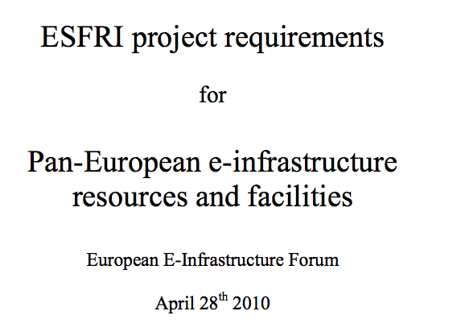
ESFRI
https://documents.egi.eu/public/ShowDocument?docid=12
EEF report (April 2010)
CESSDA, CLARIN, DARIAH
ESS, SHARE
Common requirements
single sign on
unified virtual organisations
persistent storage (and identifiers)
webservices and workflows
Notes:
Within ESFRI there has been a study to find common requirements for RIs, leading to a report in April 2010 of the EEF.
The report has consulted from the SSH projects: CESSDA, CLARIN, DARIAH, ESS, SHARE, of which I will highight the first three.
Data archiving and curation is a common need for several of the ESFRI projects.
The sensitive nature of the data to be stored leads to a need for a fine-grained Authentication and Authorization system, it also is imperative that such a system provides Single Sign On (SSO) functionality.
The ability to use grid/cloud compute facilities for the processing of the stored data is also foreseen in some projects.
In discussions with these projects they expressed their willingness to work together on pilot projects that can explore key functionality satisfying agreed requirements for identified and engaged users.
It is proposed that a series of such joint pilot projects are identified and planned across all the ESFRI sectors.
The objective would be that such pilot projects lead to working prototypes that are relevant for a range of user communities and ESFRI projects.
Subsequently the results could lead to the introduction of the successful functionality and services in the production systems of European e-infrastructures.

Slide 8
represents the linguistic community
relatively strong in computing
many exploitable language tools
research benefits from high performance computing
http://www.clarin.eu
Notes:
CLARIN is the RI for linguistics. CLARIN is a key example for various reasons.
First, many products of the human mind are expressed through language, and there are more than 6000 languages. If a humanities’ research project wants to study phenomena that are mediated through language, they either need human brain power that is conditioned for that language, or they need tools to extract the patterns of interest right through the language screen. Linguists are building resources in the form of lexica, grammars, word-nets on which computational linguists can build tools that make the various languages more transparent to digital research.
Secondly, linguistics is a rather exact science among the humanities disciplines, and has built its own track record in computing science. There is real affinity between linguists and computers.
Thirdly, the results of computational linguistics lead to technology that is applicable in real life. Applications are a driver for research.

Slide 9
initial expectations of GRID
enabling technology for workflows
sustainable tools
sustainable data
..., and all of this will be available on the internet using a service oriented architecture based on secure grid technologies
http://www.clarin.eu/the-vision
Notes:
Last, but not least, CLARIN started out with a vision to build on existing HPC technologies, such as GRID.
When connecting the world of webservices with the GRID world, something has to be done with authentication and authorisation mechanisms, because they are rather different in both worlds.
In fact the problem already occurs when you mix webservices with local tools, if you want single sign on.
In an early project CLARIN, together with BIG-GRID and SURFfederation did a pilot project that employed Short-Lived Credential Service as a bridge, connecting the Shibboleth access negotiation with that of the local tools.
So it looks as if CLARIN is really moving forward in adapting its infrastructure services to GRID technology.

Slide 10
Turning point
There is no off-the-shelf grid/federation technology; much relies on the availability of specialists who know about the details. Much adaptation and configuration work has to be done, which requires a deep understanding of the components. ... it is the interaction and integration that requires lots of efforts.
http://www-sk.let.uu.nl/u/D2R-2a.pdf
Notes:
But then, in Deliverable D2R-2a Federation Foundation for Language Resource and Technology, one can read this passage.
In the same report it is stated that the detailed knowledge that is needed to build on the GRID is not available in the client communities, and that it is difficult to get access to that expertise where it can be found, in the computing centres, due to capacity problems.
This all handles about just a part of the challenge: implementing authentication and authorisation in a webservices/grid context.

Slide 11
Current point of view
interested in data grid
for webservices: consider cloud
unclear what will turn out to be a stable technology for the CLARIN RI
Notes:
When it comes down to the construction stage, where things get implemented, CLARIN does not see readily available GRID technology that can perform the following things at the same time:
maintain large amounts of data securely
create and maintain workflows of webservices using that data
used by communities of many users
with proper authentication and authorisation
If these things can be realised quicker using cloud technology, even commercially, so be it.

Slide 12
humanities, arts and cultural heritage
mission
explore and apply ICT-based methods
link digital source materials of many kinds
exchange expertise across disciplines
key concepts
virtual infrastructure
virtual competence center
VCC1 e-Infrastructure ; VCC3 Scholarly Content
http://www.dariah.eu
Notes:
DARIAH is for arts and humanities, and cultural heritage.
The mission is to give ICT-based methods more scope, add meaningful links between sources of all (digital) kinds, and exchange expertise across disciplines.
It is planned to organise DARIAH as four Virtual Competency Centres (VCCs).
Each of the four VCCs is focused on one particular area of expertise:
-1- e-Infrastructure,
-2- Research and Education Liaison,
-3- Scholarly Content,
-4- Advocacy
Of these, 1 and 3 are most relevant for GRID computing.

Slide 13
DARIAH on the GRID?
no mention on high performance computing
scarcely mentions grid
programmatic access to data: yes
emphasis on preservation of data
But then there is TextGRID
http://www.textgrid.de/
Notes:
When I look in the documents of DARIAH and search for references to GRID,
I do not find high performance computing, but there is mention of the grid, not much though, and programmatic access to data.
The emphasis is on preservation of data.
Yet there is a real interest in GRID and a real dedication to use it.
One of the best testimonies is the TextGRID project and foundation in Göttingen, one of the DARIAH partners, which is itself a joint project between 10 partners.
It is funded by the German Federal Ministry of Education and Research (BMBF) for the period starting June 1st 2009 to May 31th 2012.
It consists of The TextGrid Repository a long-term archive for research data in the humanities, embedded in a grid infrastructure, and
The TextGrid Laboratory, a virtual research environment, with a growing set of tools.
This can be seen as an excellent testbed of what GRID can do for humanities.
Note that TextGRID is not about high performance computing. The GRID is mainly used for its datastoring capabilities.

Slide 14
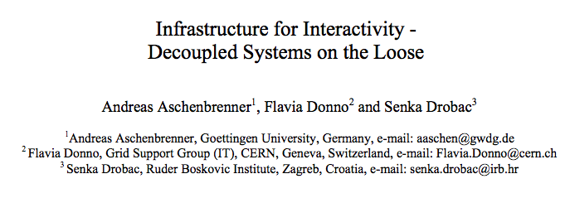
First Periodic Report 2009
announces infrastructure experiment
showing large computational needs for humanities
indexing unstructured resources in an on-demand and flexible manner
conducted on D4Science
http://dariah.eu/wiki/images/e/ea/090426_dest09_interactivegrid.pdf
Notes:
The Report in 2009 announces two experiments, with TextGRID and D4Science, but to me it was unclear whether these experiments have taken place by now.
But there is a report: Infrastructure for Interactivity – Decoupled Systems on the Loose, with many acute observations of the practice in the humanities on the one hand, and the many providing technologies in the grid world on the other hand.
I see it as a real attempt to pave the way for humanities’ use cases towards using grid and cloud technologies.
FIndings are: repositories still have to be linked to grid infrastructure.
Ways to do so are via cloud interfaces on a GRID, or loosely coupled through web technologies (REST based interface).
All in all, In the DARIAH deliverables I have not seen something conclusive about using the GRID. I think TextGRID is the most visible step forward.
I know that there have many profound discussions about the nature of the technology that should carry the DARIAH research infrastructure.

Slide 15
Umbrella for social science archives
since 1970
Upgrade in ESFRI context (FP7)
developing:
the data portal to allow seamless access to data holdings across Europe
common authentication and access middleware tools
investigating the potential of grid technologies
improving data harmonisation tools
Notes:
CESSDA is venerable and old, a liaison of social sciences archives since 1970.
Now, in the ESFRI Framework Program 7 it is undertaking an overhaul, basically to give the ICT induced dynamics a better scope.
The business of CESSDA is to provide access to large amounts of data on society, and to do meaningful things with that data, such as harmonising the results of different studies, and then analysing the quantities and qualities.
One of the subtasks of the preparatory project is to investigate the potential of grid technologies.

Slide 16
Use cases contain
data collection
applying harmonisation
collect results and analyse them further
in a collaborative environment
under severe access restrictions
develop new surveys comparable to existing ones
Notes:
The use cases in CESSDA center around the collection of data
developing methods to harmonise them,
do analytical studies on the results
It is important to do that in collaboration with researchers all over Europe,
but due to the sensitive nature of portions of the data,
the access conditions must be tightly controlled.
New scientific survey methods may be developed, and then it is important to be able to compare the new results with those of older surveys, for which lots of data of various sources must be accessed, harmonised, and analysed.

Slide 17
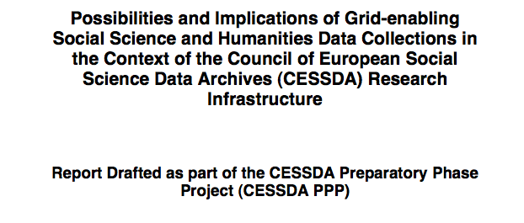
In February 2009
Yes GRID can help
but many approaches
of which maybe none enables all scenarios at the same time
http://www.cessda.org/project/doc/D11.1a_Grid-enabling.pdf
Notes:
The February 2009 report says that yes GRID is useful, but with certain caveats: GRID might solve partial problems,
but it is unclear which precise approach to choose,
and whether there is an approach that will satisfy all constraints in the relevant scenarios.
Richard Sinnott

Slide 18
May 2009 SWOT analysis
GRID solves several partial problems
current GRID technology not geared to the core of CESSDA’s problems
do realistic case studies on
GRID, Cloud, traditional client server
http://www.cessda.org/project/doc/D11.1b_Sustainability_CESSDA_e-Infrastructure.pdf
Notes:
The May 2009 analysis of Strengths, Weaknesses, Opportunities and Threats makes it more explicit.
While the GRID solves several partial problems (like single sign on),
the technology as a whole is not geared to the heart of CESSDA’s problems,
and the recommendation is: do realistic case studies and
conduct them on various technologies:
GRID, Cloud, and traditional client server.
Richard Sinnott

Slide 19
requirements
functional
enable data intensive scholarship
better support for existing hypotheses
new research questions
enriched publications
enable collaboration around sources
incremental enrichment (annotations)
connecting sources (linked data)
connecting people (collaboratories)
Notes:
A step back.
Why are humanities interested in RIs?
Let’s summarise the most important requirements, on a very high level, so that we can focus on what is really needed from GRID technology.
The highest level is to accomodate a change in scholarly dynamics due to the new possibilities generated by ICT.
We have to translate this into implementable requirements.

Slide 20
requirements
“non-functional”
respect access rights
sustainability of data and tools
ease of use and programming
performance
Notes:
Before we do that, it is handy to list some (very important) “non-functional” requirements.
Access rights may be more complicated here, because the multiple roles that the sources play: they are also exhibited in musea, published by commercial parties, etc.
Sustainability is more profound than elsewhere: these sources have often existed for centuries, consulting digital representations of these sources is likely to last for a few centuries more.
Writing applications to give beautiful access to sources should not be inordinately difficult due to underlying technology. That technology should be shielded from application programmers working for the humanities. It is this kind of “ease of use” that I have in mind, not the ease of use of the end-user (which is important as well, but that is a concern for the application developer).
Performance is important, but not that important. The quest for real high performance is still isolated. But when the need arises, HPC should be “around the corner”, so that applications can be written for every kind of performance without dramatic redesign.

Slide 21
characteristics
data from irrepeatable processes
data in many small chunks
complex interrelationships
emphasis on human interpretation
natural language processing
symbolic processing
linking to background knowledge
Notes:
GRID technology is optimised for large volumes of data, for parallelism and many instructions per second.
When GRID people look at humanities data, a first reaction might be: out of scope.
All files are small, there is no real computation.
Yes. And there are other things that do not enter into the considerations: the complex structure of the data, and the many interrelationships.
We talk about data that does not make sense without extensive interpretation, symbolic processing, and links with human background knowledge.
So people want to work with this data in other ways than with data that flows from scientific instruments.

Slide 22
human interpretation
only part of the dataprocessing can be automated
higher level patterns require higher performance computing
researchers need interaction with data and processes
store intermediate results
build virtual collections
Notes:
The humanities are working on an exciting (meta)program of trying to capture as much of human interpretation skills in software as they can.
Yet they are far from an unbroken algorithmic chain from data to cognition. So, intermediate results have to be gathered, looked at by humans, reordered, enriched, submitted to other workflows.
There is much interaction needed between researchers and their data, so the infrastructure should facilitate that.
How can we direct the technology people in such a way that they build the infrastructure that we need?

Slide 23
(virtual) use cases
a use case spells out a concrete task from the perspective of an end user
the humanities present few use cases
where HPC is essential
with “significant” amounts of data
which can be translated into batch jobs
so: virtually no concrete use cases!
Notes:
By means of use cases, but not limited, concrete, end-user use cases, but by virtual use cases.
We can learn a lot from CLARIN, DARIAH and CESSDA in terms of generic requirements for research infrastructures.
Starting with concrete end users and their concrete jobs is an unnecessary step back.
There is an other disadvantage: there are not that many concrete use cases to be found in the humanities.

Slide 24
virtual use cases
a virtual use case
spells out a generic task
from an infrastructural perspective
still meaningful to the end user
virtual use cases
pave the way for real use cases
bridge big gaps between
end users of
“foreign” infrastructure
Notes:
So let us formulate a use case that incorporates the collective wisdom of what these RIs have yielded so far.
That means that such a virtual use case spells tasks that are generic: you might see the task, in different guises, again and again in different research projects.
Such use cases highlight pieces of infrastructure that should be there in order to make it work.
They should be a foundation on which you can develop concrete use cases, in two senses: (a) concrete use cases that require the infrastructure yielded by virtual use cases as a prerequisite (b) concrete use cases that are instantiations of virtual use cases.
Such virtual use cases might cover the wide tract of land between the humanities end users and the existing, “foreign”, GRID infrastructure.

Slide 25
a specific virtual use case
smart indexes on unique resources, e.g.
speech sounds in audio sources
names in hand-written sources
artefacts in images
motifs in literary texts
task
create a comprehensive index
of patterns in all accessible collections
share that index for follow-up research
Notes:
There is nothing that forces a virtual use case to be vague.
I want to formulate a very definite, explicit, detail-rich use case, that still is a virtual use case: smart indexes.
What is an index? An index is a list of occurrences of patterns in a collection of materials. Indexes are often a first step to gain control over unanalysed material.
What is smart? An index of higher-level patterns is smart. In a corpus of spoken language, an index of occurences of emotional speech is a smart index.
You need real computing power to identify higher-level patterns. If you have the power, it is efficient to make the upfront investment to identify all possible higher-level patterns, and make them available in an index. This is a very valuable resource for all kinds of further applications and research.
With a little bit of imagination you can come up with all kinds of smart indexes, for all kinds of media and data.
It is clear that this is a relevant use case: it connects lots of data with lots of computing, and both data and results should be persistent, and it is not a bad idea to take care that indexes can be rebuilt over time!
Now let us spell out the virtual use case of creating smart indexes. We shall see that in doing so, we need to introduce various well known pieces of infrastructure.

Slide 26
smart indexes: sources
accessible collections <=
sources are readily accessible
programmatically
with minimal latency
with persistent, shareable addresses
access rights are implemented
identities can be passed on to programs
sources can be gathered in virtual collections
Notes:
It all starts with the availability of sources. It will not do that the sources can be found on the web, negotiated, downloaded, converted, normalised.
If a project undertakes to provide sources, and does all the necessary steps, it would be nice if the result were from then on easily accessible, at a single location, in a single format, by humans but also by programs, subject to reasonable rights, that can be negotiated without human interaction.
It should be possible then to gather resources in virtual collections, in order to make preliminary selections. E.g. select all sources on the right kind of medium.

Slide 27
smart indexes: processing
a smart spider visits a virtual collection
on behalf of a researcher
with his credentials
every addressable element is subjected to a smart pattern analyzer
this lends itself to parallellism
smart pattern detection <= high performance
occurrences are added to the index in the form <pattern, persistent id, fragment id>
Notes:
When the sources are in place, designated as a set of persistent identifiers, brought together in a virtual collection, we can start processing.
A spider visits every dataset in the collection, with the credentials of the researcher on whose’s behalf the index is being constructed.
Every addressable element in those datasets is analysed by means of a smart pattern analyzer, which identifies the occurrences of patterns and generates fragment identifiers from those occurrences.
Probably the identification of a single pattern is computing intensive, so in order to finish the index in reasonable time, it is necessary (and possible) to parallellize the spidering.

Slide 28
smart indexes: results
the resulting index is stored in the researcher’s workspace
the researcher may publish his index
for programmatic use
addressed with a new persistent id
new smart virtual collections are possible
third parties write subsequent applications
portals
visualisations
Notes:
The new smart index is experimental work of a researcher. Maybe the pattern recogniser’s settings were not optimal. He might want to redo the indexing.
After a while, he is confident that he has a worthwhile index at his disposal. That means, the index is in his private workspace.
The next step is that the researcher shares his index. So it should be possible to share items in your public workspace.
And, in the case of an index, it is particularly important that the index can be accessed by programs. Programs written by other researchers that have detailed questions to ask to the source material.
So the index becomes a new resource in its own right, shared or public, with a persistent identifier.
And other people can build portals, visualisations or dedicated applications that make use of this index.

Slide 29
conclusions
research projects in the humanities:
“small” projects, repeatedly accessing shared sources
many people annotating the same data
computation becoming more intensive – gradually
many computing steps to be combined in workflows
“small” data, but diverse, and deeply linked
need for sustaining sources and results
Notes:
Now let us oversee the specific characteristics of humanities’ data and projects and people:
Small projects, repeatedly accessing shared sources.
Many people annotating the same data.
Computation that gradually becomes more intensive.
Many computing steps to be composed into workflows.
Small data, but diverse and intricately and meaningfully linked together.
Need for sustaining the data and the growing web of links: persistent identification.

Slide 30
conclusions
what is the best supporting technology?
if it is GRID then
do not stick to concrete use cases
they do not mobilise the SSH comunity
start supporting virtual use cases
because then you connect technology with a community
and lots of concrete use cases will follow
Notes:
The question is not: how can humanities best use the GRID as we know it?
But: what is the best supporting technology,
and can GRID as we know it provide it?
If so, we need a step forward, out of the situation that the humanities are not expressing what they want in terms that the GRID people are used to deal with.
We need a language in which humanities express their infrastructural concerns, and that guides the GRID people to build the components that are needed.
In the ESFRI projects the humanities and social sciences really do the excercise to think “infrastructural”, now it is time for the GRID people to respond.
I think, virtual use cases such as presented here, could bridge the gap in understanding.
Whereas the concrete use case connects a scientist with a technician, these virtual use cases connect a community with a technology.
Then lots of concrete use cases will follow.

Slide 31
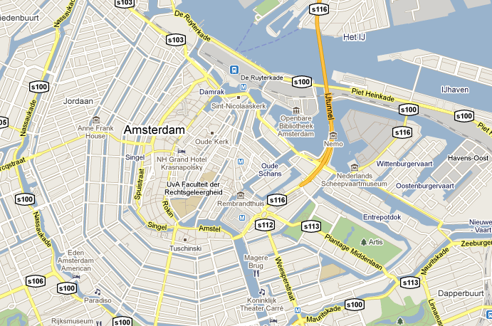
Epilogue
nothing is simple and rational except what we ourselves have invented ...
Notes:
1925 Aldous Huxley Along the Road
Those were noble and touching dreams. We are soberer now.
We have learnt that nothing is simple and rational except what we ourselves have invented, ...
that reason is unequally distributed,
that instinct is the sole source of action,
that prejudice is stronger than argument.
EGI here has landed right between the grid-like landscape and the chaotic town of Amsterdam
between the dreams of rationality and the intricacies of human reality
Make the best of both worlds!

