Slide 1
The CHAIN Project
EGI Technical Forum – Amsterdam 16 September 2010

Slide 2
Outline
Regional Grid Infrastructures co-funded by the European Commission
Commonalities and differences
A common strategy for the future
The CHAIN Project
Conclusions

Slide 3
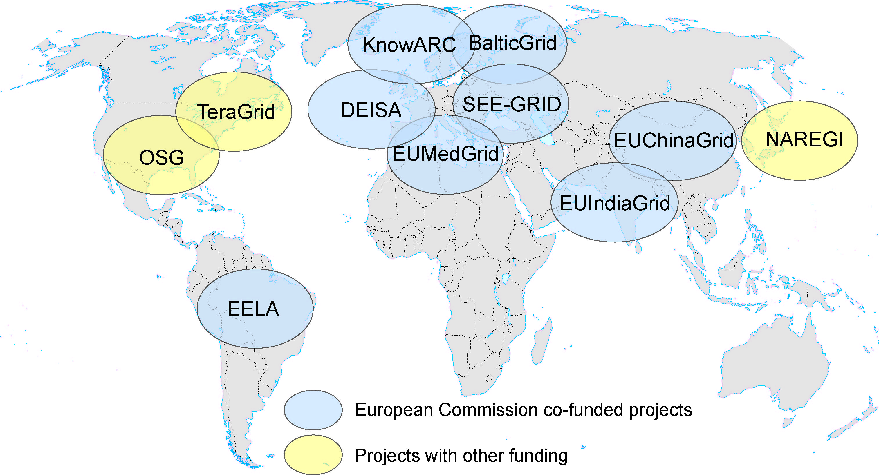

Globalisation of Grid Infrastructures
CNGrid
EUAsiaGrid
NKN & Garuda
SAGrid & SANREN

Slide 4

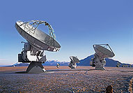
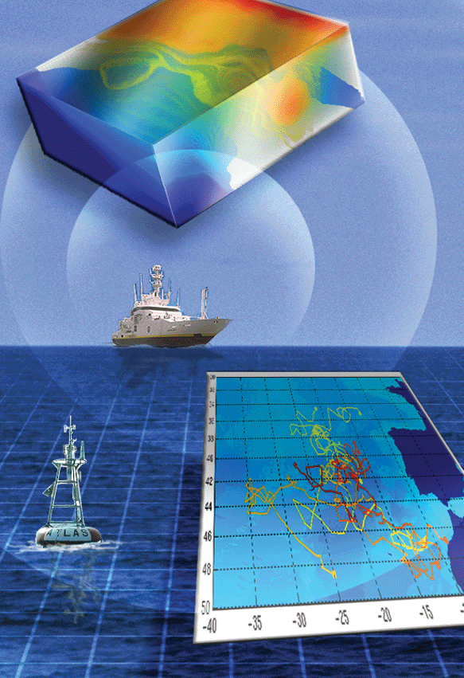
Why ? - To extend the ERA
(European Research Area)
e-Infrastructures support wide geographically distributed communities
enhance international collaboration of scientists
promote collaboration in other fields.
Grids and networks allow the access of many researchers to scientific resources (laboratories and data)
Disparity can be reduced and larger participation and contributions to high quality research.
The e-Infrastructures promote the usage of network connectivity and stimulate scientific and technical development of countries
contribute to fight the digital divide and brain drain.

Slide 5
Who ? - Two (at least) scenarios
Greenfield regions/countries
No previous Grid and e-Infrastructures activities
Scarce knowledge and/or experience in deploying/managing large e-Infrastructures.
Isolated spots of research activities with high computing demands.
Advanced regions/countries
e-Infrastructures already started/deployed
Locally developed MW.
Fair to good knowledge and experience in e-Infrastructures
High quality research groups and institutions with world wide collaborations.

Slide 6
How ? - Instruments & methods
National Grid Initiatives
  Internal (national) Infrastructures sustainability is still an issue.
Regional coordination
  Difficult to shape the demand of collaboration with Europe in a Regional perspective (bilateral agreements always preferred).
Coordination and interoperation with EGEE and now with EGI.
Stable Communication Networks co-operations still under development.
  Synergistic approach with GEANT and EU NRENs and specific regional networks projects, i.e. ALICE, EUMEDCONNECT2, TEIN3, ORIENT,….

Slide 7
Specific topics
In Greenfield regions:
gLite and European approaches have been exported;
the Grid infrastructures have been promoted and are not yet sufficiently mature to be sustainable;
The same process in Africa is just starting.
In large, rapidly developing, countries:
they have already well defined Grid infrastructures (China, India);
different Middleware implementations (not only gLite and ARC);
Internal (national) sustainability should not be an issue.
Interoperability and interoperations with European Infrastructures and sustainability are the main goals
presently addressed in the activities of short lived projects (2 years max.) with different speeds and time shifts due to the different EU calls where they have been approved;
coordination, alignment of results, common road-maps are difficult to achieve, although being strongly pursued by all the projects.

Slide 8





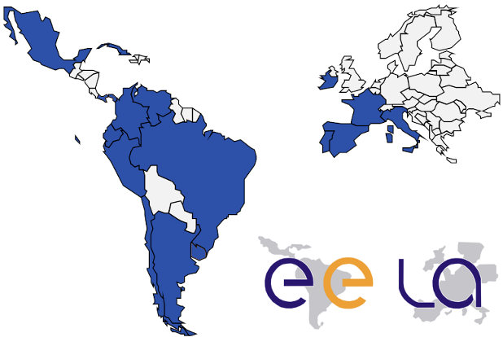
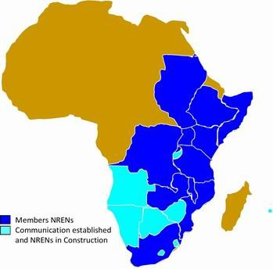
A new project
Coordination & Harmonisation of Advanced eINfrastructures
CHAIN

Slide 9
CHAIN Objectives
Define a strategy and a model for external collaboration, in close collaboration with EGI.org, which will enable operational and organisation interfacing of EGI and external eInfrastructures.
Validate this model, as a proof-of-principle, by supporting the extension and consolidation of worldwide Virtual Research Communities such as Environment & Climate Change.
Explore and propose concrete steps forward towards the coordination with other projects and initiatives (e.g. EGI.eu, EUMEDGRID-Support, EUIndiaGrid2, LinkSCEEM2, PRACE, National Knowledge Network, etc.).

Slide 10
Status & Partners
Negotiated with EC for a total contribution of 1.1 M€
Total cost: about 1.9 M€
Start Date: 1 December 2010
Partners:
  INFN (Italy - Coordinator)
  CESNET (Czech Rep.)
  CIEMAT (Spain)
  GRNET (Greece)
  IHEP (China)
  UBUNTUNET (Africa)
  CLARA (Latin America)
  PSA (India)
  ASREN (Mediterranean) Represented by INFN
  Asia-Pacific consortium Represented by INFN
Kick-Off Meeting and Launch Event 13-14 December 2010 in Rome.

Slide 11
Proposed Event Planning
Brainstorming Meeting Jointly organised with EGI (Month 3 -> February 2011)
EGI User Forum 11-15 April 2011 Vilnius, Lithuania
Other Events (Present proposal)
Event N. | Type | Venue/Region | Theme | Proposed time
W1 | Thematic Workshop | Asia | Environment & Earth Sciences | M04
W2 | Thematic Workshop | Latin America | Bio-Medical & Health | M08
E1 | High-Level Conference | Europe | Research Infrastructures | M12
W3 | Thematic Workshop | Mediterranean/ Africa | Earth Sciences & Environment | M16
W4 | Thematic Workshop | Africa | Computational Science | M20
E2 | High-Level Conference | Asia | A World of Globalised Science | M24

Slide 12
Conclusions
It’s a long road … to build stable e-Infrastructures, even in Europe. EGI is just starting now as a stable organisation to manage the Grid infrastructure.
During the last 4-5 years several Regional Grid Infrastructures have been created using the European template. These need to become sustainable.
Some rapidly developing countries have already developed eInfrastructures and are willing to interoperate with similar ones in other regions of the world.
World wide spread scientific communities have started to appreciate the opportunities of working together on large inter-regional e-Infrastructures.
It’s time to produce a coherent, multi-region and multi-path road-map for the sustainability and interoperations of those Regional infrastructures towards EGI and among themselves.

Slide 13
Thank you !

