Slide 1
Sub-Saharan Africa :
Model for support and operations.
Bruce Becker
(for SAGrid ops and JRU)

Slide 2
Overview
Southern Africa: context and rationale for inclusion on global e-Infrastructure
South Africa as a support centre for Southern Africa
SAGrid: Current resources and status
Africa ROC:
convergence of support activities
progress and “urgently needed

Slide 3
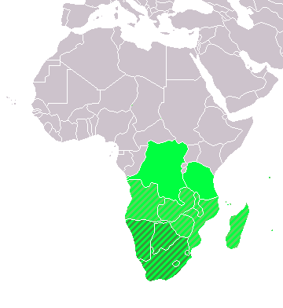
Southern Africa :
Southern Africa a region of huge potential – many resources, fast growing economies (Mozambique, Mauritius), large diaspora (SA, Zimbabwe, Angola, DRC)
Southern Africa organised in the context of the Southern African Development Community : SADC – www.sadc.int
Recently (end 2008) signed agreement to lauch regional S&T cooperation through SciTech Desk : http://www.dst.gov.za/media-room/press-releases/sadc-ministers-launch-science-and-technology-desk/
"The objectives of the SADC Science and Technology Desk will be:
to ensure that the SADC contributes to and benefits from the global pool of scientific knowledge and technological innovations; and
to facilitate national, regional, continental and global cooperation in STI.”
PRIORITY INTERVENTION AREAS, including :
SCIENCE AND TECHNOLOGY :
“Science and Technology is a key driver of socio-economic development and the achievements of most of the objectives of the SADC Common Agenda maybe facilitated by scientific and technological solutions. “
INFORMATION AND COMMUNICATIONS TECHNOLOGY :
“SADC Member States recognise the importance of ICT in meeting the challenges posed by globalisation, facilitating the regional integration agenda, and enhancing the socio-economic development prospects of the Region.”
http://www.sadc.int/index/browse/page/110

Slide 4
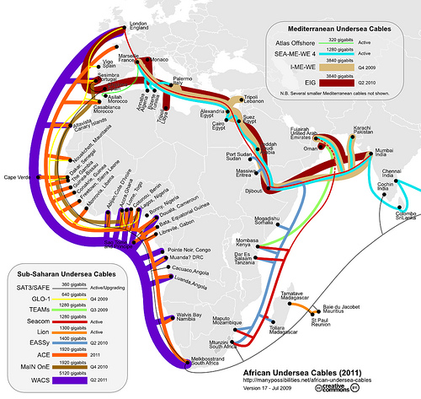
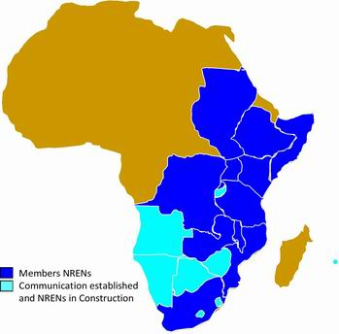
African connectivity
Africa will soon be very well connected
African NREN's championed largely by UbuntuNet Alliance
AfricaConnect project addressing cross-border connectivity, back-haul and GEANT peering

Slide 5
South African “National CyberInfrastructure Programme”
National Cyberinfrastructure programme : consolidation of computing, networking and e-Science services :
Networking : South African National Research Network SANReN : www.sanren.ac.za
Supercomputing : Centre for High-Performance Computing : www.chpc.ac.za
Distributed computing and e-Science services : SAGrid : www.sagrid.ac.za
Meraka manages and operates SANReN and CHPC, funded by DST
SAGrid is a national collaboration, funded through federation
Very close collaboration between SANReN and SAGrid – grid services are an extension of the network and convergence of computing resources.
See: http://www.chpcconf.co.za/Presentations/Monday/SA%20National%20Cyber-infrastructure%20and%20BELIEF-II%20Partnership/Colin%20Wright.pdf
http://cordis.europa.eu/fp7/ict/e-infrastructure/docs/wright.pdf

Slide 6
SAGrid : designed with the “look and feel” of an I³ project
National
Research
Network
connects
Operations, Support, Training
Users access instruments, software and computing resources independent of their location in a self-organised way, transparently across infrastructures
HPC resources
and
scientific equipment
which
self-organising
user communities
use to conduct their research
Federal/Joint Management, development, planning and research activities

Slide 7
Governance Model : SAGrid JRU
Comprises IT department heads, heads of research groups, heads of laboratories
Precursor to a National Grid Initiative (NGI) which is a binding document, has legal status.
Current SAGrid JRU consists of :

Slide 8
SAGrid : An example of an Integrated Infrastructure Initiative
A coordinated effort to address all aspects of e-Infrastructure deployment, management and usage, modelled on experiences of similar projects worldwide
Training (in collaboration with EPIKH)
Deployment (in collaboration with IGI)
Operations (incubated by GILDA, now stand-alone)
Support (incubated by GILDA, now in collaboration with IGI, EUMEDGRID-Support and CHAIN)
Interoperability and collaboration (in the context of CHAIN)
Special care has been taken on the last point, given the very good integration between SA and EU Science policies and participation of SA researchers to FP7 collaborative research projects
→ 15 Meuro between 2007 and 2009 EC contribution
→ > 100 proposals with 42% success rate in the period 2007-2009
http://ec.europa.eu/research/evaluations/pdf/archive/fp7_monitoring_reports/third_fp7_monitoring_report.pdf#view=fit&pagemode=none
Common e-Science infrastructure is essential to the success of many of these projects.

Slide 9
SAGrid Overview
Resources
Operations
Support
Middleware

Slide 10
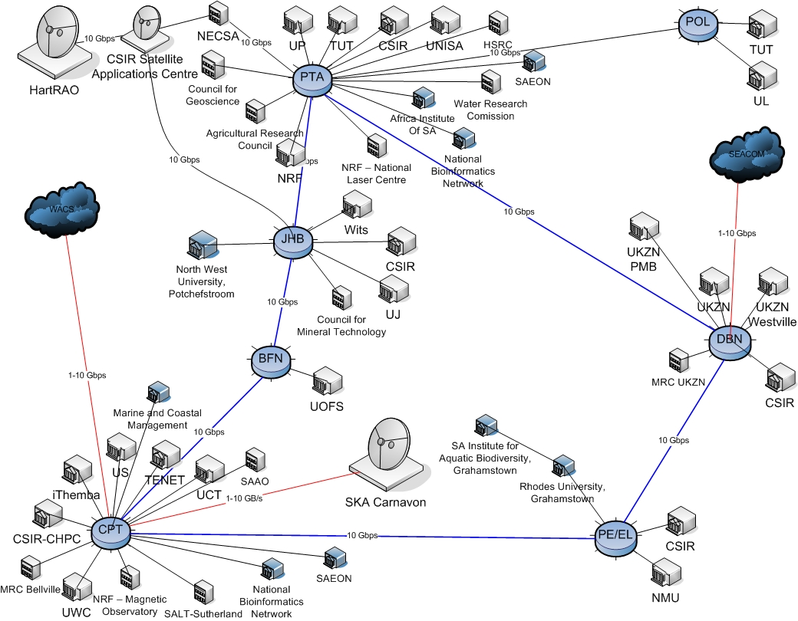
Holistic view of the HPC resources in South Africa
Figure courtesy Geoff Daniell
(SANREN)‏

Slide 11
SAGrid through the eyes of SANREN
Currently functional
Under development
Core services
CERN, IGI,
GILDA, WISDOM,
etc

Slide 12
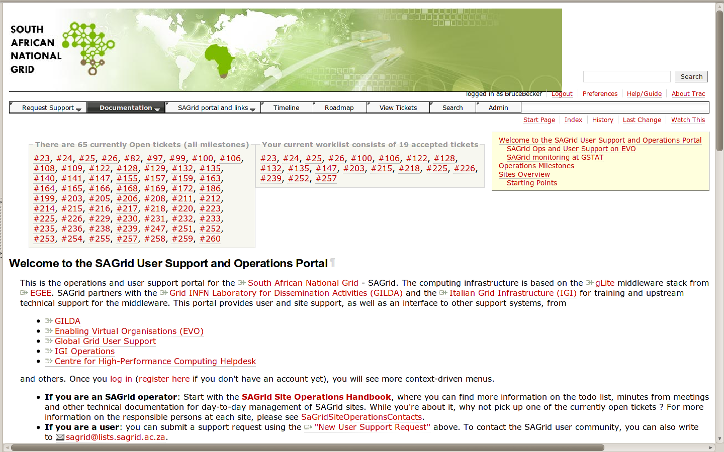
Support : South African National Grid Operations Portal
Discussions under way for integration of ops.sagrid to GGUS

Slide 13
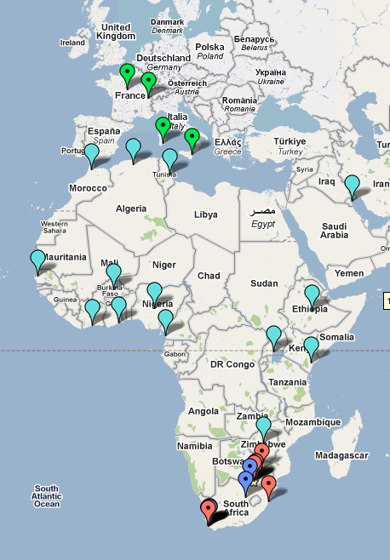
HP/UNESCO Brain Gain Initiative
20 institutes in Africa
Budget: $1M
Aeveral scientific domains
Operational and technical support from SAGrid
HP Social Innovation Office
http://www.hp.com/hpinfo/socialinnovation/ braingain.html
UNESCO project page
http://www.unesco.org/en/higher- education/reform/brain-gain-initiative/
BGI white paper
http://www.unesco.org/tools/fileretrieve/a7f2de39.pdf
NEW : Meraka-led “Catalyst” project - “Global Collaboratory” http://www.hp.com/go/catalyst

Slide 14
Need for Regional (grid) Coordination
Africa is too large for a single ROC and too sparse for “regional” centres – separate areas of responsibility by context, rather than region :
“North Africa” : EUMedSupport
“Sub-Saharan Africa” : SAGrid
South Africa is playing a crucial role in the development of Science and Technology in the region – regional cooperation is a priority area – this extends to e-Infrastructure.
Infrastructure deployment in the region means that in few years the regional e-Infrastructure “a-la EELA” will be a reality
Sub-Saharan Africa is not a unique case : CHAIN's raison d'etre...
Many scientific activities in South Africa rely crucially on the grid, yet there is no way to support them in the “traditional” EGEE/EGI-NGI context.
Currently, support is provided at two levels, on a “best-effort” basis :
1) all sites maintained locally by SAGrid operators
2) VO-level issues have their own support structures and representatives at sites

Slide 15
Current support model : ops.sagrid.ac.za routes everything (“by hand”) no way to maintain identity and no tracking / routing across infrastructures
VO Software
Updates/
announcements
Site software
updates
Middleware
releases
Site updates
And intervetions
...
...
User support
And feedback
User support
requests
“personal” communications : untracked, effort usually lost
→ result : unreliable infrastructure

Slide 16
Proposed support model : a single interface between EGI and Africa
…
Site certification
Site updates
and interventions
User support
and feedback
...

Slide 17
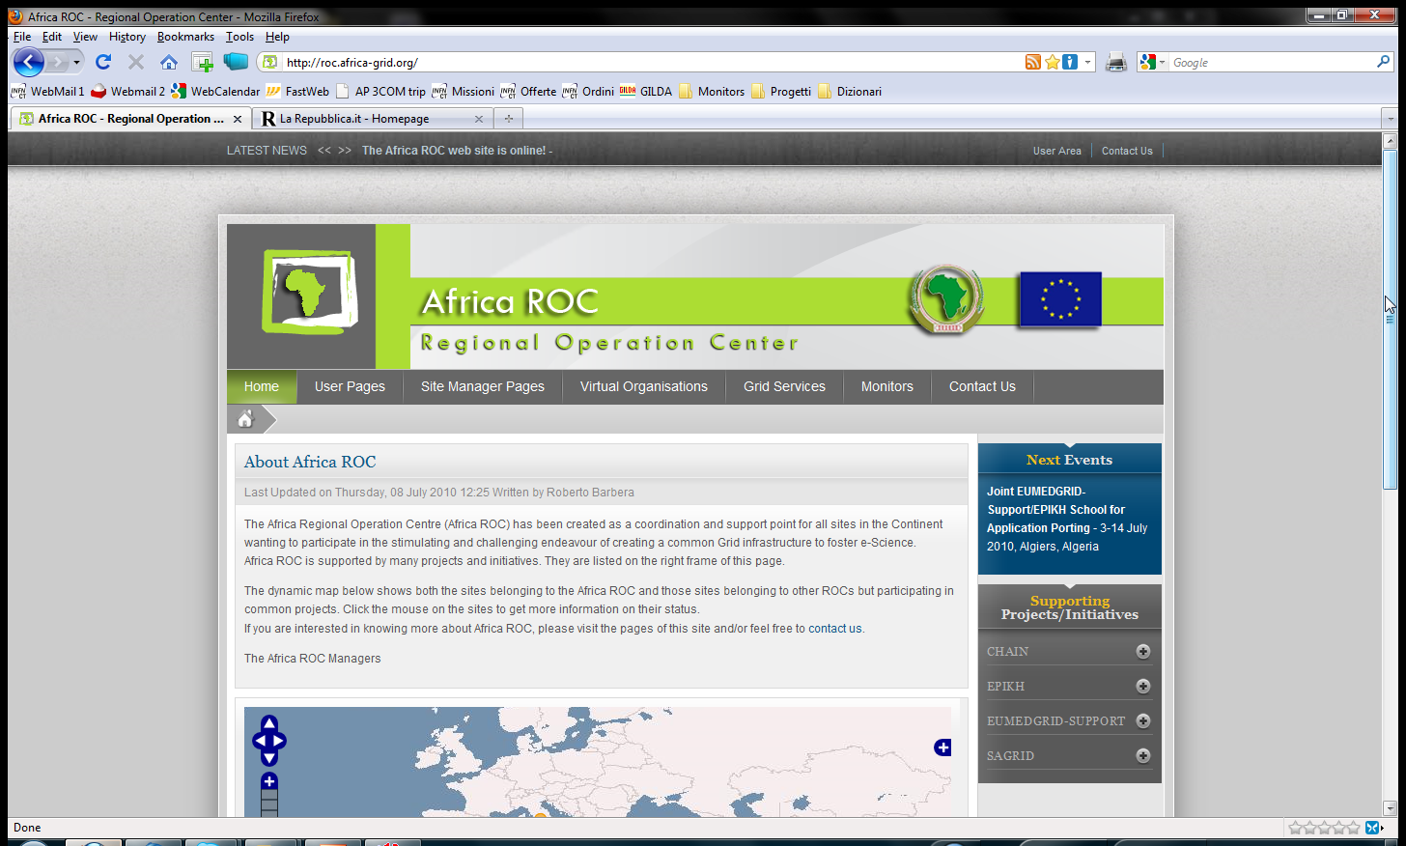
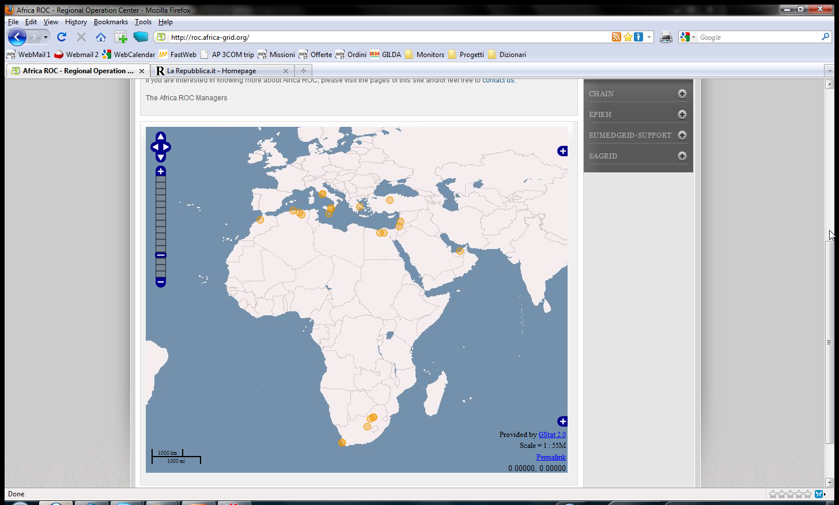
Africa ROC (http://roc.africa-grid.org)

Slide 18
Summary
South Africa has a well-established infrastructure, which includes SAGrid
Federated / jointly managed resources well integrated with good networking provide unique point of access for users, collaborations
SAGrid Operations are stable, user communities are beginning to make use of the infrastructure
South Africa aims to act as blueprint for the region, and tight cooperation with EGI and NGI's is essential at all levels
The official recognition of Afric-ROC by EGI.eu is very important (use of GOCDB, GGUS, etc.)

