Slide 1
The EPIKH Project
Roberto Barbera (roberto.barbera@ct.infn.it)
University of Catania & INFN & Consorzio COMETA
EGI Technical Forum
Amsterdam, 16.09.2010

Slide 2
The Triangle of Knowledge
Research & Development
e-Infrastructure
t-Infrastructure
Education
& Training
Innovation
t-Infrastructure
Building e-Infrastructures is a waste if we
don’t “build”, at the same time, their users.
Along with e-Infrastructures,
t-Infrastructures and training programmes are also needed.

Slide 3
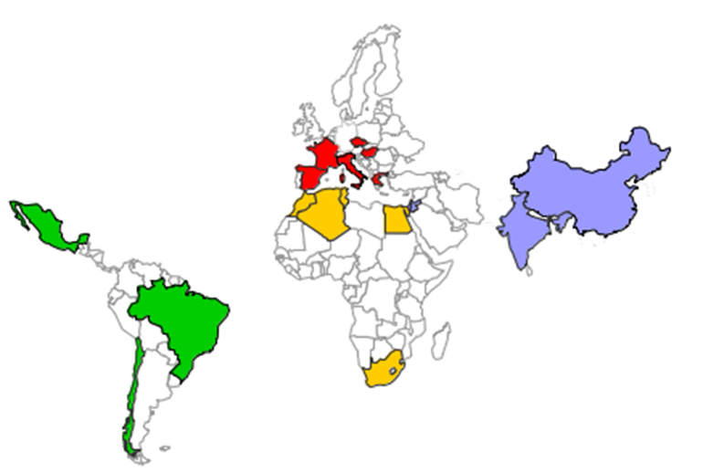
The EPIKH Project
(www.epikh.eu)
“Exchange Programme to advance e-Infrastructure Know-How” (EPIKH)
  EU FP7- Marie Curie Actions – People - International Research Staff Exchange Scheme (IRSES)
Consortium “numbers”:
  23 partners;
  18 countries;
  4 continents (Europe, Africa, Asia, and Latin America);
  115 persons involved;
  >650 researcher-months;
  >500 secondments;
Duration: March, 1, 2009 – February, 28, 2013 (48 months)
EC contribution: 1,188,000 €

Slide 4
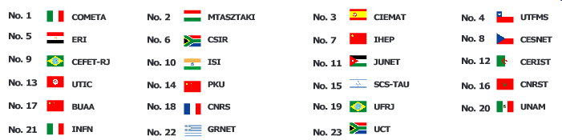
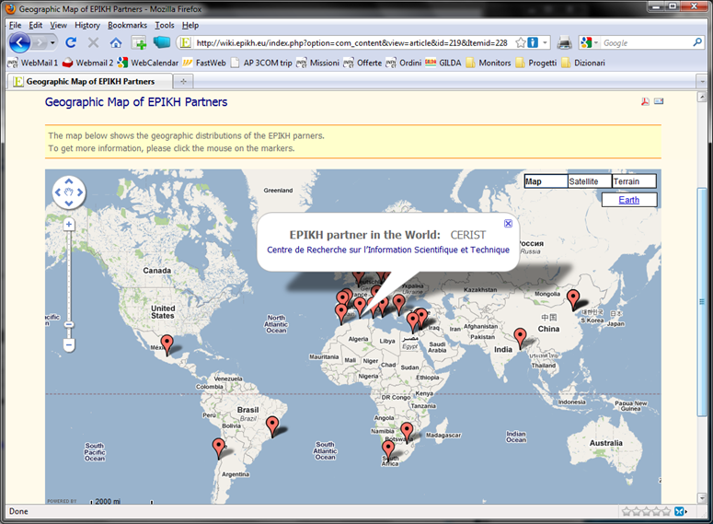
The EPIKH Partners
(http://wiki.epikh.eu/index.php?option=com_content&view=article&id=219&Itemid=228)
EGI-InSpire members

Slide 5
The EPIKH goals
Strategic aims:
  Reinforce the impact of e-Infrastructures in scientific research defining and delivering stimulating programme of educational events, including Grid Schools and High Performance Computing courses;
  Broaden the engagement in e-Science activities and collaborations both geographically and across disciplines.
Specific actions:
  Spreading the knowledge about the “Grid Paradigm” to all potential users: both system administrators and application developers through an extensive training programme;
  Easing the access of the trained people to the e-Infrastructures existing in the areas of action of the project;
  Fostering the establishment of scientific collaborations among the countries/continents involved in the project.

Slide 6
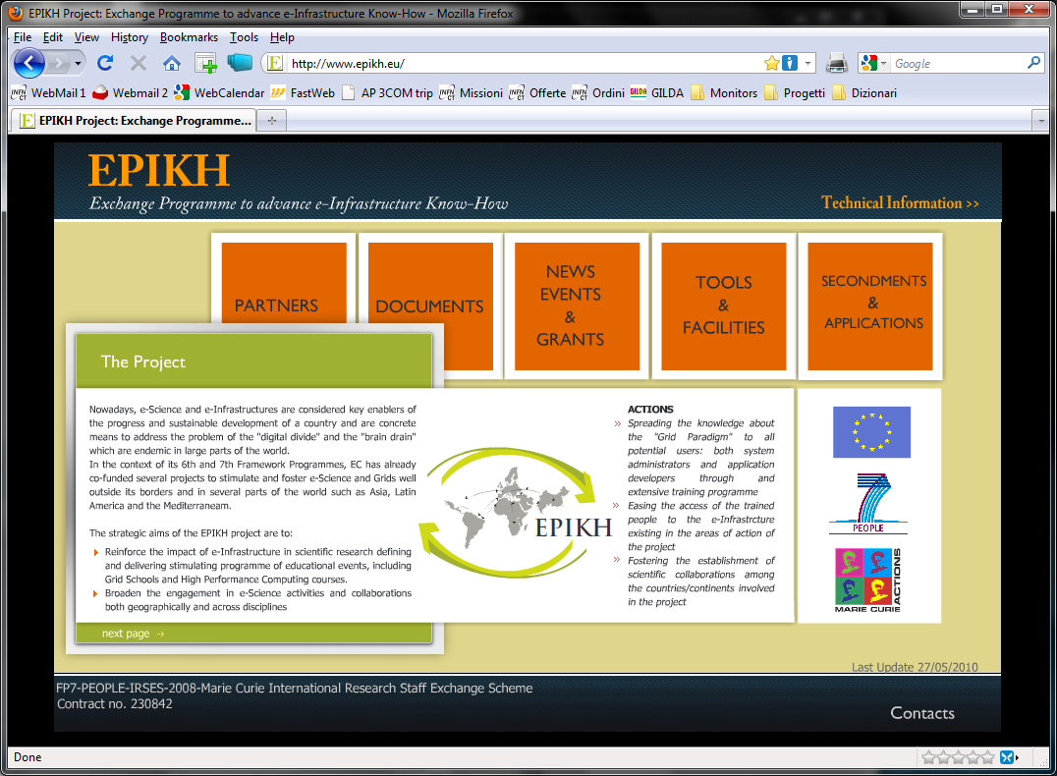
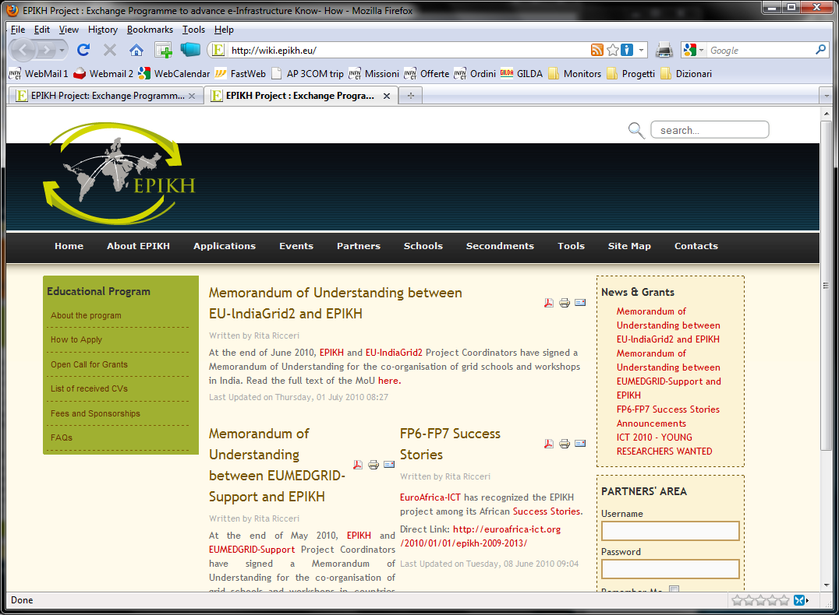
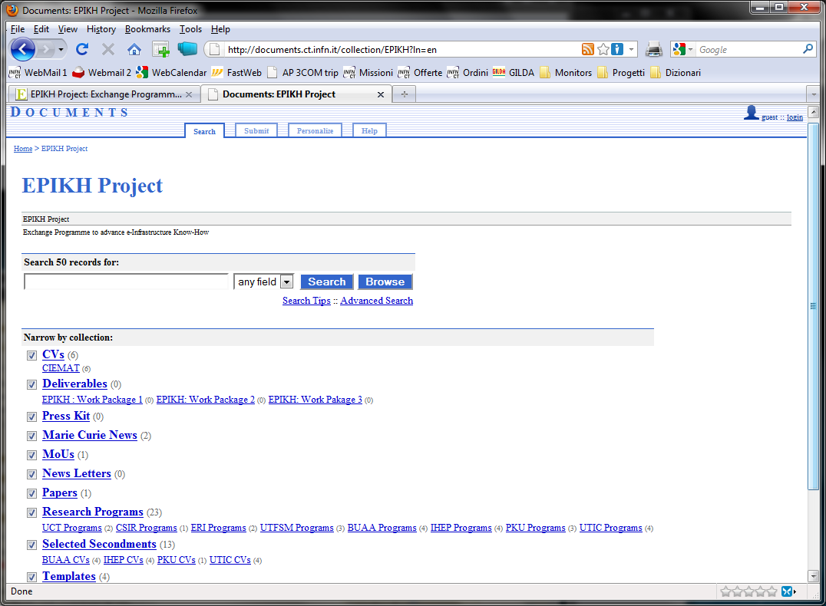
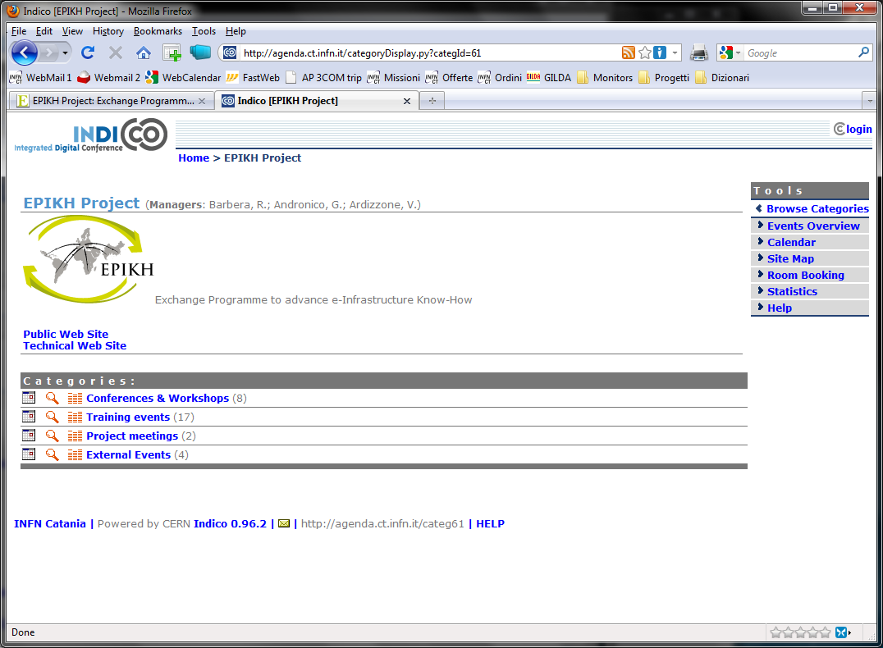
EPIKH on the web
www.epikh.eu
wiki.epikh.eu
documents.epikh.eu
agenda.epikh.eu

Slide 7

EPIKH secondments’ programme
1st Phase:
Non-EU → EU
(selected)
Res. Programs
2nd Phase:
EU → Non-EU
Grid Schools
(with 1st phase tutors)
Workshops

Slide 8
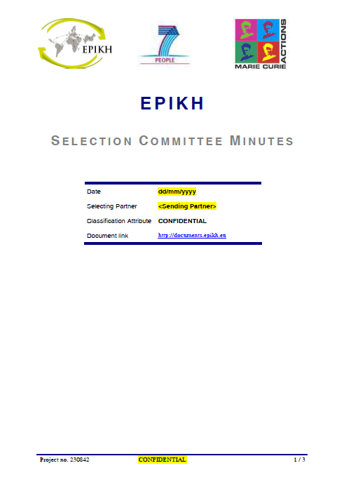
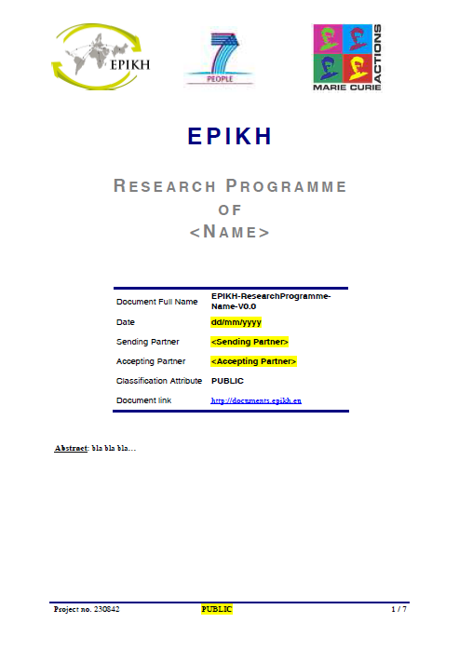
EPIKH Quality & Certification Programme
All seconded people must be officially selected against their CVs;
All Non-EU→EU secondments must have a Research Program agreed between “sending” and “accepting” organisations;
All secondments must have final reports both from the seconded person and the “accepting” organisation
  If both reports will be successfull the seconded person will be provided with an official certificate

Slide 9
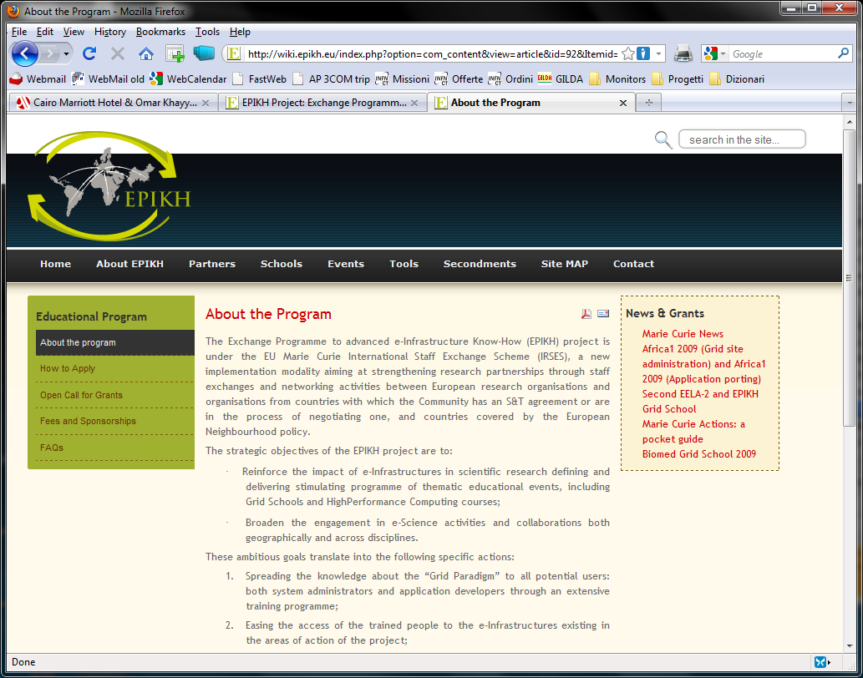

Grant opportunities
(wiki.epikh.eu)

Slide 10
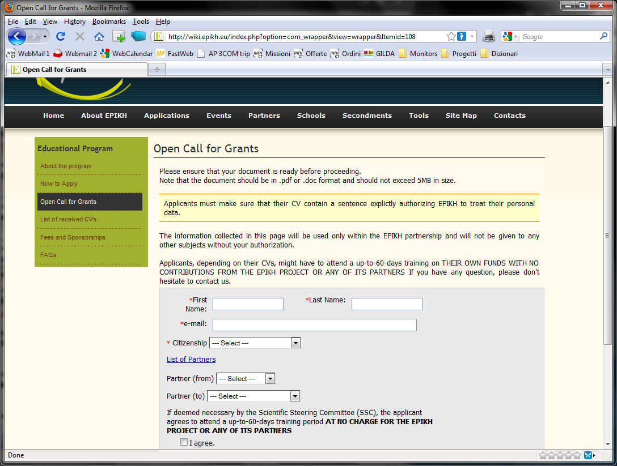
Grant opportunities
(http://wiki.epikh.eu/index.php?option=com_wrapper&view=wrapper&Itemid=108)
The call for grants is open !

Slide 11
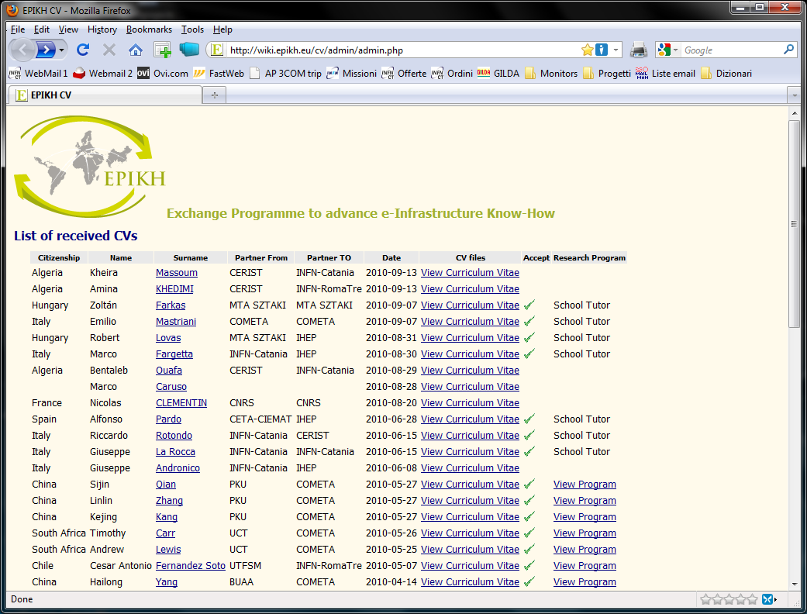
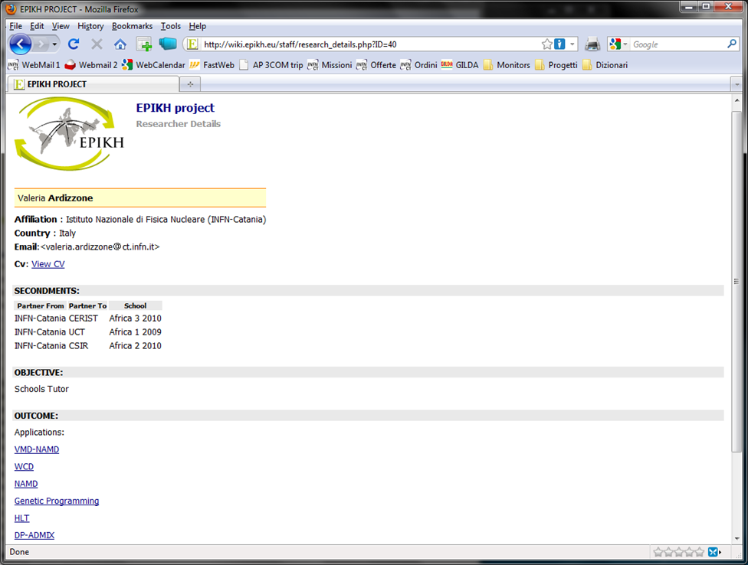
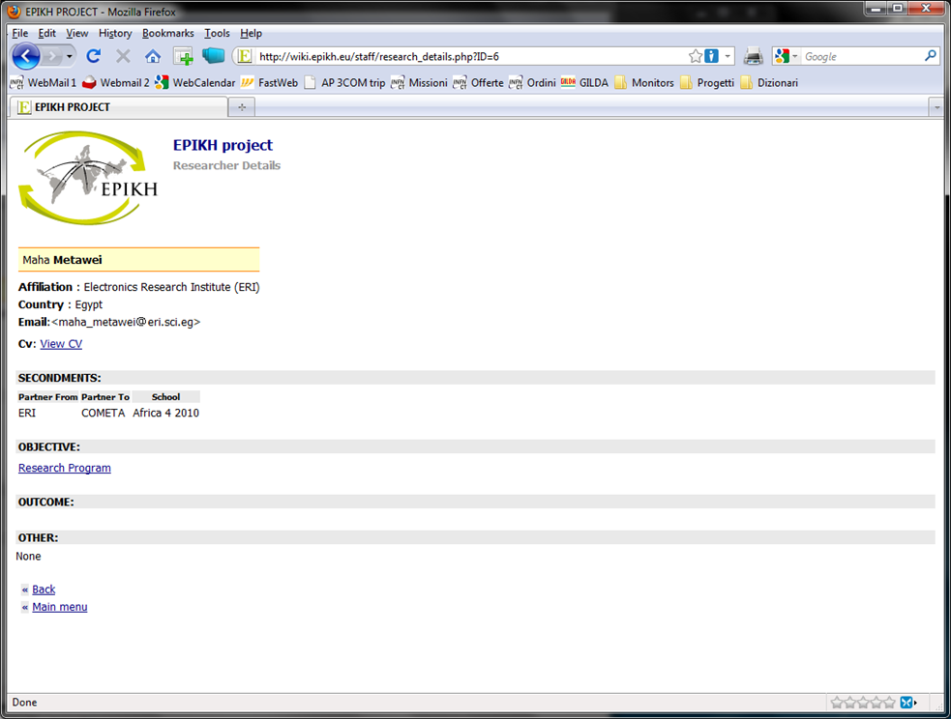
51 grant requests received;
39 selected and funded so far
Trainer
List of CVs and profiles
Trainee

Slide 12
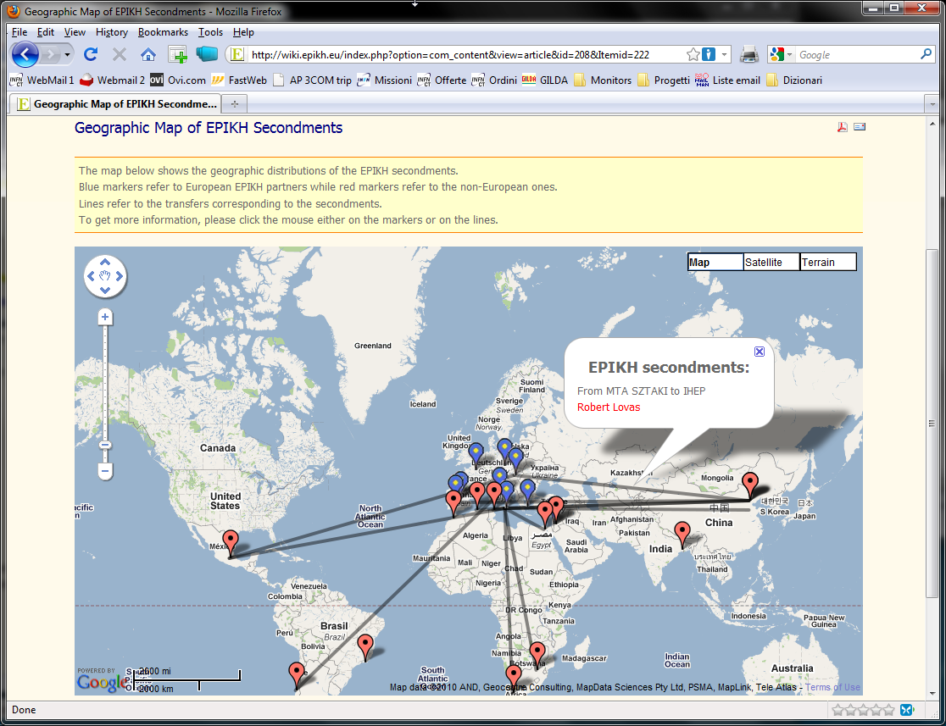
EPIKH secondments done so far
(http://wiki.epikh.eu/index.php?option=com_content&view=article&id=208&Itemid=222)

Slide 13
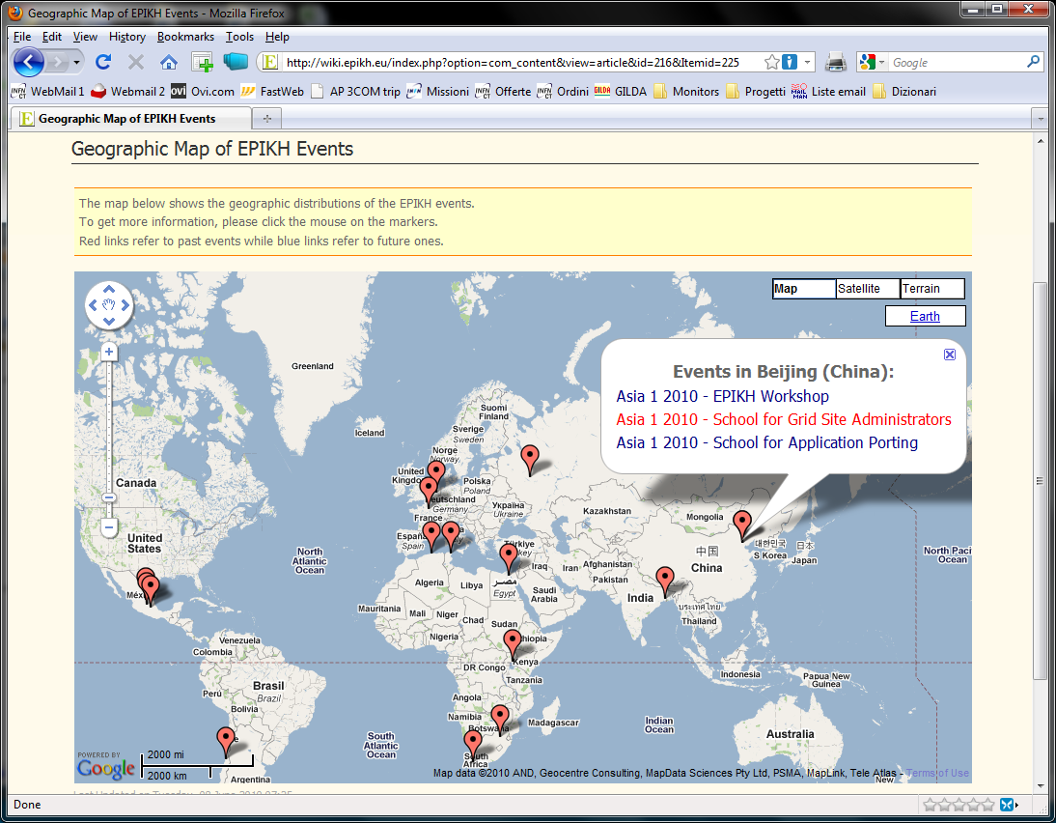
EPIKH events in the world
(http://wiki.epikh.eu/index.php?option=com_content&view=article&id=216&Itemid=225)

Slide 14
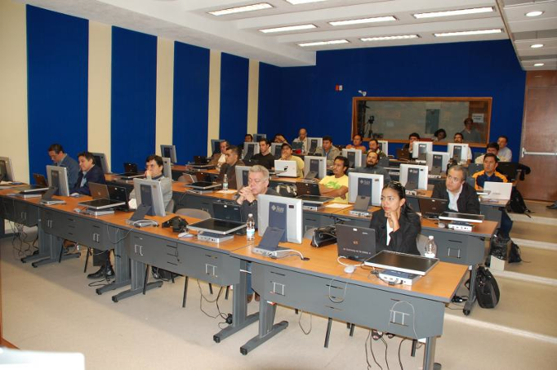



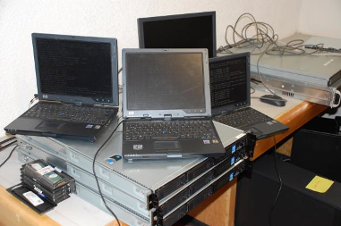
EPIKH Schools (1/2)
1-week tutorials for site administrators (with remote installations)

Slide 15
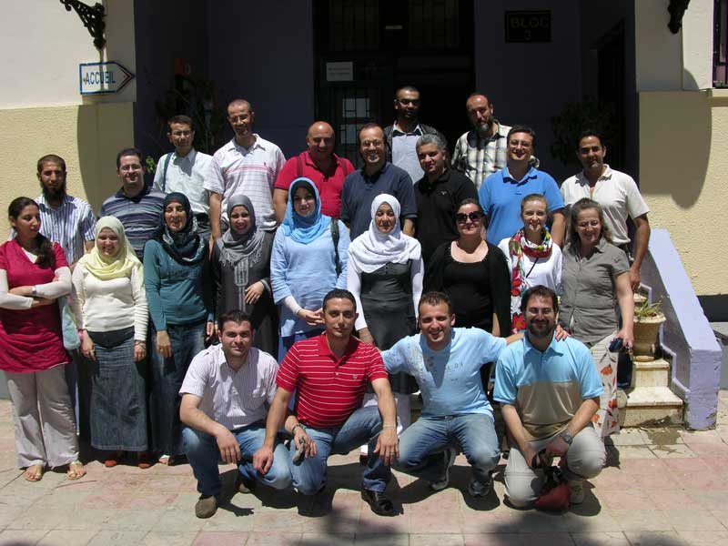
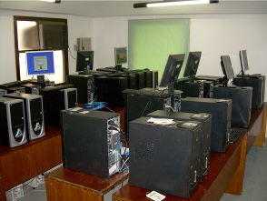
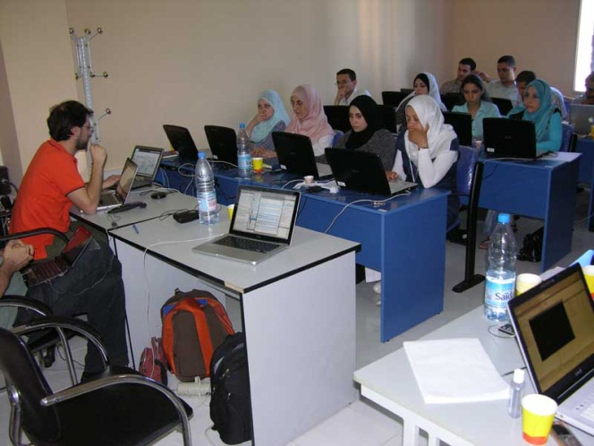







EPIKH Schools (2/2)
Grid Schools
  2 entire weeks devoted to applications’ “gridification”
  call for applications widely open
A total of 24 1-month Grid & HPC
schools and related thematic workshops
foreseen in the period 3/2009 - 2/2013!

Slide 16
School statistics
(http://wiki.epikh.eu/index.php?option=com_content&view=article&id=221&Itemid=229)

Slide 17
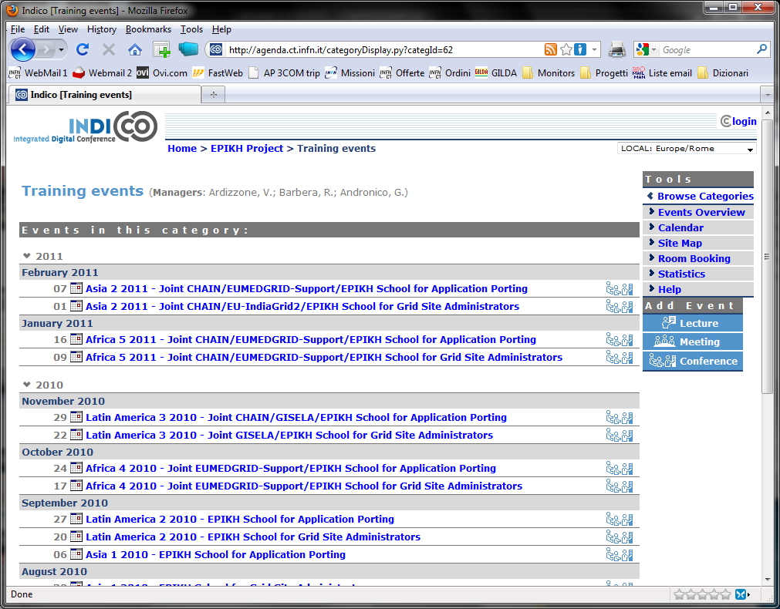
Next EPIKH schools

Slide 18
Applications’ “virtuous cycle”
Dissemination
(workshops)
Training events
(schools)
Deployment on large
Infrastructures and
inclusion in the portfolio
of demonstrative applications
“Gridification”

Slide 19
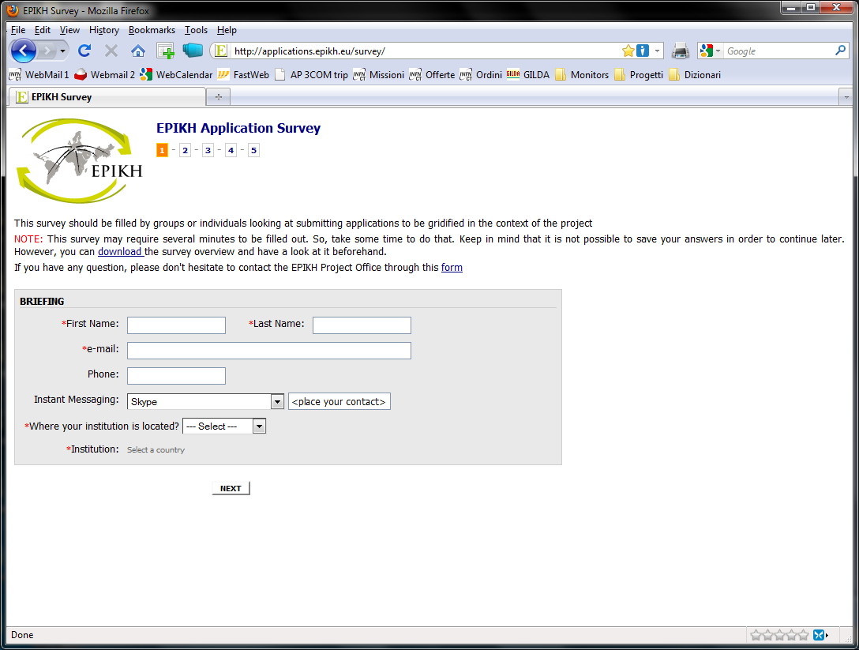
Call for applications
(http://applications.epikh.eu/survey/)

Slide 20
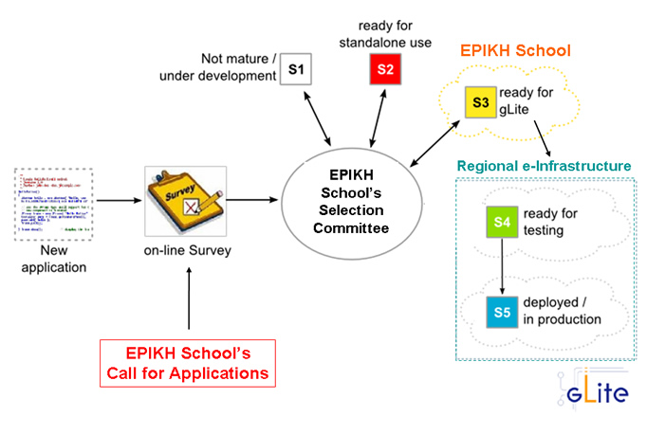
Applications lifecycle

Slide 21
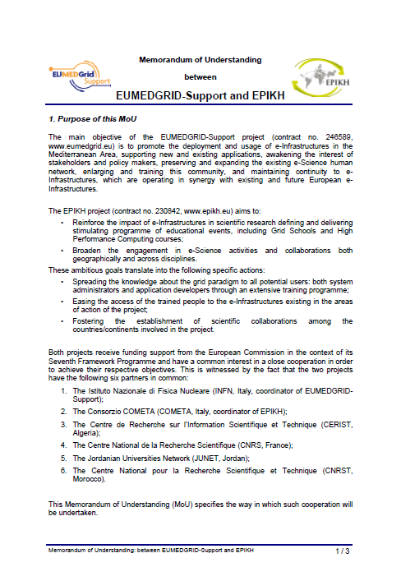
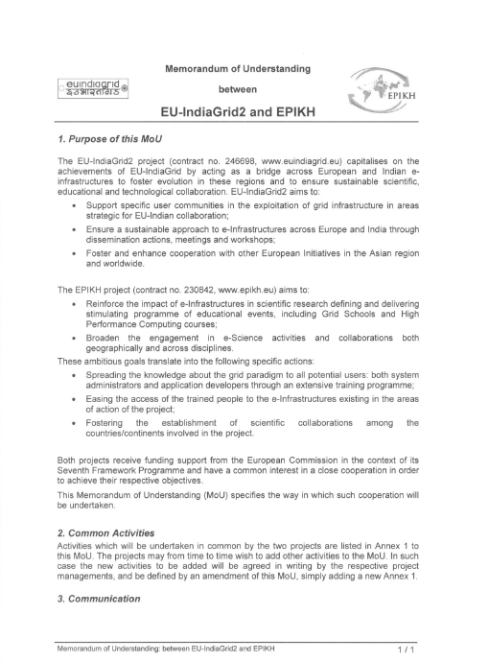
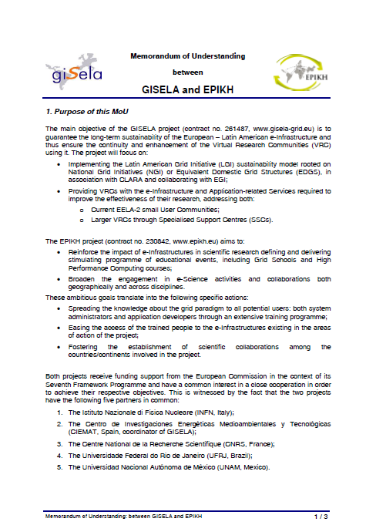
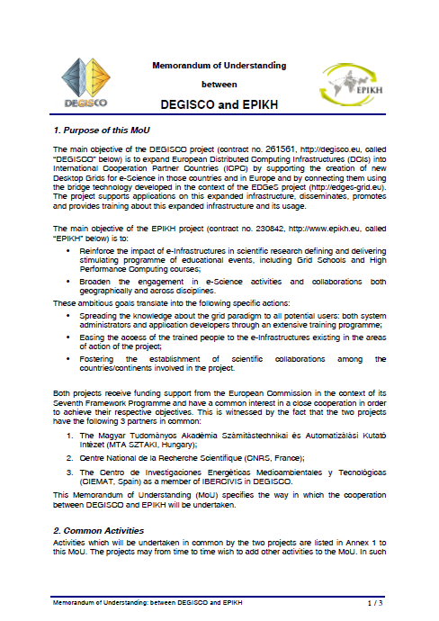
MoUs with other projects
EUMEDGRID-Support
2 more MoUs foreseen with
CHAIN and INDICATE
EU-IndiaGrid2
GISELA
DEGISCO

Slide 22
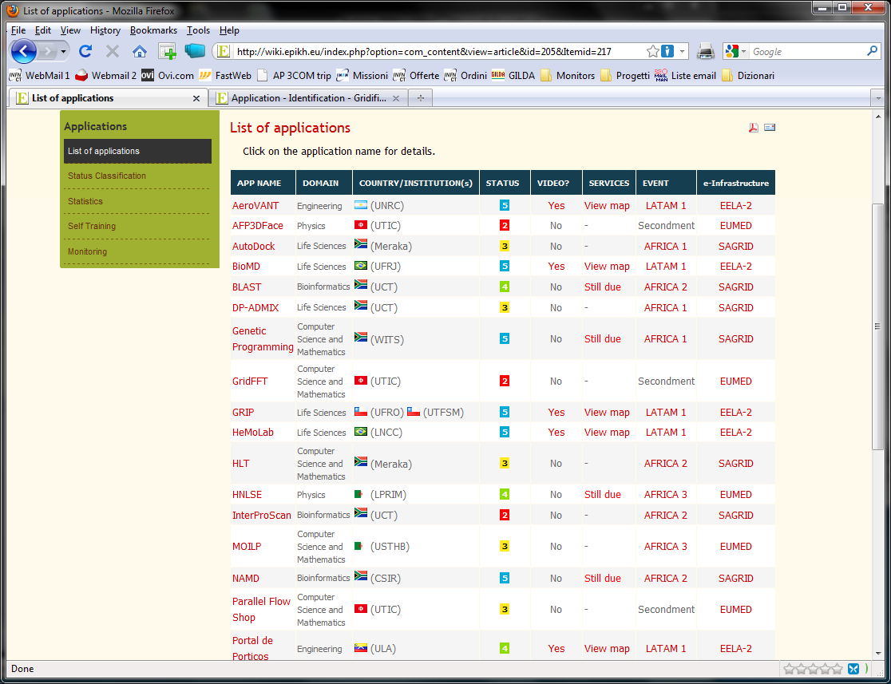
List of already “gridified” applications
(http://wiki.epikh.eu/index.php?option=com_content&view=article&id=201&Itemid=215)
Total = 26

Slide 23
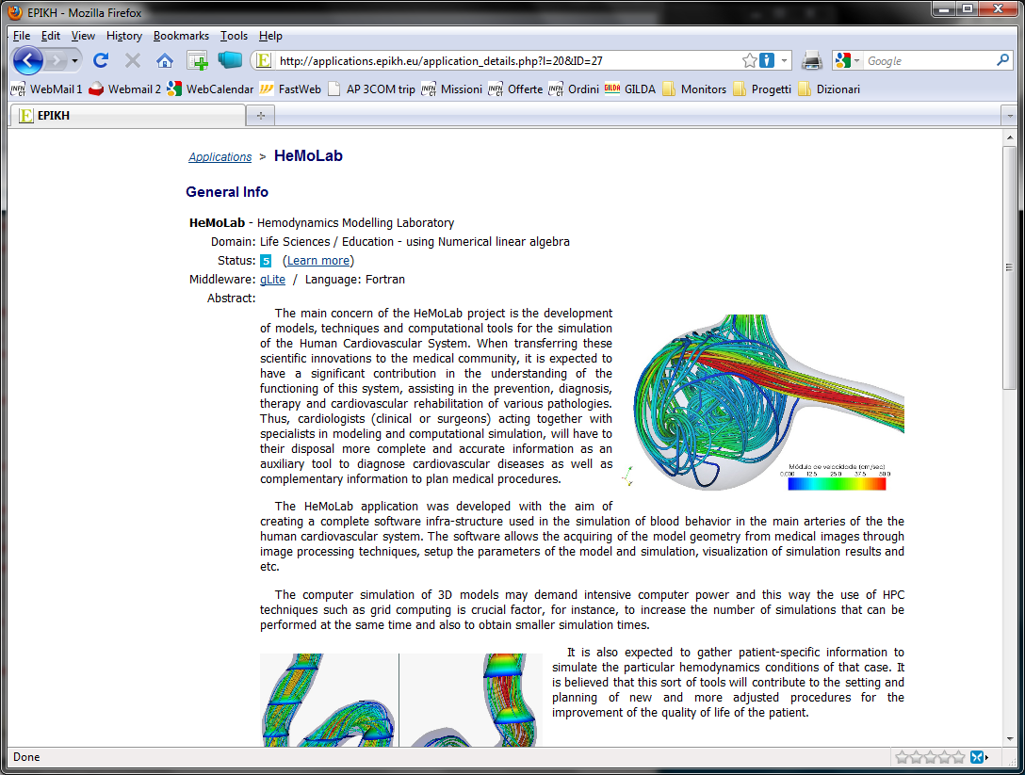
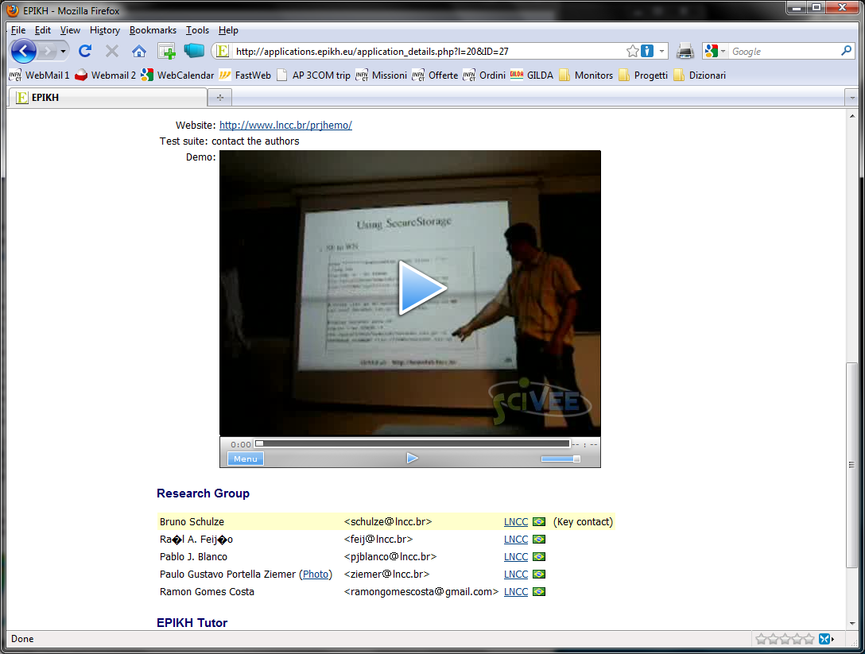
Example of application file

Slide 24
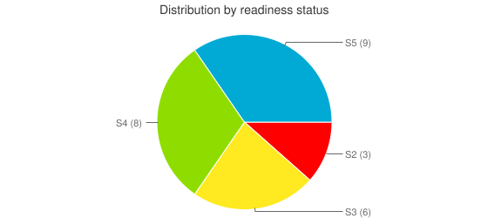
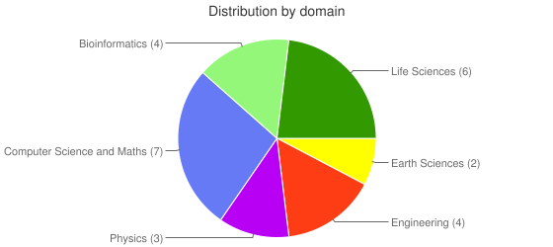
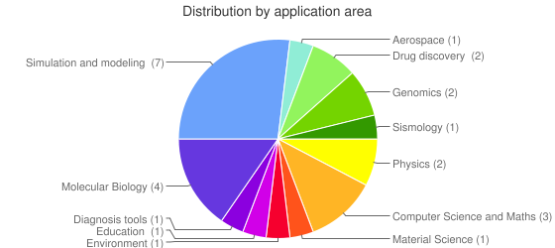
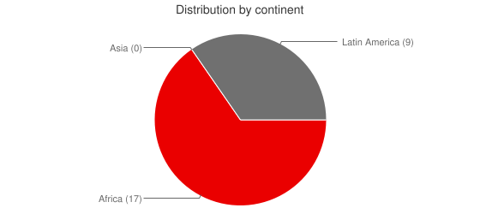
Application statistics
(http://wiki.epikh.eu/index.php?option=com_content&view=article&id=203&Itemid=220)

Slide 25
Summary and conclusions
EPIKH can represent for young brilliant scientists and technologists a unique occasion to learn and adopt the Grid paradigm through stimulating research programmes;
EPIKH can offer free technical support for anyone willing to organize local training events on Grid computing:
  It can be undergraduate courses, M.Sc. courses, Ph.D. curricula, tutorials, Grid Schools, etc.;
Thanks to EPIKH, large projects → NGIs → campuses can easily setup Grid infrastructures and deploy on them scientific applications;
EPIKH is indeed complementing the training activities of several EU projects ensuring coherence of action and increasing impact.

Slide 26

Thank you very much ! Any questions ?

