Slide 1
Riding the wave
How Europe can gain from the rising tide of scientific data
A Vision for 2030
Final report of the High Level Expert Group on Scientific Data
to be launched 6 Oct 2010
David Giaretta (Rapporteur)
STFC and APA

Slide 2
Outline
Context
Vision
Integration & initial wish list
Benefits
Obstacles

Slide 3
Digital Agenda for Europe
the policy context
DAE is one of the flagships of "Europe 2020: a strategy for smart, sustainable and inclusive growth"
Notes:
The Digital Agenda for Europe is about generating growth, by simulating a virtuous cycle of removing bottlenecks to new services and innovation, to stimulate demand and increase incentives for the new investments in infrastructures and our capacity to innovate.
There are seven pillars in the Digital Agenda for Europe. These areas were chosen because they address the biggest ICT related challenges which businesses and citizens face today. They are also the areas where coordinated efforts at EU level could have the greatest impact.

Slide 4

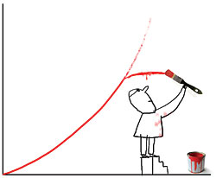
Digital Agenda for Europe
the policy context
“The Digital Agenda for Europe outlines policies and actions to maximise the benefit of the digital revolution for all. Supporting research and innovation is a key priority of the Agenda, essential if we want to establish a flourishing digital economy.”
  Neelie Kroes,
  Vice-President of the EC, responsible for the Digital Agenda
Notes:
4

Slide 5
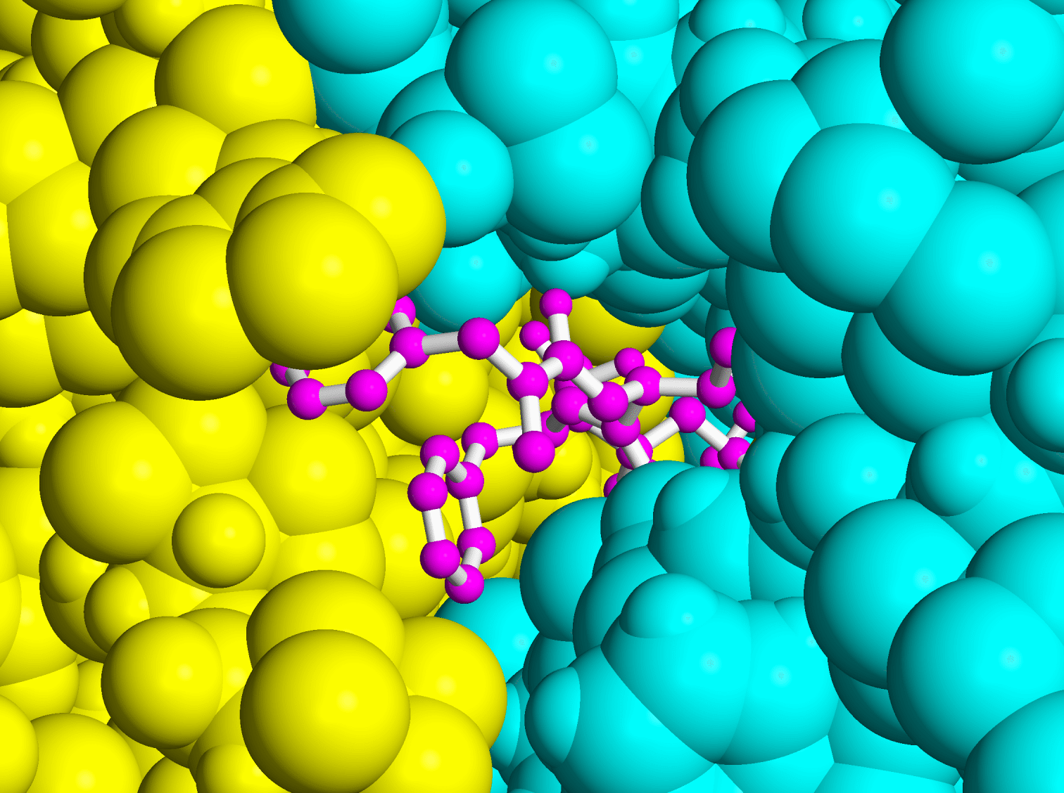
Science and IC Technologies
High-speed communications and advance computation give rise to the era of e-Science.
During the 2006 pandemics alarm, Asian and European laboratories analysed drug components against avian flu using thousands of computers distributed in network grid during 4 weeks!
This work would have taken 100 years on a single computer!

Slide 6
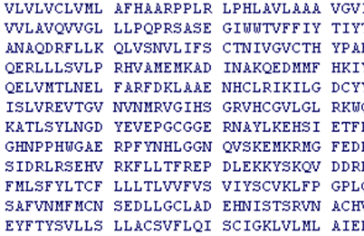
global collaboratories
With a proper scientific e-Infrastructure, researchers in different domains can collaborate on the same data set, finding new insights.
They can share the data across the globe, protecting its integrity and checking its provenance.
They can use, re-use and combine data, increasing productivity.

Slide 7

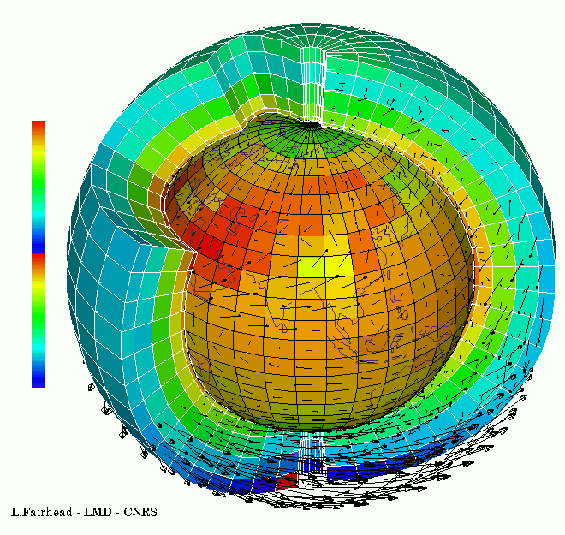

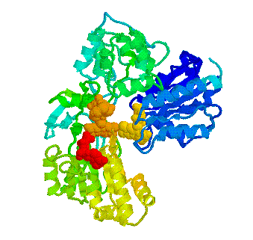
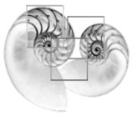
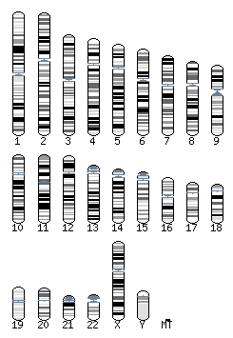


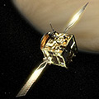
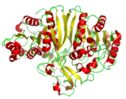
global collaboratories
They can engage in whole new forms of scientific inquiry and treat information at a scale we are only beginning to see.
… and help us solving today’s Grand Challenges such as climate change and energy supply.

Slide 8
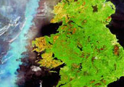
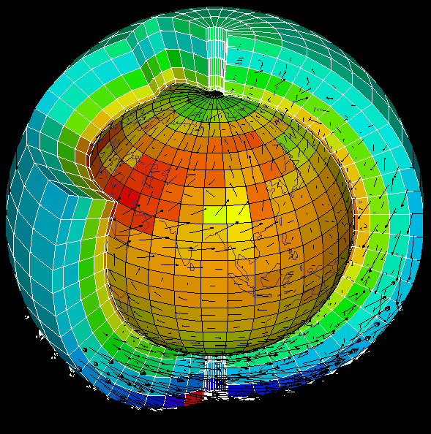
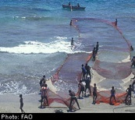
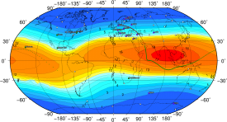
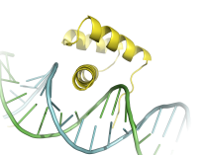

Scientific Data Infrastructure
Geo
Earth
Climate
biology
astro
scientific data infrastructure
distributed computing/software infrastructure
network infrastructure, GÉANT

Slide 9
raising tide of data…
“A fundamental characteristic of our age is the raising tide of data – global, diverse, valuable and complex . In the realm of science, this is both an opportunity and a challenge.”
  Report of the High-Level Group on Scientific Data, October 2010
  “Riding the Wave: how Europe can gain from the raising tide of scientific data”
Notes:
9
9

Slide 10
1990
2010
2030
Web not yet begun
XML not yet begin
Internet speeds kbps in universities and offices
300,000 internet hosts
Data volume ??
XXX researchers
Few computer programming languages
Transition from text to 2D image visualisation
Web 2.0 started
XML widespread
Internet speeds Mbps widespread
600,000,000 internet hosts
5.10¹⁸ bytes of data
Millions of researchers
Many new paradigms for programming languages
3-D and Virtual reality visualisation
Semantic Web
XML forgotten
Internet speeds Pbps widespread
2,000,000,000,000 hosts
5.10²⁴ bytes of data
Billions of citizen researchers
Natural language programming for computers
Virtual worlds

Slide 11
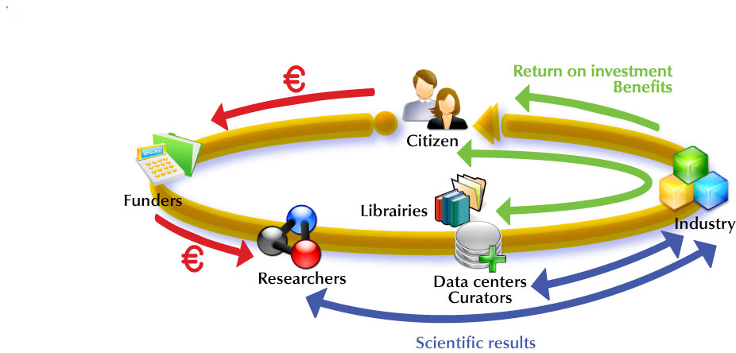
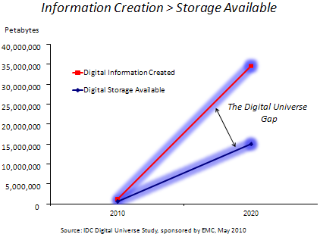

Slide 13
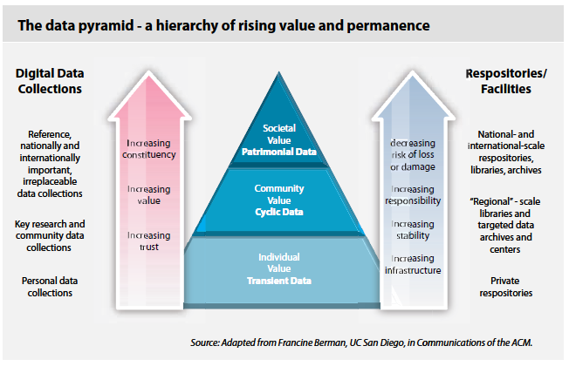

Slide 14
Outline
Context
Vision
Integration & initial wish list
Benefits
Obstacles

Slide 15
vision 2030
high-level experts group on Scientific Data
“Our vision is a scientific e-Infrastructure that supports seamless access, use, re-use and trust of data. In a sense, the physical and technical infrastructure becomes invisible and the data themselves become the infrastructure – a valuable asset, on which science, technology, the economy and society can advance.”
  High-Level Group on Scientific Data
  “Riding the Wave: how Europe can gain from the raising tide of scientific data”
Notes:
15
15

Slide 16
vision 2030
(1) All stakeholders, from scientists to national authorities to general public are aware of the critical importance of preserving and sharing reliable data produced during the scientific process.
  All member states ought to publish their policies and implementation plans on the conservation and sharing of scientific data, aiming at a coordinated European approach.
  Legal issues are worked out so that they encourage, and not impede, global data sharing.
  The scientific community is supported to provide its data and metadata for re-use.
  Every funded science project includes a fixed budget percentage for compulsory conservation and distribution of data, spent depending of the project context.
  IMPACT IF ACHIEVED
  Data form an infrastructure, and are an asset for future science and the economy.
Notes:
16
16

Slide 17
vision 2030
(2) Researchers and practitioners from any discipline are able to find, access and process the data they need. They can be confident in their ability to use and understand data and they can evaluate the degree to which the data can be trusted.
  Create a robust, reliable, flexible, green, evolvable data framework with appropriate governance and long-term funding schemes to key services such as Persistent Identification and registries of metadata.
  Propose a directive demanding that data descriptions and provenance are associated with public (and other) data.
  Create a directive to set up a unified authentication and authorisation system.
  Set Grand Challenges to aggregate domains.
  Provide “forums” to define strategies at disciplinary and cross-disciplinary levels for metadata definition.
  IMPACT IF ACHIEVED
  Dramatic progress in the efficiency of the scientific process, and rapid advances in our understanding of our complex world, enabling the best brains to thrive wherever they are.
Notes:
17
17

Slide 18
vision 2030
(3) Producers of data benefit from opening it to broad access and prefer to deposit their data with confidence in reliable repositories. A framework of repositories work to international standards, to ensure they are trustworthy.
  Propose reliable metrics to assess the quality and impact of datasets.All agencies should recognise high quality data publication in career advancement.
  Create instruments so long-term (rolling) EU and national funding is available for the maintenance and curation of significant datasets.
  Help create and support international audit and certification processes.
  Link funding of repositories at EU and national level to their evaluation.
  Create the discipline of data scientist, to ensure curation and quality in all aspects of the system.
  IMPACT IF ACHIEVED
  Data-rich society with information that can be used for new and unexpected purposes.
  Trustworthy information is useable now and for future generations.
Notes:
18
18

Slide 19
vision 2030
(4) Public funding rises, because funding bodies have confidence that their investments in research are paying back extra dividends to society, through increased use and re-use of publicly generated data.
  EU and national agencies mandate that data management plans be created.
  IMPACT IF ACHIEVED
  Funders have a strategic view of the value of data produced.
Notes:
19
19

Slide 20
vision 2030
(5) The innovative power of industry and enterprise is harnessed by clear and efficient arrangements for exchange of data between private and public sectors allowing appropriate returns for both.
  Use the power of EU-wide procurement to stimulate more commercial offerings and partnerships.
  Create better collaborative models and incentives for the private sector to invest and work with science for the benefit of all.
  Create improved mobility and exchange opportunities.
  IMPACT IF ACHIEVED
  Commercial expertise is harnessed to the public benefit in a healthy economy.
Notes:
20
20

Slide 21
vision 2030
(6) The public has access and can make creative use of the huge amount of data available; it can also contribute to the data store and enrich it. All can be adequately educated and prepared to benefit from this abundance of information.
  Create non-specialist as well as specialist data access, visualisation, mining and research environments.
  Create annotation services to collect views and derived results.
  Create data recommender systems.
  Embed data science in all training and academic qualifications.
  Integrate into gaming and social networks
  IMPACT IF ACHIEVED
  Citizens get a better awareness of and confidence in sciences, and can play an active role in evidence based decision making and can question statements made in the media.
Notes:
21
21

Slide 22
vision 2030
(7) Policy makers can make decisions based on solid evidence, and can monitor the impacts of these decisions. Government becomes more trustworthy.
  Policy makers are able to make decisions based on solid evidence, and can monitor the impacts of these decisions. Government becomes more trustworthy.
  IMPACT IF ACHIEVED
  Policy decisions are evidence-based to bridge the gap between society and decision-making, and increase public confidence in political decisions.
Notes:
22
22

Slide 23
vision 2030
(8) Global governance promotes international trust and interoperability.
  Member states should publish their strategy, and resources, for implementation, by 2015.
  Create a European framework for certification for those coming up to an appropriate level of interoperability.
  Create a “scientific Davos” meeting to bring commercial and scientific domains together.
  IMPACT IF ACHIEVED
  We avoid fragmentation of data and resources.
Notes:
23
23

Slide 24
Outline
Context
Vision
Integration & initial wish list
Benefits
Obstacles

Slide 25
Pre-research documents
Grey literature?
Learning
materials
Raw data
Processed
data
Books,
reviews, etc.
Repository
e-Infrastructure
Secondary
publications
Research
documents
Published reports
Theses
Patent documents
Pre-prints
Source: eSciDR study

Slide 26
Climatology
Biology
Astronomy
Chemistry
History
Astronomy
History
Earth Science
Biology
Researcher 2
Earth Science
Common Science Data Infrastructure
Researcher 1
Scientific World
Community Support Services
Chemistry
Data Services
Aggregation in broad disciplines
Non Scientific World
Earth Observation
Climatology
Crystallography
Ground Truth
Bio-chemistry
Earth Science
Physical chemistry
Separate disciplines

Slide 27
Source: High-level Group on Scientific Data
Aggregated Data Sets
(Temporary or Permanent)
Other Data
Climatology
Biology
Scientific Data
(Discipline Specific)
Astronomy
Chemistry
Workflows
History
Aggregation Path
Demography
Researcher 2
Researcher 1
Scientific World
API
Data Discovery & Navigation
Workflows Generation
Community Support Services
Data Services
Computing Infrastructure
Persistent Storage Capacity
Integrity
Authentication & Security
Non Scientific World

Slide 28
A collaborative Data Infrastructure – a framework for the future
Trust
Data Curation
User functionalities, data capture & transfer, virtual research environments
Data generators
Users
Data discovery & navigation
Workflow generation
Annotation, interpretability
Community Support Services
Persistent storage
Identification, Authenticity, workflow execution, mining
Common Data Services

Slide 29
Initial wish list
Open deposit, allowing user-community centres to store data easily
Bit-stream preservation, ensuring that data authenticity will be guaranteed for a specified number of years
Format and content migration, executing CPU-intensive transformations on large data sets at the command of the communities
Persistent identification, allowing data centres to register a huge amount of markers to track the origins and characteristics of the information
Metadata support to allow effective management, use and understanding
Maintaining proper access rights as the basis of all trust
A variety of access and curation services that will vary between scientific disciplines and over time
Execution services that allow a large group of researchers to operate on the stored date
High reliability, so researchers can count on its availability
Regular quality assessment to ensure adherence to all agreements
Distributed and collaborative authentication, authorisation and accounting“
A high degree of interoperability at format and semantic level
Adapted from the PARADE White Paper

Slide 30
Outline
Context
Vision
Integration & initial wish list
Benefits
Obstacles

Slide 31
Beneficiaries | Benefits
Citizens | Appreciate the results and benefits arising from research and feel more confident in how their tax money is spent Find their own answers to important questions, based on real evidence Pass on knowledge and experience to others, and make a contribution to the knowledge society beyond their immediate circle and life-spans
Funder and policy makers | Make evidence-based decisions Eliminate unnecessary duplication of work Get greater return on investment
Researchers | Have all data and tools easily available, increasing productivity Cross disciplinary boundaries, gaining new insights and producing new solutions ‘Stand on the shoulders of giants’
Enterprise and Industry | Use the best available information for R&D, increasing productivity Create new knowledge, markets and job opportunities Provide a strong industrial and economic base for European prosperity Increase opportunities for mobility and knowledge exchange

Slide 32
Outline
Context
Vision
Integration & initial wish list
Benefits
Obstacles

Slide 33
Impediments | What we could do to overcome them
Lack of long term investment in critical components such as persistent identification | Identify new funding mechanisms Identify new sources of funding Identify risks and benefits associated with digitally encoded information
Lack of preparation | Ensure the required research is done in advance
Lack of willingness to co-operate across disciplines/ funders/ nations | Apply subsidiarity principle so we do not step on researchers’ toes Take advantage of growing need of integration: within and across disciplines
Lack of published data | Provide ways for data producers to benefit from publishing their data
Lack of trust | Need ways of managing reputations Need ways of auditing and certifying repositories Need quality, impact, and trust metrics for datasets
Not enough data experts | Need to train data scientists and to make researchers aware of the importance of sharing their data
The infrastructure is not used | Work closely with real users and build according to their requirements Make data use interesting – for example integrating into games Use “data recommender” systems i.e. “you may also be interested in...”
Too complex to work | Do not aim for a single top down system Ensure effective governance and maintenance system (c.f. IETF)
Lack of coherent data description allowing re-use of data | Provide “forums” to define strategies at disciplinary and cross-disciplinary levels for metadata definition

Slide 34


Digital Agenda for Europe
“Making this a reality is a more difficult task…”
Neelie Kroes, Vice-President of the EC, responsible for the Digital Agenda will formally receive the HLG report from the chairman of the group, John Wood.
This report of the HLG on Scientific Data will be an invaluable input for formulating the European research and research infrastructure policies.
All, citizens and organisations, are invited to take note of this report and use it as background reference when discussing EU priorities
Notes:
34

Slide 35

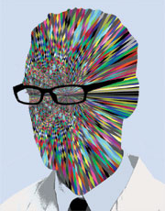
e-Infrastructures
underpinning a creativity machine…
“We humans have built a creativity machine. It’s the sum of three things: a few hundred million of computers, a communication system connecting those computers, and some millions of human beings using those computers and communications.”
  Vernor Vinge (Nature, Vol 440, March 2006)
Notes:
35
In the end, computers plus networks plus people [researchers] add up to
something significantly greater than the parts.
The ensemble eventually grows beyond human creativity.
To become what? We can’t know until we get there.

Slide 36
END

