Slide 1

AAI Needs of the Earthscience Grid Community
Horst Schwichtenberg
horst.schwichtenberg@scai.fraunhofer.de
EGI InSPIRE

Slide 2
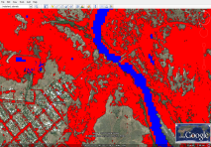
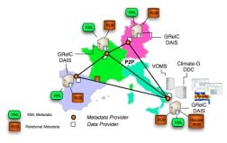
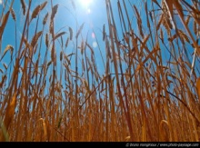
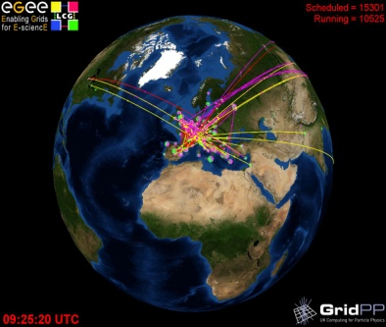
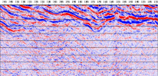
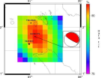




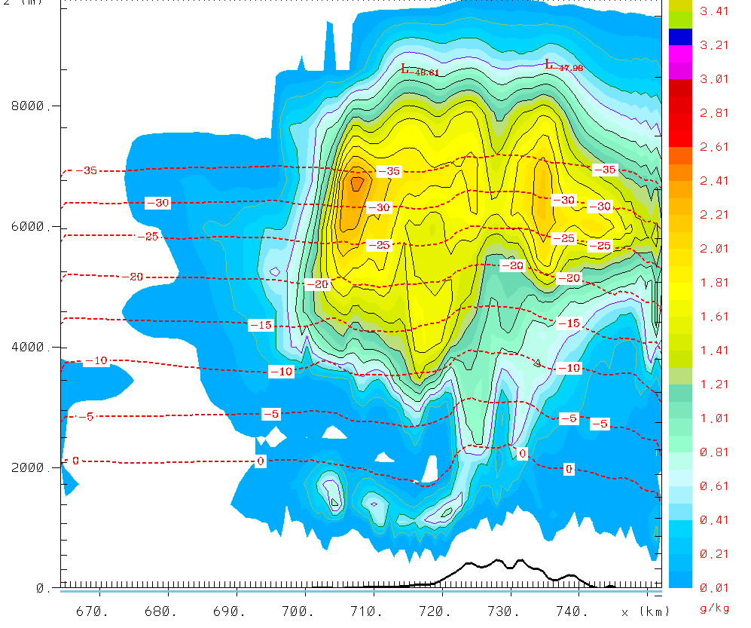
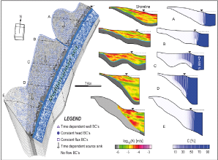
ES Applications
Flood
Climate - GRelC
EMA (France), IISAS (Slovakia), SRI (Ukraine)
Biodiversity
BRGM (France), Footways(France), JKI (Germany)
CMCC (Italy), IPSL (France), Univ Cantabria (Spain),
SCAI (Germany)
GMES
EGU
G-OWS
Climate - El Niño
Cantabria – EELA2
GMES
WDCS
GEOSS
Meteorology
Greece: AUTH, IASA, NOA; SRI (Ukraine), GCRAS (Russia)
WDC
EGU
GEOSS
IEEE
SEIS
Univ. Cantabria – EELA2
IEEE
SEIS
Geosciences- Geocluster
UBO
OGC
ESA
OGC
ESA
Seismology
INSPIRE
INSPIRE
Civil Protection
NASA
Civil Protection
ERCIM
UN-SPIDER
I
CGGVeritas (France), DSI-IRD,Geoazur,IPGP,
IPGS, ISTEP, Sisyphe,
NASA
AUTH (Greece), IPGP (France), AUTH (Greece),
Tubitak Ulakbim (Turkey), Univ. patras (Greece),
INFP (Romania)
CODATA
Pollution
Hydrology
Pollution
Geospatial platform
IMAA(Italy), INFN(Italy), EMA (France), IMHO(Portugal)
CYCLOPS Platform
ds
Presentation and Fruition Services
CRS4 (Italy), Univ. Genève, Univ. Neuchâtel,INHGA ( Romania),
Institute for Water Resources "Jaroslav Cerni",
Belgrade and CSASA at University of Kragujevac, Serbia
Business logic Services
CYCLOPS Infrastructure
IPP-BAS (Bulgaria), IASA (Greece), EnvVO-SEEGRID
Spatial Data Infrastructure Services
Security Infrastructure
Geospatial Resources Services
Interoperability Platform
Advanced Grid Services
GRID Platform (EGEE)
Environmental Monitoring
Resource Infrastructure
Processing Systems
Infrastructure
Data Systems
Sensor systems

Slide 3
Earth Science Data
Data is Central for ES
Data of multiple sources and formats
  Archived sensor data or derived data
    Several sensor types
    Several data processing levels
    Filtering, Subsetting, Formatting, Gridding, etc.
  Model output
Requirement to relate or analyse relation of many data sets
Different providers => different systems

Slide 4
Exemplary overview
Researcher
Geographical Information Systems
Other
Institutional Resources
Compute Infrastructures
Data Centers / SDIs
Notes:
SDI = Spatial Data Infrastructures

Slide 5
GIS
Researcher
Geographical Information Systems
Other
Institutional Resources
Compute Infrastructures
Data Centers / SDIs

Slide 6
Geographical Information Systems (GIS)
Access mostly based on OWS
  Web Service Specifications of the Open Geospatial Consortium (OGC)
  Originally does not specify Authentication or Authorization
  OGC Services are broadly accepted in spatial data oriented ES domains
Work in progress:
  GeoXACML (authorization for spatial data)
  OGC call for OWS and Shibboleth interoper. (ref implementation: http://esdin.fgi.fi/wiki/index.php/Esdin:AuthIE:Client)
  OGC Authentication Interop Experiment:
    The following mechanisms are planned and on test: HTTP Authentication, HTTP Cookies, SSL/X509, SAML, Shibboleth and OpenID.
    ➔ Shibboleth + OpendID (US) are relevant for ES
    WS-Security with SAML/X509/Kerberos
  Developments by G-OWS, Genesi-DR (Elsag-Datamat), INFN OGC roadmap on the way
  Developments for Globus-OGC by lat/lon, deegree (see also OGF-OGC)
Notes:
GeoXACML: Geospatial eXtensible Access Control Markup Language
WS-security is extensible with various AA mechanisms (SAML, Kerberos, X509 …)
OpenID is not an SSO, but favoriesiert by US →
Latlon globus project: http://www.gdi-grid.de/
Kerberos Certificates by Microsoft

Slide 7
Data Centers
Researcher
Geographical Information Systems
Other
Institutional Resources
Compute Infrastructures
Data Centers / SDIs

Slide 8
Security environem
• OWS environment:
– Not yet standardized
– Browser based approach:
• No security at all
• OpenID, Shibboleth
• Username/Password (HTTP)
• GeoDRM
• gLite environment:
– Consolidated security approach based on:
• X509 Certificates
• VOMS Proxies
• DN/FQAN matching AuthZ
• Coupling the two environments:
– Client side: username/password (Shibboleth, OpenId, …)
– Server side: X509 Certificates, VOMS Proxies
• How?
– Shibboleth Credentials (Identity Provider)
– SLCS Service (ShortLivedCredentialService)
– VASH Service (VOMSAttributesfromShibbolethService)

Slide 9
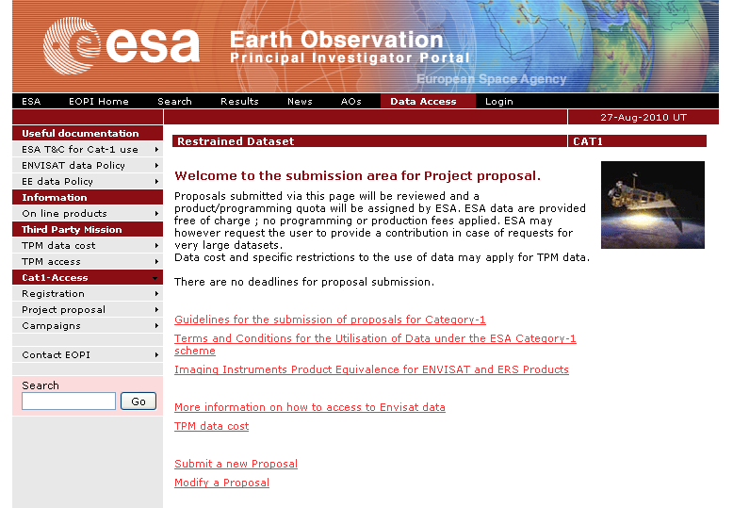
Data Centers /
Spatial Data Infrastructures (SDI)
e.g. ESA EO data
Application for Access
Personal Registration
Different AC Methods
  (S)FTP Password Auth
  Proprietary Access Clients
  Send physical media per mail ☺
Access to ESA data is also possible for ES users today via the GENESI-DR infrastructure
see GENESI-DR project and follow up
A first application interface to the GENESI infrastructure was developed by ES in EGEE-III
  AA was not solved – two CAs
Notes:
EoPortal client?

Slide 10
Data Centers
Data Policies can imply further security requirements regarding storage & processing
It might
  be commercial / protected by NDAs
  represent years of research (fear of prior publication)
INSPIRE, WMO and other large ES organizations define regulations
  Problem for ES: how to protect licensed data on the compute infrastructues

Slide 11
Compute Infrastructures
Researcher
Geographical Information Systems
Other
Institutional Resources
Compute Infrastructures
Data Centers / SDIs

Slide 12
Compute Infrastructures
Recent Years: Most used infrastructures are based on gLite (EGEE), Globus (e.g. NGI-De), Unicore (DEISA)
Personal X509 certificates in many infrastructures by
  National Authorities (compliant with EUGridPMA, IGTF)
  Problem of the PKI infrastructure:
  not accepted by browser (e.g. Verisign, etc.); no hierachy on national level
  Own CAs
Virtual Organisation membership, proxy certificates, delegation
Not useable in commercial clouds
Notes:
Things will change with cloud, kürzer

Slide 13
Institutional Resources
Researcher
Geographical Information Systems
Other
Institutional Resources
Compute Infrastructures
Data Centers / SDIs

Slide 14
Institutional Resources
e.g. Access to data of prior research
*nix user accounts
LDAP / AD
Kerberos
VPN

Slide 15
Other resources
Researcher
Geographical Information Systems
Other
Institutional Resources
Compute Infrastructures
Data Centers / SDIs

Slide 16
Other resources
E.g. proprietary portals, catalogues, maps, etc.
  Simple password auth
  OpenID / Shibboleth (SAML)
  Custom RBAC systems
  Custom authentication methods (robots, …))
Licensed / restricted software
Notes:
Vielleich raus

Slide 17
Summary of Requirements
Access control for data and code
  Protect scientific work (ACLs for code & data) down to a single user (e.g. CGGveritas in EGEE-III, licencing)
  End-to-End data/code protection (storage node to compute node to …)

Slide 18
Summary of Requirements
Federated identity and single sign-on
  Interfaces/API
    Security Assertion Markup Language (SAML) support, as well as support for the OAuth WRAP, WS-Trust, and WS-Federation protocols...
    Available on Cloud infrastructures! We will switch between GRID and Cloud – Data will be available on cloud …
  SSO solutions based on
    Shibboleth, OpenID (future requirement for OGC Services)
AA for Science Gateways
  Automatic certificate generation (e.g. Robot, ...) to provide open public community services with compute resources on EGI in the background
  AA interoperability for workflows and aggregation of services (see federated identity and SSO)
Notes:
Shibboleth and SAML relationship → http://shibboleth.internet2.edu/Shibboleth-SAML-FAQ.html
List of Shibboleht enabled services: https://spaces.internet2.edu/pages/viewpage.action?pageId=11484
Further information: http://switch.ch/aai/support/
Oauth Wrap: is in RFC 5849; Facebook and Twitter support OAuth;
GeoRM?
Robot certificates (Genius grid portal; transparent access to compute resources): http://www.biomedcentral.com/1471-2105/10/S6/S21 ; paper is from June 2009.

Slide 19
Sources
OGC OWS-6 Security Engineering Report: http://portal.opengeospatial.org/files/?artifact_id=35461

Slide 20
Thanks for your attention!

