Slide 1
National R&E Networks: Engines for innovation in research
Erik-Jan Bos – EGI Technical Forum 2010
Amsterdam, The Netherlands – September 15, 2010
Notes:
0
0

Slide 2
Erik-Jan Bos
Chief Technology Officer at Dutch NREN SURFnet
Member of the Executive Committee of the FP7 Project GN3
Co-chair of the Technical Working Group of GLIF, the Global Lambda Integrated Facility
The opinions in this presentation are mine, and
not necessarily those of one or more of the bodies
mentioned above.

Slide 3
E-Infrastructures users today experience…
Many separate components of the e-Infrastructure:
Computing
Storage & Data Management
Networks
Identity management systems & solutions
Tools and applications
Scientific instruments
Components that are not aligned and do not interoperate well today

Slide 4
E-Infrastructure Vision
Researchers can work together simply and efficiently by seamlessly linking all kinds of e-Infrastructure services
The development of new applications for the e-Infrastructure is stimulated
Middleware enables the usability of these e-Infrastructure services in a user-friendly way
Bandwidth, for IP & Lightpaths, does not need to be scarce

Slide 5
Some observations: User perspective
More and more data-centered
Research within virtual organisations
Research is a global activity
Clouds and cloud services are coming towards us fast, fuelling the discussion “build or buy”
Open Access
Facilities shared and linked by ICT

Slide 6
Some observations: Provider perspective
Requirements ahead of general needs and markets
High demands coming from ICT-competent users
Growing set of demands coming from researchers without ICT knowledge
Huge amount of ICT-service offerings outside of the institutes

Slide 7
Hence…
It’s about services and their integration
Close collaboration with users and e-Infrastructure providers is urgently needed
Coordination between domains on a worldwide scale should be our focus
Open innovation is KEY

Slide 8
E-Infrastructure is global
Environment is inherently multi-domain
Each domain is progressing at its own pace
Federated services
Open standards
(Re-)using best current practices
Users and providers together need to work on finding and walking on an optimal path forward:
Nurture domains and grow them strong
Avoiding lowest common denominators

Slide 9
Nordic situation
NORDUnet & Nordic DataGrid Facility

Slide 10
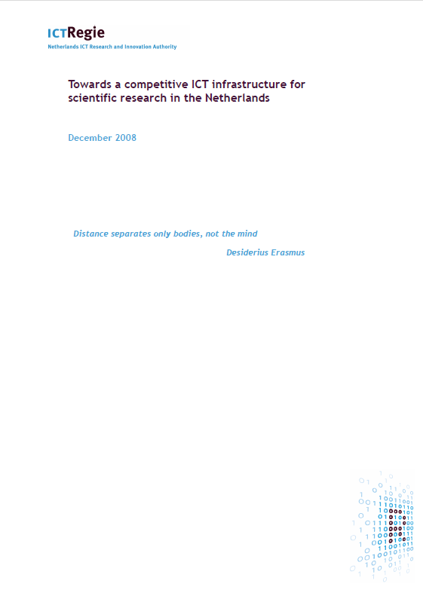
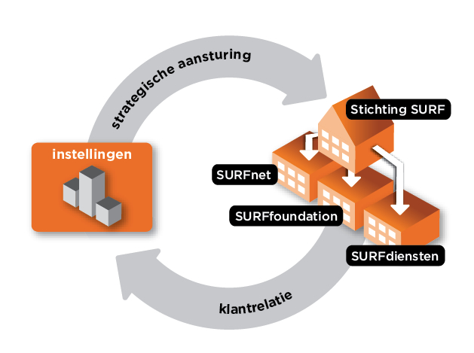
Dutch situation
ICTRegie Report
SURFnet: Owned by and working for the users in R & HE in NL: On the demand side of the market

Slide 11
Open Innovation is KEY
The power of collaboration, with users and with peers worldwide
Select the most appropriate way for achieving results:
Basic services (core package)
Temporary services and showcases
Collaborate, challenge, and share knowledge
Challenge talented people and organisations

Slide 12
New research -> new ICT requirements
Explosion in the amount of data from experiments and simulations
Examples: LHC, LOFAR, e-VLBI
Need for near real-time processing of very large datasets
Example: LHC Atlas trigger
Increase in remote collaboration:
Distributed sensors
Shared computing and storage grids
Virtual teams, virtual organisations
Accessing cloud services in a seamless way

Slide 13
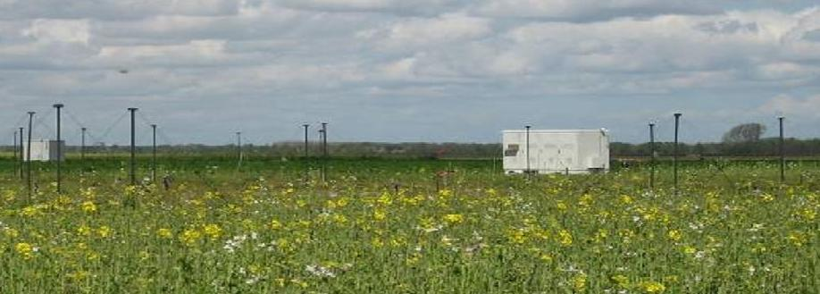
Example: distributed low frequency array LOFAR
A distributed multibeam array for radioastronomy
Large number of very simple antennas, with very high bandwidth connections

Slide 14
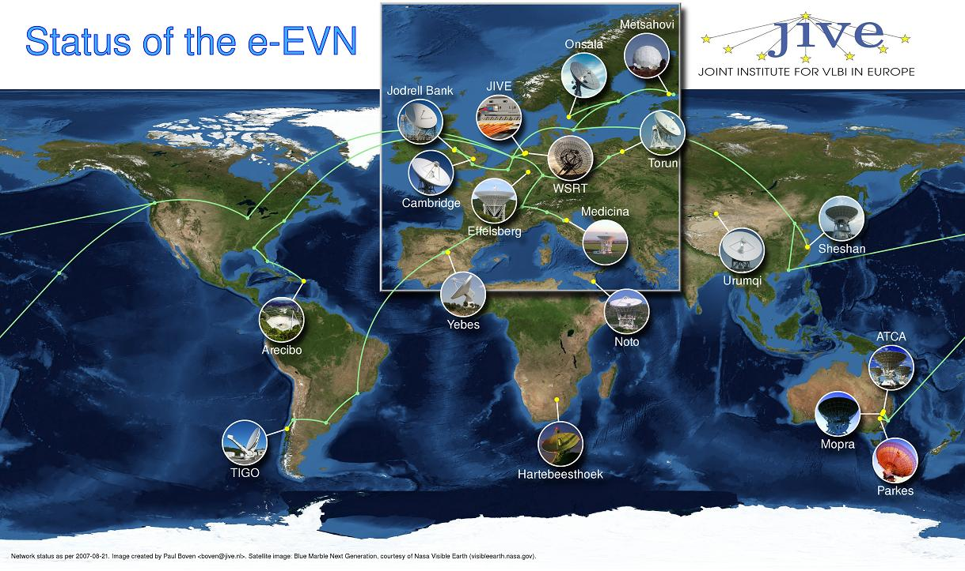
Example: e-VLBI, a global radiotelescope

Slide 15
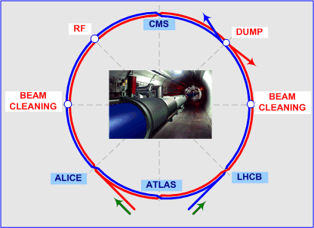
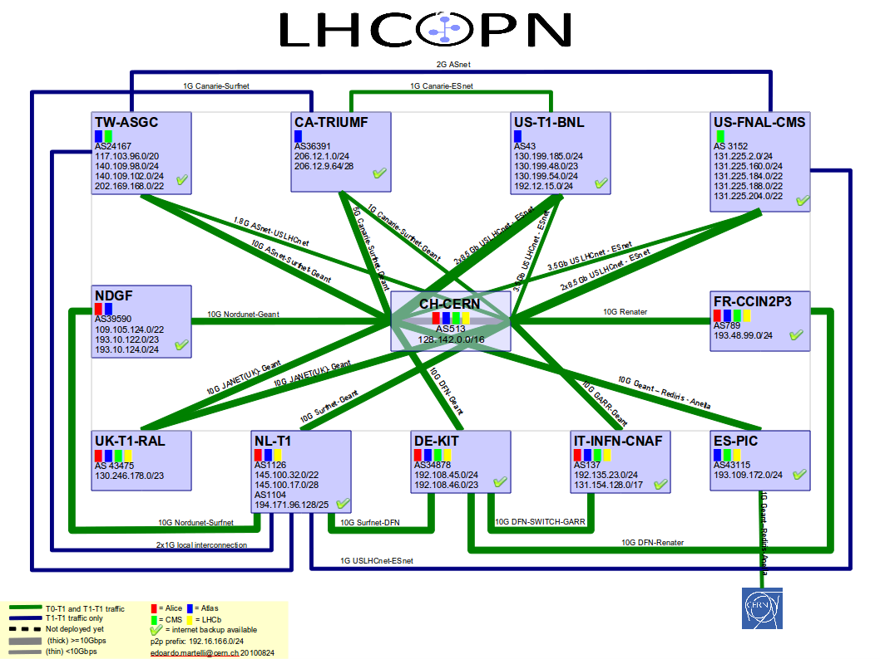
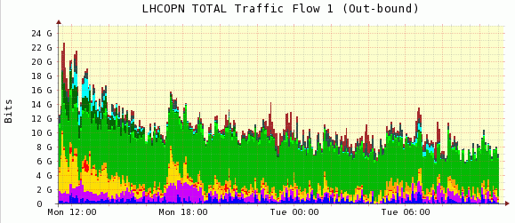
Example: LHC Computing Grid and LHCOPN

Slide 16
The Case for NRENs
NRENs are special, providing advanced services to (H)E&R
Spill-over of results into commercial sector of country
Country should cherish the NREN
Can lead to large advances in knowledge economy of country
http://www.terena.org/publications/files/20090127-case-for-nrens.pdf

Slide 17
Areas to work on
Hybrid end-to-end network
The basis for all collaboration, providing efficient,
unlimited data transport.
Trusted identity
offering secure and seamless access to all the electronic
materials and facilities that researchers, instructors,
and students need.
Pioneering collaboration environment
that reaches beyond existing boundaries and that seamlessly integrates the services and tools
provided by a large number of suppliers.

Slide 18
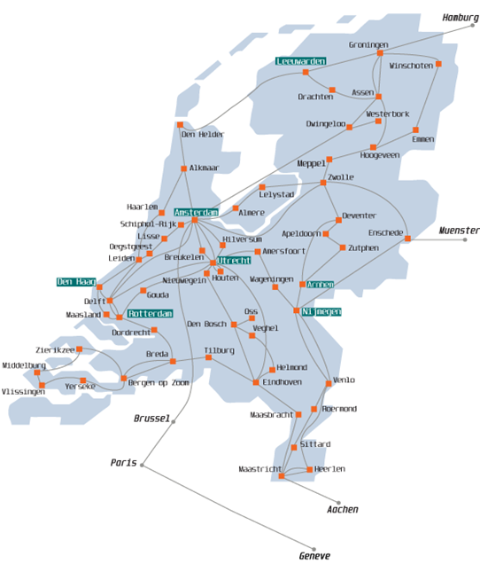
Hybrid end-to-end network in NL
11.000+ km dark fiber, into connected organisations
Own photonic network
Network Services:
IPv4 and IPv6
Fixed and dynamic Lightpaths
Collapsed IP backbone with routers at only 2 locations
Notes:
17

Slide 19
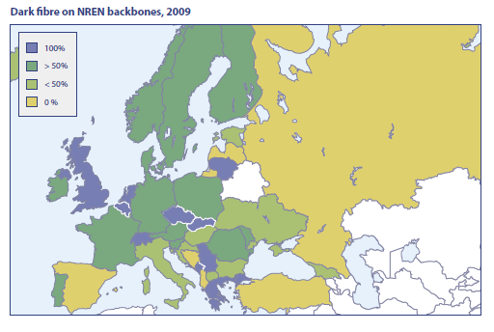
NREN Dark Fibers - 2009
Source: TERENA Compendium 2009
Notes:
18

Slide 20
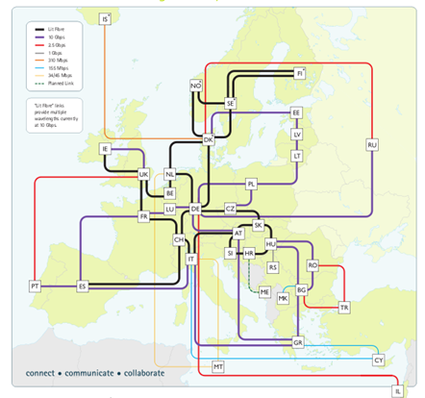
The GÉANT Network

Slide 21
Hybrid end-to-end network: Lightpaths
Dark Fiber is the basis for building research infrastructures
Lambdas form the building block for high capacity research networks
Lightpaths are full lambdas or a dedicated part, for end-to-end, high bandwidth data transport with fixed characteristics
Fixed lightpath: always on
Dynamic lightpath: under control of users and their applications

Slide 22
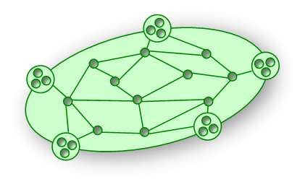
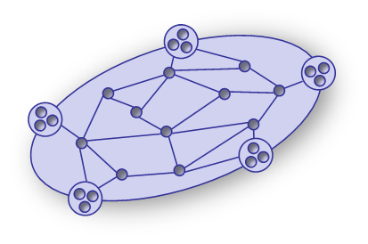
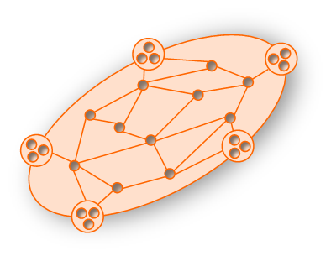
Federated Multi-Domain Networking
Fenius / NSI
NSI-C
NSI-A
AUTOBAHN
DRAC
NSI-B
OSCARS

Slide 23
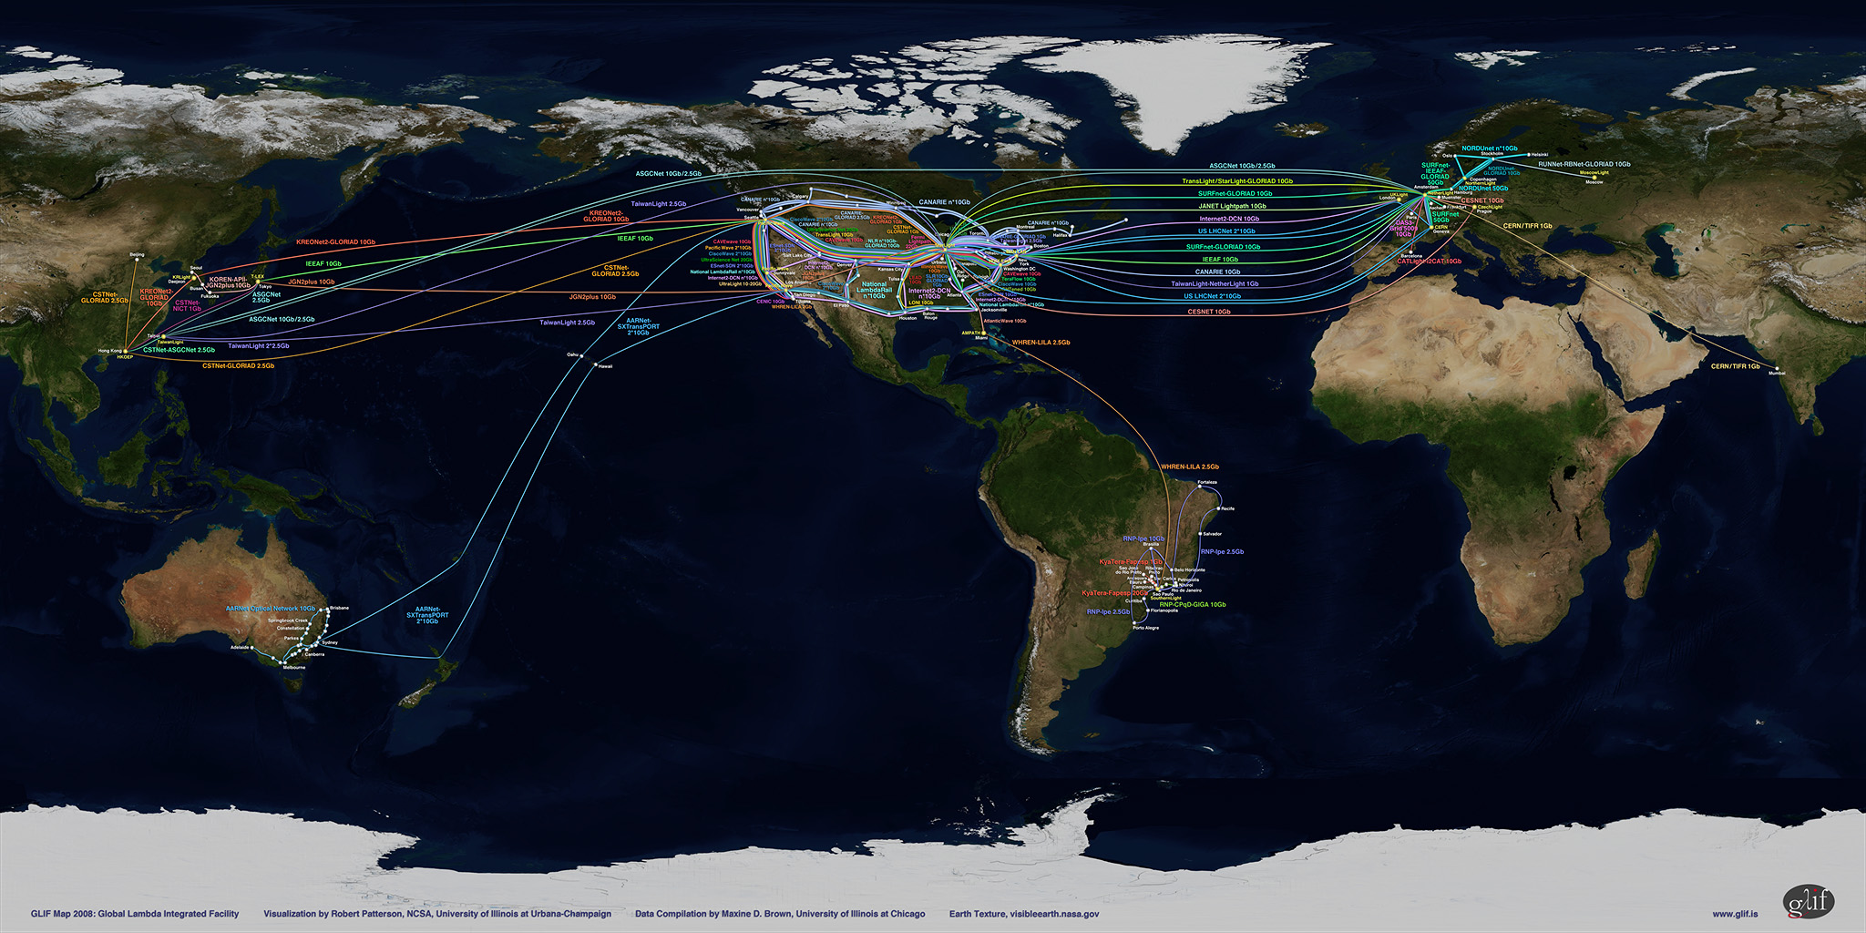
Global Lambda Integrated Facility
Notes:
22

Slide 24
Resources in GLIF
Lambdas
GOLEs (GLIF Open Lightpath Exchanges)
GOLEs form a crucial part of the emerged and growing global lambda grid:
Open = Policy Free
Exchange = Cross-connect your lightpaths
Vision: Linking the World with Light

Slide 25
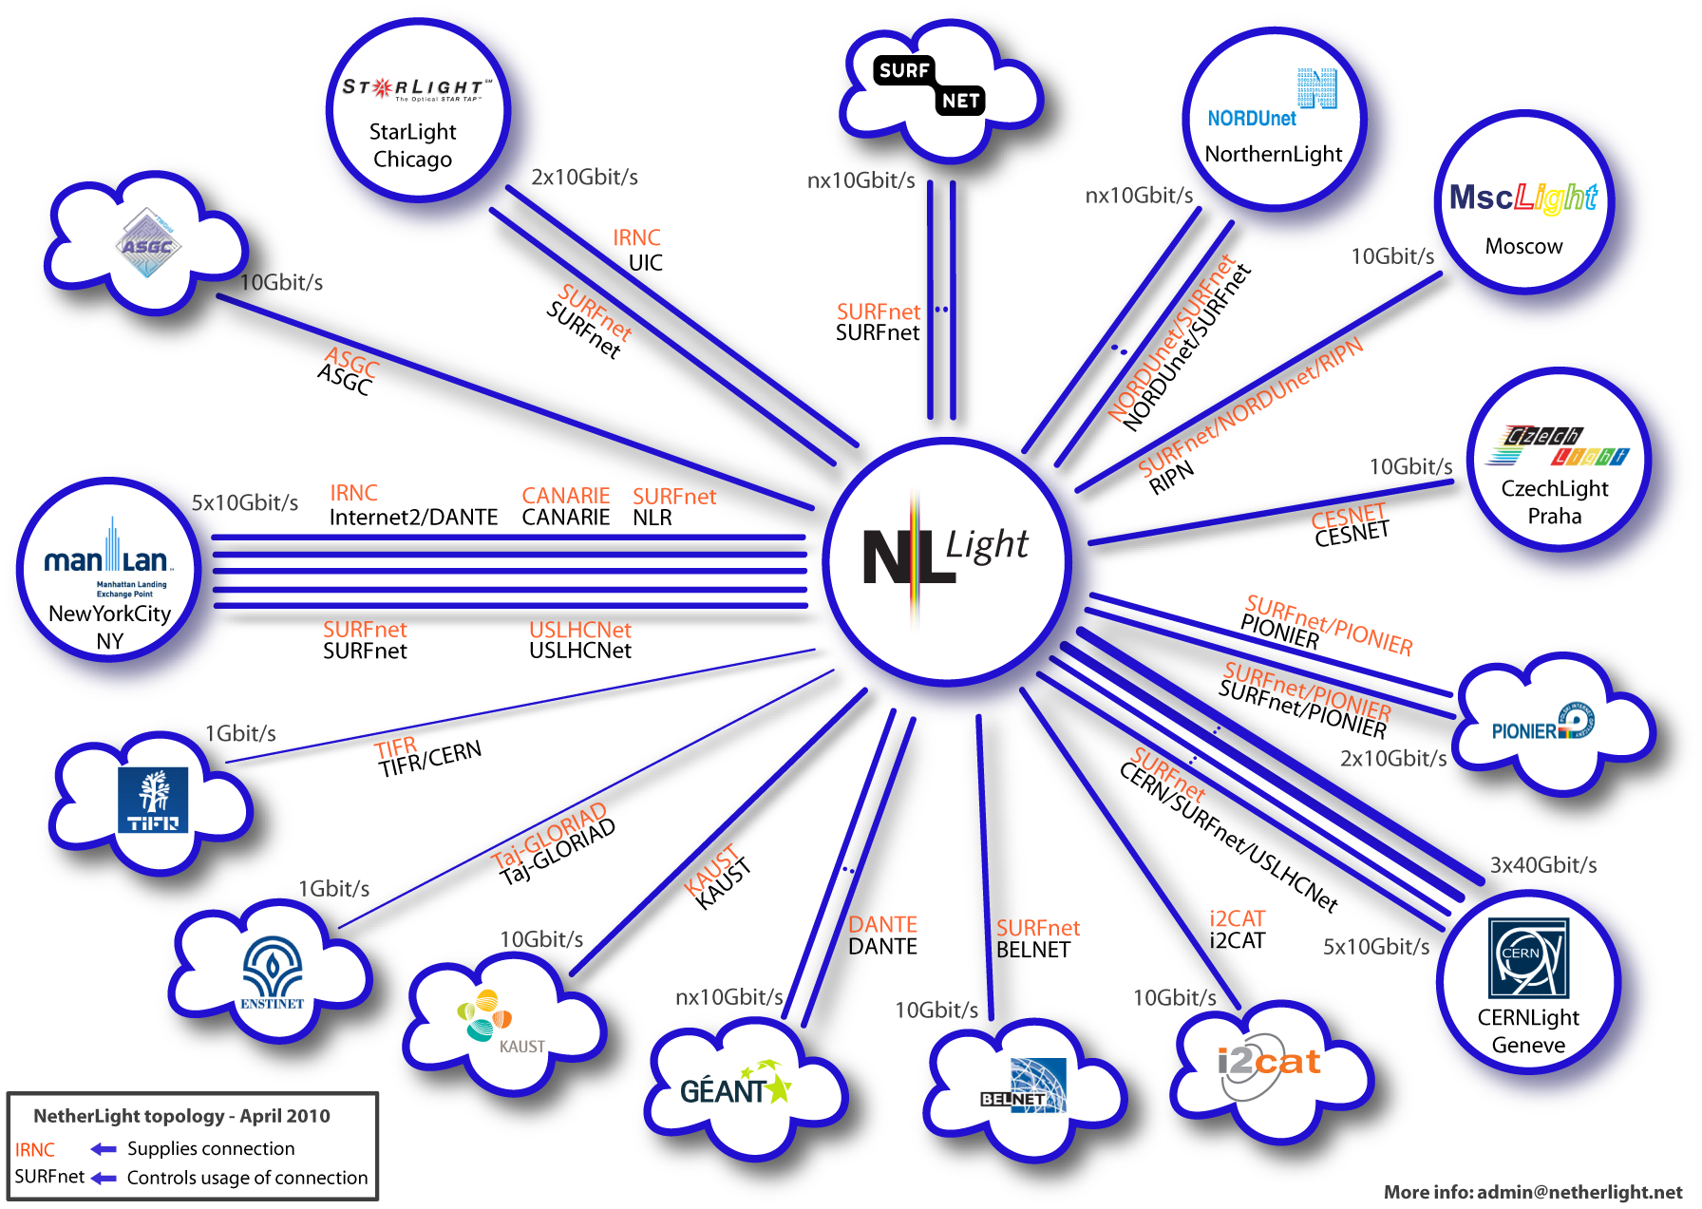
NetherLight: The GOLE in Amsterdam
Notes:
24

Slide 26
Federated Identity Management
Trusted identity
offering secure and seamless access to all the electronic
materials and facilities that researchers, instructors,
and students need.
Interconnect Service Providers and Identity Providers in a scalable and flexible way for SSO and ZSO
Challenges ahead are to expand the functionality of Identity Federations for:
the pioneering collaboration environment
greater control of privacy by the end user
scalable support for use/guest use
multi-domain through inter-/confederations

Slide 27
SURFfederatie Functional View
#59
#45
Identity Providers
SURFfederatie CORE
Service Providers
A-Select Cross
Credentials
A-Select Cross
Applications
Shibboleth
Central
Federation
Components
SAML 2.0
SAML 2.0
#700,000
WS-Fed / ADFS
WS-Fed / ADFS

Slide 28
Certificates for Grids, possibilities to explore
NREN (TERENA) server certificate service to identify Web/SSL servers and service endpoints
NREN federation infrastructure and trust available to obtain certificates for grid access
Machine-to-machine Web Services (SOAP/REST) access through delegated (person) authentication
From legacy SSL/PKI based transport to WS-Trust/Oauth 2.0 calls
Short-lived tokens for offline jobs

Slide 29
Online Collaboration
Pioneering collaboration environment
that reaches beyond existing boundaries and that seamlessly integrates the services and tools
provided by a large number of suppliers.

Slide 30
Three generations of collaboration tools
1. Stand alone applications:
Like ships in the night
2. Applications connected to Federated Identity Management infrastructures:
Uniform method for AuthN and AuthZ
Still much unaware of each other
3. Applications aware of each other:
Access through Federated IdM infrastructures
Group functionality as the basis -> VOs
Ability to share data between apps

Slide 31
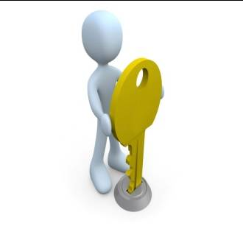
Gen 1 collaboration tool
File Sharing App
Notes:
30

Slide 32
Gen 2 collaboration tool
Notes:
31

Slide 33
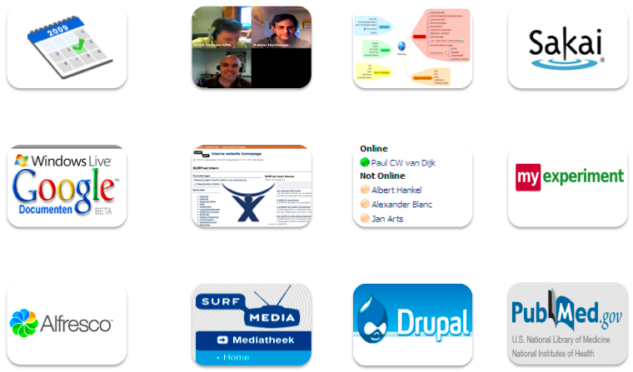
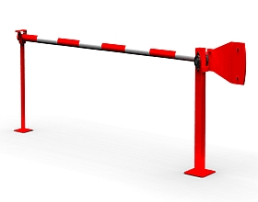
Adding federated Identity Management

Slide 34
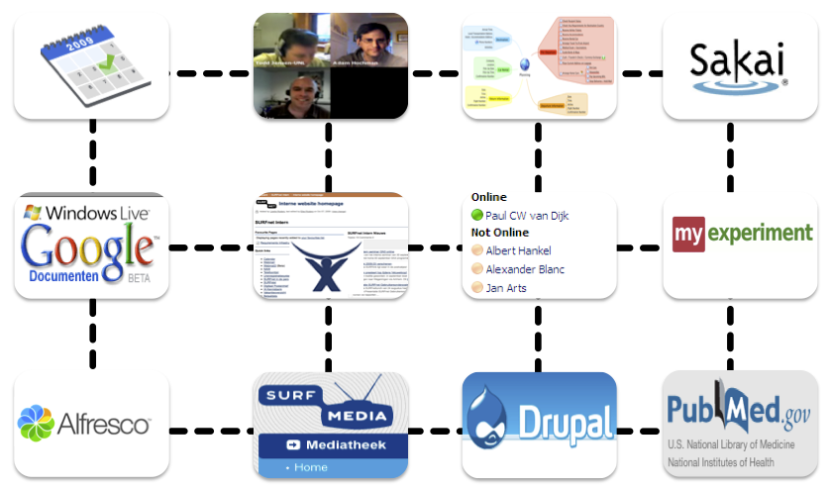
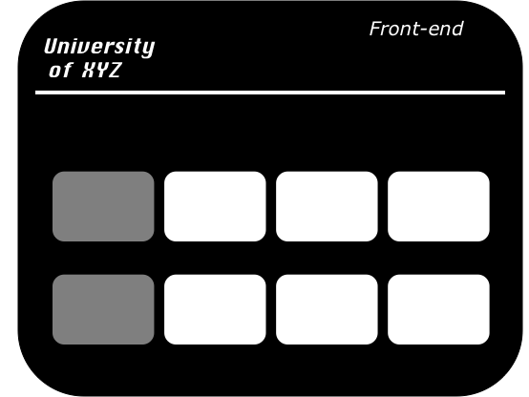
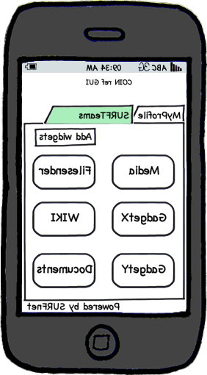
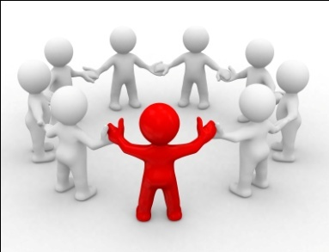
Collaboration Infrastructure
Notes:
33

Slide 35
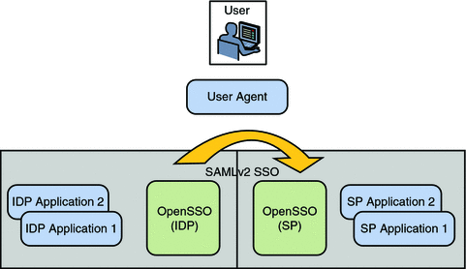
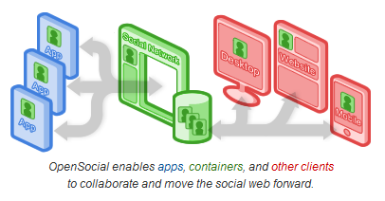
Collaboration Infrastructure
CoIn is a blend, a synergy between:
Federated IdM and Group middleware
Social Networking
Collaboration Tools

Slide 36
Conclusions
The demands from scientific research users are still ahead of what the market can provide
The integration of Computing, Storage, Networks, Identity Management, Collaborations Tools and Scientific Instruments is the true next paradigm shift
Clouds and cloud services will become an integral part of research networks
Close collaboration between users and e-Infrastructure providers is essential to realize the true Collaboration Infrastructure

Slide 37
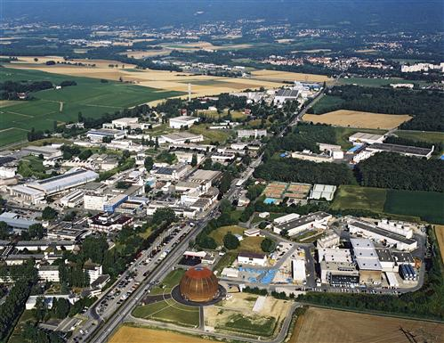
Thank you! Questions?
10th Global LambdaGrid Workshop:
CERN, Geneva, Switzerland
13-14 October 2010
Hosted by: CERN
Program and details at: http://www.glif.is/meetings/2010/
E: erik-jan.bos@surfnet.nl
T: +31 30 2305305

