Slide 1
GGUS Roadmap
Torsten Antoni
KIT | GGUS
antoni@kit.edu

Slide 2
Overview
GGUS redesign
Cross-project workflow for MW issues
GGUS fail-over system improvement
Review of legacy support units
Migration of SU mailing lists to „egi.eu“
Review of documentation
GGUS-VOMS integration
Improvement of GGUS interfaces
Report generator enhancement

Slide 3
GGUS Redesign

Slide 4
MW workflow
Details need to be defined with DMSU
Details need to be defined with EMI
Contact with IGE needs to be established
Implementation of agreed workflows
TPM
GGUS
DMSU
IGE
EMI
PT 1
PT 2
PT 3
PT 4
PT 5
PT n
Bug Tracking Tool(s)

Slide 5
GGUS Fail-over System
GGUS fail-over system consists of two major parts:
BD back-end fail-over
Based on Oracle RAG (with Dataguard)
At two separate location at KIT
Web front-end fail-over
Currently active/passive fail-over that needs manual intervention by on-call engineer
Move to an automated active /active system

Slide 6
Legacy Support Units
Lots of legacy support units from EGEE still in GGUS
Some are still active and need to be transfered to EGI
Restructuring of the SU list
Renaming SUs
Some need to be deleted or kept as „former support unit“ to not lose information

Slide 7
Mailing List Migration
Currently a lot of support units have mailing lists in the CERN e-groups
After SU clean-up we want to move the SU mailing lists to the EGI mailman system
„su-xy@mailman.egi.eu“

Slide 8
Documentation Review
GGUS documentation collection: https://gus.fzk.de/pages/docu.php
Needs adaption to EGI
Changed workflows
New logos
New location?

Slide 9
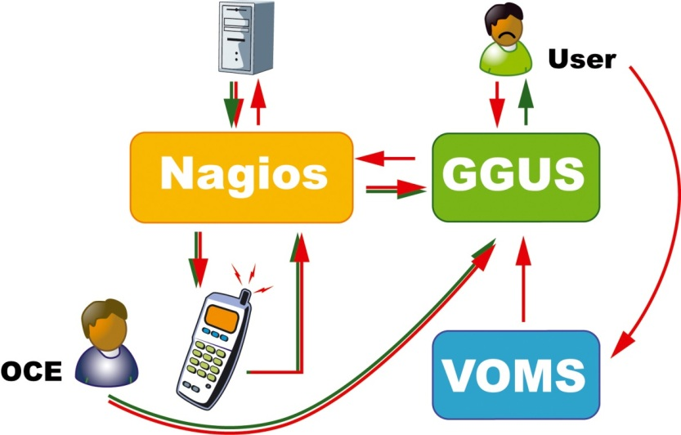
GGUS-VOMS Integration
Finalize GGUS-VOMS synchronisation automation
Currently manual intervention is still necessary to update the user DB with user properties
This will be replaced by an automatism

Slide 10
GGUS interfaces
Standard interface to NGI helpdesks
Web services or Messaging
Some functionality in GGUS in not yet implemented in the interfaces
e.g. ticket relations (master/slave or parent/child)

Slide 11
Report Generator
Tool to self-create statistics and metrics
Select your report and save it in various formats
New types of reports will be created
e.g. „response time per support unit“

Slide 12
Overview
GGUS redesign Sept 2010
GGUS-VOMS integration Sept 2010
Cross-project workflow for MW issues Oct 2010
Report generator enhancement March 2011
GGUS fail-over system improvement Dec 2010
Review of legacy support units Dec 2010
Review of documentation Dec 2010 then continuous
Improvement of GGUS interfaces Not yet scheduled
Migration of SU mailing lists to „egi.eu“ March 2011

Slide 13
Newsflash
Contact with IGE has been established (here at the TF)
Details of DMSU discussed and agreed (here at the TF)
Feedback to MW providers from Technology Unit or Staged Rollout via GGUS as a special ticket type

