Slide 1
Project Moonshot
Daniel Kouřil
EGI Technical Forum 2010
www.project-moonshot.org

Slide 2
Identity federation
Goal: to allow users in one organisation to access resources in another, using their home credentials
Requires additional infrastructure, trust and policy; this is often known as a “federation”.
Significant benefits for users, and identity and service providers
Single sign-on for users, improving the user experience.
Makes it easier for identity providers to adhere to data protection legislation.
SSO reduces helpdesk burden for identity and service providers.

Slide 3
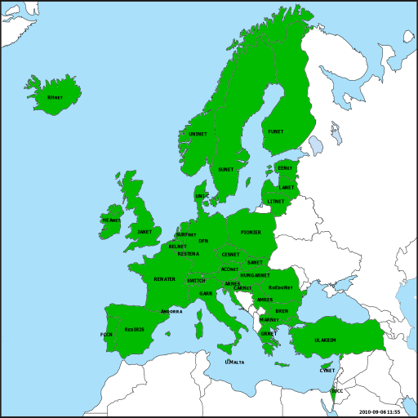
eduroam
A federation providing wireless network access and roaming in > 50 countries.
Allows users from participating institutes to obtain connectivity at other institutions using their „home“ credentials.
AAI based on RADIUS and EAP
Credentials are protected.

Slide 4
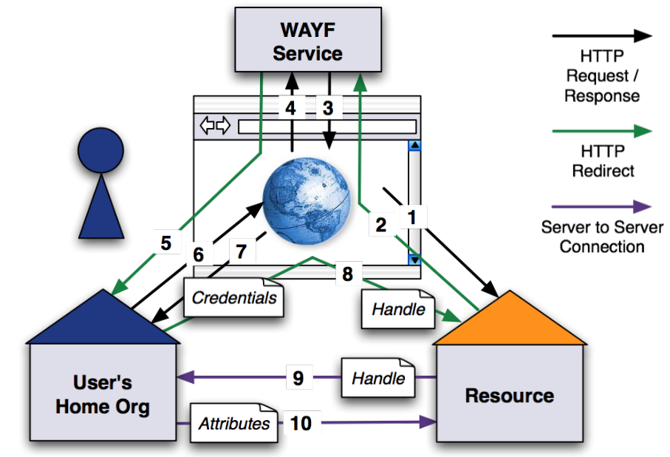
SAML-based web federations
SAML : an XML-based dialect to exchange security assertions (authN & authZ data)
Becoming increasingly popular nowadays
Based solely on HTTP and web
Internet 2 Shibboleth
Microsoft ADFS
schema from SWITCH AAI

Slide 5
Moonshot authentication system
Enables the use of identity federations and SAML for non-web applications
Address some current issues of contemporary web-based federations
A novel approach to establishing trust between actors
Targeting the „core“ internet protocols
SSH, SMTP, IMAP, NFSv4, HTTP, ...

Slide 6
Moonshot architecture
Built on tested and proven „components“
SAML, RADIUS, EAP, GSS-API
Client
Service Provider
Identity Provider
EAP peer
(Supplicant)
EAP
authen
ticator
AAA
client
EAP
server
AAA
server
EAP lower
layer
(e.g. 802.11)
GSS-API
EAP lower
layer
(e.g. 802.11)
GSS-API
SAML
IdP
Application
(e.g. SFTP)
Application
(e.g. SFTP)

Slide 7
Moonshot project
First stages started cca in Spring 2010
lead by JANET (UK)
kick-off meeting next week
Co-funded by GN3 and JANET
Participants have experience with all areas needed
Strong focus on standardization
IETF WG (AbFab) to be established
several IETF drafts published

Slide 8
Goals planned
To deliver
a standardised technical architecture.
production-quality open-source implementation.
packaged and shipped with Debian Linux (by August 2010).
a test-bed for interoperability testing.
high quality documentation.
an active community of users and developers.
Highly ambitious but achievable.

Slide 9
Possible bright future
Allow access from Org1 and Org2
Resources of Org1 and Org2 (CE, SE, ...)
GRAM, WMS, CREAM | gridFtp | SSH, NFSv4
and Org3
Users‘ passwords are NOT exposed to the services
Users don‘t need new credentials
Authorization rules can utilize users‘ „home“ attributes
Information about users is up-to-date
Users do not need to register in advance
Identity Federation
Org 3
- „home“ credentials (e.g., passwords)
Org 1
Org 2

Slide 10
Comments / questions?
www.project-moonshot.org

