Slide 1
Shared Services and Tools: Dashboards.
EGI Technical Forum 2010
J. Andreeva, M. Devesas Campos, J. Tarragon Cros, B. Gaidioz, E. Karavakis, E. Lanciotti, G. Maier, S. Mitsyn, W. Ollivier, R. Rocha, T. Sadykov, P. Saiz, L. Sargsyan, I. Sidorova, D. Tuckett
CERN :: IT :: ES

Slide 2
Outline
Importance of monitoring
Experiment Dashboard
Framework
VO-specific applications: Data Transfer Monitoring
Common applications for Job Monitoring and Site Commissioning
Future Plans
Summary

Slide 3
Importance of monitoring
WLCG integrates more than 170 computing centres in 34 countries.
More than 100,000 jobs are running concurrently for the LHC VOs using various middleware platforms and submission methods.
Powerful and flexible monitoring systems are required in order to maintain and improve a highly distributed system.
Monitoring the computing activities for a given VO is essential in order to estimate the quality of the infrastructure and to detect any problems or inefficiencies.

Slide 4
Experiment Dashboard
Not coupled to a specific Workload or Data Management System or a grid middleware.
Covers the full range of the experiments’ computing activities:
  Job Monitoring, Data Transfer and Site Commissioning.
Sufficiently generic to support multiple HUC outside the scope of HEP and LHC.
Heavily used by the four LHC experiments.
  More than 4000 monthly visitors just for CMS.

Slide 5
Experiment Dashboard
Provides solutions focused on different user categories.
  VO-specific solutions.
  Common solutions.
Common framework that provides the building blocks for the main components of the monitoring system.
Common way of instrumenting VO-specific frameworks to report monitoring information to Dashboard.
Common applications.

Slide 6
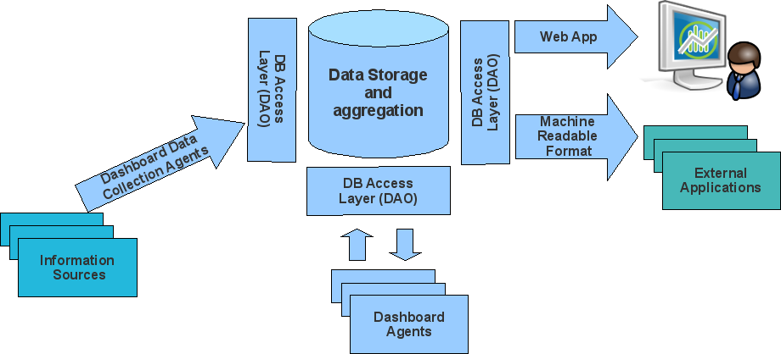
Framework
Information Collectors + Data repo + User Interfaces
The Dashboard applications are built on top of the framework.

Slide 7
Monitoring of the Computing Activities
Data Transfer Monitoring
  ATLAS DDM Dashboard, ALICE Transfer Efficiency, CMS Data Access Monitoring.
Job Monitoring
  Task Monitoring, Job Summary, Historical Views.
Site Commissioning
  Site Status Board, Site Monitoring based on the SAM results, Dashboard Google Earth: provides a global view of the LHC computing activities.

Slide 8
Data Transfer
Example: Dashboard DDM for ATLAS.
VO-specific application.
Plays a central role in ATLAS computing operations - used by the shifters 24/7.
Serves more than 1000 unique visitors per month and up to 25k pages are viewed daily.

Slide 9
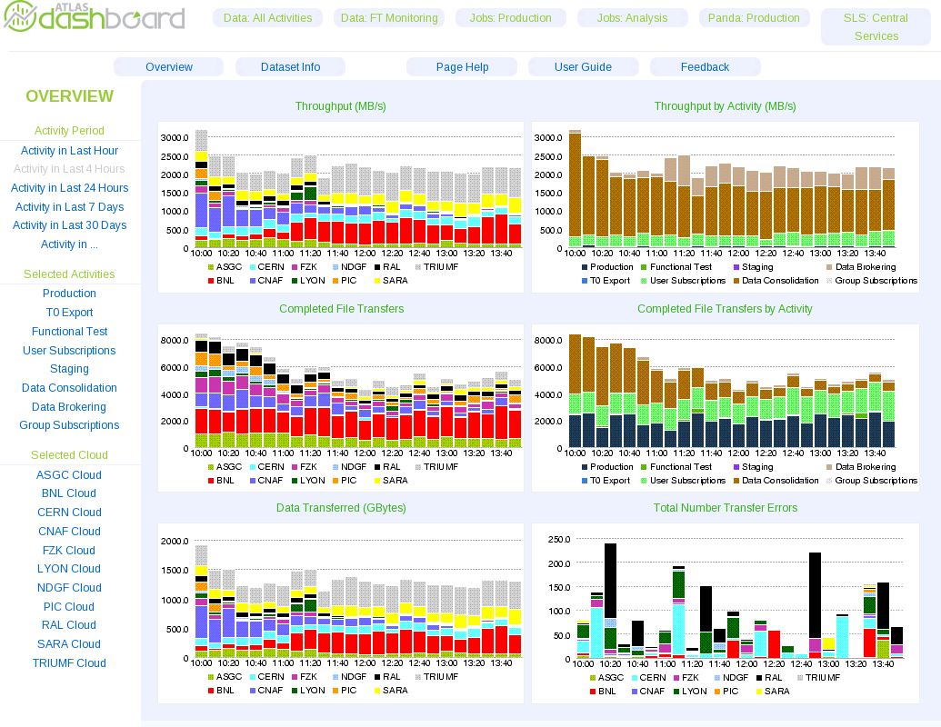
Snapshot

Slide 10
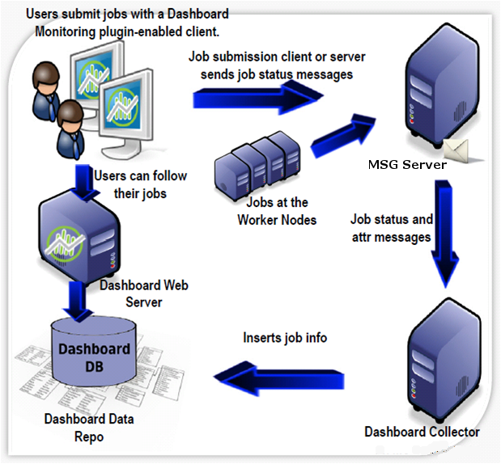
Job Monitoring
Common
It works transparently of the job submission method:
  local submission, pilot submission, etc
Aimed at different types of users:
  individual scientists using the Grid for data analysis, user support teams, site admins, VO managers, managers of different computing projects.

Slide 11
Task Monitoring
Collects and exposes a user-centric set of information to the user regarding submitted tasks.
Focused on the user's perspective.
Offers a wide selection of graphical plots.
User-driven development.
Heavily used for CMS – up to 350 daily users.
A version for ATLAS is coming.

Slide 12
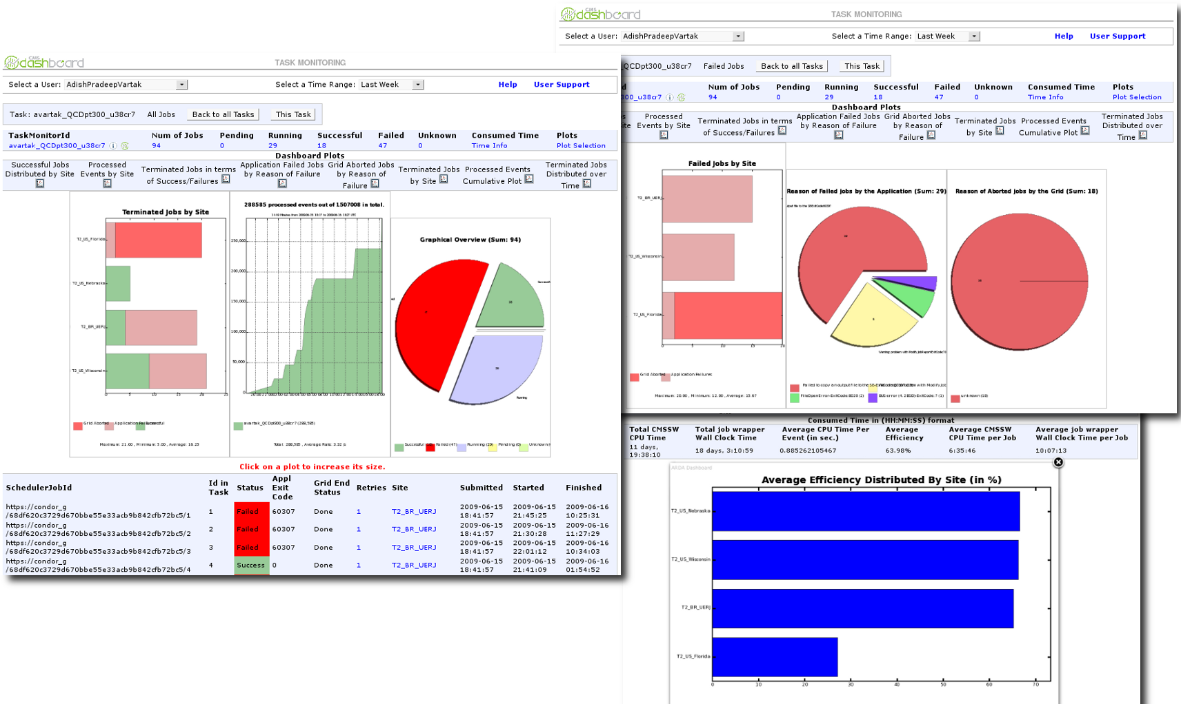
Task Mon: Snapshots
Processed
Events
over Time
Distribution
by Site
Failure Diagnostics for Grid and
Application Failures
Distribution
by Status
Detailed Job Information
Efficiency Distributed
by Site

Slide 13
Job Summary and Historical View
Job Summary enables very flexible access to recent monitoring data and shows the job processing of a VO at run-time.
The Historical View is useful for understanding how job efficiency and job failures fluctuate over time.

Slide 14
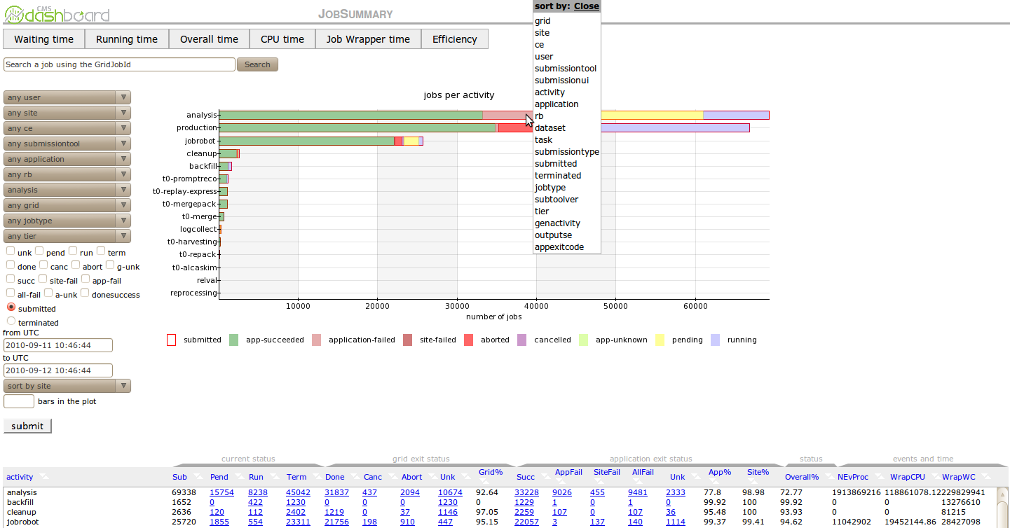
Job Summary Snapshot

Slide 15
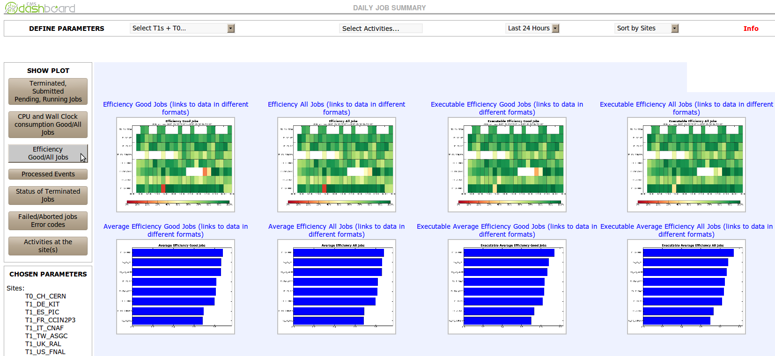
Historical View Snapshot

Slide 16
Site commissioning
Common
Dashboard offers quite a few solutions for Site and Service Monitoring:
  Site Monitoring based on the Service Availability Monitoring (SAM) results
  Site Status Board
Both applications provide a status evaluation of the sites and services within a VO.

Slide 17
SAM Visualisation
An interface to the SAM tests used by the four LHC VOs.
SAM is being used for the validation of sites and services.
Close collaboration with the SAM, Nagios and Grid View teams. Contributions from the Bhabha Atomic Research Centre (BARC) in India.
SAM was extended by the Dashboard team to calculate the usability of the sites from the VO perspective.

Slide 18
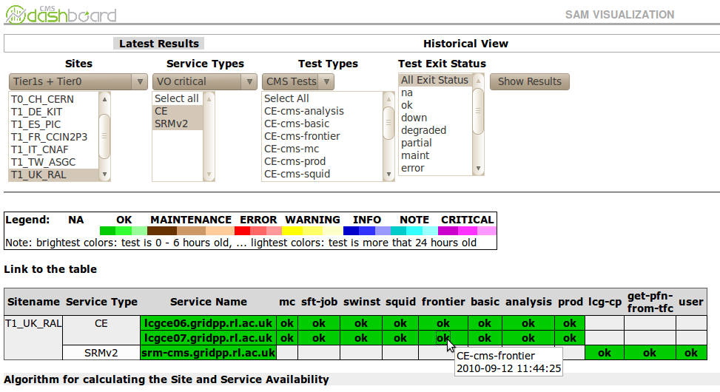
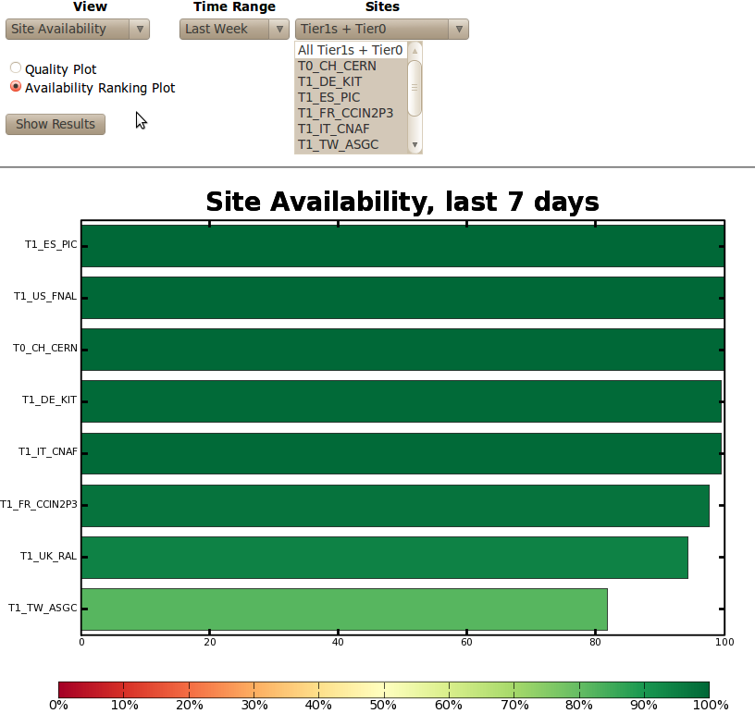
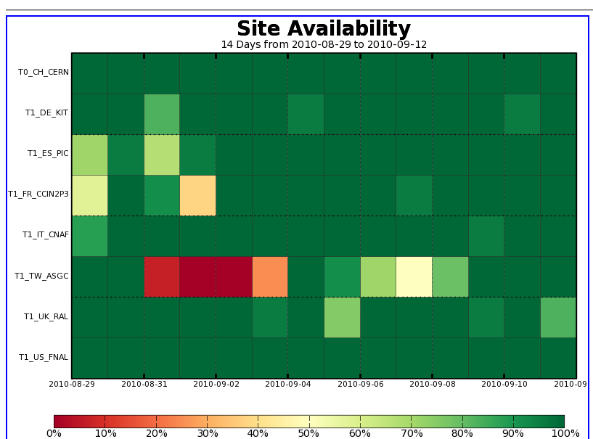
SAM Visual. Snapshots

Slide 19
Site Status Board
Originally developed for the CMS VO.
Extended and used by the four LHC VOs.
Provides a single entry point for the monitoring of site performance from the VO-perspective.
Customisable metric store and user interface.
Runtime and historical monitoring data.
Used in computing shifts, site commissioning and space monitoring.
~150 unique visitors per day just for CMS.

Slide 20
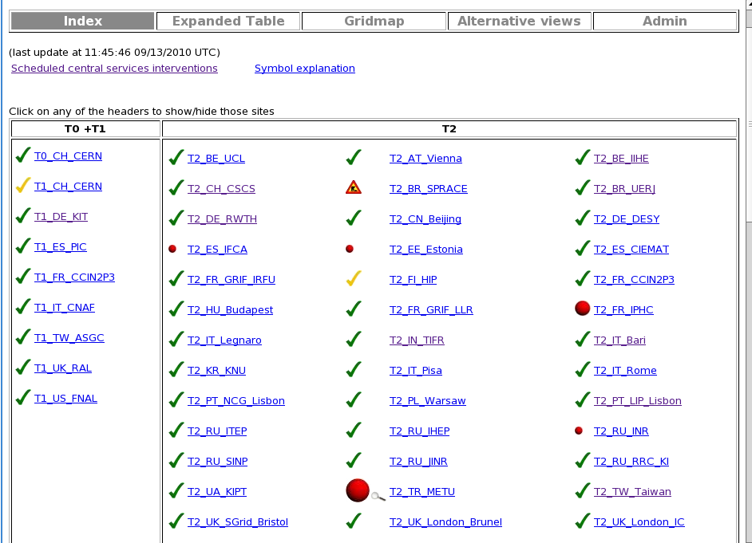
SSB Snapshot
Sites are arranged by groups
Status is calculated from metrics defined as critical by VO
Icon represents current status and its size represents how many hours the site has been in error
Site maintenance information
Links to support tickets when site under investigation

Slide 21
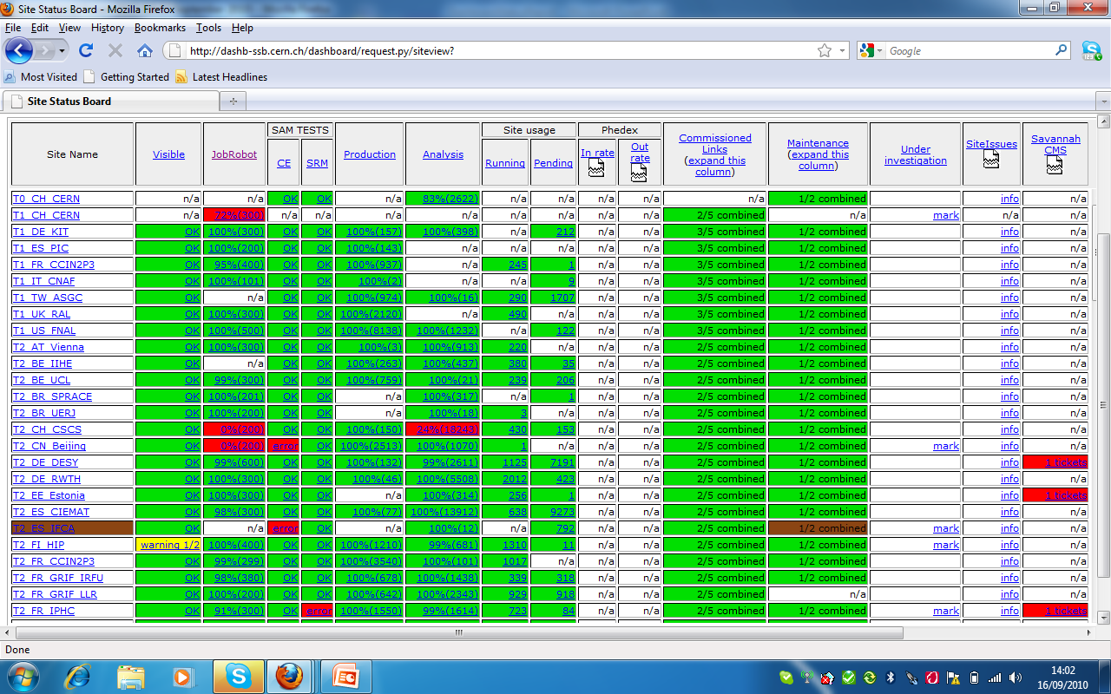
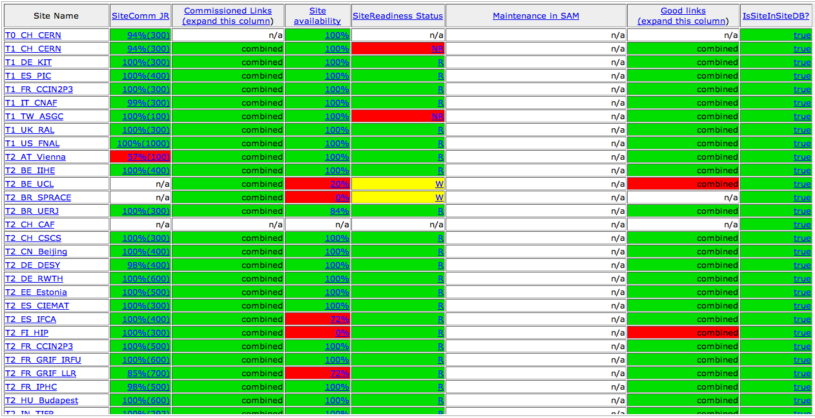
Metric Results

Slide 22
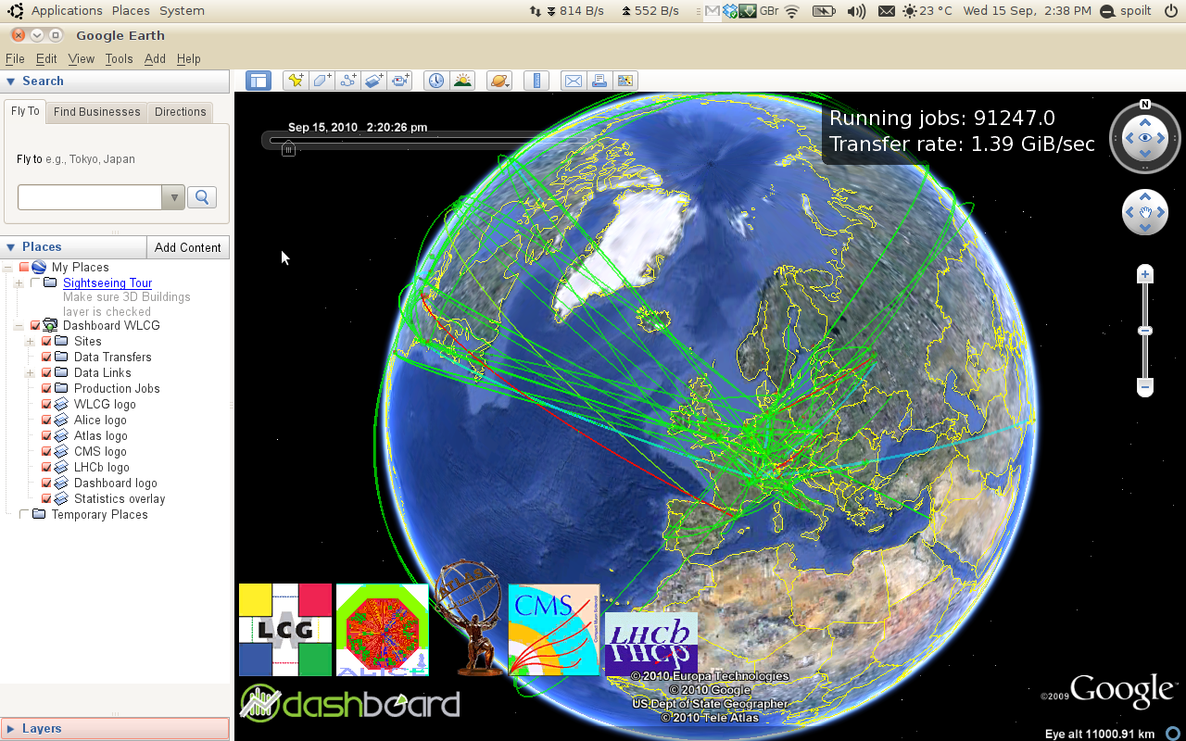
Global Picture
In addition to the previous applications, Dashboard offers a global, cross-vo, view of the LHC computing activities.

Slide 23
Future Plans
Effort to provide generic solutions.
A prototype implementation for ATLAS is being evaluated.
The solutions provided for the site commissioning are constantly improving due to the requests of the community.

Slide 24
Summary
Used heavily within the LHC community.
Provides common solutions that can be used for VOs outside the LHC and HEP:
  Common framework
  Common way of instrumenting VO-specific framework to report monitoring updates
  Common transportation method
  Common applications
http://dashboard.cern.ch

