Slide 1
AAA in LifeWatch
Axel Poigné
Fraunhofer IAIS
axel.poigne@iais.fraunhofer.de

Slide 2
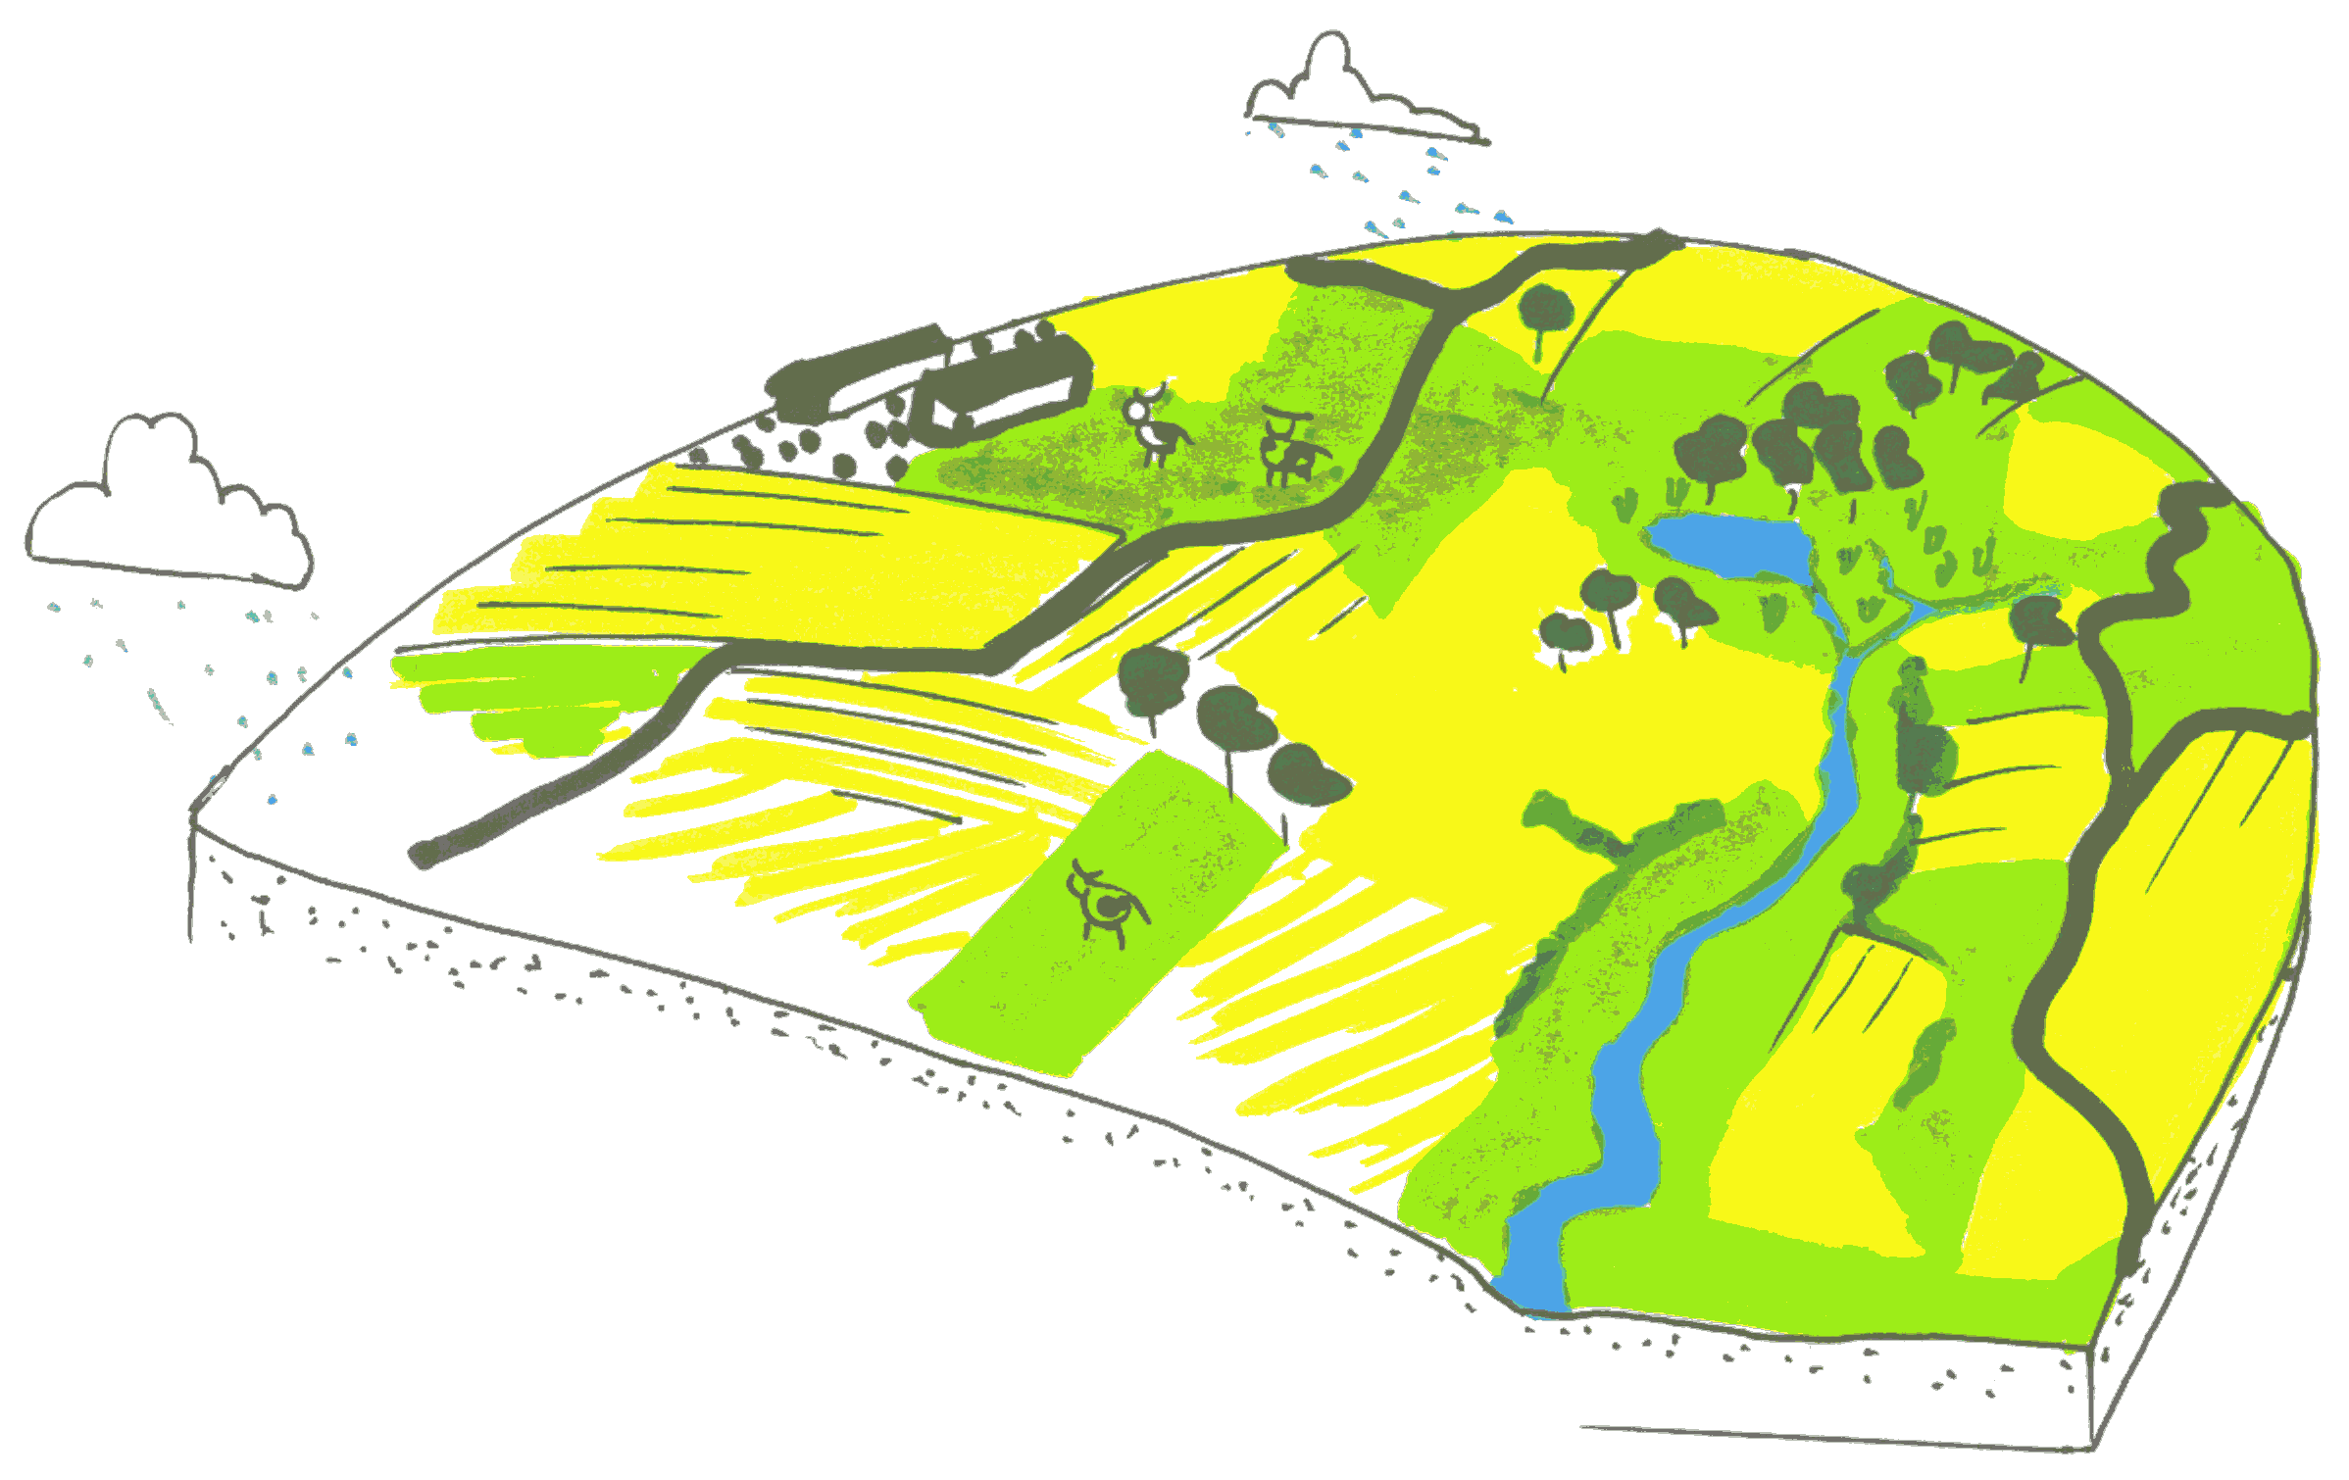
LifeWatch on a Slide
What lives
Where & when
Why (together)
For how long

Slide 3
Scenario 1: Data Resources
“Databases”: from Excel sheets to Oracle
Access
Observation data
Open: aim of scientific networks, GBIF
Restricted (red-listed species)
National LifeWatch Node (home-grown security)
Restriction applies to parts of the document -> fine-grained authorisation
Other data
Probably not for free

Slide 4
Tentative example: Aggregated List of Occurrences of a red-listed species
Federated Authentication
objection from local sites, lacking trust ?
Local Authorisation
What about using an aggregation service provided by a third party?

Slide 5
Scenario 2: Computational Resources
Workflows as basic paradigm in LifeWatch
GRID needed ?
Phylogenetics ✔
Other areas: Niche modelling, … (not yet ?)
Users are not necessarily computer literate
Scientists with little/some/deep knowledge in IT Keep the barriers as low as possible
Integrate fine-grained authorisation mechanisms in workflows?

Slide 6
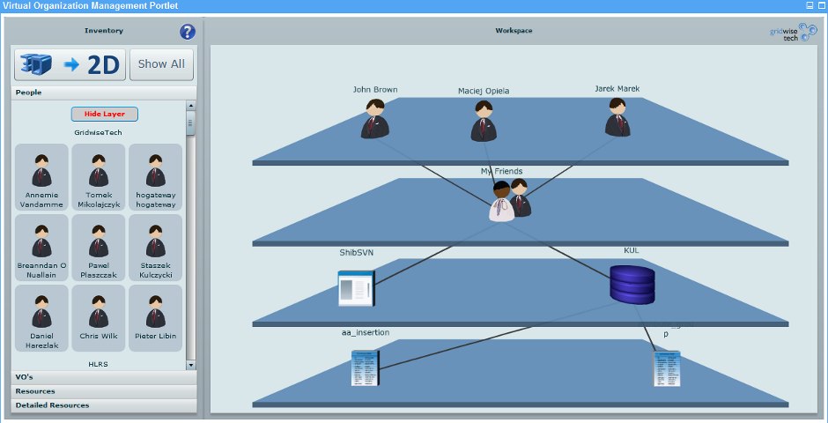
Scenario 3: Virtual Organisations
Should be easy to set up
Fully integrated with AA
Source: http://gridwisetech.com/adhoc

Slide 7
Requirements
Low Barriers
Fine-grained Access to data / services
Authentication: Single Sign-on
Authorisation Enforcement
At provider ?
At national nodes ?
Combination ?
Integration with
Workflow management
Virtual organisations

Slide 8
Present Thoughts
X.509 not appropriate
too much hassle handling certificates
Use Shibboleth
Grid: PERMIS, SARoNGS (Credentials Translation, VOMS)?
Interaction with workflows ?
Use OpenID complementarily

