Slide 1
DCI Collaborations
Steven Newhouse

Slide 2
Today’s Sessions
DCI Collaborative Roadmap
https://documents.egi.eu/document/172
Overview followed by a panel discussion
Standards & Interoperability
Prioritised capabilities within the UMD Roadmap
Which standards can define these capabilities?
SIENA
More broader standards for Grids & Clouds

Slide 3
Collaborative Roadmap

Slide 4
The DCI Projects
Project | EDGI | EGI-InSPIRE | EMI | IGE | StratusLab | VENUS-C
Start Date | 01/06/2010 | 01/05/2010 | 01/05/2010 | 01/10/2010 | 01/06/2010 | 01/06/2010
Duration (months) | 24 | 48 | 36 | 30 | 24 | 24
Total Budget | 2,436,000 € | 72,000,000 € | 23,000,000 € | 3,693,000 € | 3,137,221 € | 8,803,046 €
Funding from the EC | 2,150,000 € | 25,000,000 € | 12,000,000 € | 2,350,000 € | 2,300,000 € | 4,500,000 €
Total effort in person-month | 281 | 9241 | 1115 | 277 | 340 | 639

Slide 5
Taxonomy
EGI-InSPIRE
Operational
Infrastructure
Venus-C
EDGI
StratusLab
Users
IGE
EMI
Technology
Resources

Slide 6
Timeline (4yrs)
EGI-InSPIRE
EMI
IGE
EDGI
StratusLab
Venus-C

Slide 7
DCI Roadmap
Record how the DCI projects will interact
As a community
Pairwise interactions
Common documents across the projects
To be used unaltered by the projects

Slide 8
A Vision for EU DCIs
A decade of community building
Current Challenges
The Next Five Years
Benefits for different stakeholders

Slide 9
The Last Decade

Slide 10
Current Challenges
Barriers to large-scale adoption of e-Infrastructure
Sustainability of e-Infrastructures has not been clear
Advances in ICT for these communities have matched their data analysis needs
Current service offering do not match other communities needs
For multi-year projects this is a risk – addressed by EGI
ESFRI and related projects will push these boundaries
Need to deliver a flexible federated production infrastructure

Slide 11
Our Unique Selling Points!
Compute resources near storage resources
Co-locate the processing near the data
‘Free’ High Speed Networks
Massive bandwidth allows data to be moved
Ability & processes to share resources
Over a decades experience of building trust
Close links to data-oriented users
Data use and patterns unique to researchers

Slide 12
Adoption of Best Practice
Commoditisation
Hardware: HTC & HPC affordable to all
Networking: GBs can be moved over WAN
Software: Open source software comes of age
Virtualisation
For transactional models →
The ‘Cloud’: A model based on compute not data
For large distributed data-oriented models →
The emergence of true ‘function shipping’?

Slide 13
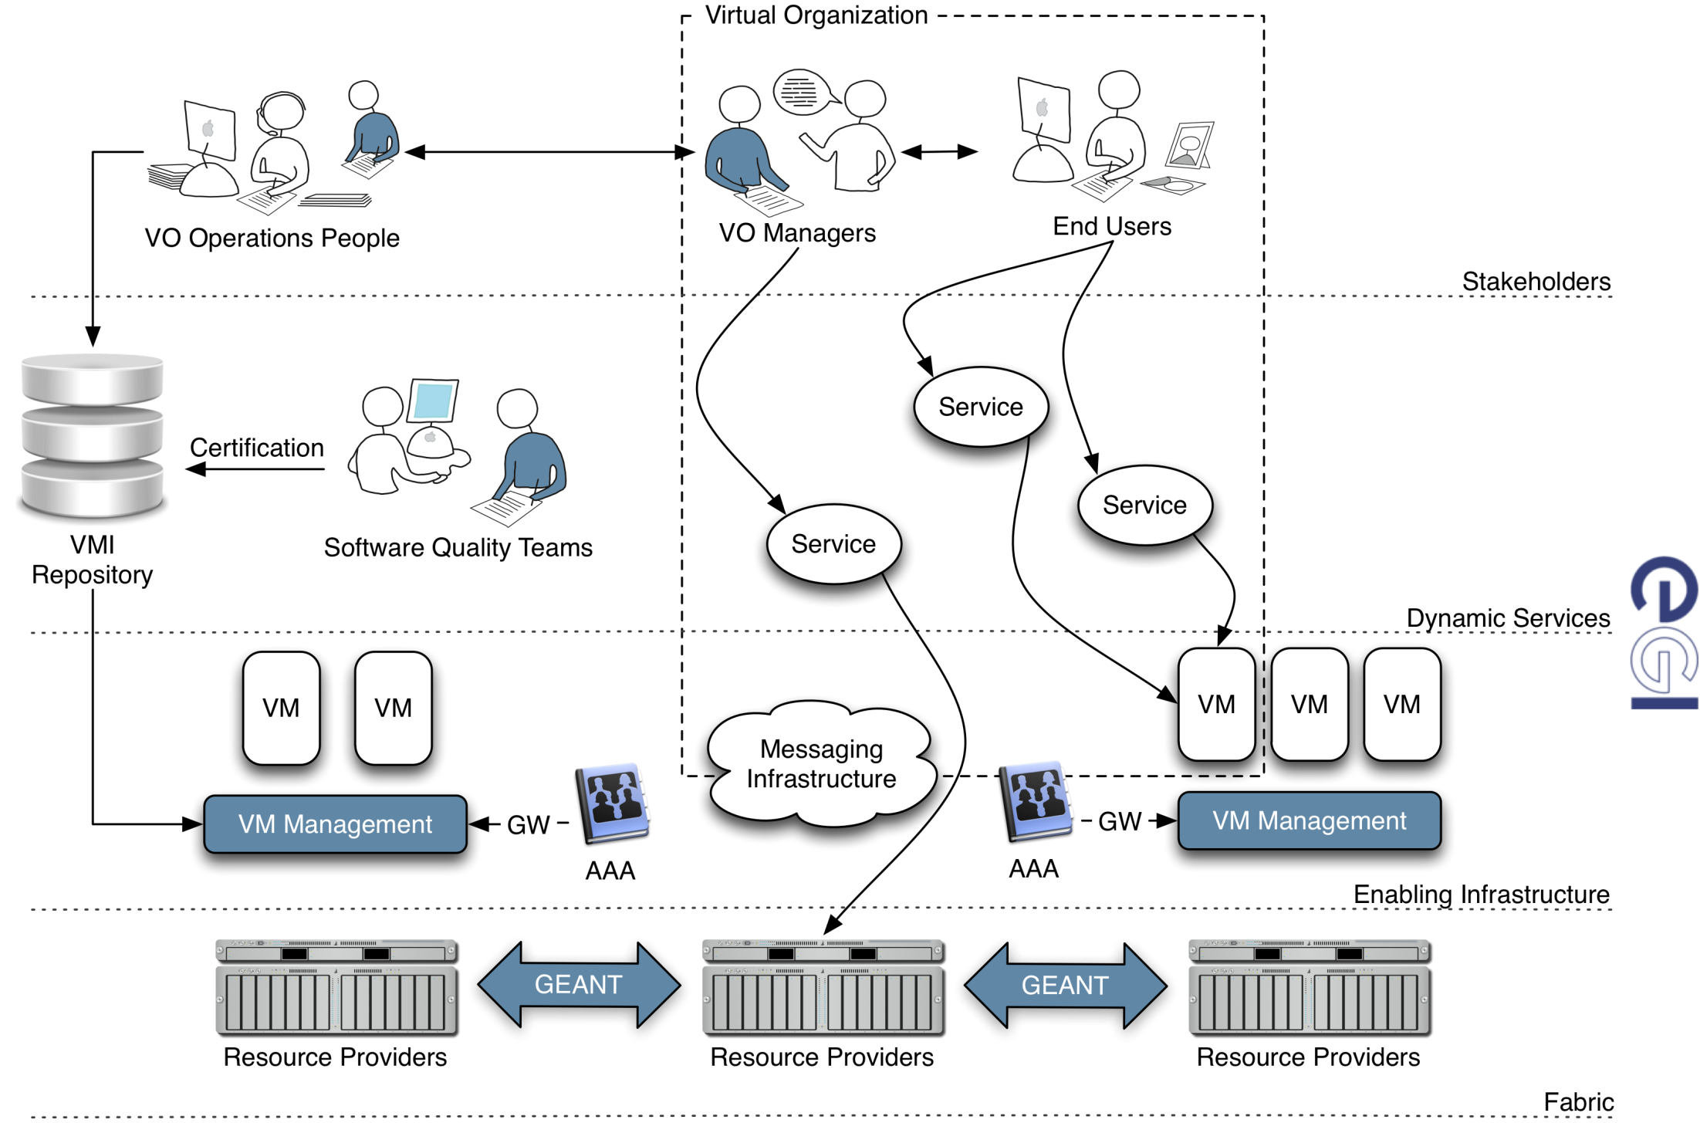
The Future?

Slide 14
Infrastructure Providers
Flexible software deployment across EU
Automate the deployment at & across sites
Easier to support different user communities
Separation of security models for:
Deployment
User

Slide 15
Software Providers
Deployment in a virtualised environment
Self configuration becomes an issue
Management & monitoring interfaces
Existence in a dynamic environment
Messaging to support transient services
Integration into systems management
Movement towards autonomic management

Slide 16
End-Users
Reliably getting the software environments they need when they need them!

Slide 17
Benefits
Able to meet the challenges of scaling out to new communities with different needs
Brings the definition of the software environment closer to the end-user
Gradual migration from real to virtualised services

Slide 18
Opportunities
Autonomic provisioning across Europe
VRC Operation Centres:
Linking users to the e-Infrastructure through services & support

Slide 19
Questions?

Slide 20
Panel
Steven Newhouse (EGI-InSPIRE)
Alberto Di Meglio (EMI)
Helmut Heller (IGE)
Peter Kacsuk (EDGI)
Cal Loomis (StratusLab)
Andrea Manieri (VENUS-C)

Slide 21
Questions
Is such a federated European infrastructure:
Achievable?
Inevitable?
What role do you see your DCI project in this activity?
Which DCI projects do you need to interact with to move towards this goal?
Others…

