Slide 1
Monitoring of the infrastructure from the VO perspective
Julia Andreeva, CERN
on behalf of the Experiment Dashboard team
EGI Technical Forum
Amsterdam, September 2010

Slide 2
Table of content
Monitoring of the infrastructure from the VO perspective
- goals
- complexity
The Experiment Dashboard as an example of the generic VO monitoring system:
- architecture
- implementation including instrumentation of the VO-specific workflows and services
- impact on the quality of the infrastructure
- examples of the Dashboard applications
Summary

Slide 3
VO monitoring. Motivation.
Follow VO computing activities on the GRID:
data transfer and data processing
Estimate quality of the infrastructure from the VO perspective:
Whether the site/service provides functionality required by VO
How efficiently site/service performs the VO tasks
Efficiency of the real computing activities of the user communities provides the best indicator of the quality of the infrastructure

Slide 4
VO monitoring. Complexity.
Should combine information related to the generic GRID middleware and services with VO-specific information (VO-specific workflows, applications, services)
Should work transparently across various infrastructures and middleware flavours used by a given VO
Needs to serve different categories of users
In case of the LHC VOs the scale of the computing activities and the size of the used infrastructure represent an important challenge for designing and support of the monitoring systems

Slide 5
Experiment Dashboard as an example of the VO monitoring system
Initially developed for the needs of the LHC community.
Used by 4 LHC VOs (ALICE, ATLAS, CMS and LHCb). Some applications are not LHC-specific and can be used outside the scope of the LHC community.
In difference with the monitoring systems which were developed inside the LHC experiments, the Experiment Dashboard intends to provide common solutions which are not coupled with a particular workload management or data management system or a particular GRID middleware.
Though not all applications are generic. Those which use the VO-specific data sources can be specific to a particular VO (for example, ATLAS Data Management Monitoring).
Additional complexity comes from the scale of the LHC computing activities and from the fact that the infrastructure they are using is heterogeneous
Example: The LHC users run concurrently more than 100K jobs using various middleware flavours and submission methods

Slide 6
Main areas covered by the Experiment Dashboard Applications
Job processing monitoring
provides monitoring applications for various categories of users:
users running their tasks on the GRID
site administrators
managers of the computing projects and VO managers
Data management monitoring
monitoring of the data transfers
monitoring of the data access
Site/service monitoring from the VO perspective
Site usability portal based on the results of SAM tests
Site Status Board – provides a flexible framework for evaluating sites from various perspectives . Fully customizable regarding set of monitoring metrics and user views
Cross-VO view of the computing activities of the LHC community
at the scope of a single site or at the global WLCG scope
SiteView, WLCG in GoogleEarth

Slide 7
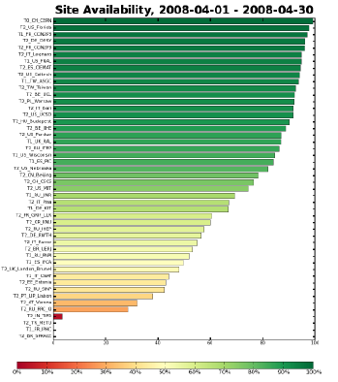
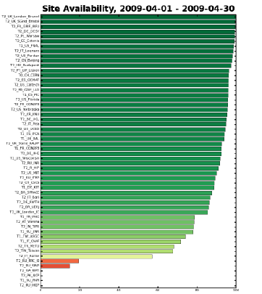
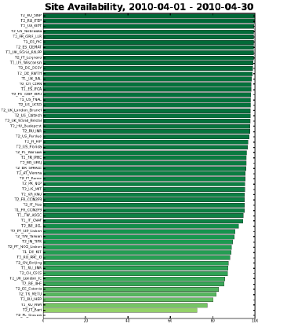
Example of the positive impact of the monitoring on the improvement of the quality of the infrastructure (1)
Site usability interface developed in a close collaboration with the CMS community is widely used by the CMS for the site commissioning activity. Due to site commissioning activity substantial progress was done over last years in the improvement of the quality of the distributed sites and services used by CMS. Currently this application is deployed and used by 4 LHC VOs. Site usability plots are used as an important metric for weekly reports for the WLCG management board.
Comparison of the CMS Site usability plots for 2008, 2009, and 2010
correspondingly

Slide 8
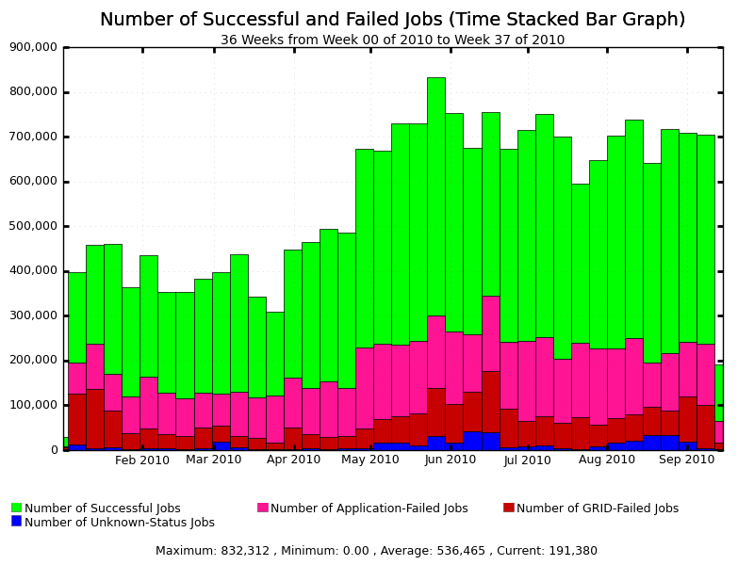
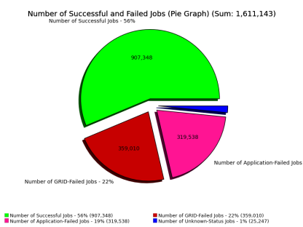
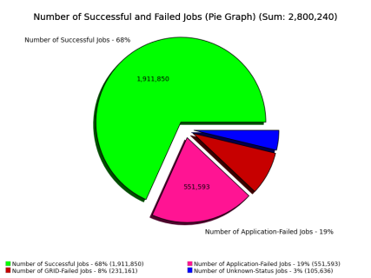
Example of the positive impact of the monitoring on the improvement of the quality of the infrastructure (2)
Dashboard generates weekly reports with monitoring metrics related to data analysis on the GRID (number of users, number of processed jobs, number of used slots, success rate, most important failure reasons). Based on these reports the CMS analysis support team takes actions in order to improve success rate of the user analysis. Every substantial negative fluctuation of the success rate is being investigated and addressed. This allowed to increase of the success rate of the user jobs since the beginning of 2010
Monthly success rate statistics for CMS user analysis jobs in January and August of 2010 correspondingly . Success rate improvement 12 %
Failures of user jobs include failures caused by user errors

Slide 9
Experiment Dashboard framework
All Dashboard applications are constructed in the generic Dashboard framework (developed in Python), which provides construction blocks for the main components of the monitoring system :
- data collectors
- data repositories
- user interfaces and APIs for data retrieval

Slide 10
Implementation. Various use cases
Enabling complete data flow from the information source to the user interface
Includes instrumentation of the information sources including VO workflows, enabling data transfer, defining data repository schema , providing data repository , UIs and APIs for data access.
Examples of applications: Job monitoring, ATLAS DDM monitoring
Aggregating data from the existing monitoring systems in order to provide a high-level cross-VO view
Includes data aggregation and visualization with or without persistency of the aggregated data
Examples of applications : SiteView, WLCG in Google Earth

Slide 11
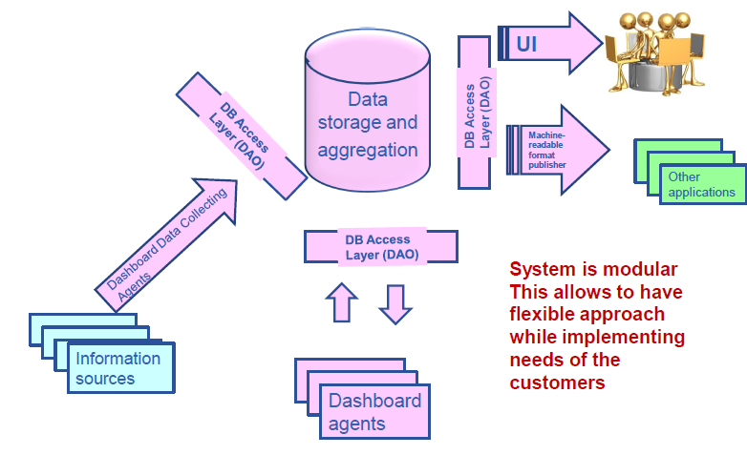
Data flow in the Dashboard framework (1)

Slide 12
Data flow in the Dashboard framework (2)
Generic libraries enabling data reporting are provided for instrumentation of the information sources. Their implementation depends on the used data communication mechanism.

Slide 13
Data flow in the Dashboard framework (3)
For historical reasons Dashboard uses several implementations for data transfer. Recent development aims to evaluate Messaging System for the GRID (MSG) as a common solution for asynchronous communication between data source and data consumer

Slide 14
Job monitoring example (1)
Dashboard Data Repository (ORACLE)
Job submission client or server
Dashboard consumer
Message server (MonAlisa or MSG)
Dashboard web server
Jobs running
At the WNs
User WEB interfaces
Data retrieval via APIs

Slide 15
Job monitoring example (2)
Job monitoring which is currently in production uses MonAlisa as a messaging system. The apmon library is used in order to enable reporting from the running jobs and job submission clients or servers.
New version which uses MSG and stomp_util library for data reporting was prototyped recently.
Dashboard Data Repository (ORACLE)
Job submission tool client or server
Dashboard consumer
Message server (MonAlisa or MSG)
Dashboard web server
Jobs running
At the WNs
Dashboard UIs
Other applications

Slide 16
Job monitoring example (3)
The same data repository is used for multiple applications. Each of them is focused on a particular use case , for example “Task monitoring” for users running their jobs on the GRID and user support teams, “Interactive view” and Historical view” for providing current job monitoring status or job monitoring metrics as a function of time. In this case target community is VO managers, managers of the various computing projects and site administrators.
In addition to the web pages information is available in machine readable format and can be consumed by other applications, for example for local fabric monitoring.
Dashboard Data Repository (ORACLE)
Job submission tool client or server
Dashboard consumer
Message server (MonAlisa or MSG)
Dashboard web server
Jobs running
At the WNs
Dashboard UIs
Other applications

Slide 17
Example of the application which provides cross-VO view
In addition to the common solutions offered by the Experiment Dashboard, the LHC VOs use multiple monitoring systems developed inside the VOs. This variety is big and creates a problem for providing global cross-VO picture, correlate and compare monitoring metrics, etc…
VO-specific examples: Dirac for LHCb, Phedex for CMS.
In order to provide a cross-VO global view data aggregation from the VO-specific monitoring systems was enabled in the Dashboard framework. This implementation is generic and can be adapted by any community outside the LHC scope.

Slide 18
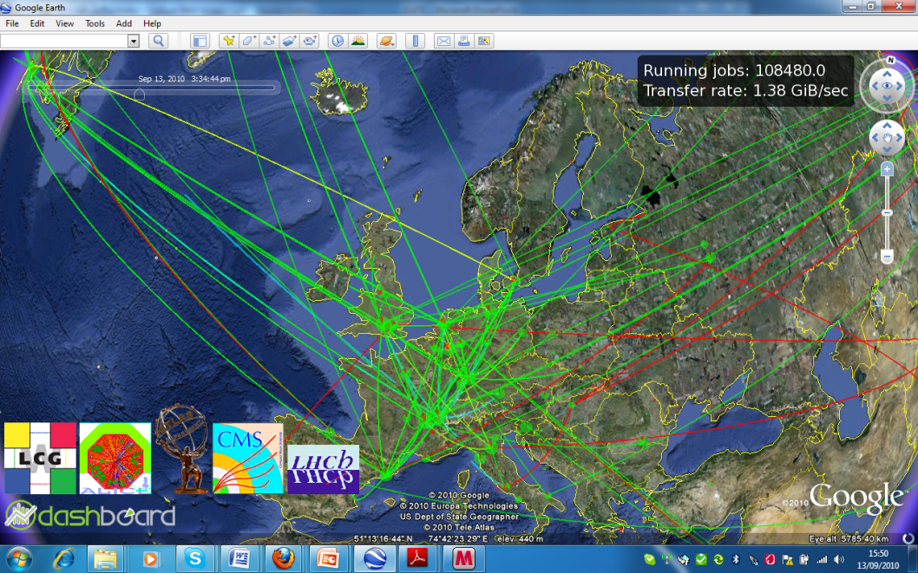
WLCG in Google Earth
Google Earth display showing the WLCG activities is an example of the Dashboard application which provides cross-VO global view
Google Earth is used for visualization
Dashboard collectors consume real-time monitoring data from the VO-specific monitoring systems
Every few minutes Dashboard server generates new input file for the Google Earth client to show LHC data transfer and job processing activities on the GRID.
Application is displayed at many computing sites like CERN, IN2P3 , PIC, JINR …
It is being used at various events as a dissemination tool.

Slide 19
Summary
Monitoring of the user computing activities provides the best indicator of the quality of the infrastructure
The Experiment Dashboard is used for monitoring of the LHC computing activities. It provides applications which allow to facilitate the operational tasks and to ensure the steady improvement of the infrastructure quality
Usage of the system is steadily growing, functionality is being extended.
The Experiment Dashboard offers common solutions which can be used outside the scope of the LHC community.
http://dashboard.cern.ch

Slide 20
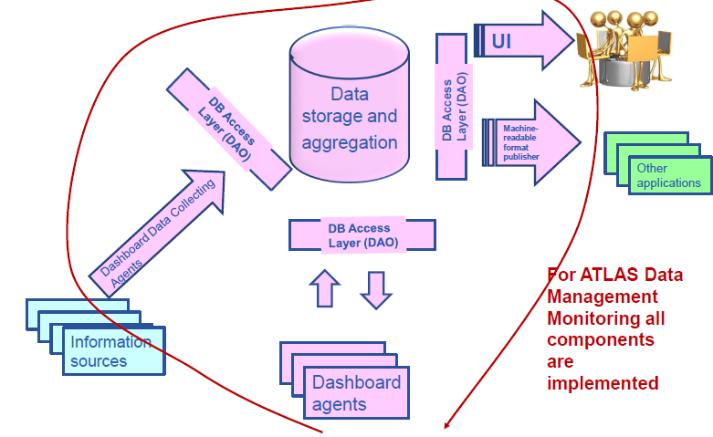
Backup slide. Complete or partial implementation of the data flow in the Dashboard framework (1)
For generic Job monitoring application and ATLAS data management monitoring the complete chain is implemented

Slide 21
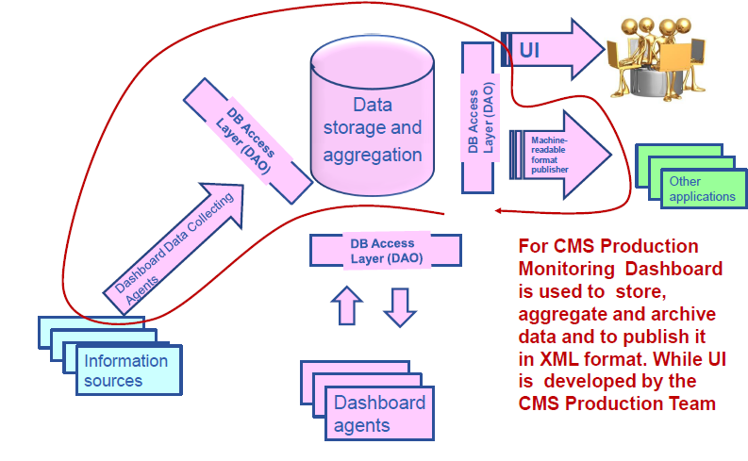
Backup slide. Complete or partial implementation of the data flow in the Dashboard framework (2)
For CMS production monitoring, Dashboard is used to store, aggregate and archive data. The UI is developed by the CMS production team

Slide 22
Site Status Board example (1)
Site Status Board provides a framework which enables a flexible data container with a customizable user interface
The content of the data repository consists of numeric or status metrics which are provided by the VO in a simple CSV format. A single monitoring unit is a site, but can be overloaded. Some metrics are standard and are using GRID-related monitoring sources like BDII, GOCDB or OIM, etc… Time interval for every metric update and it’s criticality are configured by the VO. Site availability from the VO perspective is calculated based on the set of metrics which are defined as critical by the VO.
The customization of the UI is implemented through various views. Every view takes into account a given set of metrics. Several metrics can be combined in a single column.
In addition to a current state of the infrastructure, SSB keeps history of the evaluation of all metrics and of the site status as a function of time and exposes them in a graphical form or in various machine readable formats (XML,CSV,JSON).

Slide 23
Site Status Board example (2)
Site Status Board is deployed for 4 LHC VOs.
Application is generic and has nothing specific for the LHC community
Used as a single entry point to overview the state of the distributed sites from the VO perspective
Used for the computing shifts. Only in CMS the application is accessed daily by 150 unique visitors

