Slide 1
Integrating Cloud Monitoring and Accounting with Grid Operational Tools
Vangelis Floros, GRNET
Instrumenting the Infrastructure,
EGI Technical Forum, Amsterdam, 14 Sept. 2010

Slide 2
Overview
The SratusLab project
Goals
Infrastructure
Work done so far
Monitoring and Accounting
Basics
Requirements from the combination of cloud and grid technologies
Impact on operational tools
Conclusions and Future work

Slide 3
The project
StratusLab (StratusLab.eu)
Enhancing Grid Infra. with Virtualization and Cloud Technologies
1 June 2010—31 May 2012 (24 months)
6 partners from 5 countries (CNRS, UCM, GRNET, TCD, SixSq, TID)
Budget: 3.1 M€ (2.3 M€ EC)
Activities
WP1 (NA): Project Coordination
WP2 (NA): Interaction with Targeted Communities
WP3 (NA): Dissemination
WP4 (SA): Software Integration and Distribution
WP5 (SA): Infrastructure Operation
WP6 (JRA): Innovative Cloud-like Mgt. of Grid Svcs. and Resources

Slide 4
The goals
Bridge cloud and grid technologies
Understand technology gaps and implications from combining these two approaches in the same environment
Provide production level grid services on top of cloud technologies
Develop cloud-like approaches for grid service provision

Slide 5
Grid Resource Center with StratusLab Distribution
users
Grid Resource Center
Grid Services
Cloud API
StratusLab
Distribution
Private Cloud
Public Clouds

Slide 6
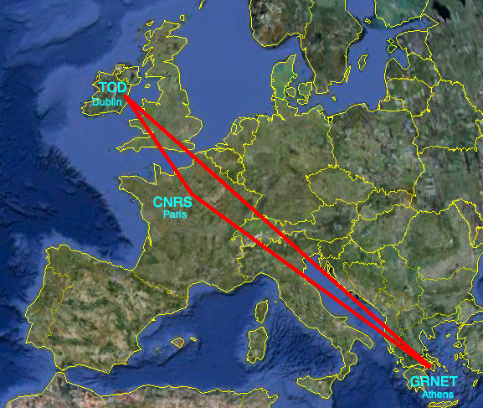
StratusLab Infrastructure
GRNET and CNRS provide the computing infrastructure
31 nodes, 248 cores
30-35~TB of storage
Connectivity through GÉANT
TCD provides the appliance repository
Apache server
Access through WEBDAV
200~GB and growing

Slide 7
Work done so far
Test installations of OpenNebula 1.4 and 2.0 beta
Official supported platforms RedHat and Debian (actually using CentOS 5.5 and Ubuntu 10.04)
Deployed two minimal grid sites
GR-42-STRATUSLAB (CE, SE, 2xWNs)
GR-43-STRATUSLAB (CE, SE, 5xWNs)
SAM tests running in Greek NGI
MPI support enabled
Quattor integration and WN tests
Started working on aspects of monitoring and accounting

Slide 8
Layers of monitoring
Grid Services
(WMS, SE, BDII, MPI etc)
Cloud Services
(VMs, V storage, V network, hosted software)
Physical Infrastructure
(hosts, network, storage)

Slide 9
Solving the monitoring puzzle
Too many things to monitor
Individual tools exist to monitor the different layers of such infrastructure
Nagios, Ganglia: Grid and Physical layers
Cloud specific based on virtual machine manager
Cloud interfaces (OCCI, AWS EC2, VMWare vCloud APIs) provide basic monitoring of virtualized resources
Internal/Administration APIs (OpenNebula XMP-RPC) provides extended monitoring of virtualized and physical resources
Combined Grid Cloud and Cloud Phys. Infr. needed for a holistic view of the resources

Slide 10
Accounting
WHO is doing WHAT, WHERE, for HOW LONG
Enforce site policies, user quota
“Charge” users based on usage
Guarantee fair share of resources among users

Slide 11
Accounting in the grid and the cloud
Grid
A large volume of information is kept enabling the profiling of the resource utilization by grid users
Resources consumed during job submission (CPU, Memory)
Volume of data and number of replicas in SE/LFC
Used primarily to better understand resource utilization and take scheduling decisions
Cloud
Pay per usage model
Proper, accurate and detailed accounting is fundamental
Important for charging users based on:
Virtual Appliances used
Network bandwidth consumed
Storage occupied

Slide 12
Grid on the Cloud
Grid sites on the cloud
Dynamic and Elastic
Nodes can be added and removed on the fly
Storage can be allocated and released on demand to satisfy temporal peak demands
VMs can be migrated to enable optimum performance (e.g. collocate them to run OpenMP and MPI code)
Challenge: Apply the pay-per usage model for grid sites
One resource provider might host multiple grid sites form different domains
Fair share among this sites or “credit”-based approach will be required
Implications from hosting grid services in hybrid cloud environments
Impact of grid workloads on cloud utilization
Profiling of cloud resource usage
Co-relate cloud utilization with grid workloads

Slide 13
Grid/Cloud interaction examples
Use the right VM for the right job:
Multicore WNs to run OpenMP code
Collocated WNs (same node or same rack) for optimal inter-process communication suitable for MPI parallel applications
Cloud-aware LRMS and/or WMS
Scheduling decision on site and on VO level
Cloud-aware BDII
Able to cope with dynamic behavior of virtualized grid sites

Slide 14
Conclusions
Deploying grid sites over cloud services introduces new challenges
Impact on both layers (grid and cloud)
Accounting per VO, site, users
What information should be available to whom
Proper monitoring and accounting is crucial
Avoid double accounting
Check consistency between the two layers
Gets even more complication when applying cloud bursting approaches using commercial cloud services

Slide 15
Future work
Work has just started in StratusLab
basic experiments
development of proof-of-concepts
OpenNebula evolves
Takes into account requirements stemming from grid-over-cloud
Advanced user management, monitoring and accounting capabilities
Will need close interaction with other players
EMI to convey middleware requirements
EGI to adapt grid operations and tools to the dynamic nature of cloud-based grid sites

