Slide 1
ATLAS Distributed Data Management – Overview and recent work
Fernando H. Barreiro Megino
CERN-IT-VOS

Slide 2
Introduction to ATLAS DDM

Slide 3
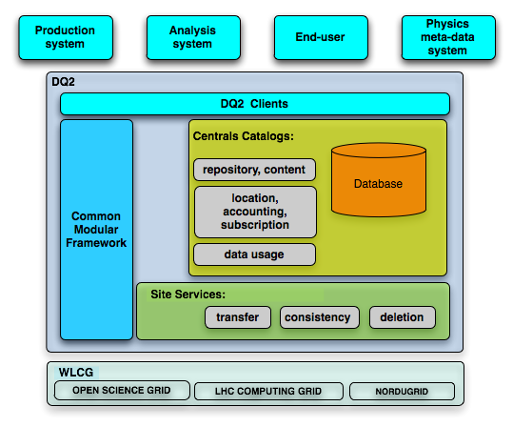
The overview
Manage the experiment’s data:
Data placement
Bookkeeping & accounting
Data access to the other systems and end-users
OSG
EGEE
NorduGrid

Slide 4
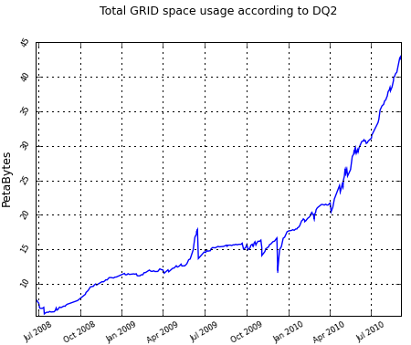
The scale
In production since 2004 and considered one of the largest data management environments
Volumes managed today:
~43PB
~1.7 million datasets
~130 million files
distributed across >100 sites
STEP09
10GB/s
Data taking
Aggregated data transfer record: 10GB/s (Plot from the ATLAS DDM Dashboard)
2010-05-19

Slide 5
Recent work

Slide 6
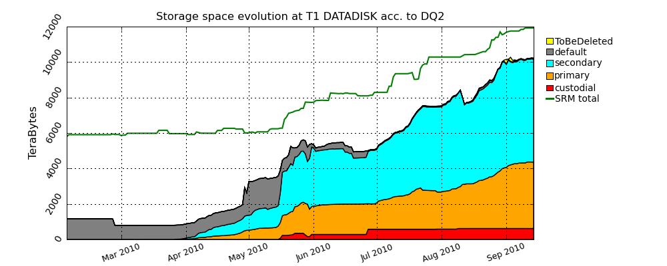
Data ranking
Concept introduced by ATLAS Distributed Computing
Distinguish Computing Model (CM) replicas from additional replicas
Custodial: Master replica (Must be kept, usually archived on MSS)
Primary: Following CM
Secondary: In excess of CM, may be deleted
Default: Not ranked yet
Introduction of data ranking concept
Start of meaningful ranking and bootstrapping
Bootstrapping complete

Slide 7
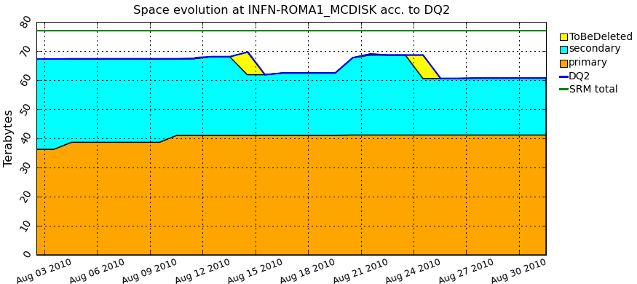
Automatic site cleaning
Andrii Tykhonov (Jozef Stefan Institute, Ljubljana), Angelos Molfetas (CERN)
Optimize the usage of storage space: Keep sites full with interesting data
Once a sites has no free space left, the cleaning agent will select secondary, unpopular (measured by DDM Popularity) replicas to delete
Experience from early usage:
Need to improve the efficiency of the cleaning: reduce grace periods and run more frequently
Different sites have different needs – need the possibility of tuning the replica reduction algorithms per site
Need to be more aggressive in data deletion

Slide 8
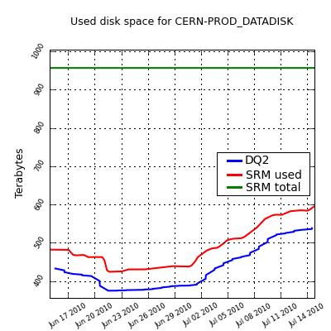
Storage space publication
Wahid Bhimji (University of Edinburgh)
Motivation: compare volumes of used space in storage with volumes known by DDM catalogues
SRM provides partial information: does not take into account offline/broken disks
Evaluating the information provided by the Information System:
Some sites do not publish any storage space information in IS
Some sites publish wrong values (also not in agreement with SRM)
Discussion on how to improve Storage Space publication initiated by Simone Campana in last GDB
At CERN the difference between a CASTOR pooldump and the SRM Used space is 50TB.
The storage space volume accounted by DQ2 confirms the CASTOR pooldump value.

Slide 9
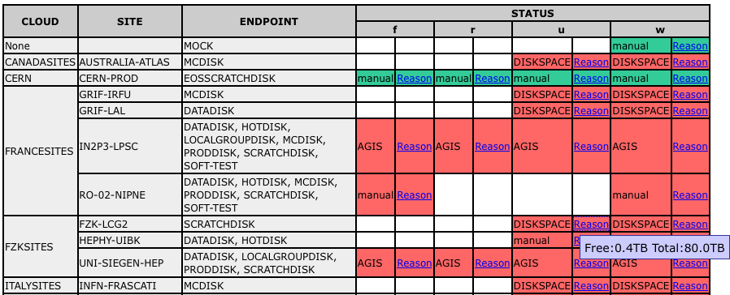
Centralized site exclusion
Read
Write
Published GOCDB and OIM downtimes
Possibility of manual entries
Full spacetokens
All the information is propagated to the Site Status Board

Slide 10
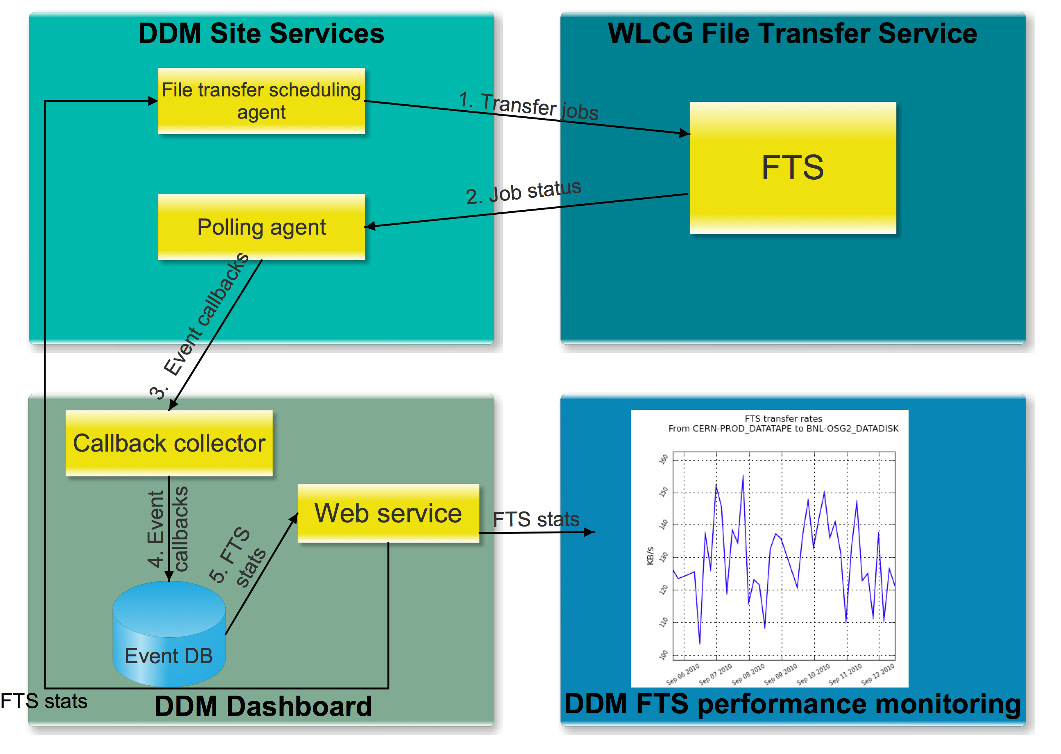
FTS usage optimization and monitoring (work in progress)
David Tuckett (CERN-IT-DNG)

Slide 11
Summary
Development work focused on optimization and automation
Improved usage of storage and network resources
Reducing need of human operations

Slide 12
Acknowledgements
Maestro Simone Campana
Vincent Garonne
Stephane Jézéquel
I. Ueda

