Slide 1
Regional dissemination
Catherine Gater Dissemination Manager

Slide 2
Dissemination overview
Dissemination task within EGI-InSPIRE is in WP2, NA2-External relations
Aim is to disseminate the work of the EGI and its user communities within the project and worldwide.
Will work with NGIs and other projects such as SIENA and e-ScienceTalk

Slide 3
EGI Global Task
EGI Global task coordinated by EGI.eu in Amsterdam
Catherine Gater
Dissemination Manager
Sara Coehlo
Science Writer
Neasan O’Neill
Dissemination Officer
?
Dissemination Officer

Slide 4
NGI International Task
37 partners, including 31 funded partners in Europe and 6 unfunded (Taiwan, Australia, Singapore, Indonesia, Malaysia and the Philippines)
Vicky Huang ASGC
Mariusz Sterzel CYFRONET
Klemens Noga CYFRONET
Péter Dóbé BME
Richárd Kápolnai BME
Jana Hrdličková CESNET
Suvi Alanko CSC
Tatiana Strizh E-ARENA
Baiba Kaskina IMCS UL
Kristiāna
Mūze-Feldberga IMCS UL
Aleksandar Belic IPB
Aleksandar Bogojevic IPB
Slobodan Vrhovac IPB
Arad Alper IUCC
Nadav Grossaug IUCC
Wilhelm Bühler KIT-G
Lilit Axner KTH
Michael Hammill KTH
David Horat LIP
Goncalo Borges LIP
Hugo Miguel da Silva Gomes LIP
Miklos Kozlovszky MTA SZTAKI
Robert Lovas MTA SZTAKI
Stuart Kenny TCD
Burcu Ortakaya TUBITAK
Hakan Bayındır TUBITAK
Maria Poveda UCY
Marios Dikaiakos UCY
Peter Kurdel UI SAV
Tim Dyce UNIMELB
Vicente Hernández UPVLC

Slide 5
Staying in touch
Wiki site wiki.egi.eu/wiki/TNA2.2_Dissemination
Inspire-NA2-dissemination mailing list
Face-to-face meetings
Document server http://www.egi.eu/about/intranet/document-server
Website www.egi.eu

Slide 6
Staying in touch
Twitter www.twitter.com/egi_inspire
Flickr www.flickr.com/photos/european-grid-initiative
www.youtube.com/europeangrid
group European Grid Initiative
GridCa blog www.gridcast.org

Slide 7
Key documents
EGI-InSPIRE Presentation
Dissemination Plan (updated each year)
EGI-InSPIRE Paper
Website with key collaborative tools
Dissemination Handbook (coming soon)
EGI Newsletter (quarterly)
Annual review of website content

Slide 8
Branding - logos

Slide 9
Branding – colours, fonts
Logo font = Helvetica Condensed Bold

Slide 10
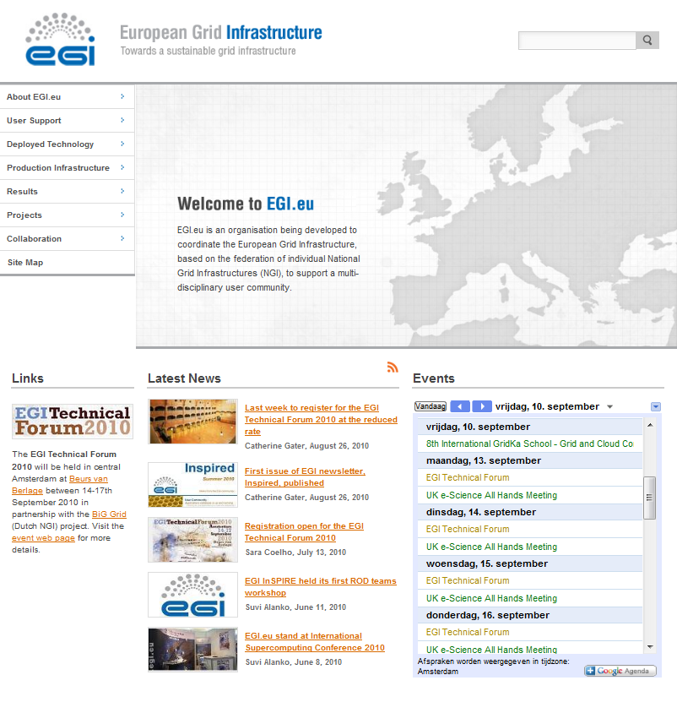
Website

Slide 11
Publications

Slide 12
Coming soon
Dissemination Handbook
Dissemination Plan
Poster and presentation templates
Media guides
Updated website
Outreach for User Forum
Booths at ICT2010, e-Challenges?, OGF30/GRID2010, SciTech Europe 2010, SuperComputing10

