Slide 1
EGI: Up and Running!
Steven Newhouse
Director

Slide 2
EGI.eu Established
Catherine Gater
Chief Administrative Officer
& Dissemination Manager
Tiziana Ferrari
Chief Operations Officer
Stephen Brewer
Chief Community Officer
Michel Drescher
Technology Manager
Rob van der Meer
Organisation Manager
Sergio Andreozzi
Policy Development Manager

Slide 3
The EGI.eu Staff
In total 16 staff based at the Science Park
Next round of recruitment
User Community Support Officer
Policy Development Officer
Dissemination Officer
Positions will be advertised on website
http://www.egi.eu/about/jobs

Slide 4
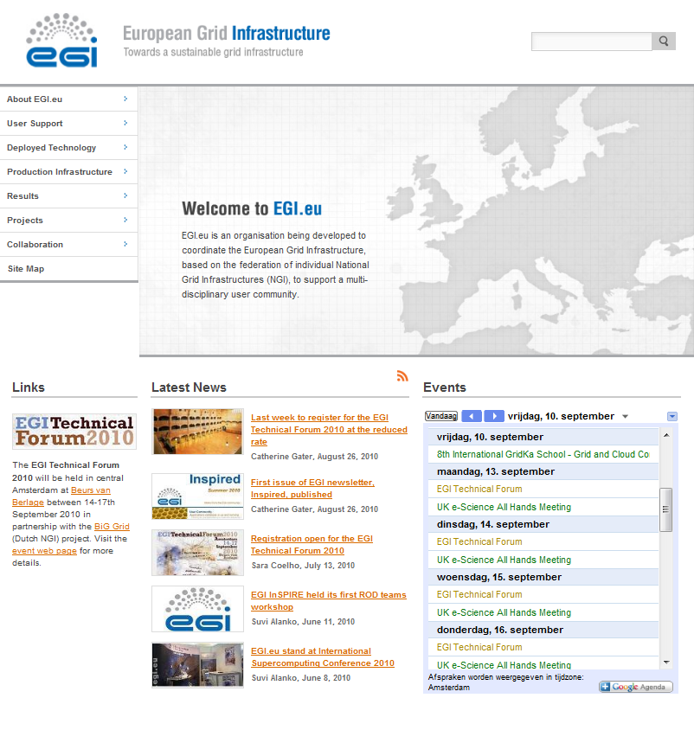
Follow EGI on line

Slide 5
EGI.eu Support Services
Administrative & Technical Services
Account & group management (SSO)
Web, wiki, mailing lists
Indico, Jabber, Document database
http://www.egi.eu/about/intranet
Over 860 people registered in SSO
Across the whole EGI community

Slide 6
EGI.eu Activities
EGI-InSPIRE started 1st May 2010
Grant Agreement now signed
473 staff registered with partners
e-ScienceTalk started 1st September 2010
Continuation from GridTalk
Beyond Grids to eScience

Slide 7
Highlights from May-July 2010

Slide 8
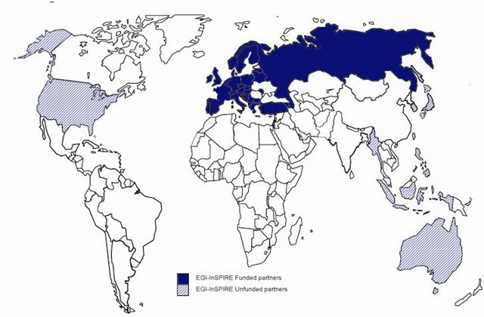
The EGI-InSPIRE Project
Integrated Sustainable Pan-European Infrastructure for Researchers in Europe
A 4 year project with €25M EC contribution
Project cost €72M
Total Effort ~€330M
Effort: 9261PMs
Started 1st May ‘10
Funded
Un-Funded
Project Partners (50)
EGI.eu, 39 NGIs, 2 EIROs
Asia Pacific (8 partners)

Slide 9
Transition to EGI
The world did not end on the 30th April 2010!
Global and national operational services continued
Site management, security, monitoring, accounting, helpdesk, etc.
Several user support services migrated
Application database, training, etc.
Thank you to the partners in EGI-InSPIRE for working alongside EGEE-III during the last few months to achieve this smooth transition.

Slide 10
Moving to an NGI Model
Move from ROC to NGIs
Central Europe
CE has moved to individual NGIs
South-East Europe
Incorporating non-EGEE sites
Continuing process of moving to individual NGIs
EGI Global Services Established
Human coordination provided by EGI.eu
Technical services by partners within EGI

Slide 11
A Virtuous Cycle
Users
Requirements
Technology
Assessment
Infrastructure
Production quality infrastructure built from technology deployed across Europe
Users represented by Virtual Research Communities in the User Community Board
USAG: User Services Advisory Group
OTAG: Operational Tools Advisory Group
Resource providers represented by NGIs/EIROs in the Operations Management Board
New technology releases assessed against defined criteria before being deployed
Technology Coordination Board prioritised for Technology Providers

Slide 12
Technology Innovation
Partnership with technology projects
EMI (European Middleware Initiative)
IGE (Initiative for Globus in Europe)
EDGI (European Desktop Grid Initiative)
StratusLab
VenusC
Standards across Grids and Clouds

Slide 13
Policy Boards
Terms of Reference have been drafted
Being approved and then boards established
Operations Management Board
Includes participants of EGI.eu by default
Others included by Infrastructure MoUs
User Community Board
Virtual Research Community MoUs
Technology Coordination Board
Technology Providers MoUs and SLAs

Slide 14
Some Early Thank Yous!

Slide 15
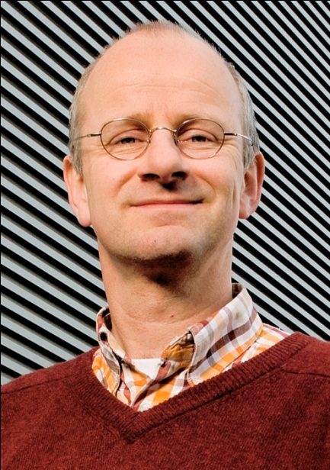
The Local Host
Arjen van Rijn
Nikhef Institute Manager
Chairman BiGGrid Executive Board
EGI.eu Executive Board
Behind the bid for hosting EGI.eu

Slide 16
Wireless connectivity has been provided by
Installation by the Nikhef, SARA & EGI.eu staff
led by David Groep , Tristan Suerink & Ramon de Jong

Slide 17
Further Sponsors

Slide 18
Local Sponsors

Slide 19
Media Sponsors

Slide 20
EGI Technical Forum An Overview

Slide 21
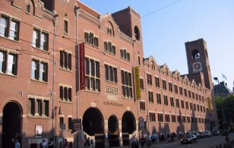
Welcome to EGITF 2010
Enjoy this magnificent venue in Amsterdam
Try not to get lost!
Four days of activity
EGI-InSPIRE
EMI & IGE
TERENA
Regional Projects

Slide 22
Tuesday
Virtual Research Communities
European E-Infrastructure Forum (EEF):
ESFRI Social Sciences & Humanities
Instrumenting the Infrastructure
AAI Needs of the DCIs
User Training: Getting started with EGI
Software Provisioning in EGI

Slide 23
Wednesday (1/2)
EEF Requirements & the ESFRI Projects
Environmental
Summary & Next Steps
Data Management Requirements in EGI
Virtual Research Communities
EGI User Support Services
Telling Your Story

Slide 24
Wednesday (2/2)
Operations: Grid Oversight & OLAs
TERENA: NRENs and Grids Workshops
DCI Projects & their Interactions
MPI Status & Developments

Slide 25
Thursday
Enabling Cloud Computing for eScience
Heavy User Communities
European Middleware Initiative
Initiative for Globus In Europe
Regional Initiatives
Regional Dissemination
Security Discussions

Slide 26
Friday
Closing Plenary & Awards Ceremony
NGI User Support Teams
EGI User Communities & Desktop Grids
Training
Security
Using Desktop Grids
Grid Oversight
Software Rollout into Production

Slide 27
Social Activity
Demonstrations and posters
All week until Thursday 2pm
Located in the Exhibition/Lunch/Coffee room
Voting closes Thursday 2pm
Return your votes to the front desk
Winners announced at the Closing Plenary
Tuesday Evening: Welcome Reception
Thursday Evening: Conference Dinner

Slide 28
Follow EGI on line
Read the conference blog at www.gridcast.org
Follow EGI on at http://twitter.com/egi_inspire (#egi2010)
Download the conference iPhone app from http://bit.ly/aqNYUQ.
Live web streaming at http://globalplaza.org/spaces/global/events/egi-technical-forum-2010-2.
Photos will appear on our stream at http://www.flickr.com/photos/european_grid_initiative (use the egi2010 tag for your own photos)
Videos online on at http://www.youtube.com/europeangrid

Slide 29
Welcome
Technical Forum 2010

Slide 30
EGI User Forum 2011
EGI User Forum 2011
11-15 April, Vilnius, Lithuania
Hosted by NGI LitGrid, presented by Vilnius University and BAIP.
In partnership with EMI.
Organisers AIM Group Baltic UAB
Call for papers opens October 2010
See www.egi.eu/EGIUF2011 for more details

