Slide 1
User Support
Claire Devereux, STFC

Slide 2
User Support team
?

Slide 3
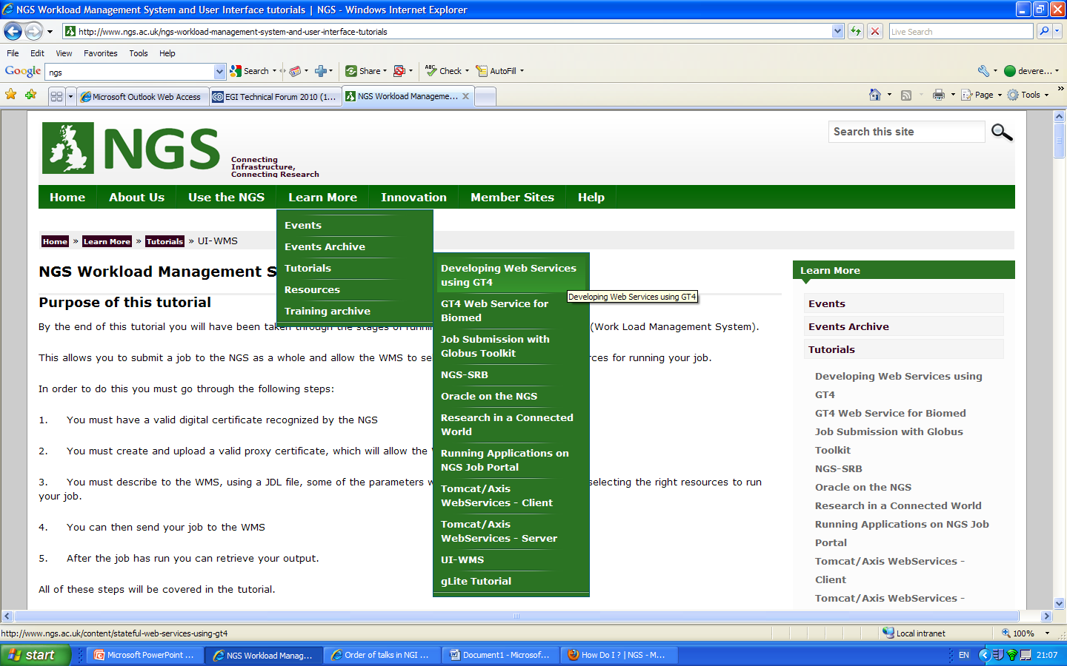
Training

Slide 4
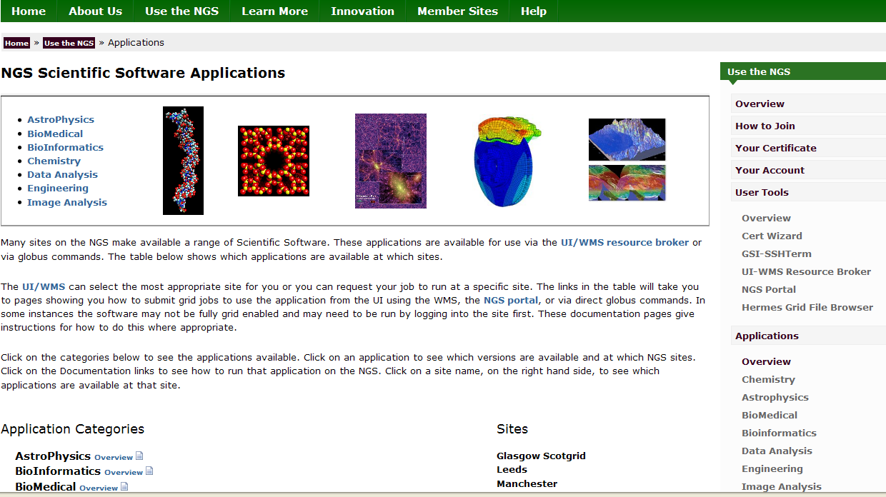
Scientific Applications (1)

Slide 5
Scientific Applications (2)

Slide 6
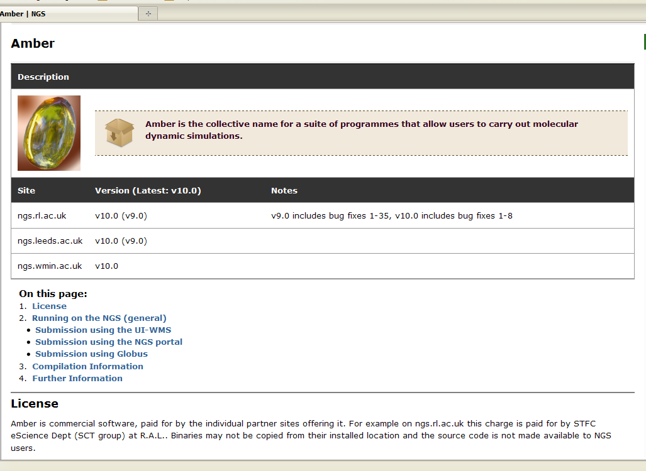
Scientific Applications (3)

Slide 7
VO’s
VOMS servers
Manchester
VO hosting
GridPP ~ EGI
NGS

Slide 8
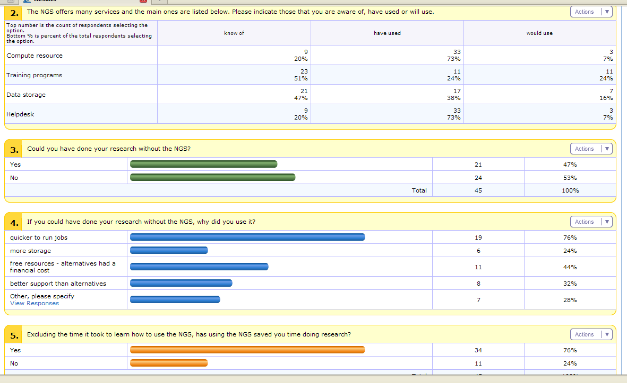
User requirements

Slide 9
Helpdesk
- direct
support@gridsupport.ac.uk - Footprints

Slide 10
New communities
Roadshows
Workshops

Slide 11
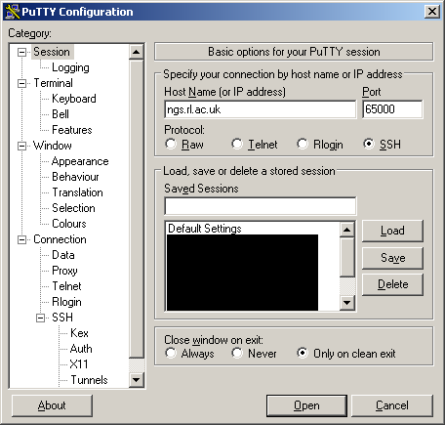
New Tools/Services
MEG
Certificate Wizard
NGS Portal

Slide 12
Success stories
55,000 contigs split into 55
MPI BLAST used via UI/WMS
30 days work cut to 10 hours

Slide 13
Services
Offer… experience
Diverse users
Specialist tools
Require… GGUS

Slide 14
Questions?
claire.devereux@stfc.ac.uk
NGS Innovation Forum,
23-24 November 2010 @ RAL, STFC, UK
Registration and Poster Call OPEN
www.ngs.ac.uk

