Slide 1
Points for a discussion between the Regional Initiatives and
EGI.eu/EGI
(gathered points from circulated emails...)

Slide 2
Our Goal
Goal:
Define relationships between different bodies/actors/communities to maximize their benefits and optimize their efforts for extending the global e-Infrastructure serving the users and e-Science worldwide

Slide 3
Actors
EGI = EGI.eu + NGIs
  Their bodies, ToRs, obbligations, users
Regional Initiatives / Projects
  CHAIN as a coordination project
Virtual Research Communities and their users
  In the EU and outside it
  their Resources and Data, their Requirements, their goals

Slide 4

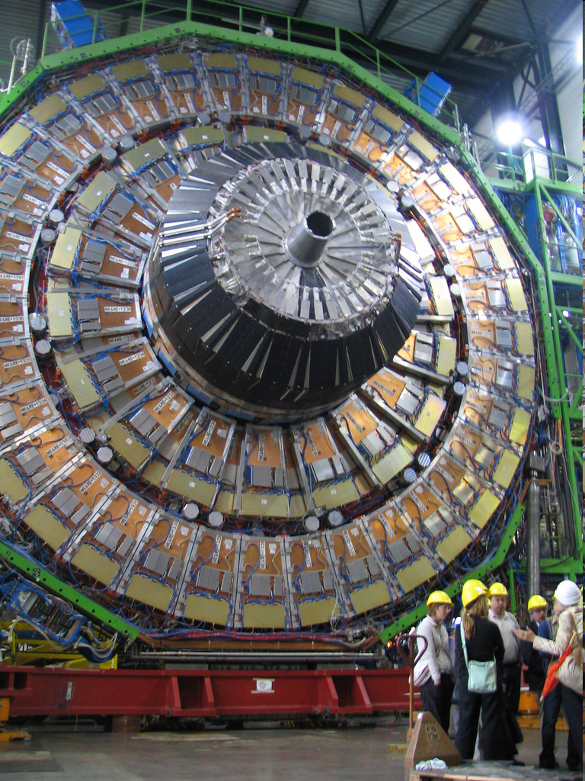
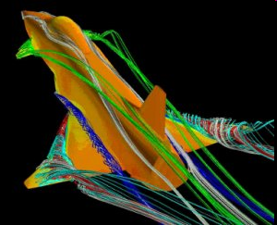
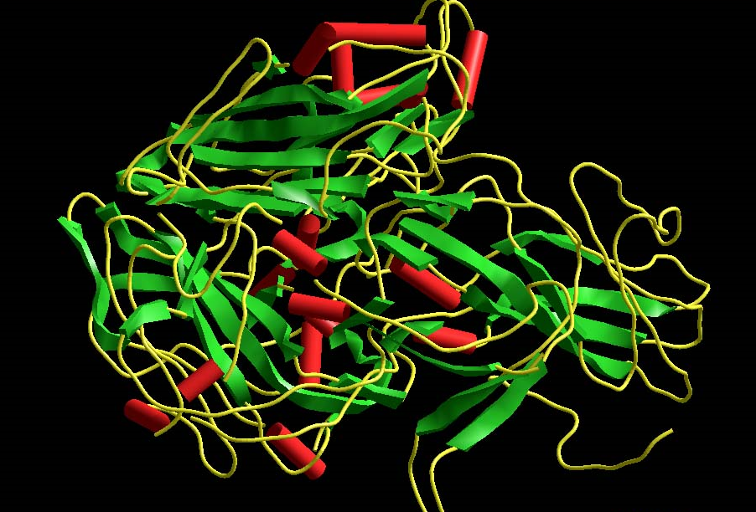
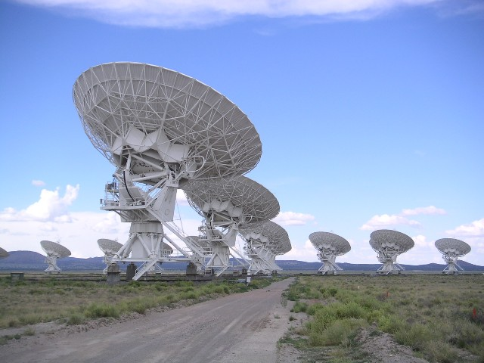
Scenario: extending global e-Science
- Global e-Infrastructures for global science:
users
Regional Initiatives
users
EGI (EGI.eu and NGIs)
users

Slide 5
Issues
Harmonize/Understand different perspectives and needs
Differences:
  lifetimes
  contexts:
    Network Connectivity in the regions
    Maturity of CAs, NGIs, NRENs..
    Maturity of the user communities and their IT know how

Slide 6
What to discuss overall
Relationship of EGI and Regional e-Infrastructures
Exchange views on what we expect from EGI, as well as what EGI is expecting from us
  How are we going to interact in practice ? Common approach of Regional e-Infrastructures to VRC support, under the auspices of EGI.

Slide 7
Points for discussion:
1) How the "pool" of Regional e-Infrastructures could officially contact (large) VRCs (Life, Earth Sciences, HEP,...) to:
  let them know of the Services offered in each Region, by each of the e-Infrastructure,
  interact on a coordinated way on common perspectives e.g. training, development of new services,...

Slide 8
Points for discussion: Workshops
2) Organization of WorkShops:
  BrainStorming meeting CHAIN-EGI (Feb 2011)
  "Regional e-Infrastructures meet VRCs"
    in the forthcoming 4-5 months after the EGI Forum, to progress on VRC support…

Slide 9
Points for discussion: MoUs
3) Status of the MoUs / MoU proposal
  Get feedback from EGI.eu Policy Management
  Get the proposals and perspective by the Regional Initiatives

Slide 10
Points for dicussion 3/3
4) Required services to the Regional projects to interoperate with the EGI infrastructure
5) SLAs and OLAs to be enforced by the Regional Projects
6) Cooperation EGI-Regional Projects at the User Support level (GGUS) and Operations related procedures/tools (GOC-DB, monitoring
7) Models for the Regional ROCs - metrics to monitor

