Slide 1
APEL Status and Plans
Cristina del Cano Novales

Slide 2
APEL
Collects cpu time and normalisation
Identified by UserDN, FQAN, Site, VO, date
Summarised by month/site/VO; month/site/FQAN; month/site/UserDN
UserDN is encrypted in transit

Slide 3
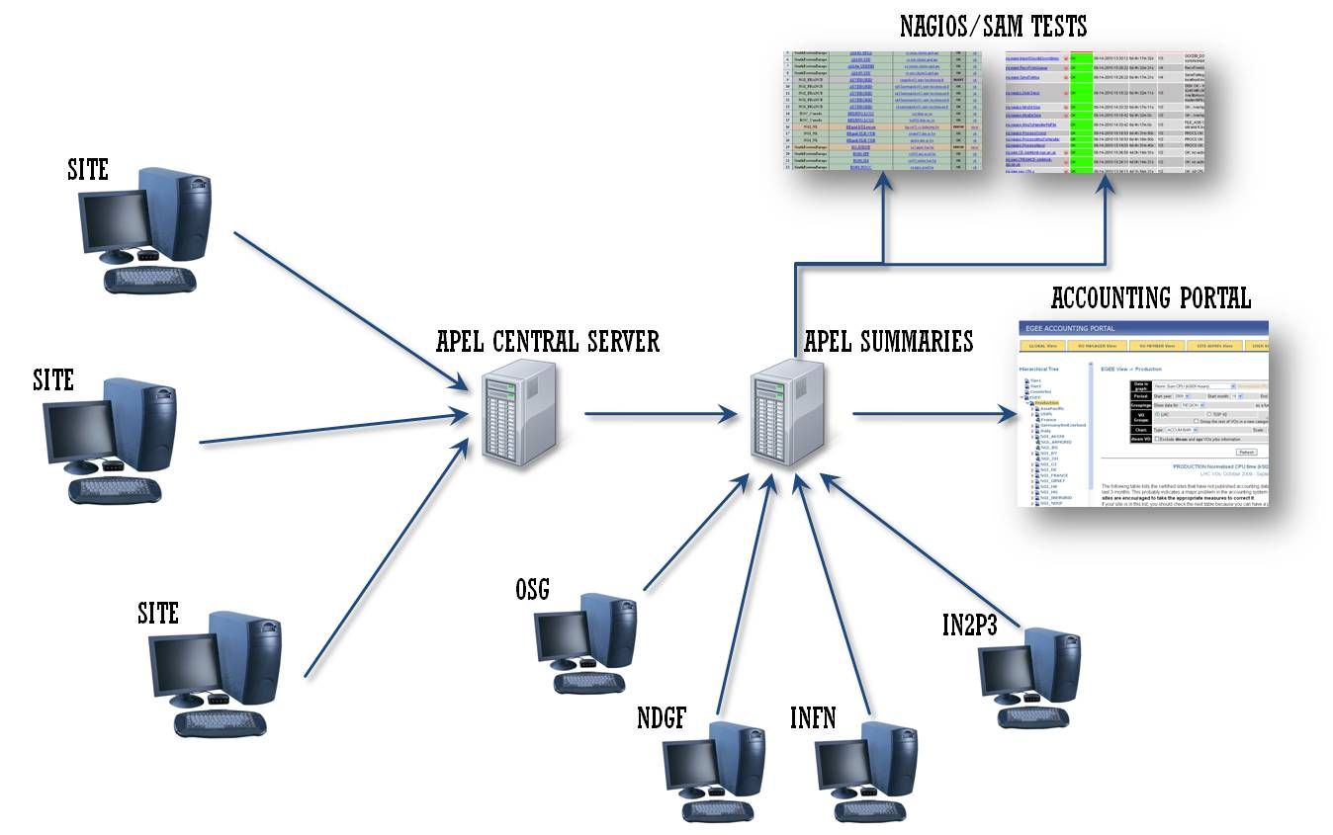
APEL Architecture

Slide 4
Accounting Portal
Displays njobs/cpu/wallclock/normalised cpu/normalised wallclock/ cpu efficieny
Allows dynamic queries on
date, site, VO, region
Trees of Tier1, Tier2, Countries, EGEE
Reports for monthly Tier1, Tier2 accounts
Dump to spreadsheet
User, VO, and VO Manager views

Slide 5
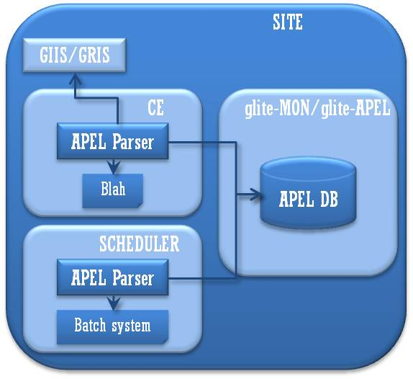
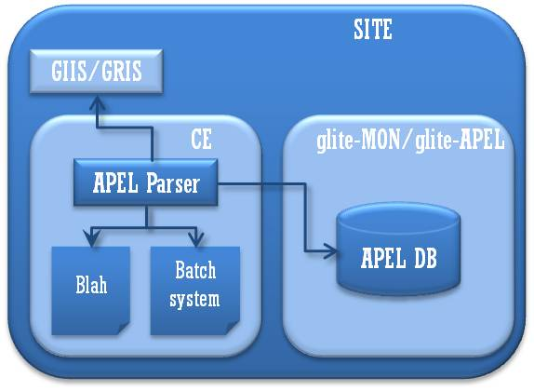
Current Status - Parsers
Notes:
The second model used to work with Globus but we need to verify that it still works with the latest release.

Slide 6
Current Status - Parsers
Recently changed to reading CPUScalingReferenceSI00 value if available – otherwise reading GlueHostBenchmarkSI00
As a temporary arrangement, sites are asked to benchmark using HEPSPEC06 and convert to SI00 using conversion of 4.0
Portal display either SI2K or HS06, converting between them.
No current issues – some minor bugs
Still supporting PBS, LSF, SGE and Condor
(with the help of the batch system supporters)

Slide 7
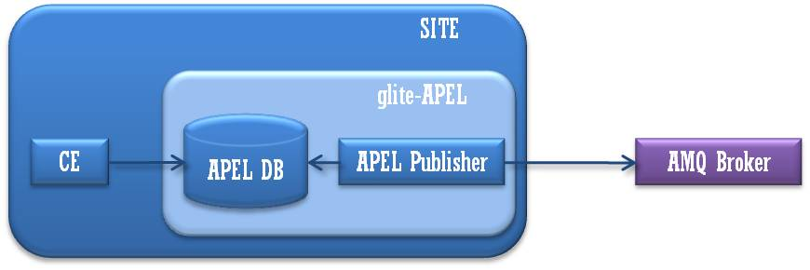
Current Status - Publisher

Slide 8
Current Status - Publisher
glite-APEL released into production in June 2010
glite-APEL to replace glite-MON
Transport of records based on ActiveMQ (replacing RGMA)
No changes to functionality
One update to glite-APEL certified – currently in roll-out

Slide 9
Current Status
Beta testing for glite-APEL node first half of year by five sites
IN2P3-LAPP, IN2P3-CPPM and GRIF in France
GR-04-FORTH-ICS in Greece
Australia-ATLAS
Currently 31 sites publishing via ActiveMQ
~190 sites publishing with RGMA
~104 sites publishing directly with MySQL

Slide 10
Current Status – ActiveMQ
Serbia and France with GGUS ticket to track migrations of sites in ROC
Couple of Spanish sites + one soon
UKI in progress (couple of sites)
Sites with publishing problems (i.e. CERN)
Spontaneous migration
New sites (directly installing glite3.2)

Slide 11
Roll-out Plan
EGI Operations Management Board agreed on 13/9/10
All NGIs should now migrate their sites using APEL to publish using glite-APEL.
R-GMA central registry will be switched off at the end of 2010.
Sites who have not migrated will continue to collect and store accounts locally and will catch up once they migrate.
Direct database Insertion will continue until new summary publishing client is available.
Work with sites who wish to publish job records from their own data without using the APEL client.

Slide 12
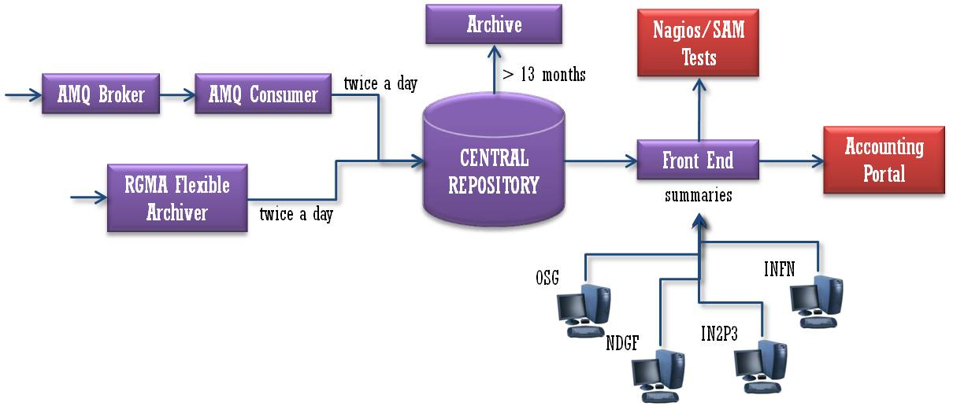
Current Status – APEL Server

Slide 13
Current Status – APEL Server
Records added to central database twice a day
AMQ consumer and RGMA archiver working in parallel – two days worth of records in each
Central Repository contains all individual records (13 months only)
Records older than 13 months are archived

Slide 14
Current Status – APEL Server
Processes and summaries of data created twice a day:
Encryption/decryption of UserDNs
Normalisation of CPU/WallClock time
Anonymous summary: per site, VO, month and year
User summary: per site, VO, user, role, group, month and year
Other statistics:
SpecInt history: per site, specint value, month and year
Metrics and metrics cumulative: per week

Slide 15
Future Plans - Parsers
MPI Accounting:
Session in parallel with this one
Some issues:
Torque deficiencies, potentially others
GPU usage accounting?
Multi-core/Multi-thread?
Release of new patch soon:
Problems closing file handles (too many open files)
Clusters/subclusters/CE names in the site’s BDII

Slide 16
Future Plans - Publisher
Summary publishing
Currently sites can only publish individual records
Summary publishing to be implemented
Publisher to be used by OSG, NDGF, INFN and IN2P3
First step in regionalisation

Slide 17
Future Plans – APEL Server
ActiveMQ:
Decommissioning RGMA APEL infrastructure
By the end of the year
NGIs asked to migrate as soon as possible
Broker:
Move to use the production network of brokers

Slide 18
Future Plans – APEL Server
Interfaces:
All regions to publish via AMQ/APEL publisher – remove MySQL direct insertion
OGF-RUS interface – standard interface for publishing into the APEL database

Slide 19
Future Plans – APEL Server
Other:
Topology database at CERN
Tier0, Tier1 and Tier2 sites, federations and pledges
Optimising database for increasing number of records
Year | Sites | Jobs
2003 | 2 | 23
2004 | 52 | 893320
2005 | 172 | 6038027
2006 | 294 | 21276589
2007 | 326 | 61326182
2008 | 356 | 150861027
2009 | 391 | 230965570
2010 | 387 | 259102045

Slide 20
Future Plans – Regionalisation

Slide 21
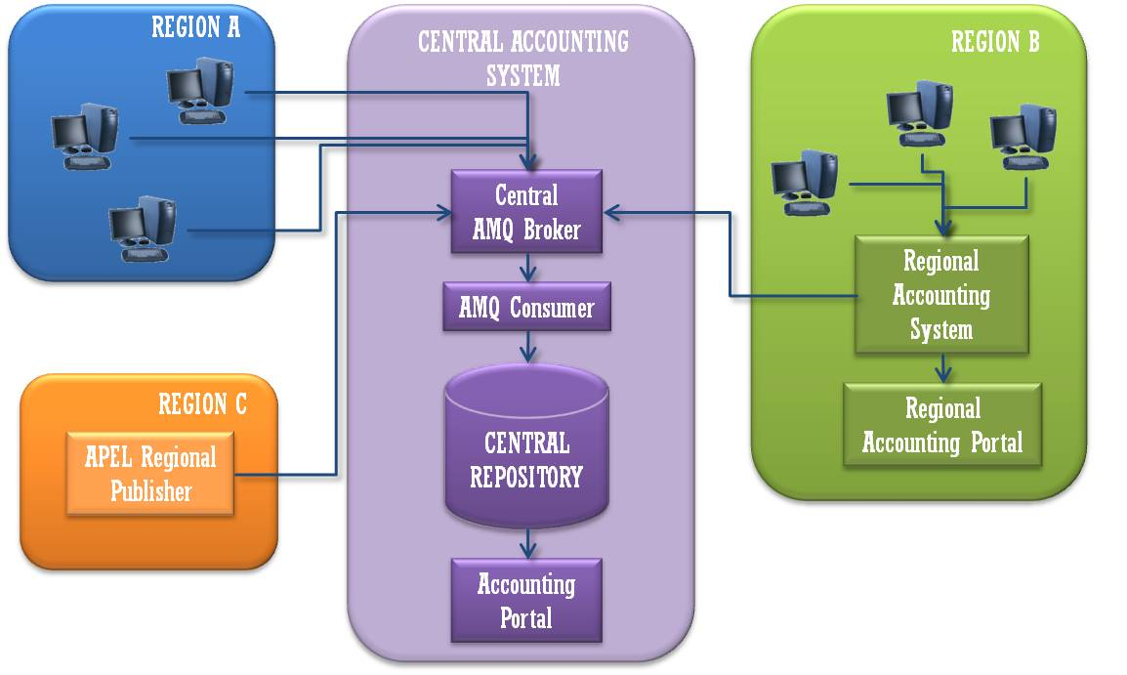
Regionalisation - Plan
All regions to publish via ActiveMQ
Provide regional accounting system
Allow regions to continue using central system
Collect records from other grids/tools via same interface
Not happening on the first year of EGI/EMI

Slide 22
Regionalisation – Current Status
Currently no distribution of the central repository for regional deployment
Most sites using APEL client publishing directly to central system
Other grids/subgrids using direct insertion into the APEL database
NDGF
OSG
INFN
IN2P3

Slide 23
Regionalisation – Next Step
First step moving other grids to use ActiveMQ client
Region C sites only publish summaries
APEL publisher to publish summaries

Slide 24
Current Status - General
APEL Nagios tests implemented
2 tests: Apel-Pub and Apel-Sync
Pub: Date of the most recent record for each site
< 7 days – OK
7 to 31 days – WARNING
> 31 days – ERROR
Sync: Comparison between number of jobs on site and centrally
< 10 – OK
10 to 100 – WARNING
> 100 – ERROR
No data – UNKNOWN

Slide 25
Current Status - General
Apel-Pub is critical
Apel-Sync is NOT critical
Tests created in APEL server – then published to message bus
Currently SAM and Nagios tests in parallel – waiting for confirmation

Slide 26
Questions?
APEL-SUPPORT@JISCMAIL.AC.UK
http://goc.grid.sinica.edu.tw/gocwiki/ApelHome

