Slide 1
EGI-InSPIRE SA3: Services for HEP – Status Report
Maria Girone, CERN

Slide 2
Outline
Brief overview of Services for HEP
More information in MS603 (in review)
Status of the personnel
What has been achieved so far
Outlook

Slide 3
Services for HEP – MS603
The services used by High Energy Physics experiments at the LHC can be classified as:
Experiment services – developed, maintained and operated by the collaborations themselves
Middleware services – generic services at Grid middleware layer, typically operated by WLCG
Infrastructure services – fabric-oriented services operated by the sites
Database services
Concentrating primarily in the first but also second area (details next)

Slide 4
Experiment Services
Experiment services provide functionality very specific to one experiment and the corresponding computing model
Use generic m/w where possible
ALICE: AliEN
ATLAS: PanDA, DDM
CMS: CRAB, Analysis Server, Production Agent, PhEDEx, DBS
LHCb: DIRAC
Covered in this presentation
Covered in later presentations
Future SA3 HEP activity

Slide 5
Middleware Services
Data Management: LFC, FTS
Workload management: Ganga, Condor-G, gLite WMS, glideinWMS
Persistency services: CORAL, POOL, COOL, FroNTier
Monitoring services: HammerCloud, Experiment Dashboard, SAM, Nagios
Security Services: VOMS, VOMRS, MyProxy
Computing Services: LCG CE, CREAM CE, OSG CE, ARC CE
Storage Services: CASTOR, dCache, DPM, xrootd, StoRM, BeSTMan
Covered in this presentation
Covered in later presentations

Slide 6
Status of the task - Personnel
Person | Task | Start Date
Loth | optimization of access to detector conditions data | June
Barreiro | operations & integration support for HEP experiments | June
Trentadue | development, support and maintenance for WLCG Persistency Framework | July
Santinelli | experiment integration and operations support | April 2011 (unfunded until then)
Lanciotti | experiment integration and operations support | October
Spiga | experiment integration and operations support | October
INFN1 | ATLAS oriented tasks | JAN 2011?
INFN2 | CMS oriented tasks | JAN 2011?
Funded & unfunded PM all accounted

Slide 7
Persistency Framework
Alexander Loth, Raffaello Trentadue

Slide 8
Persistency Framework – Overview
Three packages which address HEP requirements for storing and accessing several different types of scientific data
Used by ATLAS, CMS, LHCb
CORAL is an abstraction layer with an SQL-free API for accessing data stored in relational databases
POOL is a hybrid technology store for C++ objects, using a mixture of streaming and relational technologies
COOL handles the time variation and versioning of the conditions data of the HEP detectors

Slide 9
Persistency Framework – Results
Work on POOL/CORAL has focused on deep technical issues, test suites, debugging build problems and complex run-time issues (RF)
SA3 funded effort was able to provide very rapidly (within days) needed assistance to the HEP communities at a critical point in early data taking
Details are in the slide notes
COOL-related work has focused on the optimization of access to detector conditions data (caching strategies and technologies) (AL)
Notes:
For POOL, the analysis and debugging of some problems observed during the automatic nightly builds and tests is on going.
In fact the nightly test used in POOL were affected by many errors during their running.
Among them, the most relevant ones were concerning the category of Relational Storage service. The problem issued by a bug in the code due to the missing of namespace in the classes defined for each test with the same name but with different implementation. Moreover, a bug in the build file of CMT was responsible for the overwriting of the static library created always in the same directory and with the same name. The bug has been fixed adding a suffix to distinguish the name of the library for each test, both at the level of LCGCMT and POOL tests configuration.
The last problem found was concerning a conflict originated by simultaneous access to the same object in the database due to the parallelization of the test procedure over all the different slots and platforms. To fix this bug, a start and a stop have been defined in order to lock any test procedure while another is using the database.
Finally a really complex debugging of CORAL is on going concerning the Oracle errors caused by a temporary network failure during a database reading or writing application running. The main error has been already reproduced simulating via software the connection lost by means of a local port forwarding. An action very urgent and that is already on going is to add an exception to be raised whenever the disconnection occurs.

Slide 10
DIRAC Distributed Infrastructure with Remote Agent Control
Roberto Santinelli

Slide 11
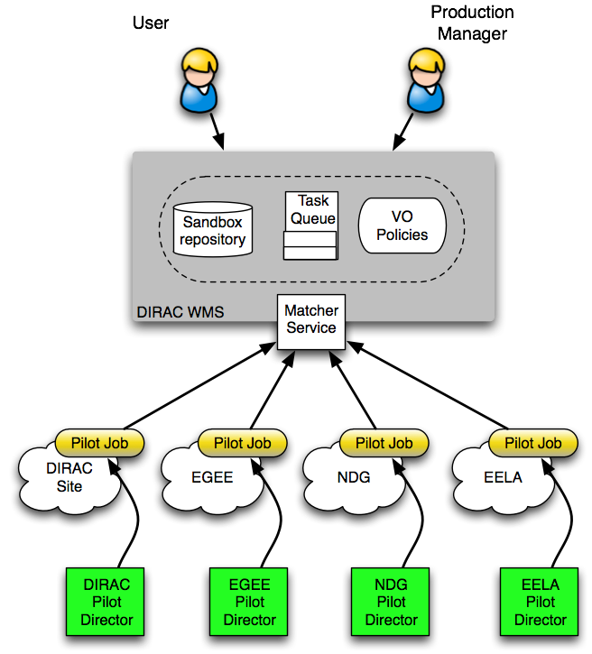
DIRAC WMS
The DIRAC WMS is based on the pilot job concept
User jobs are submitted to a central task queue & are picked up by a pilot job
The pilot jobs are submitted by Pilot Directors
This allows to apply global policies across heterogeneous resources

Slide 12
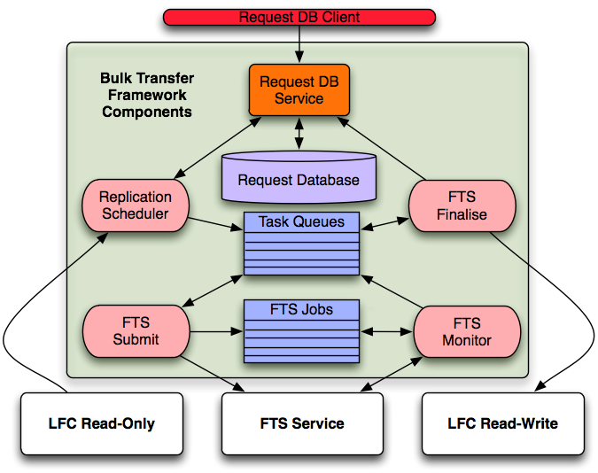
DIRAC DMS
Manages all data distribution operations between Pit, Tier0 and Tier1s
Features include:
Automatic transfer scheduling
Full failure recovery
Redundancy: transfer requests stored in multiple Voboxes
Comprehensive checks of data integrity in SEs and Catalogs

Slide 13
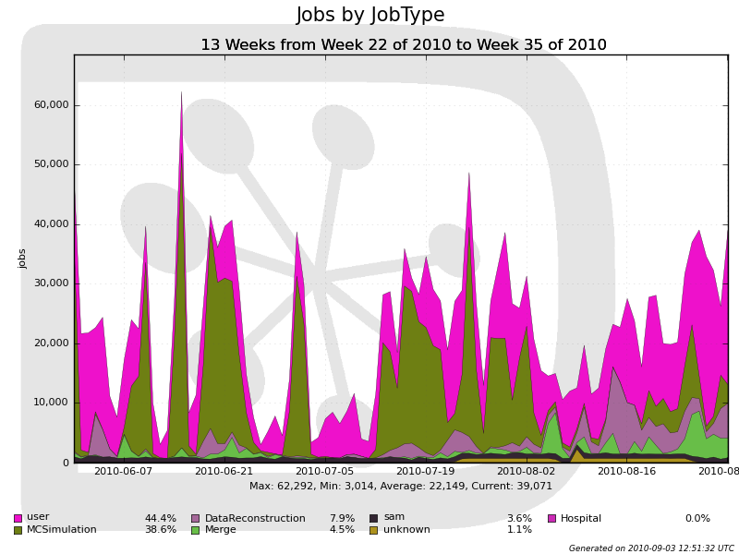
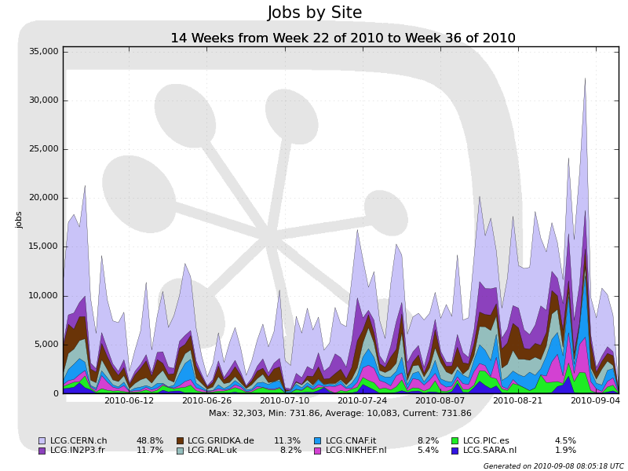
Successful use of Grid from data taking to Physics Conferences
Large user activity (30K jobs/day), spikes close to conferences (ICHEP)
Real Data Reconstruction/Stripping/Merging and reprocessing
Up to 8K jobs / day at Tier1s
All Activities running concurrently

Slide 14
Distributed Data Management
Fernando H. Barreiro Megino

Slide 15
ATLAS Distributed Data Management
Responsible for the replication, access and bookkeeping of ATLAS data across more than 100 distributed grid sites
Enforces ATLAS data management policies
Designed as a set of independent clients and services to ensure scalability and fault tolerance
Underlying use of FTS, LFC & GFAL

Slide 16
ATLAS DDM – Recent Work
SA3 funded work is focused on
Optimization of storage resources: Storage accounting and automatic site cleaning
Improving network usage: Current effort on monitoring and improving the usage of FTS
Automation of the site blacklisting system to reduce the need for human intervention
The results of this activity have provided valuable input to discussions on data placement versus caching as part of future WLCG data management policy
The details will be covered by Fernando

Slide 17
SA3 HEP: Outlook & Summary

Slide 18
Outlook
Future activities include not only SA3 HEP specific work but also contribution to the key milestone D6.2 on sustainability
Check point will be the forth-coming EGI User Forum
April 11 – 15 in Vilnius, Lithuania
FP8 and other future funding: how do we react to what was described by Kostas Glinos on day 1?

Slide 19
Summary
Work package ramped up well in Q1 – most positions filled
Workplan inline with DoW and experiment priorities
Continue to emphasize the needs for commonality and sustainability
Looking to increase synergies across experiments and also application domains, such as LS & ES projects in which group is involved
e.g. EnviroGRIDS, PARTNER, ULICE, …
Effort contributed to project within a very short time

