Slide 1
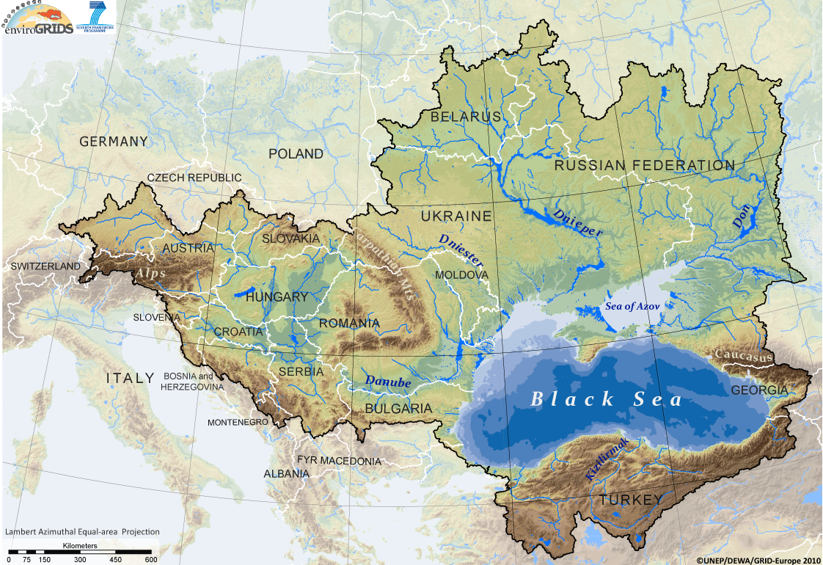
ENVIROGRIDS brief overview
Łukasz Kokoszkiewicz

Slide 2
Area of research: over 2 000 000 km²
Notes:
To address all of the issues connected to environmental changes in a Black Sea Catchment, EnviroGRIDS project was founded.
Why this Catchment?
With the adhesion of Romania and Bulgaria to the European Union, the Black Sea becomes a European Sea.
enviroGRIDS is centered of the Black sea hydrological catchment (more the terrestrial part than the Black sea bassin itself)
More than 2 million square km
25 countries
Some of Europe longest and largest rivers (Danube, Dnieper, Southern Bug, Dniester, and the Don)
Inhabited by around 160 million people
The core environmental problem of the Danube River Catchment can be described as “ecologically unsustainable development and inadequate water resources management” [1]. The problems are caused by different factors such as inadequate management of wastewater/solid waste, ecological unsustainable industrial activities, and inadequate land management and improper agricultural practices. They generate several direct consequences: pollution of surface/groundwater, eutrophication, and accelerated runoff/erosion. These consequences have, in turn, the following main effects: decline in quality of life, human health risks, degradation of biodiversity, economic decline, and reduced availability of water. The Black Sea itself is also affected by severe environmental degradation [2].
Say the ultimate goal of envirogrids is to contribute to a more environmentaly sustainable future of the BSC, to address some societal benefits and to improve environmental concerns.
It will achieve that by building the capacity of scientist to assemble Observation system in the Black Sea Basin, the capacity of decision makers to use it, and the capacity of the general public to understand the important environmental, social and economical issues at stake.

Slide 3
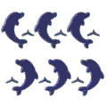
DHMO
Project timeframe: April 2009 – March 2013
Total budget of €8.1 mio. (€6.2 mio. EC contribution) and 1367 man-months.
The EnviroGRIDS Project Team includes 27 partners from 15 countries, representing also several European (CERN, EEA) and United Nations organizations (UNEP, UNESCO).
Among these partners, 22 belong partially or entirely to the Black Sea Catchment.
Eight partners belong to an International Cooperation Partner Countries (Ukraine, Georgia and Russian Federation) and five to Associated Countries (Switzerland and Turkey).
Five partners can be defined as Small and Medium Enterprises (SME).
Notes:
Fortunately we have a large range of skills and expertise among the 27 partners of the project that all have particular tasks to fulfill in the project.
Partners involved in grid computing in the project are circled in RED

Slide 4
Project structure
WP1 : Project management
Finance
Reporting
Meetings
Web sites
Quality control
Intellectual property
Conflicts
Gap analysis
Inter-operability
WP2: Spatial Data Infrastructure
Remote sensing
Sensors
Gridification
SDI
WP3: Scenarios for 2050
Demography
Climate
WP4: Hydrology with SWAT
Data
Calibration
WP5: Impacts on GEO SBA
Biodiversity
Energy
Land cover
Integration
Scenarios
Ecosystems
Agriculture
Health
Disasters
WP6: Observation systems
GEO network
For citizens
For decisions makers
Vulnerability
WP7 : Capacity building
End users
Live trainings
Virtual trainings
Publications
Decision makers
Notes:
In order to move towards this ambitious objective, enviroGRIDS is organized in 7 work packages:
WP2 is centered on data management and grid technology
WP3 is setting the scene for the future of the Black Sea catchment in terms of climate, land cover and demographic changes
WP4 is running the hydrological SWAT model
WP5 is exploring the impact of these changes on several GEO societal benefit areas through pilote studies
WP6 is creating new observation systems of citizens and decision makers
WP7 is disseminating the ideas of the projct through different types of trainings

Slide 5
technical objectives
data gap analysis
modeling of large scale, high resolution distributed hydrologic processes
developing a grid-enabled Spatial Data Infrastructure (SDI)
spatially explicit regional scenarios of development
develop access to real time data from sensors and satellites
develop early warning and decision support tools at regional, national and local levels
Build capacities in the Black Sea region to enhance data interoperability, by promoting on OGC and open standards (ISO 19115/19119/19139; web services WMS, WFS, WCS)
Notes:
to run a gap analysis on existing regional observation systems to prepare recommendations for improvement of networks of data acquisition in each region/country,
Create regional scenarios of development in function of expected climate, land cover and demographic changes
to gridify the software that compute large scale resolution modeling of distributed hydrologic processes,
to develop the access to real time data from sensors and satellites,
to streamline the production of indicators on sustainability and vulnerability of societal benefits. Streamline data process from data warehouses, to scenarios, hydrological models, impacts assessments and finally to disseminations tools.
to provide policy-makers and citizens with early warning and decision support tools at regional, national and local levels.
to build capacities in the implementation of many new standards and frameworks (INSPIRE, GEOSS,..).

Slide 6
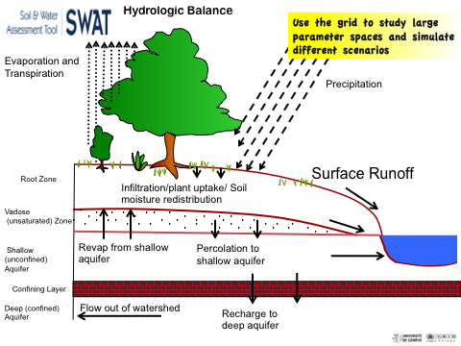
SWAT
SWAT (Soil and Water Assessment Tool) is a river basin, or watershed, scale model.
It predicts the impact of land management practices on water, sediment and agricultural chemical yields in large complex watersheds with varying soils, land use and management conditions over long periods of time.
Notes:
- SWAT widely is used around the world by entire hydrology community.
SWAT and related software is constantly developed in many institutions around the world
SWAT was developed since the early 1990s.
- SWAT will the model every part of an hydrological model across the full landscape under study.
- The main input of water is precipitation, which divides itself into Surface Runoff, Lateral flow, Return Flow, Recharge of Aquifer and of course evaporation.

Slide 7
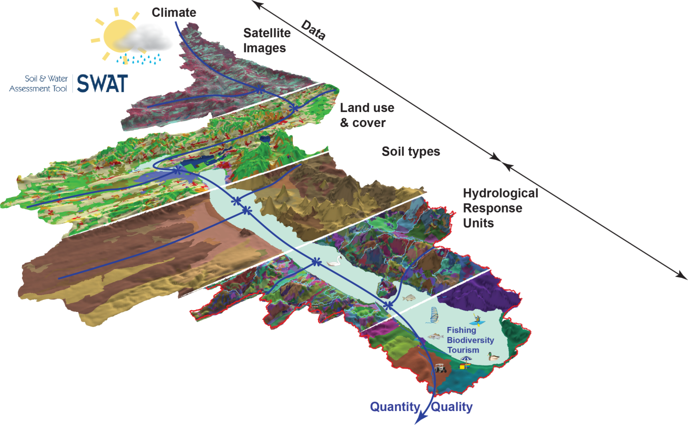
swat
Models
Notes:
We already used SWAT on Lake Balaton in Hungary and many users are using this tool around the world to study their river catchments. In order to run this model, we need relatively simple data:
Altitude and slope
Land cover
Soil characteristics
Climatic time series of temperature and rainfall data from weather stations
Then, in order to calibrate the model we need hydrological data to fit the model to the observations

Slide 8
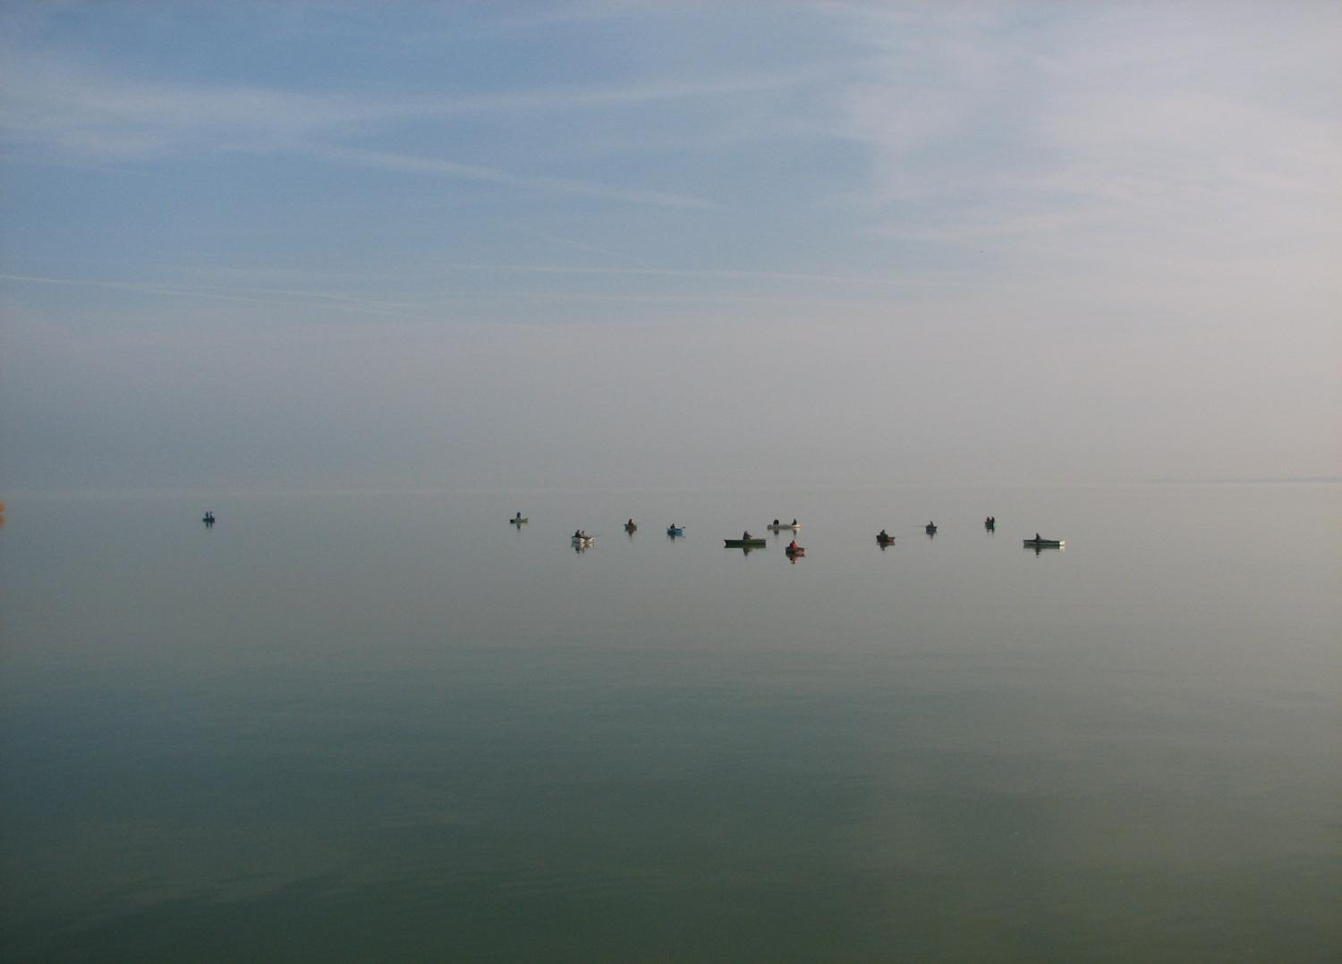
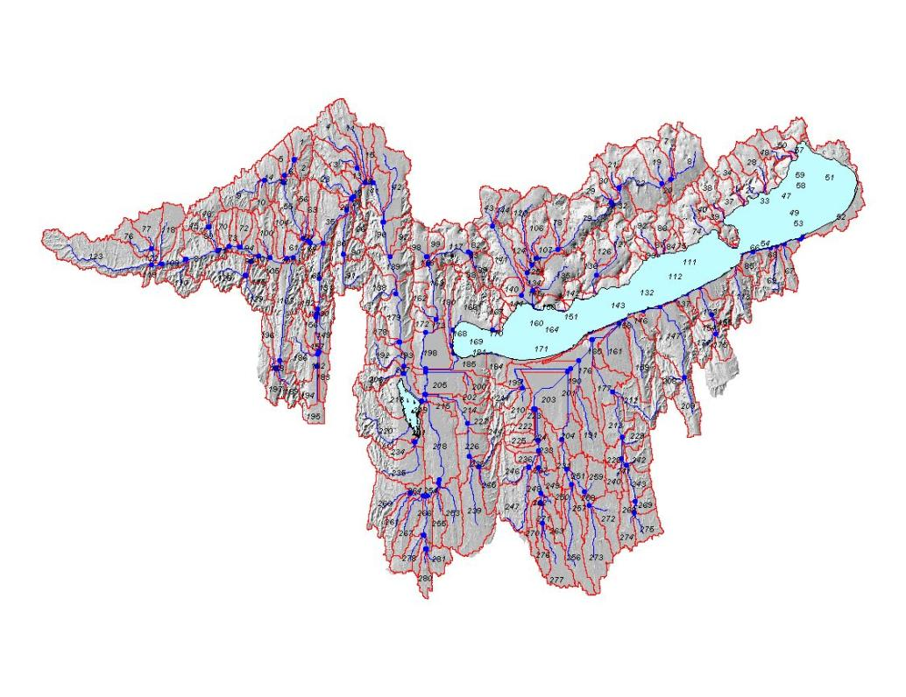
Hydrological modeling
Notes:
This is visualisation of hydrological model of Balaton Lake.
Blue lines are rivers
Blue dots are rivers inlets
Red lines are the borders of sub-basins used in calculating predictions for the hydrological model.

Slide 9
SWAT
gridification
Sub-basin based model splitting
The main idea is to split model itself based on sub-basins.
Calibration and uncertainty analysis (SWAT-CUP)
Calibration of SWAT models requires running SWAT simulations hundreds of times with different parameters set.
To run SWAT and related software on the grid we are successfully using Ganga and Diane software.
Notes:
Important part of the project is SWAT gridification. Right now it splits onto 2 main use cases:
- Sub basin based model splitting and running each sub-model separately on the grid.
Calibration and uncertainty analysis that right now requires the most computing power due to necessity of running SWAT simulations hundreds of times.
To run SWAT and related software on the grid we are successfully using Ganga and Diane software.

Slide 10
Thank you
www.envirogrids.net
www.cern.ch/ganga
www.cern.ch/diane
gangamon.cern.ch

