Slide 1
TSA2.3 Software Validation
MS503
Software Provisioning Process

Slide 2
Objectives
Verify software (UMD+OT) quality criteria before the staged rollout (SR)
EGI-InSPIRE will accept only certified and validated software

Slide 3
Verification of QC
Testing is done by the SP (can include NGIs, and user communities)
Major Release: Full testing of the SP+SA2
Minor Release: SP tests and SA2 verifies and does random testing
Revision Release: SP tests and SA2 verifies

Slide 4
Request Tracker (RT)
Used to follow all the Software Validation process from “Unverified” components to “Verified” or “Rejected”
Prevents unverified (low quality, no tested) components from entering in production (and SR)
Template for verification (SV report or QA report) with QC
SP will access the SV process & reports

Slide 5
Verification of QC
The ticket enters Unverified
The SP has to provide links to the documentation and reports of the Generic and specific criteria tests
SA2.3 Verifies the documentation and reports for each criteria if is OK or not and comments (template of the report)
If ALL OK, ticket is set as “Verified” and component moved to SR

Slide 6
If not accepted
SP is notified
Has time (1-2 days) to clarify and correct
If OK now, is accepted
Otherwise, the ticket is closed as “Rejected”

Slide 7
SV Timeline (see MS402)

Slide 8
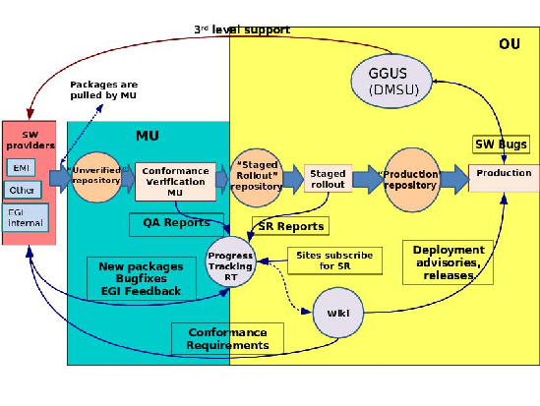
Software Provisioning Workflow

Slide 9
Metrics
Number of new versions by SP, percentage rejected. If more than 20% rejected, the TCB will be notified
Number of back-outs of a software component once it has entered into production, percentage for each SP
Number of incidents related to the new versions of software when in production, percentage of a SP
Number of software incidents found in production that result in changes to quality criteria (M.SA2.3).
Number of new releases validated against defined criteria (M. SA2.4).
Mean time taken to validate a release (M. SA2.5).
Number of releases failing validation. (M. SA2.6).

Slide 10
See also (references)
Quality Criteria (https://wiki.egi.eu/wiki/EGI-InSPIRE:UMDQualityCriteria)
MS402: Deploying Software into the EGI Production Infrastructure
MS501: Establishment of the EGI Software Repository and associated support tools
EGI Repositories http://repository.egi.eu

Slide 11
Status
Procedure ready
Generic criteria ready, pending some specific criteria
Need to prepare template for checking

Slide 12
Next steps
Configure RT (template to verify QC can be a word-excel sheet)
Something like:
User Documentation: Valid // DA // Comments
Communicate the procedure to SP
Setup/train people-> “Validator on duty”
Start validating
Collect metrics

Slide 13
Challenges
SLAs with SP, communicate the validation procedure to SP
Convince SP to verify software according to QC
Level of in-depth documentation review (this is not a deliverable review…)
Current software status…
Too many software updates-> Too much load (metrics)

Slide 14
Conclusions
Software Testing is done by the Software Providers
SA2.3 (TU) checks documentation & reports and then (un)validates. Random tests & participation in testing with the SP
Low quality components won´t be validated -> will never go to Production -> more stable infrastructure (less features?)

