Slide 1
EOSC TCOM
Giacinto Donvito (EOSC-hub Technical Coordinator, and WP10 Leader INFN)
04 October 2019
Dissemination level: Public/Confidential If confidential, please define:
Disclosing Party: (those disclosing confidential information)
Recipient Party: (to whom this information is disclosed, default: project consortium)

Slide 2
Agenda
Summary of D10.4: EOSC-hub proposal for EOSC tech architecture
Building blocks and technical specifications: organisation of the activity to identify building blocks and define/revise/improve the related technical specifications
Feedback collection on D10.4 and tech specifications
Report from the EOSC Architecture working group (Mark): focus on the status of the liaison on the technical architecture work
Collaboration with RDA

Slide 3
EOSC Technical Architecture

Slide 4
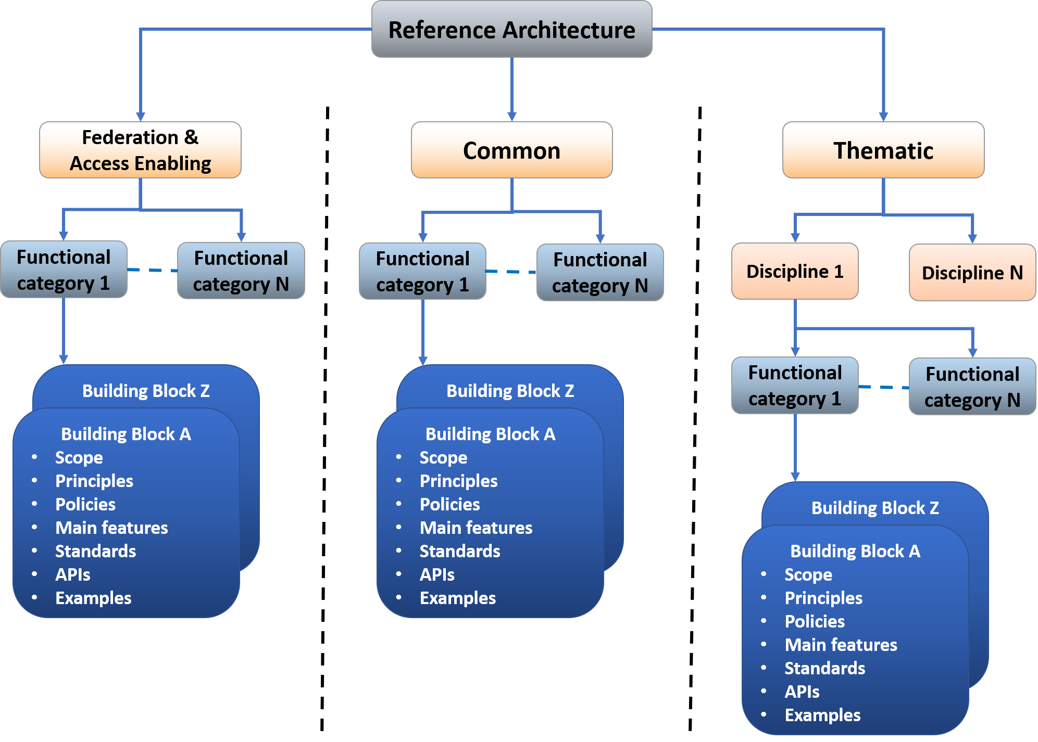
EOSC Reference Architecture
Reference architecture: template solution for an architecture
common vocabulary
list of functions and some indication of their interfaces (or APIs)
internal/external interactions
EOSC Technical Architecture
Infrastructure level
Working on defining:
Main blocks, functions, interfaces, APIs, standard as technical concepts, common vocabulary

Slide 5
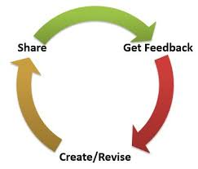
Define the Building Blocks of the EOSC architecture
Identify EOSC architecture building blocks for Access Enabling and Federation, Common and Thematic services
Define EOSC architecture building blocks
Common approach for all service categories
Mapping the features to Technical Specifications including High-level architecture & Interoperability guidelines
Iterative approach to identify building blocks and improve the technical specification
Start from the most relevant use cases
Define the technical specification and get feedback
Involve external people with expertise in the area

Slide 6
Family of EOSC compliant services per Block
Services in a Building Block
Follow the EOSC technical specification
Are able to interoperate
Examples:
AAI services compliant with the AARC Blueprint
Monitoring/Accounting systems able to exchange/share information
Building Block

Slide 7
Technical specification template per Block
Introduction
Short description of the building block highlighting its main functions
High-level Service Architecture
Reference architecture of the building block highlighting the interfaces towards the other building blocks
It does not refer to any specific service
Adopted Standard
List with references of the main adopted standards and protocols/API
Interoperability guidelines
Describe how similar services can be made interoperable with this macro-feature
Examples of solutions implementing this specification
Services compliant with this specification

Slide 8
EOSC Technical Architecture
Users
GUI/API
Thematic services
Common services
APIs and std interfaces
APIs and std interfaces
APIs and std interfaces
APIs and std interfaces
EOSC Portal
Workflow Management
Big Data Analityics
Data Annotation
Making science products FAIR
APIs and std interfaces
APIs and std interfaces
APIs and std interfaces
APIs and std interfaces
Federated Discovery and Brokerin,/supporting (Federated AAI)
Federations tools
AAI, Accounting, monitoring, Helpdesk, etc.
APIs and std interfaces
APIs and std interfaces
APIs and std interfaces
APIs and std interfaces
Cloud IaaS
Cloud Orchestrator
Data Discovery
Metadata management
Other Portals and Marketplace
APIs and std interfaces
APIs and std interfaces
APIs and std interfaces
APIs and std interfaces
APIs and std interfaces
Data/Compute/Storage Resources

Slide 9
EOSC Technical Architecture
Users
GUI/API
Thematic services
Common services
APIs and std interfaces
APIs and std interfaces
APIs and std interfaces
APIs and std interfaces
EOSC Portal
Workflow Management
Big Data Analityics
Data Annotation
Making science products FAIR
APIs and std interfaces
APIs and std interfaces
APIs and std interfaces
APIs and std interfaces
Federated Discovery and Brokerin,/supporting (Federated AAI)
Federations tools
AAI, Accounting, monitoring, Helpdesk, etc.
APIs and std interfaces
APIs and std interfaces
APIs and std interfaces
APIs and std interfaces
Cloud IaaS
Cloud Orchestrator
Data Discovery
Metadata management
Other Portals and Marketplace
APIs and std interfaces
APIs and std interfaces
APIs and std interfaces
APIs and std interfaces
APIs and std interfaces
Data/Compute/Storage Resources

Slide 10
Feedback collection on D10.4
Ongoing in the EOSCsecretariat platform:
https://www.eoscsecretariat.eu/eosc-liaison-platform/post/have-your-say-eosc-hub-proposal-eosc-technical-architecture
Please share the link with your contacts

Slide 11
Define/revise/improve the related technical specifications
Select a subset of technical specifications
Federation → very relevant for the federation core
Common
Define a (small) team for each tech specification
Experts from the project
Invite external experts in if-is-needed basis
Target
Consolidate first set of specifications by the end of the year
Action for each TCOM member

Slide 12
Feedback on technical specification
When a tech specification is ready (considered enough mature) we can start the feedback collection
Publish it in a dedicated confluence space https://confluence.egi.eu/display/EOSCDOC/EOSC+Documentation+Home
Any technical specification ready?
AAI?

Slide 13
Report from the EOSC Architecture working group
Mark

Slide 14
RDA
Status of the collaboration

