Slide 1
OMB November 2019
Matthew Viljoen, Operations Manager
EGI Foundation

Slide 2
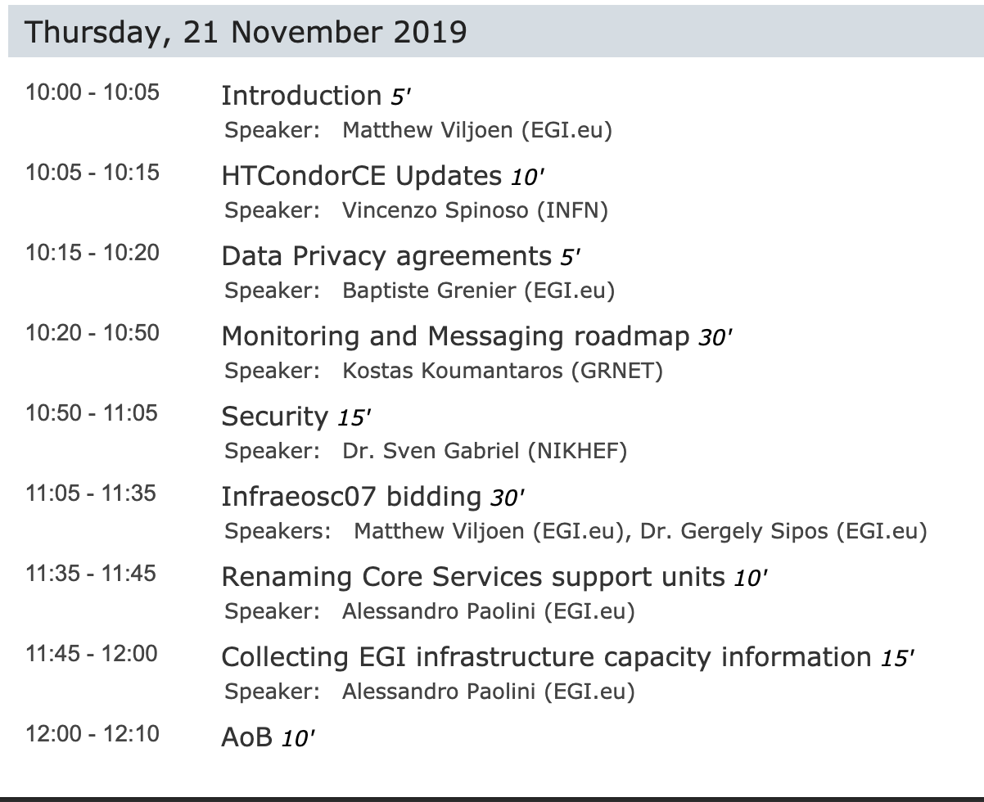
Agenda

Slide 3
Opening of Phase IV bidding
https://confluence.egi.eu/display/EGIBID/Call+2019
If you don’t have access let us know
Important dates
21 Nov ‘19 – invitation for bidding opens
20 Dec ‘19 – bidding deadline
15 Jan ‘20 – evaluation and shortlisting completed
Further details later on

Slide 4
Next OMB
3rd Thursday of the month
16 January 2020
To be confirmed on ML

