Slide 2
Big Data Analytics for agricultural monitoring using Copernicus Sentinels and EU Open Data Sets
EOSC Early Adopter
Kick-off, 22 November 2019, Amsterdam (NL)

Slide 3
Overview
CAP monitoring context
Overview of DIAS
How does DIAS fit in the EOSC context
What do we have already, what’s next
What will we do in the EOSC Early Adopter project

Slide 4
Copernicus DIAS for CAP CbM
Commission Regulation 2018/746 introduces “Checks by Monitoring” (CbM) as replacement of sample-based “on the spot checks” (OTSC)
CbM requires to uniquely locate agricultural parcels and check agricultural activity with Sentinel-1 and -2 data series for 100% of the territory
Thus, CbM is potential application domain, for which coordinated value adding on DIAS platforms bring operational benefits to the EU CAP managers
Basis for decision by DG GROW to support DG AGRI in “DIAS onboarding” of Paying Agencies which opted for CbM by 1 January 2019 (ES, IT, BE (F), DK)
Through ESA work orders, with technical supervision of JRC, until end 2019

Slide 5
Why is DIAS useful for CbM?
Annual volume of Copernicus Sentinel 1 and 2 for a moderate sized EU Member State (50,000 km²) is several 1000s of images
20-30 TB, requiring download, storage, processing, more storage, analysis
Not pull (as in current OTSC) but push (new data on a daily basis)
CbM is for 100% of the CAP area aid applications (OTSC for <5%)
Needs to be highly automated, scalable, “always on”
Similar to a large extent for all Member States, (more) scope for harmonization and sharing of a “plug and play” model.

Slide 6
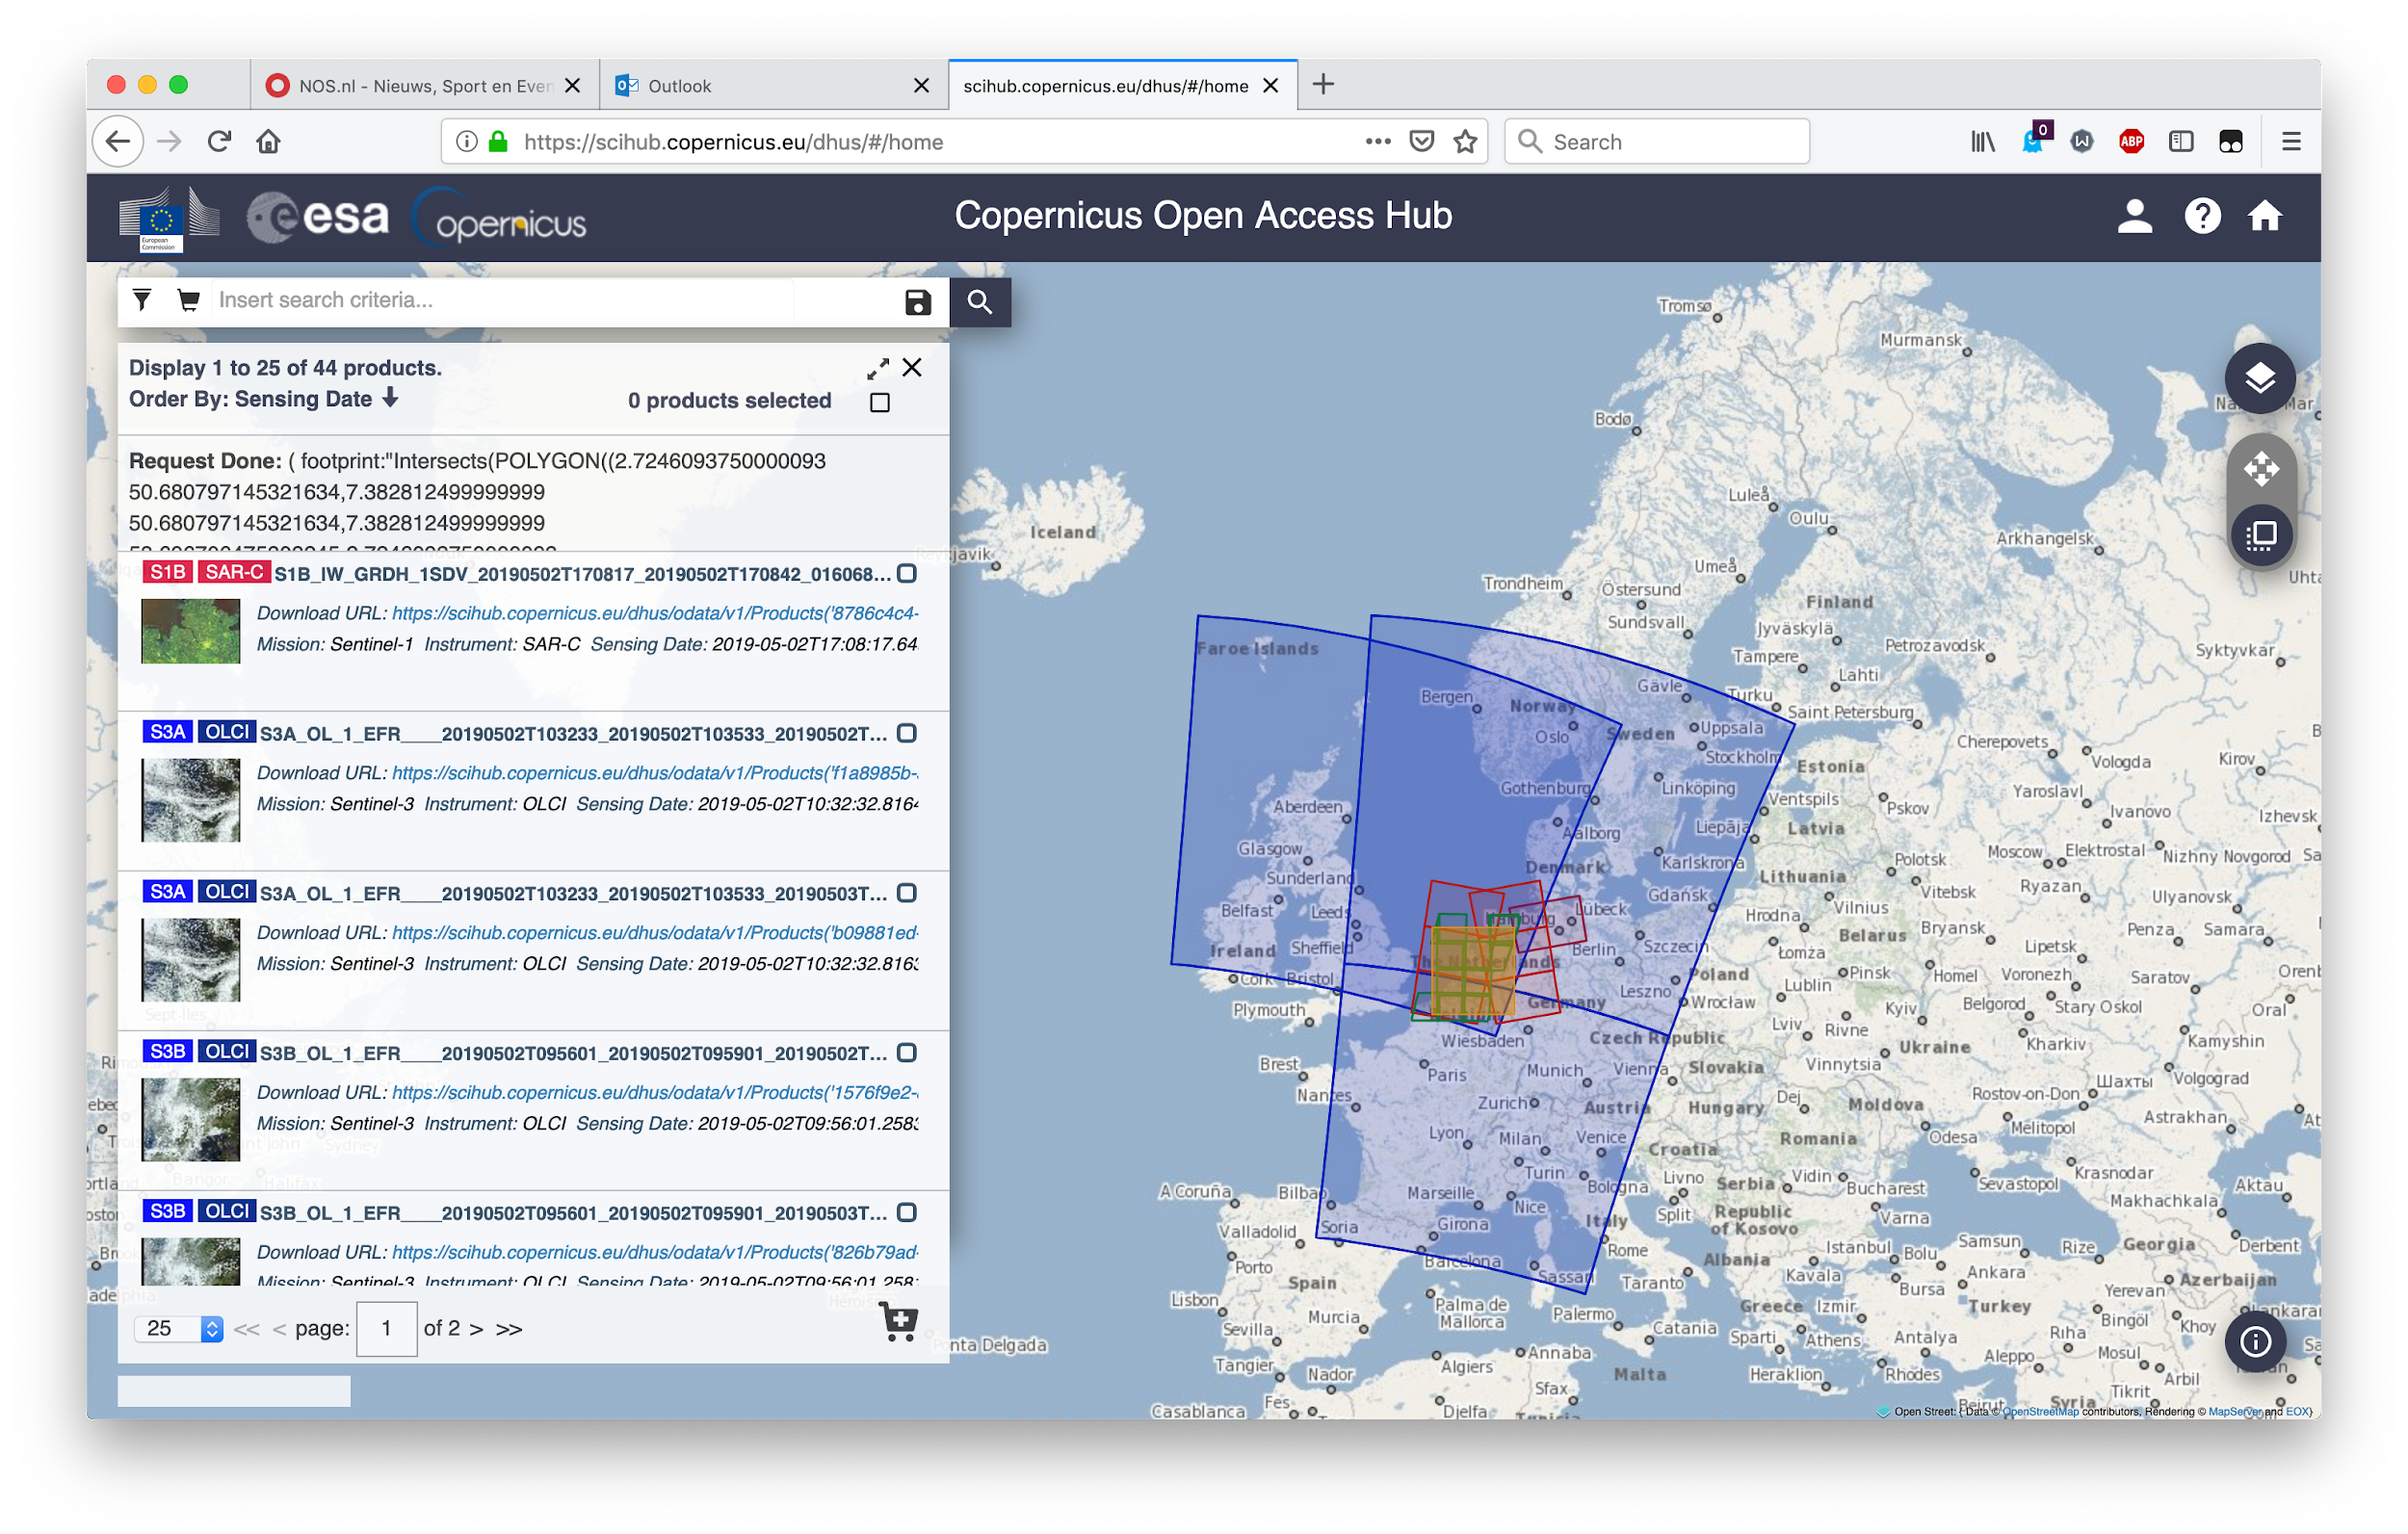

Slide 7
Rationale for EOSC
An obvious “Big Data Analytics” domain, but poorly served by consolidated European capacity
Until recently, BDA better served by AWS and Google Earth Engine, but Copernicus DIAS initiatives demonstrate feasibility of European catch-up.
European solutions tends to be fragmented, across thematic use, national audiences, user sectors. No concerted science community support.
European solutions are not state-of-the-art, don’t scale well, are not user friendly.
Europe does not have a consolidated plan to maintain the full data archive!

Slide 8
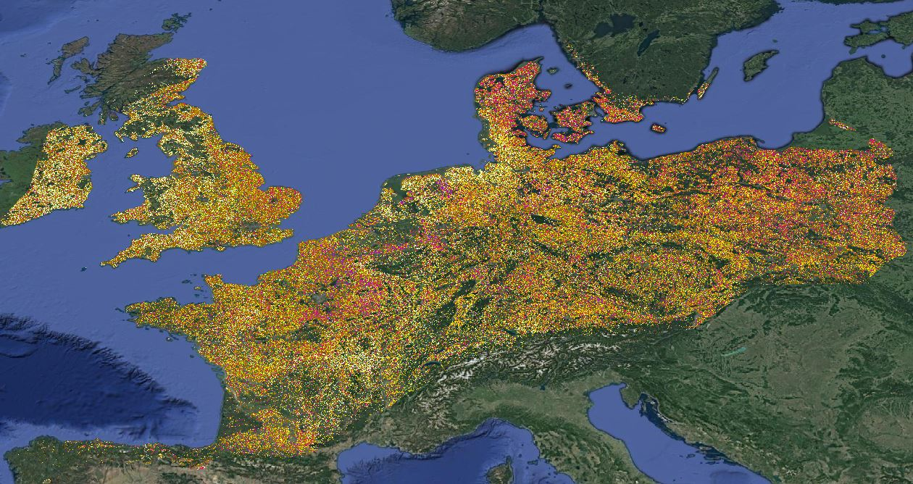
Continental scale crop classification
Using European Sentinel-1 data
Using European LUCAS 2018 survey data
On Google Earth Engine...

Slide 9
What’s a DIAS (the tech view)?
Object storage giving access to [partial] copies of the ESA scihub archive
An interface to find what is available on the DIAS
A platform to select and configure cloud resources for processing
Configurable processing to run in “front end” or “backend”
Documentation [on line, off line] on the various components and technical issues
Technical support for IT infrastructure and (through partners) EO specific issues

Slide 10
The “third party” profile
IT-wise DIAS is still very much a “barebones” Infrastructure as a Service (IaaS)
The “third party” needs to piece together the components to set up relevant functionalities, using DIAS resources
In the CbM context, this requires expertise in:
Linux virtual machine (VM) install and configuration (S3 store)
Spatial data bases
(Python) programming for geospatial analysis
VM “orchestration” for parallel computing (Docker, k8s)
Good news: all essential components are Open Source!

Slide 11
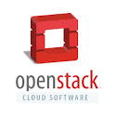
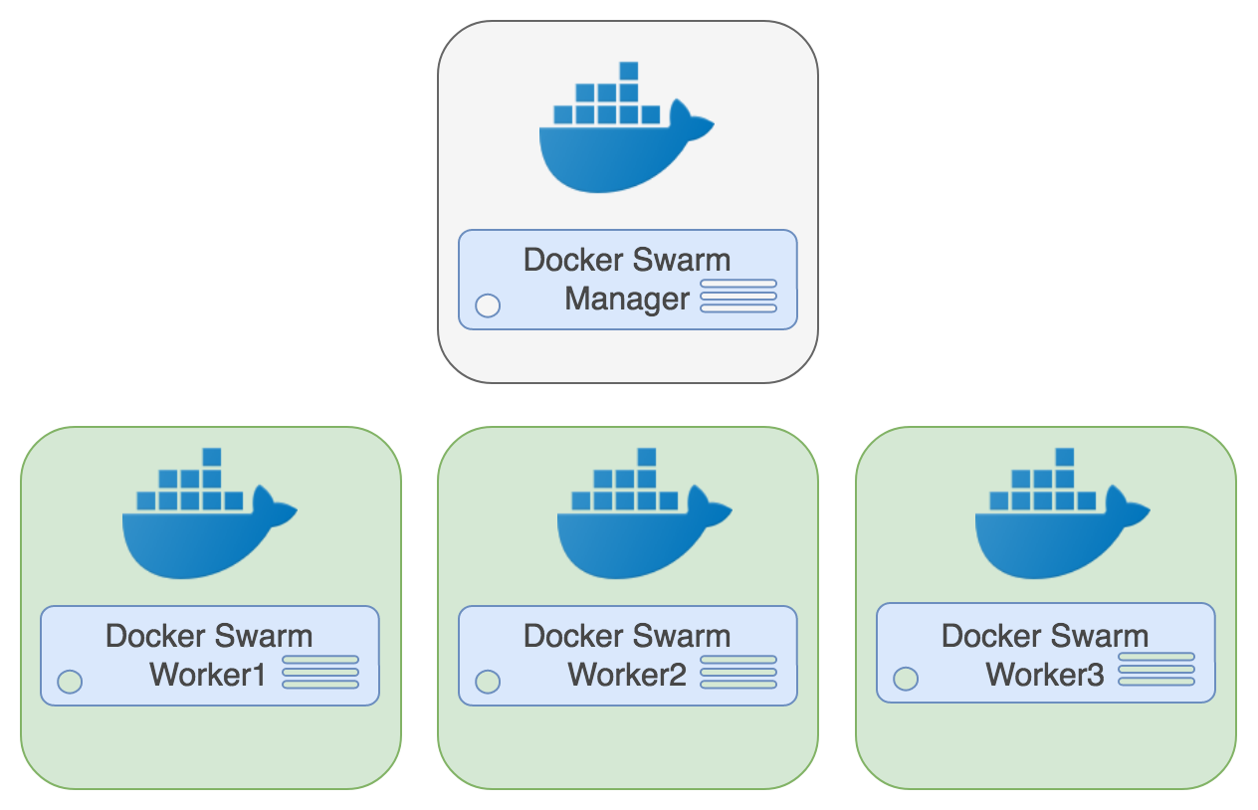
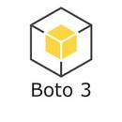
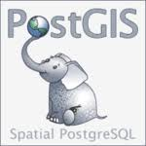
Open Source software components used in CbM DIAS pilots
Notes:
The Open Source components JRC uses in the DIAS pilots.
11

Slide 12
JRC focus
JRC takes the “third party” role on behalf of DIAS onboarders
Test commonality of DIAS platforms, portability issues, set up standard workflow, demonstrate key functions, initiate “knowledge transfer”
Includes:
full territory Copernicus Application Ready Data (CARD) generation (S1-BS, S1-C6, S2-L2A)
time series extraction for full annual agricultural parcel sets (2017, 2018, 2019)
machine learning, analysis and visualization
shared documentation and code

Slide 13
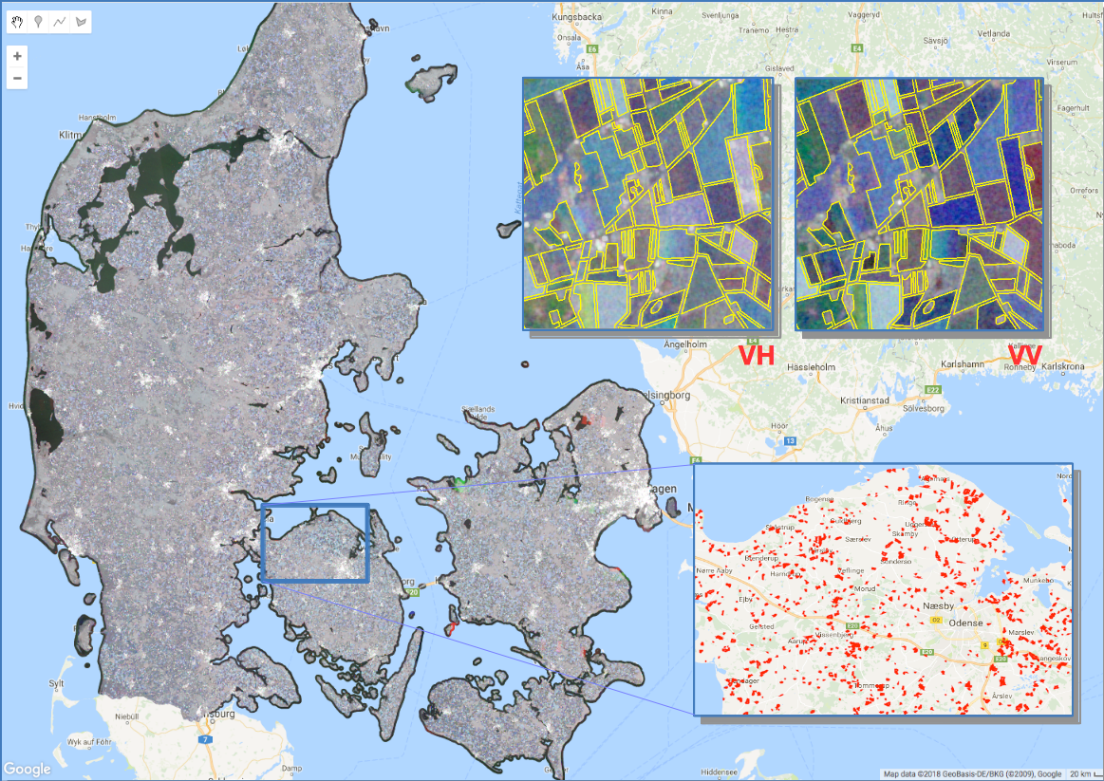
S1 provides consistency
(~200 images per year)
Machine learning applied to S1 weekly time series
Splits 95-5 “outliers”
Follow up with additional imagery (S2) and other measures
Runs on DIAS!
Notes:
Example “reduction” of S1 time stacks for use in machine learning.
13

Slide 14
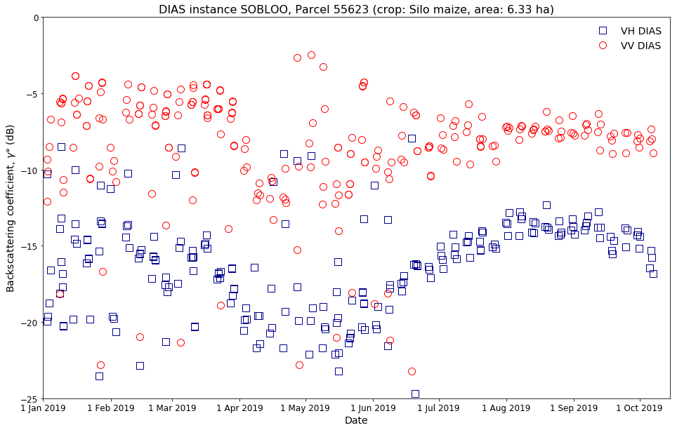
Big Data Analytics
Access to full time series
Extracted for 560,000 parcels
DK on SOBLOO
Similar for other MS-DIAS pairings
From CARD-BS
Notes:
For each of the CbM pilot countries, we can generate time series for any of the agricultural parcels, e.g. for Sentinel-1 calibrated geocoded backscattering coefficients (Level 2 derived from S1 GRD using the Sentinel-1 toolbox)
14

Slide 15
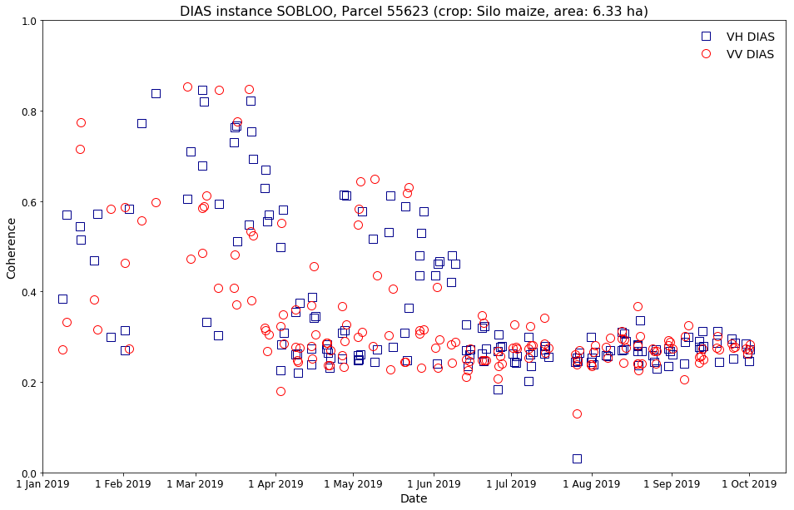
Big Data Analytics
idem
CARD-C6
(6-day coherence)
Notes:
For 6-day coherence, Level 2 derived from S1 SLC, using the Sentinel-1 toolbox

Slide 16
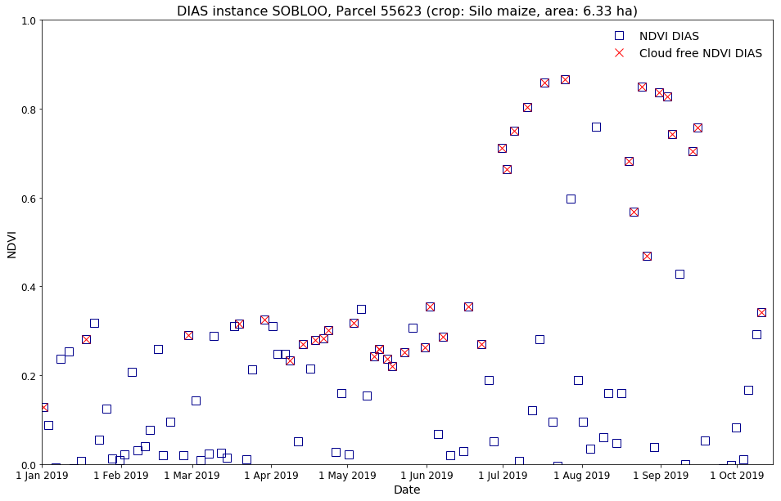
Big Data Analytics
idem
CARD-S2
(Level 2 S-2)
Optionally filtered on cloud cover
Notes:
...and Level 2A Sentinel-2 (atmospherically corrected by ESA using SEN2COR)

Slide 17
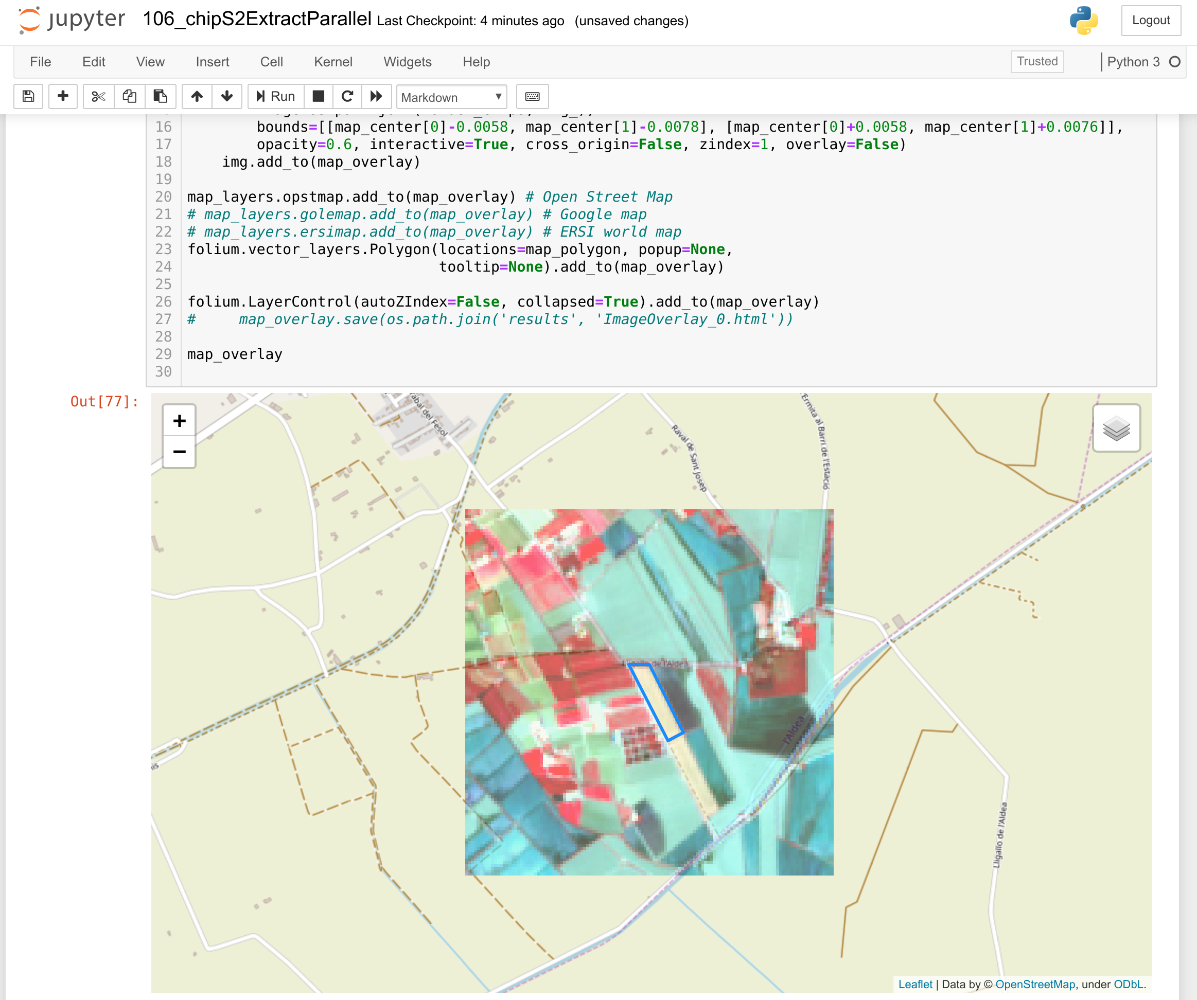
Big Data Analytics
Check an outlier
Identified with machine learning on S1 time series
Cross-checked against S2 chip for relevant part of the season
Notes:
In this slide, we show an overview of an outlier identified in a series of Sentinel-2 chips over the relevant part of the growing season.

Slide 18
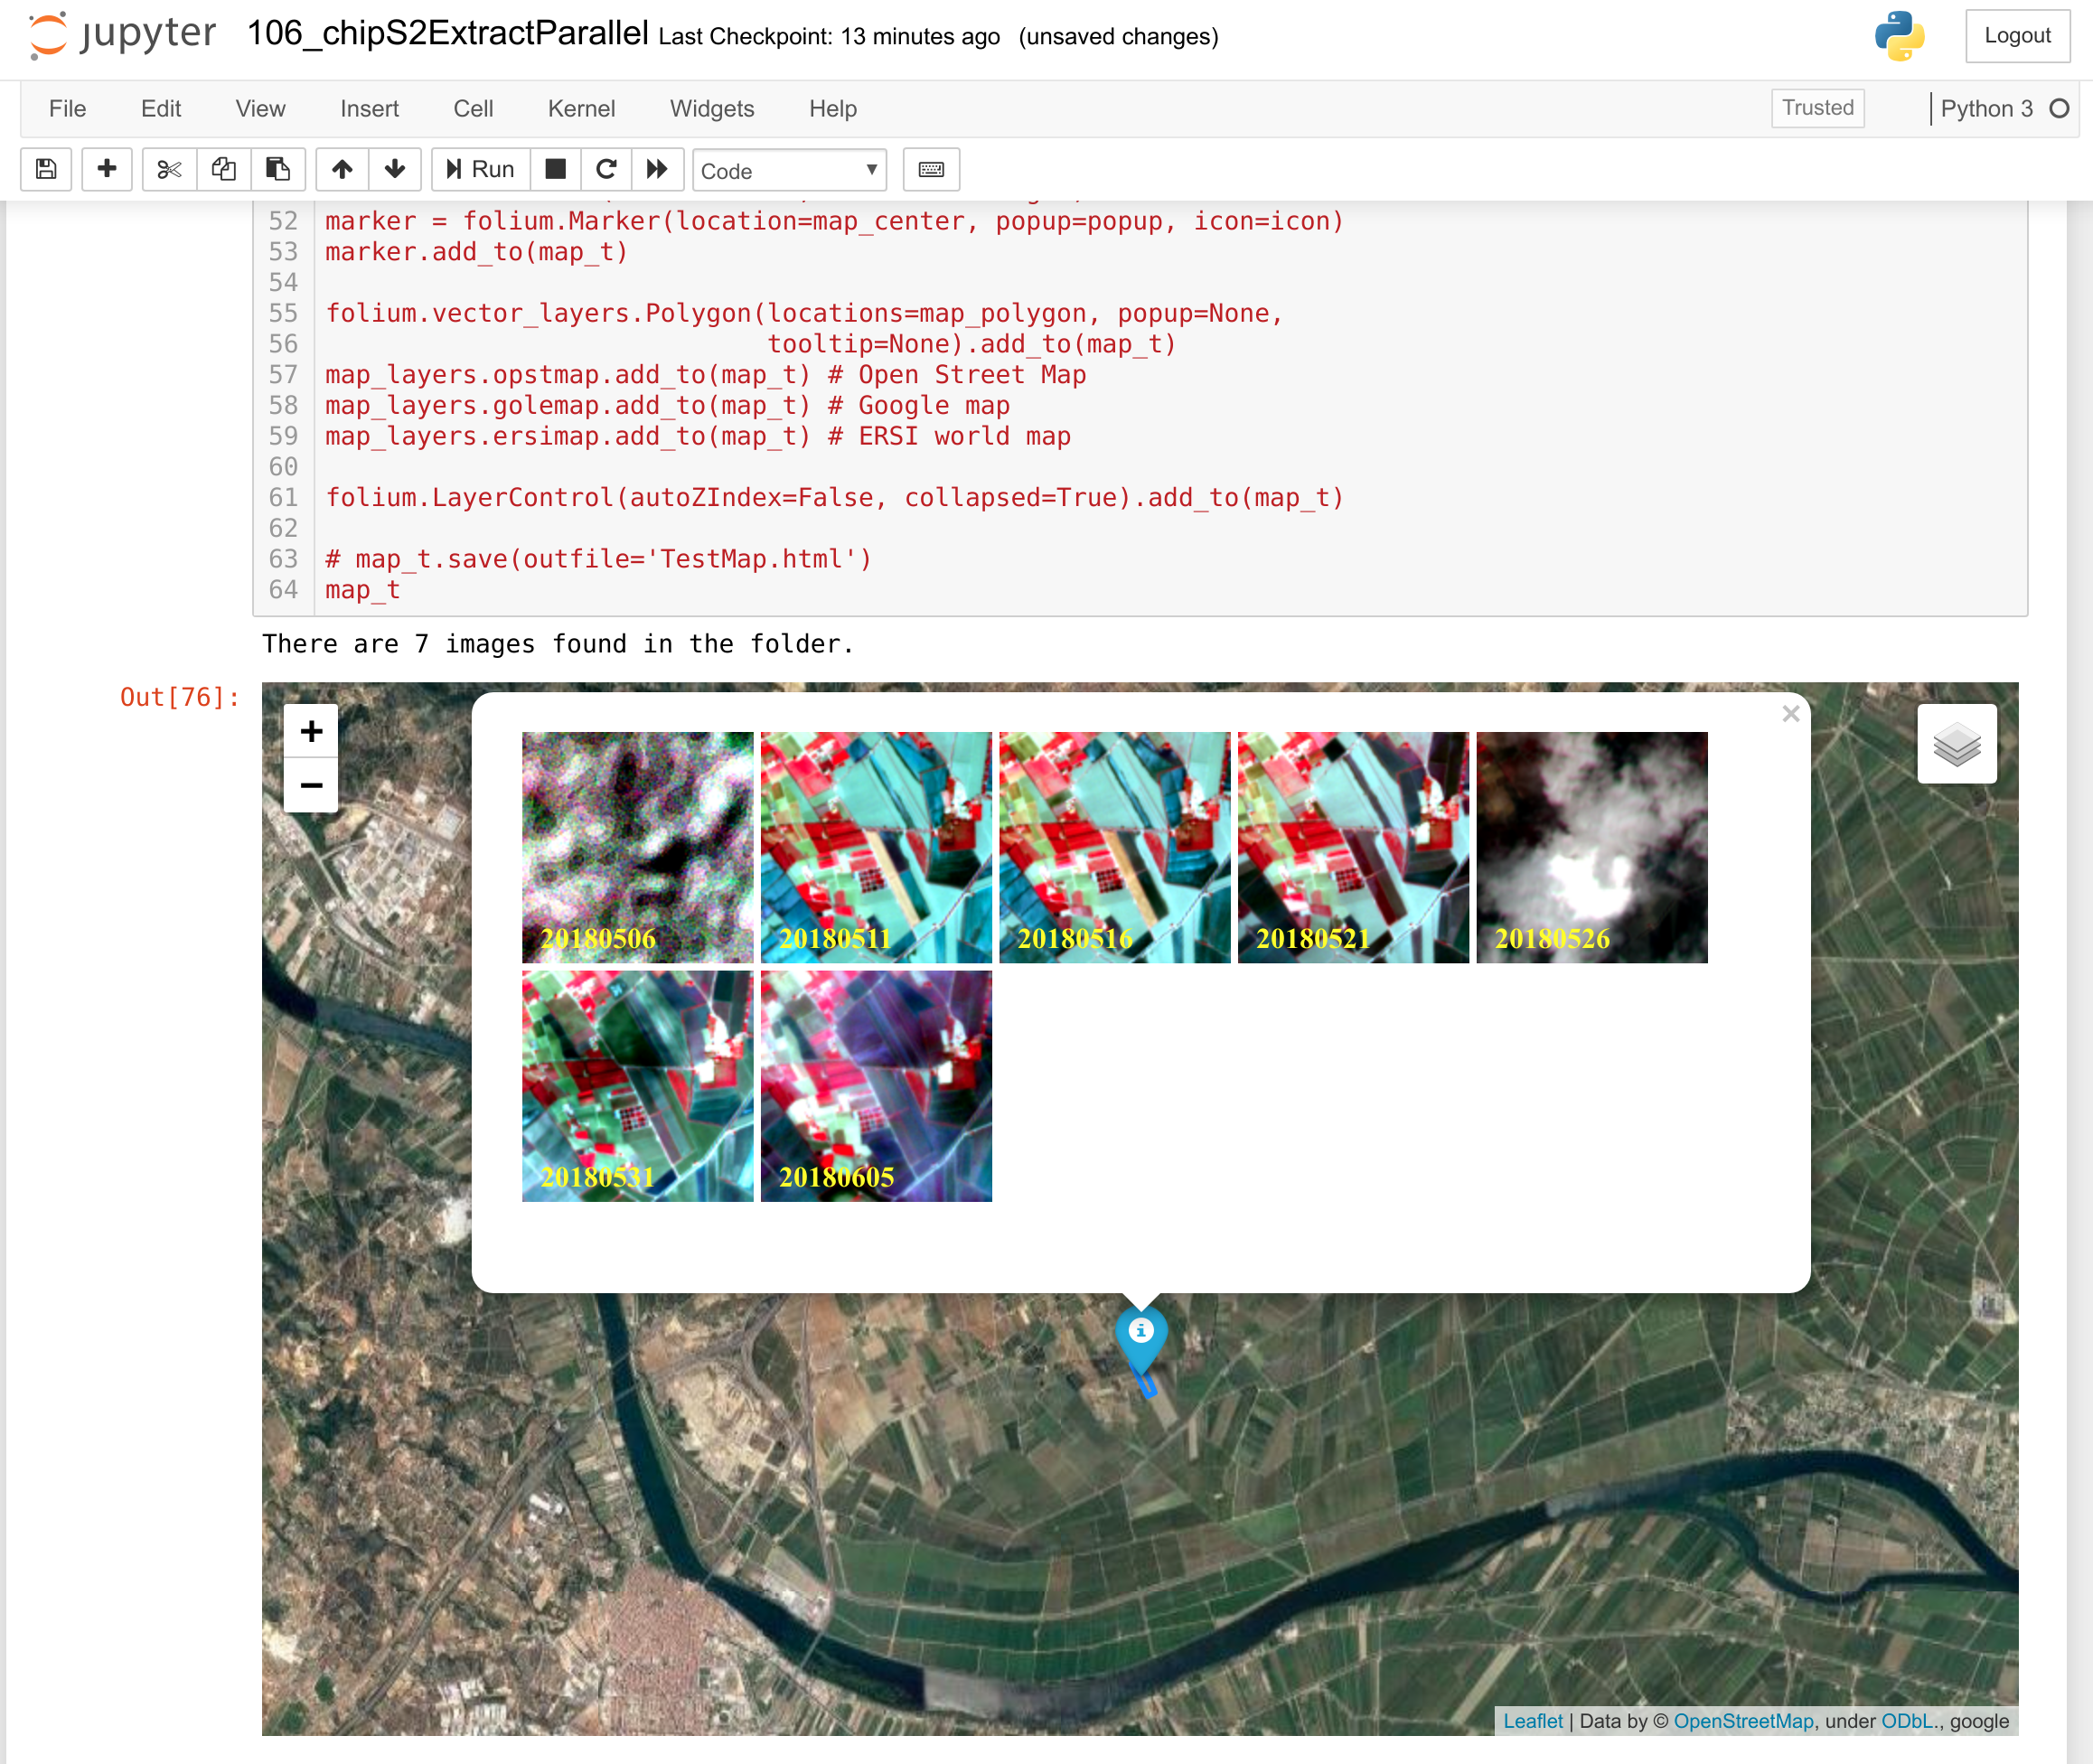
Big Data Analytics
idem
with time series of S2 chips
For any location in CbM coverage
For any CARD product
For full season
Combining Jupyter notebooks and parallel python
Notes:
In this slide, we show an overview of an outlier identified in a series of Sentinel-2 chips over the relevant part of the growing season.

Slide 19
Technical conclusions
Core functionality is mature enough to support operational data generation
DIAS portability issues are minor: all based on same core IaaS. Minor variation in components are abstracted in JRC code
Performance is scalable through resource marshalling, adequate for CbM
Role of a technically adept third party (or in-house expert) is essential
“Knowledge sharing” through common code/documentation one of the clearest benefits to DIAS onboarding. Allows rapid expansion (in 2020).

Slide 20
Costs factors
Cost factors for DIAS use include:
Access to Sentinel store (included in account)
CARD generation (a large VM back-end process + store)
Parcel extraction (a single, moderate size VM)
A database server (idem, but with large disk)
Orchestrated (per hour) use of multiple VMs for large parallel tasks
A notebook server for analytics, web map server
DIAS use is modular. Some components can be run on non-DIAS solutions or in-house (e.g. database), for cost control.
CARD generation is “generate once, use often”, e.g. in other than CbM (national) use contexts (e.g. environment, forestry, science, etc.)

Slide 21
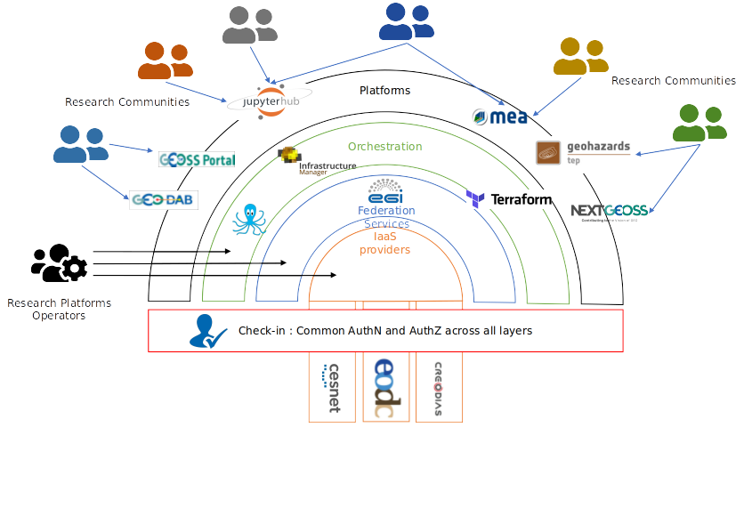
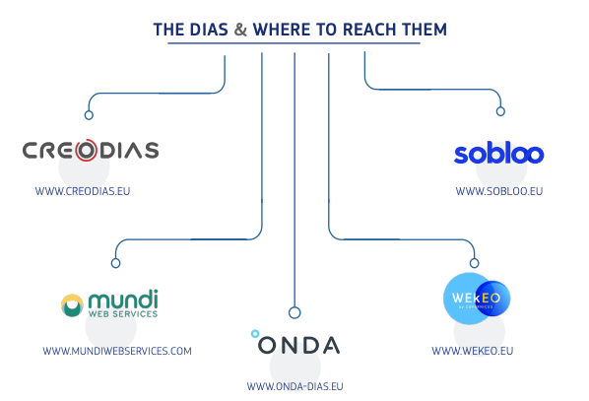
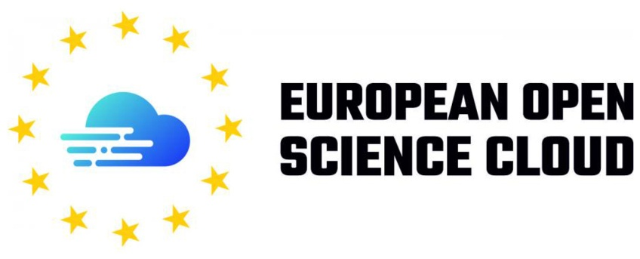

Slide 22
EOSC for EO Science Community
Become the permanent host of the on-line long term archive of Sentinel data
Closely coupled with cloud computing infrastructure
Federating existing initiatives (CollGS, DIAS, TEP) into a sustainable platform
Benefit from expertise in other EOSC Big Data user communities for cutting edge structured data access, massive parallel processing, and intelligent APIs
Leverage leading European Open Source solutions in geospatial data analysis into a scalable computing infrastructure, with novel remuneration concepts
Bring the added value of EO data into wider [science] community of [non-space] users, through open science data sharing and education.

Slide 23
EAP focus
Demonstrate “generate once, use often” amongst different user domains
Demonstrate regional (NL & NRW) and cross-domain benefits
Pilot elements of EOSC as the permanent Long Term Archive
Look into “low hanging fruit” improvements to storage and compute
Build out the Big Data Analytics functionalities in Jupyter notebooks
Document, code, tutorials
Notes:
FWC financed by DG AGRI (not GROW). DIAS spent most of their resources on core archive and infrastructure. Until now, they have done little to look into advanced solutions (they have few incentives to do so). This can only be done inside the federated EOSC. DIAS is a natural extension of a federated EOSC. ESA no longer maintains an on-line access to the LRA.

Slide 24
Thanks!
Any questions?
Contact pavel.milenov@ec.europa.eu guido.lemoine@ec.europa.eu

