Slide 1
OMB February 2020
Matthew Viljoen, Operations Manager
EGI Foundation

Slide 2
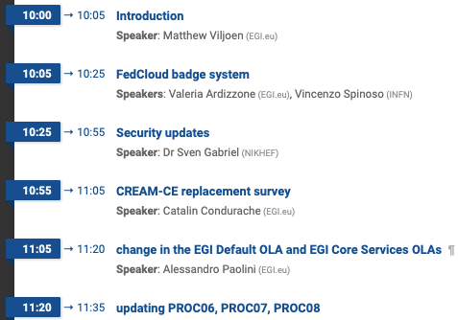
Agenda

Slide 3
Centos8 in UMD
Current support situation
CentOS8 published first release in September 2019, about 10 years lifetime ahead
CentOS7 remaining lifetime is about 5 years
SL6 to be retired end of this year
Actions
Prepare new UMD5/CentOS8
Preparing UMD5 to host also CentOS7 (only products that offer a maintenance period for CentOS7 over the next years)
Planning retirement of SL6
Need to contact all the Product Teams one by one to get a clear statement about the support calendars
Everything tracked on https://wiki.egi.eu/wiki/Next_middleware_release
Note
Move from YAIM to Ansible/Puppet. To be discussed at EGI Conference
Notes:
with retirement of sl6, yaim will no longer be distributed

Slide 4
OMB and WLCG GDB
OMB includes ops tools requirements gathering & roadmap validation
Limited WLCG participation at OMB
From 2020, will actively use GDB to ensure ops tools meet WLCG requirements

Slide 5
Future events
EGI Conference 2020 23-25 June, Lyon
F2F OMB
Service Delivery Annual Plan
NGI International Liaison
CondorCE training
EOSC-hub Week 2020 18-20 May, Karlsruhe
Notes:
in2p3
eosc-hub week – inc. archtecture, rop, spf & tech workshops

Slide 6
Next OMB
23 Apr 2020 (3rd Thursday of the month)
To be confirmed on ML

