Slide 1
Making Fusion Data FAIR as a prerequisite to using Open Cloud Resources
Authors : Marcin Plociennik (PSNC) Shaun de Witt (UKAEA) Frederic Imbeaux (CEA) David Coster (IPP) Par Strand (Chalmers)
This slide set is released under CC-BY-SA-4.0

Slide 2
Background
The EOSC provides potential opportunities in terms of scalability and flexibility which have never previously been available to European researchers, including those involved in the fusion community.
For Fusion community, the uptake of resources provided by the cross infrastructure projects, including those provided by EGI and EUDAT has been hampered by a number of policy, political and infrastructure related issues.
Recent drives by EUROfusion and some national funding agencies are starting to bridge these issues.
The potential use of external HPC and cloud resources offer the community access to larger scale and newer technologies.
Increased uptake of cloud facilities making use of the planned FAIR data portal for Fusion is being investigated

Slide 3
Context and activities
Several recent initiatives to bridge Fusion community and EOSC ecosystem
EOSC-hub Fusion Competence Center to evaluate selected data management technologies and AAI
Pilot of B2* and OneData services
Use of containerized IMAS (ITER Modeling and Analysis Suite) environments
Testing fusion workflows on the cloud – using uDocker and Singularity
EOSC-Pilot use case related to cloud compute technologies uptake
Prominence service which is now available through EGI via the EOSC marketplace
EUROfusion AAI pilot – to pilot selected Federated AAI technologies
FAIR – Fair4Fusion project – to work on FAIR related issues -> focus of this presentation

Slide 4
Fusion vs other Big Science
Where are my data?
Which flight do I need
to get access
experimental data?

Slide 5
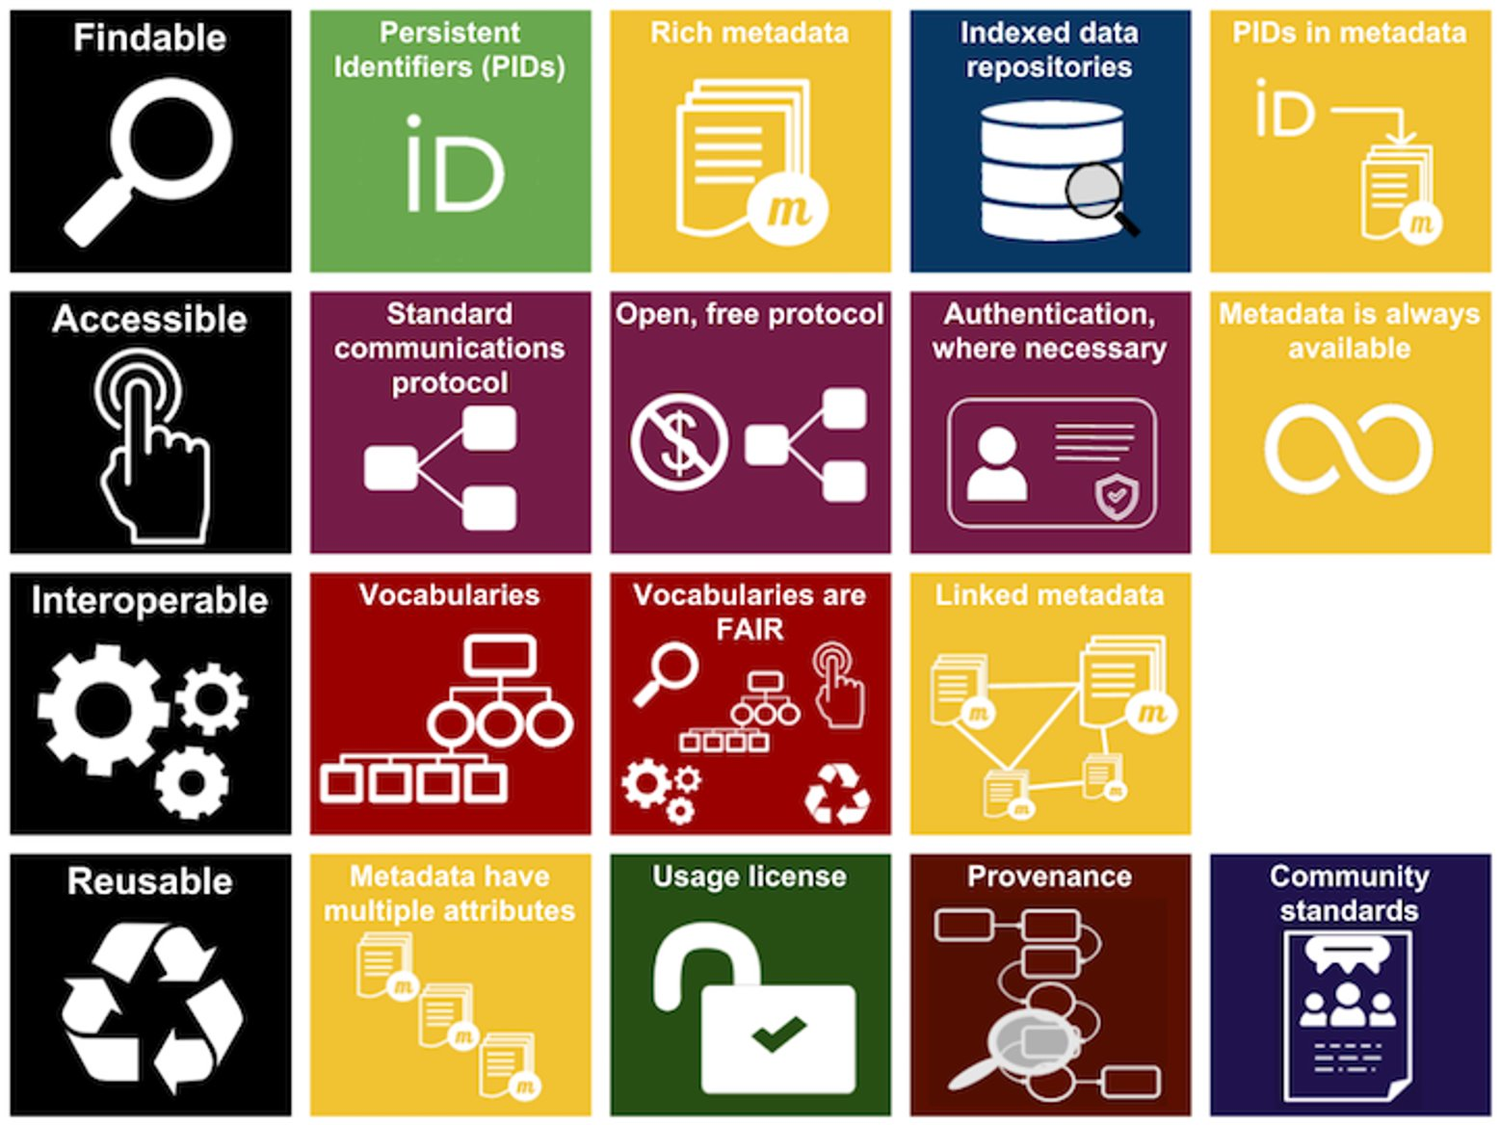
Where does Fusion sit in FAIR?

Slide 6
Fair for Fusion – Open Access for fusion data in Europe
Project duration: 24 months
(2019-2021)
Total budget: € 1 987 960
In Fair4Fusion we work on: Comprehensive assessments of FAIR data requirements and open data issues in fusion programme Recommendations on the best technical approaches for providing access to data Development of support platforms and tools required to implement an open data policy adapted to the needs of the fusion research programme. Pooling the talent and knowledge from big science programmes and organisations With the objectives of: Further developing tools and platforms needed for an open data approach. Raising the profile and awareness of FAIR and open data within the fusion programme. Laying the foundations for implementing an open data policy adapted to the needs of the present and especially the future fusion energy research programme, particularly in the run up to the operation of ITER from the middle of the next decade.
Consortium: 7 partners
Project website: https://fair4fusion.eu/

Slide 7
Fair4Fusion ambition
F4F
The Magnifying glass, Tap, Gears set, Recycle sign, Storage, Infinity, Discussion, Shield, and Man User icons made by Freepik from www.flaticon.com are licensed by CC 3.0 BY. All other icons made by ARDC. Entire FAIR resources graphic is licensed under a Creative Commons Attribution 4.0 International License
we have addressed issues of community standards and metadata always available and linked metadata in year 1

Slide 8
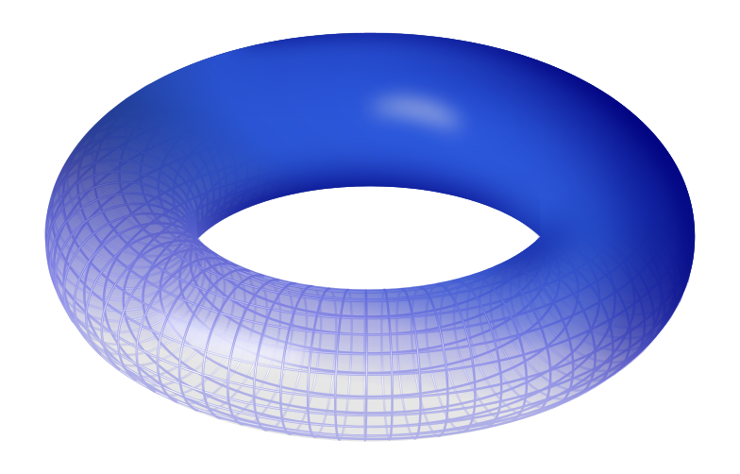
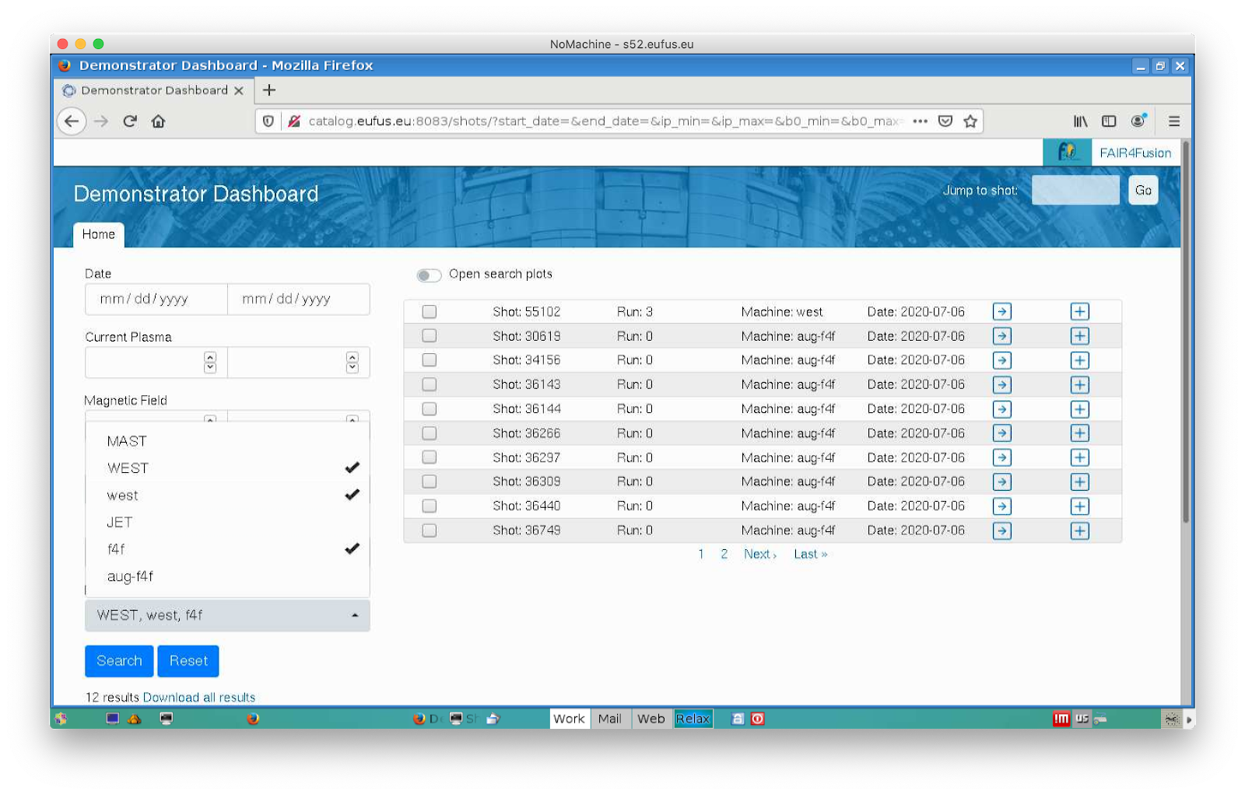
Goals outputs: Fair for fusion innovation
F4F
Torus Image © Leonid_2. licensed under the Creative Commons Attribution-Share Alike 3.0 Unported license

Slide 9
Expected outputs: Fair for fusion innovation
Develop Tools and Platform needed for an open data approach
Evolving existing data towards FAIR data compliance
Tools and platform to demonstrate the benefits of FAIR
Increase Trust in data by including relevant provenance information - a well-defined metadata schema
Allow for easy cross site data identification and access, with a flexible approach to data delivery.
Raise the profile and awareness of FAIR data within the fusion program
Lay the foundations for implementing an open data policy particularly in the run up to ITER
Ensure policies meet both FAIR requirements and data is ‘as open as possible, as closed as necessary’
Ensure the architecture meets user requirements in terms of scalability, flexibility and ease of use.

Slide 10
Project approach
Requirements, Policies and Data Landscape
Blueprint Architecture
Demonstrators
FAIR Components
Components development
Technology Evaluator

Slide 11
Data Identification and Policy Landscape
Existing experiments have some internal degree of FAIRness
But not across the EU fusion community
Need a way to make scientific analysis (i.e. metadata and data) interoperable across multiple fusion experiments.
Benefits not only for manual database queries
but would also enable the use of new methods of research with Data Mining and Machine Learning techniques at an unprecedented scale
The IMAS Data Dictionary is recommended for achieving interoperability within the community.

Slide 12
Use Case Definitions
Developed with fusion researchers and members of FAIR groups
76 user stories identified so far
Covers
Security
Data Access
GDPR
Searching & Querying
Experimental Impact
Visualisation
Who
Fusion scientists / data scientists / members of the public
What
scalar data / 1-d data / 2-d data / structured data
Limitations
usually from the data providers (GDPR, no impact on operations, cost)

Slide 13
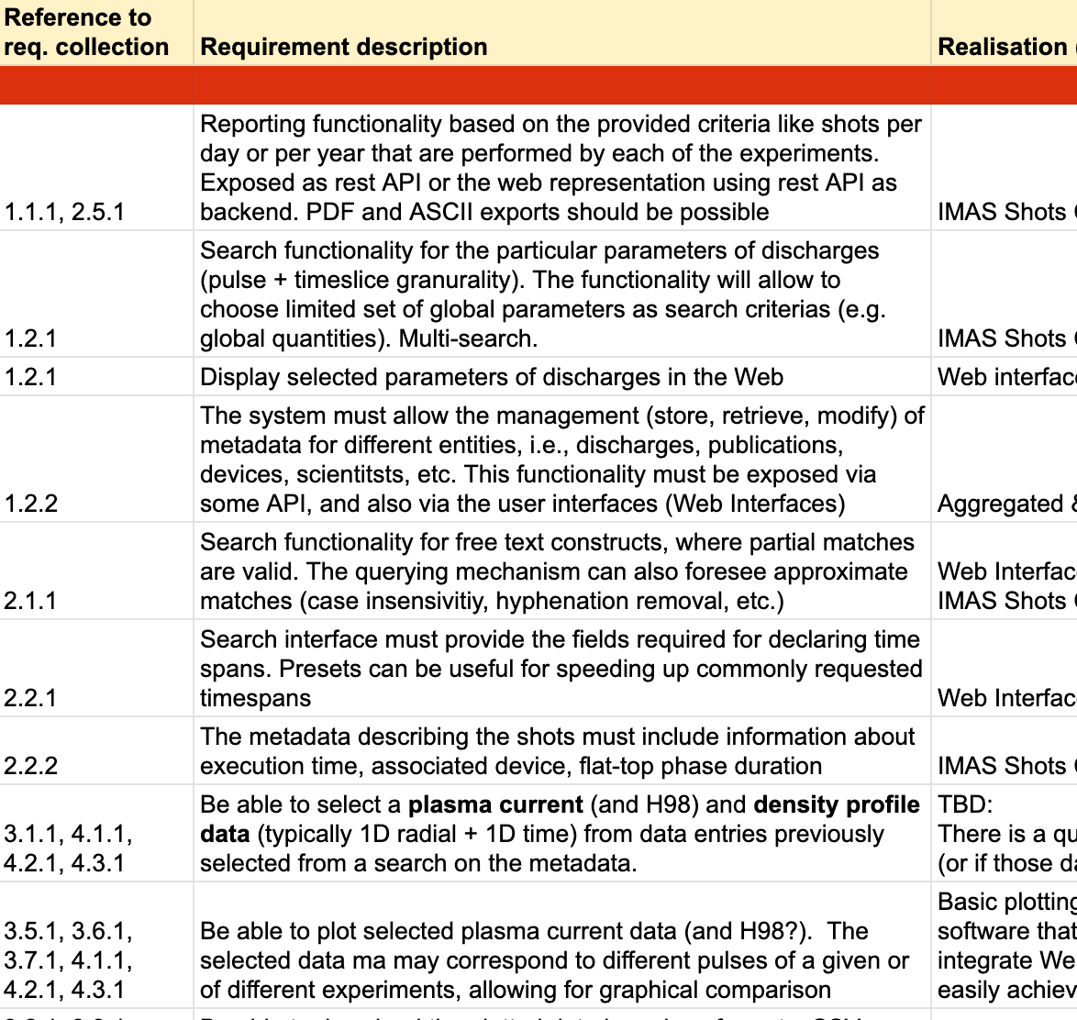
Requirements Specification
Converting the use cases and user stories into a list of the technical requirements specification
99 requirements
Requirements used for prototype planning and blueprint architecture
Definition of the functionalities in the blueprint
44 functionalities grouped into 11 categories

Slide 14
Functionalities list - categories
F1 Search
F2 Visualisation and accessing outputs
F3 Report generation (output metadata resulting from the Search)
F4 User Annotation Curation Management
F5 F4F Metadata Management
F6 Subscriptions and notifications
F7 Versioning and provenance
F8 Authentication
F9 Authorization/Access restrictions
F10 Accounting
F11 Licensing

Slide 15
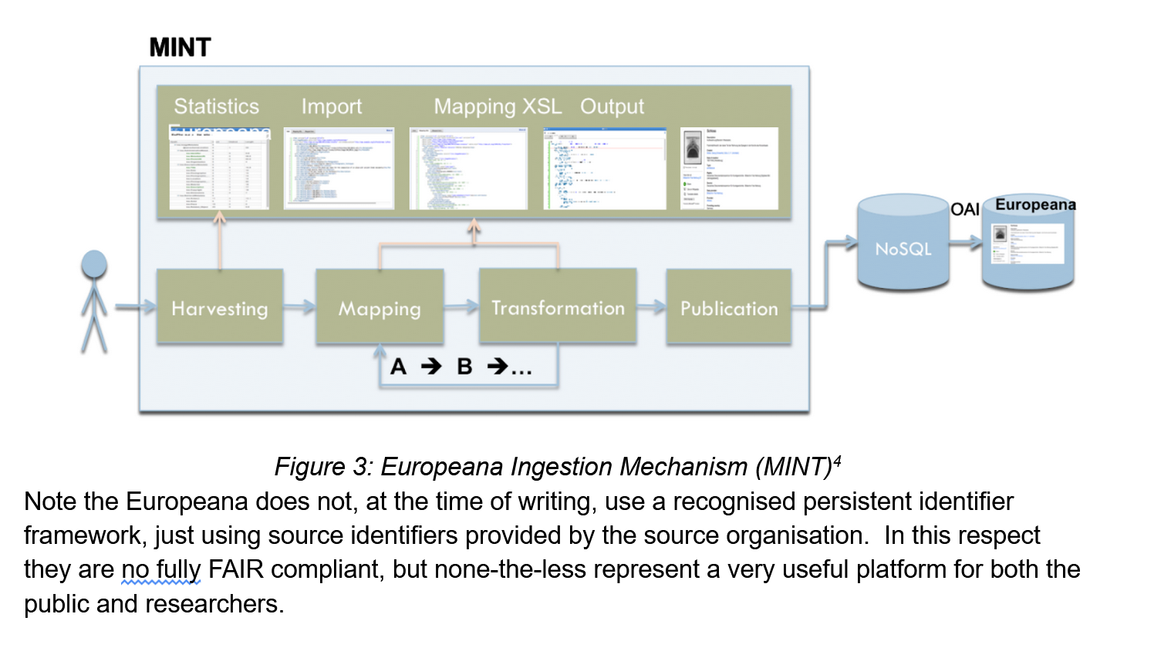
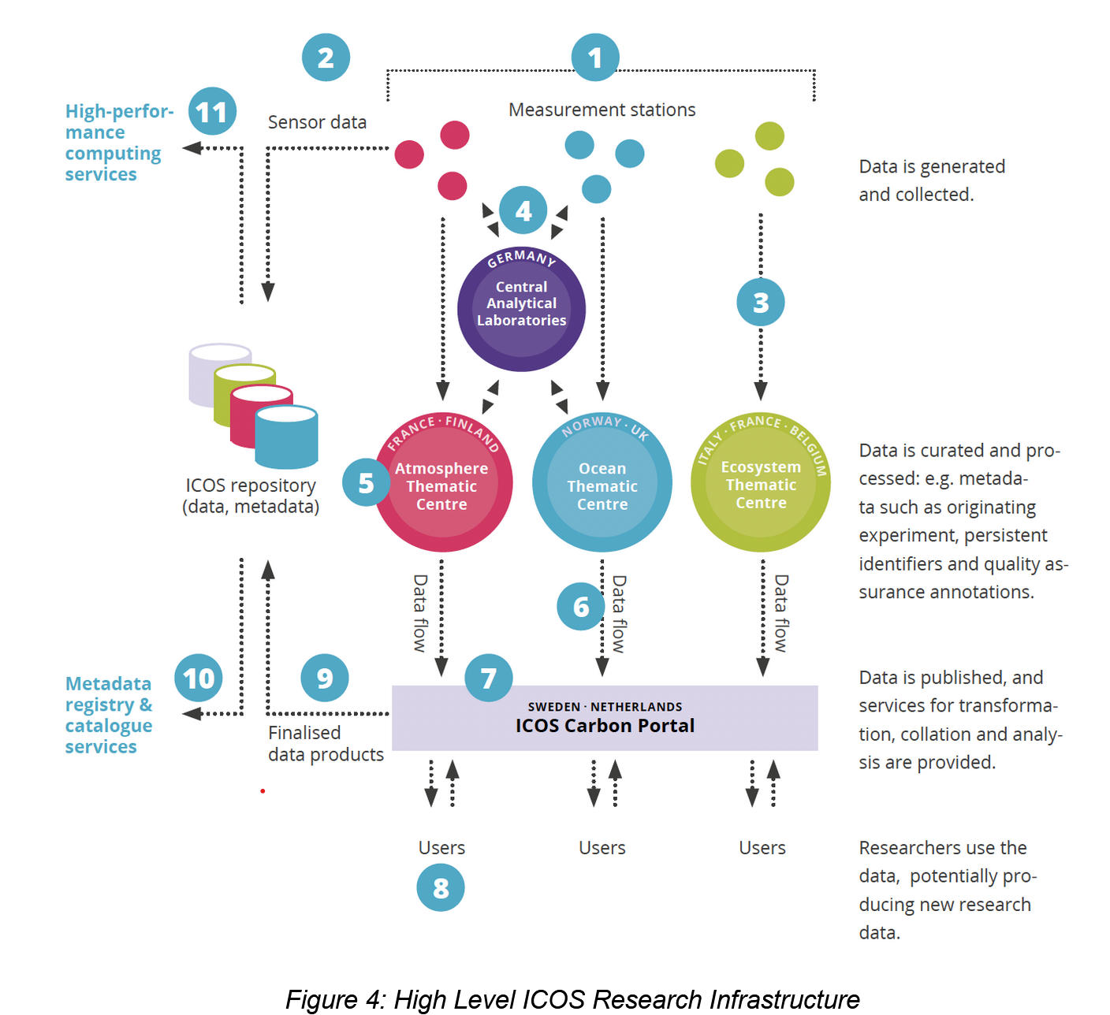
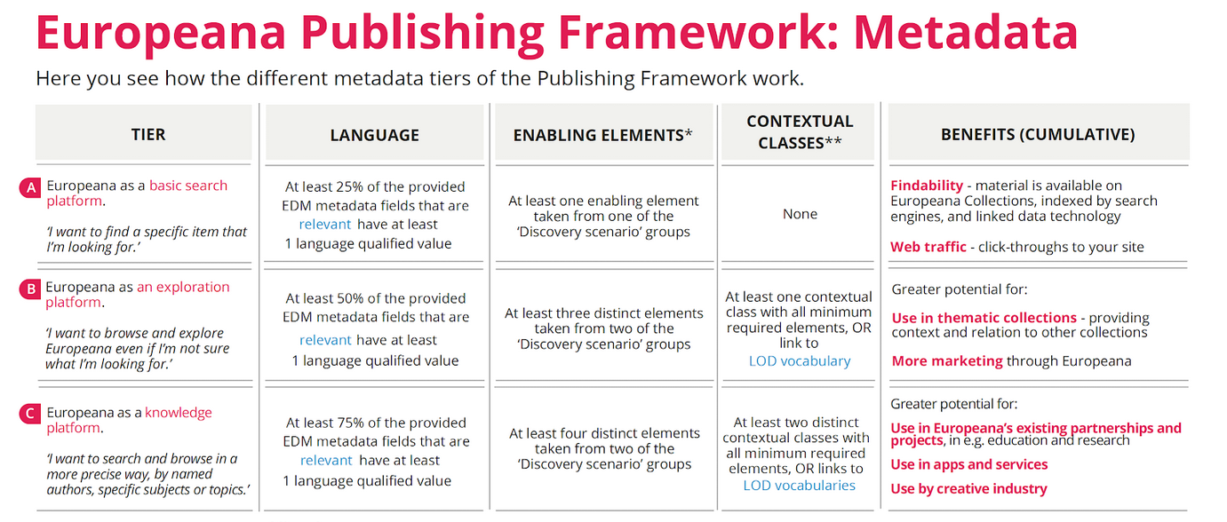
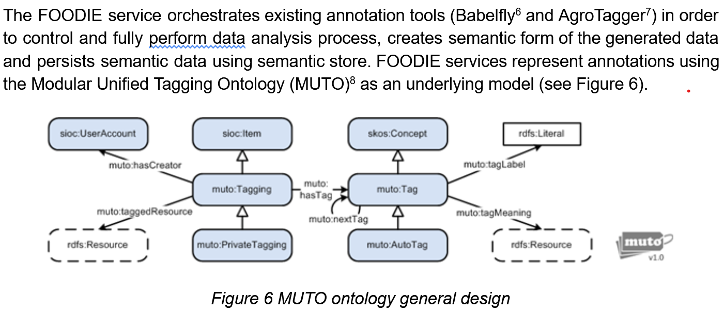
Investigation of other platforms
An investigation of other FAIR platforms and their architectures to look for reuse opportunities.
CLARIN
EUROPEANA
ICOS
FOODIE
ROHUB
EVER-EST
EOSC Eocystem Projects

Slide 16
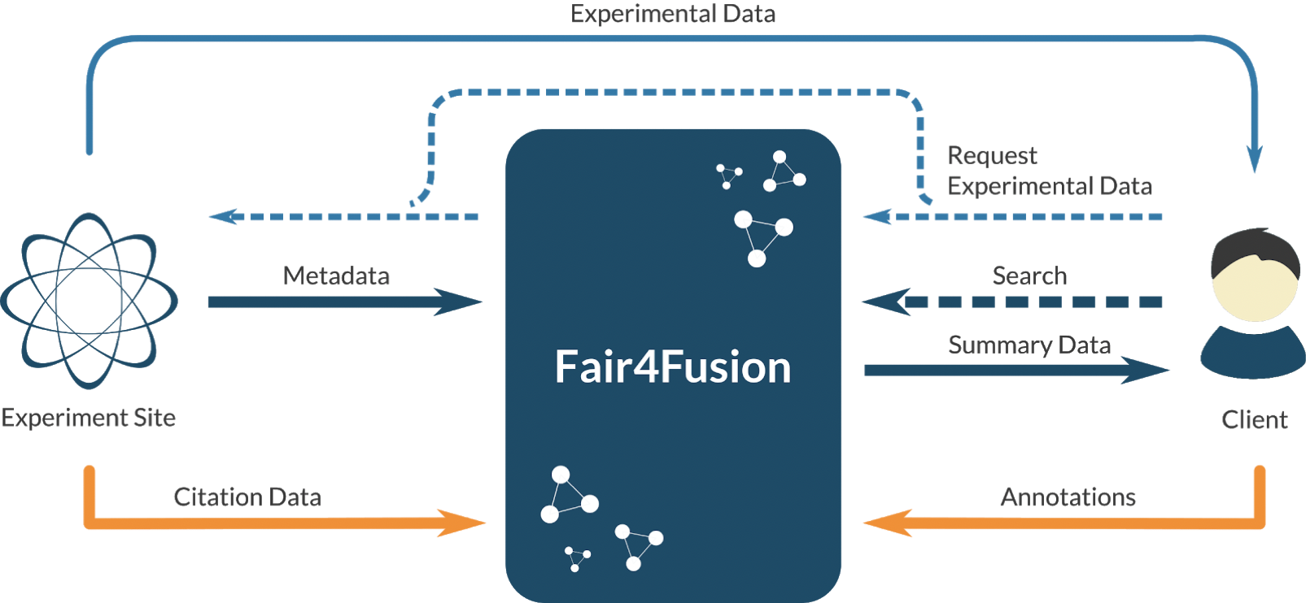
Architectural Blueprint for Fusion Open Data Framework
The architecture of the pilot implementation
Long term Blueprint architecture for Fusion Open Data Framework
Blueprint content (current status):
Fusion background, experiments
Current state of the art – policies and data access, fairness
User stories , requirements, list of functionalities
Architecture
Baseline architecture
Components
Relationship, standards, protocols
Initial technological options
Draft available for comments:
https://shortly.cc/nlQhJ

Slide 17
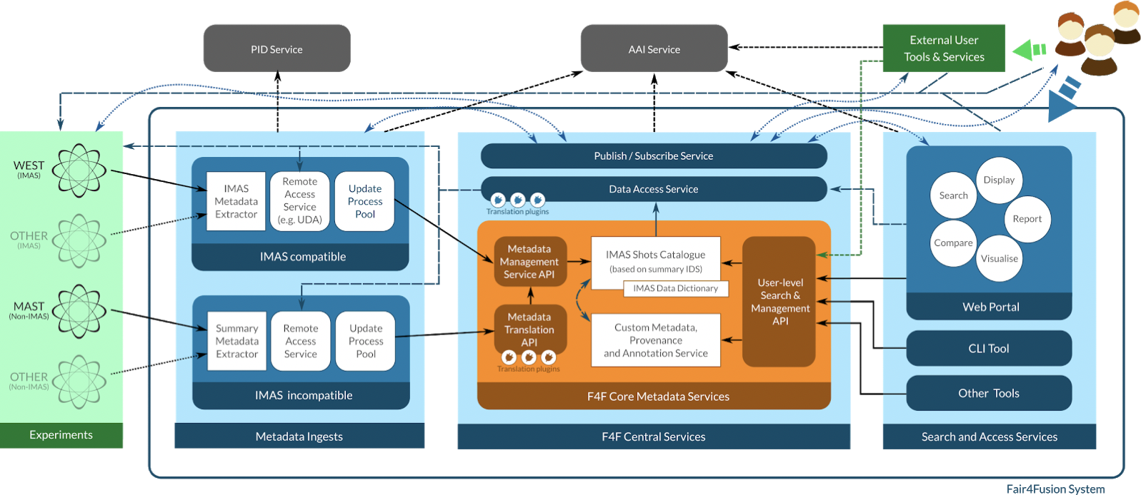
Draft Blueprint Architecture

Slide 18
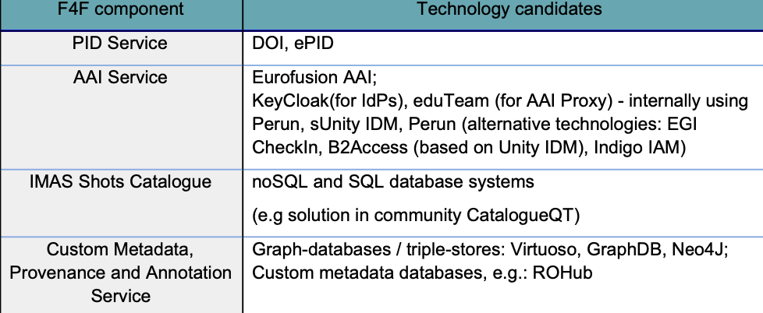
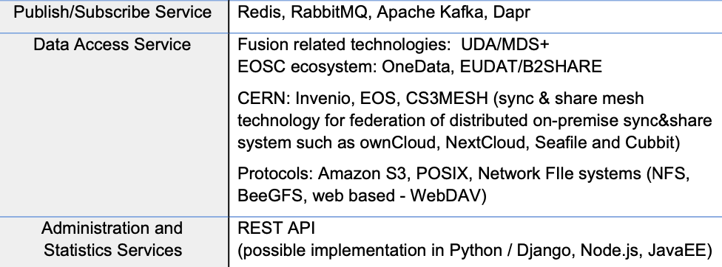
Technology Survey and Evaluation
Conducting a technology survey of existing technologies and open data platforms and their designs to assess their suitability for use in the fusion community
Iterative process
Initial feedback for the demonstrators
Evaluation of the selected solution against the user requirements and the FAIR principles
Result:
Report describes the details of the technology survey,
Initial technology table have been included into the Architecture Blueprint

Slide 19
Metadata Standards and Ontology Mapping
Agreed to use Summary IDS as basis for physics metadata schema
IDS structures already based on extensive discussions with the community
Augmented with elements from Dublin Core to support FAIR
Gathered list of existing fusion glossaries
Which sort of highlights the issue with developing a Ontology
Investigating use of OAI-PMH for harvesting
…but looks like a ‘push’ model from experimental sites is more suitable

Slide 20
Data Interoperability 4 FAIR and Open Data
Investigated different PID solutions and obtained relevant costings
Demonstrated interoperability of DataCite and Handle systems
Proposed recommendations on granularity at which they could and should be applied
Shot/Pass level strongly recommended for interoperability
Other levels at site discretion
Investigating long term funding sources

Slide 21
Standardised Models of Provenance
Proposed modelling provenance in W3C PROV
Started mapping existing MAST provenance data to PROV
Highlight gaps
Identify areas for improvement
Gathering information of provenance information at other sites
Develop tools to allow easy mapping between existing practices and PROV
Create a template in machine readable format which sites can fill in existing PROV information and integrate into processing chains

Slide 22
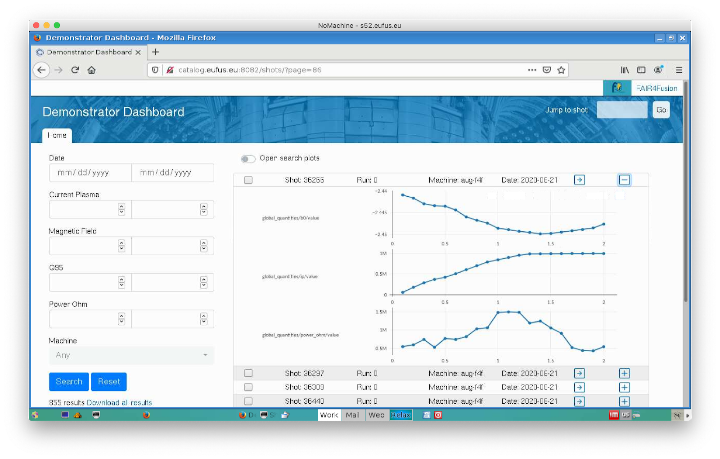
Fair4Fusion Demonstrators
Two different demonstrators to prioritise different technologies and approaches (presented during previous session ;) )
Demonstrator #1
Data and metadata ingestion from various sites
Based on re-use of existing components
Use of IMAS and EUROfusion Gateway
Using Federated AAI
Demonstrator #2
Alternative metadata representations
Alternative visualisation frameworks
Search technologies

Slide 23
Summary
Big step forward for the community towards FAIR and Open Data
EOSC ecosystem technologies, services and best practices as an inspiration
Looking forward to feedback from EOSC community on the Blueprint Architecture to validate correctness of approaches
Still to do…
Data access from the portal – looking into EOSC technologies
Demonstrate data subscription service so downloaders get a notification
Actually get a PID service up and running for the community
Complete blueprint architecture

Slide 24
Questions?
For more please follow us on social media and check the web site for project updates
https://www.fair4fusion.eu
@fair4fusion
https://www.facebook.com/Fair4fusion
https://www.linkedin.com/company/fair4fusion

