Slide 1

Workflow Orchestration on Tightly Federated Computing Resources: the LEXIS approach
EGI 2020 Conference
Nov 2nd, 2020
Workflow management solutions
Marc Levrier (speaker, ATOS)
ALBERTO SCIONTI (speaker, LINKS)
Notes:
Cover Page

Slide 2
LEXIS overview

Slide 3

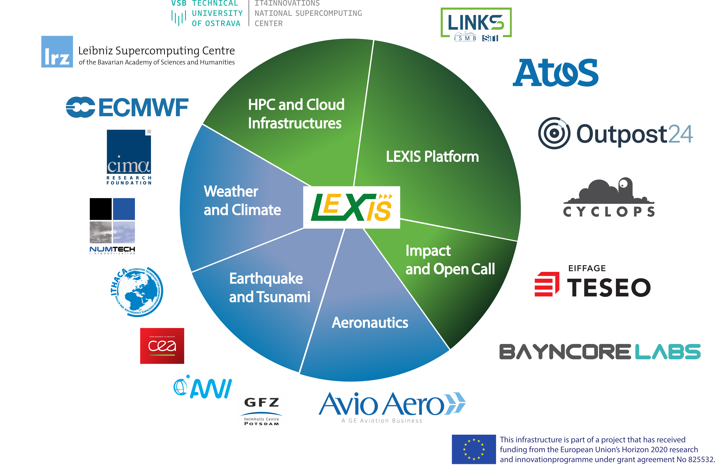
Lexis consortium
At the confluence of HPC, Cloud Computing & Big Data
Large-scale EXecution for Industry & Society
HPC & Cloud resource providers
Scientific institutions
Industrial companies
Information Technology providers

Slide 4



LEXIS PILOT PROJECTS
General information - https://lexis-project.eu/web/
Aeronautics
Computation Fluid Dynamics (CFD),
Rotating parts (gearboxes),
3D Visualization
Earthquakes & Tsunamis
Earthquakes & Tsunami prediction models, geographic and urban databases, emergency organization, urgent computing
Weather & Climate
Weather & Climate models (WRF) and various post-processors for flood, wildfire & agriculture applications

Slide 5
WORKFLOWS & Orchestration in the lExis federation

Slide 6
WHY workflows and Orchestration?
Motivations and drivers
Aeronautics
Need to assess usability of cloud HPC platform for new engineering methodology (workflow) involving modern CAE tools and accelerators for improved accuracy in CFD applied to aviation gearboxes.
Earthquakes & Tsunamis
Automated execution of urgent computing tasks, event-triggered & deadline-dependent simulations for short-term forecasts, near-real time analysis
Weather & Climate
Inherently hybrid cloud/HPC. Urgent simulations when one computing centre is unavailable, large-scale data assimilation (e.g. from sensor networks) for better prediction, use of specific Weather and Climate Data distributed data management solution & general purpose LEXIS DDI

Slide 7
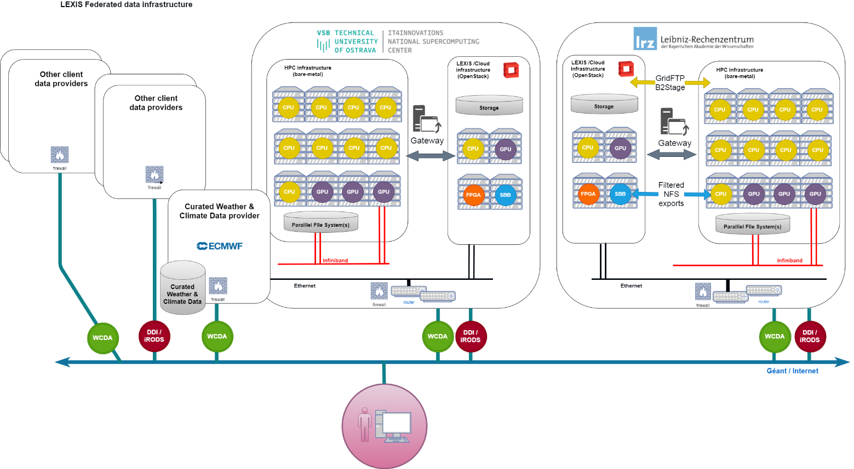
resulting architecture overview
High level view of the LEXIS HPC, Cloud & Big Data federation
Federation of European computing centres
HPC & Cloud service providers, Data providers
Unified & distributed data management
Orchestration
Federated Authentication & Authorization Infrastructure (AAI)
Masking of technical and operational differences across organizations

Slide 8
inputs to Orchestration
Technical requirements collected from pilot use cases
Collection of requirements from pilots (LEXIS early codesign):
Application workflow representations
  BPMN diagrams showing processing and data management steps
  Various technical constraints (time-bound, resource-bound...)
Infrastructure requirements:
  Type of computing, storage or visualization resources
  Sizing & performance
  Security & confidentiality constraints
Workloads:
  Application constraints: supported operating systems, licenses
  Type: Bare metal / Virtual machine / Container
Data management:
  Databases, plain files, objects
  Transfers, compression, encryption...
  Business-specific needs (curated data, access to external repositories...)

Slide 9
weather & climate worflow example
BPMN diagram

Slide 10
technology: key components
& challenges

Slide 11


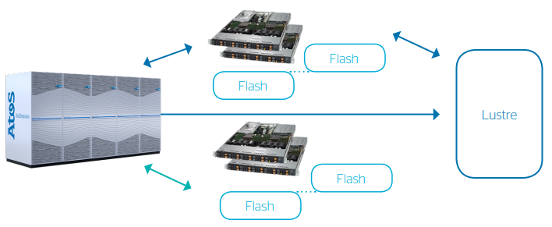
Accelerator infrastructure components
Bring multiple acceleration devices to LEXIS pilot application workflows
Burst Buffers (NVME data nodes)
GPU
FPGA
I/O acceleration
Parallel FS cache
Accelerated computing
3D remote visualization
On-the-fly file processing*
TsunAWI code acceleration
HW installed – Service deployed
HW installed – Service deployed
HW installed - Code acceleration study is continuing, data acceleration is ready for implementation
* Encryption, compression, rasterization, format conversion

Slide 12




distributed data infrastructure (DDI)
Federation
Object
Collaborative & federated data (across HPC providers)
Internet and scientific networks
HPC Provider
Object, file
or block
Cloud file storage (at each HPC provider e.g. CEPH)
I/O response time
LAN file access
Regular file servers (NFS home directories)
Parallel block IO
HPC / Parallel File Systems (GPFS, LUSTRE…)
Near-RAM
Smart Burst Buffers (NVMe acceleration)

Slide 13





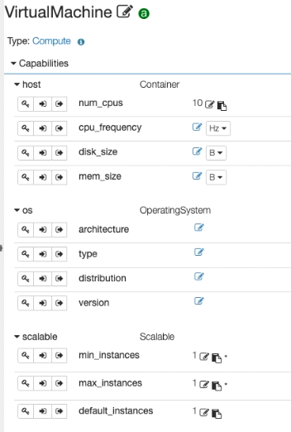
Workflows & Orchestration tools
Application Template
Alien4Cloud and Yorc orchestration modules
Public Net
A4C+Yorc deployed on LRZ and IT4I sites
Full application workflow mgmt:
  Rich catalog of components
  Definition of an application templates (TOSCA format)
Workload management:
  Deployment and execution on HPC and Cloud resources
  OpenStack built-in interface
  HEAppE HPC middleware plugin
  Cross-site resources (IT4I, LRZ)
Data mgmt & orchestration policies:
  Leveraging LEXIS DDI for effective data transfer between sites and Cloud-HPC
  Placing workflow tasks on most suitable resources
Components
Container
HEAppE
Job
...
Docker
compute
network
HEAppE
Job
Catalog
CopyToJob
A4C
Compute
YORC
configurable
Workflow execution
https://github.com/alien4cloud/alien4cloud
https://github.com/ystia
http://heappe.eu

Slide 14
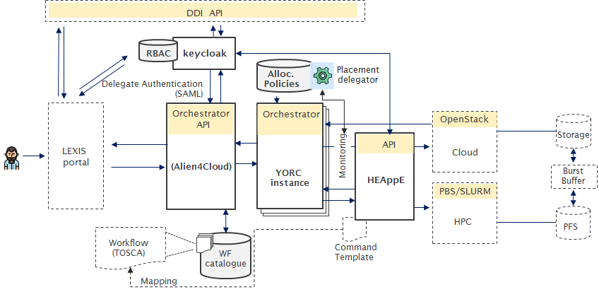
LEXIS integration approach
Orchestrator service system architecture

Slide 15
lExiS Federated AAI

Slide 16
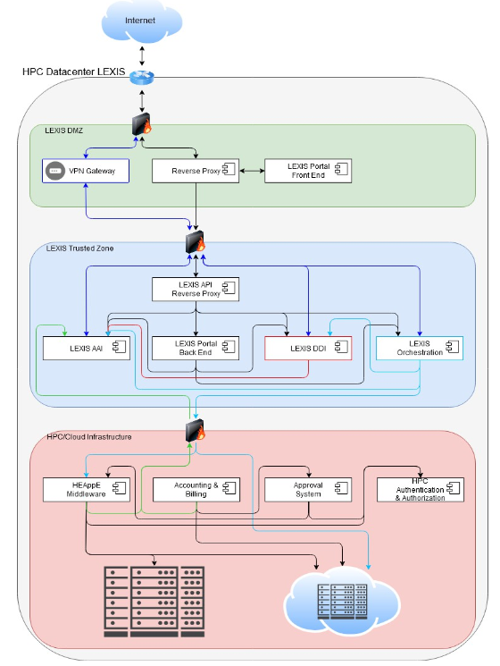




LEXIS Security requirements
LEXIS own AAI solution with trusted access to HPC from PI approval
Security-by-design
  Zero trust, minimal attack surface, separation of concerns
Modern frameworks
HPC infrastructures are protected
  Isolated by the HEAppE middleware (developed in IT4I)
  Deployed in both IT4I and LRZ
Flexible
  Blurs differences between HPC centres
  Provides SSO across the LEXIS federation

Slide 17


Federated AAI
Internet
LEXIS cross-site AAI implementation
HPC Datacenter LEXIS
LEXIS DMZ
VPN Gateway
Reverse Proxy
LEXIS Portal
Front End
LEXIS Trusted Zone
LEXIS API
Reverse Proxy
LEXIS AAI
LEXIS Portal
Back End
LEXIS DDI
LEXIS Orchestration
HPC / Cloud Infrastructure
HEAppE
Middleware
Accounting &
Billing
Approval
System
HPC Authentication
& Authorization

Slide 18
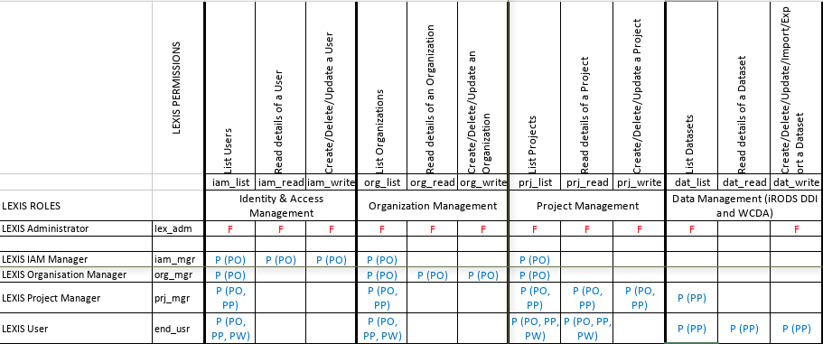
Role-based access control
RBAC matrix
5 main LEXIS roles: Administrator, Support, Organization Manager, LEXIS Project Manager, LEXIS User
Roles configured in Keycloak and reflected in the LEXIS DDI folder structure

Slide 19
lexis project and user approval process
Request for resource allocation
Ongoing design of an approval process and system:
To map supercomputing centre project (HPC/cloud resource allocations) to authorized LEXIS computing projects
LEXIS users must ask supercomputating project PIs (project investigators) in one or more centre for permission. Once approved, this association officially grants access to this center's allocated resources
No direct or explicit link between the LEXIS and HPC centre accounts is created at this stage.
The HEAppE secured middleware is in charge of this internal/technical account creation.
The centre's (internal/technical) account is associated with the approved supercomputing project
An approval system will help automate the association between the LEXIS computing project and projects in the individual supercomputing centres

Slide 20

COnCLUSION
Next steps and go live
2D/3D remote visualization enhanced workflows
Implicit or explicit selection of accelerators in workflow definition
Tight integration of workflows in LEXIS web portal
Support of urgent computing and realtime deadlines
Providing easy access to the HPC/BD/Cloud resources for SMEs/Industry
LEXIS platform adaption by Open Call
  https://lexis-project.eu/web/open-call

Slide 21


















Contacts
Large-scale EXecution for Industry & Society
marc.levrier@atos.net
alberto.scionti@linksfoundation.com
consortium
Notes:
Back Page
Social network icons refer to speaker (he/she has to link his/her accounts)

Slide 22
Thanks you!
Don’t miss our other presentation:
Federated Research Data Management in LEXIS!
by Mohamad Hayek & Johannes Munke
today at 4:15pm
https://indico.egi.eu/event/5000/contributions/14373/

