Slide 1
EGI Conference 2020
2-5 November 2020, Amsterdam
Digital Platform Integrating Complex Software Solutions for Decision Support System Dedicated to the Implementation of Sustainable Mobility Measures in Port Cities
Prof. Eden MAMUT, "Ovidius" University of Constanta
Laurentiu OANCEA, Gabriel PRODAN, Cosmin TACCIU. MEDGreen Innovation Cluster

Slide 2


Specific Objectives
Improving the governance by enhanced cooperation between the Municipality and the Port administration in order to plan and implement innovative mobility solutions and of integrated structures of spatial planning
Creating a more sustainable and healthier city-port environment
Development of a transport infrastructure and of an integrated mobility system to attract residents and to support the diversification of the local economy
Improving the efficiency of the urban freight transport in the cities in relation with the port

Slide 3

Local Authority
Municipality of Constanta
Local Authorities
From
Metropolitan Area
Metropolitan Area
Association
Businesses
Constanta
Port Authority
CONSTANTA
LOCAL
CONSORTIUM
Research
“Ovidius”
University
of Constanta
Know-how
European
Integrated
Projects
Civil society
European Center for Development
Association
Innovation
MEDGreen
Cluster

Slide 4
Specific measures for Constanta
New models of mobility governance for port cities:
  1CTA1 – Demonstration of SUMP strategies to strengthen the core to growth pole accessibility for economic and social cohesion
  1CTA2 – Establishing decision-support forum
Life styles based on new types of mobility to port cities:
  2CTA1 – Allocating road space for walking and cycling
  2CTA2 – Reducing car dependency for port workers
  2CTA3 – Raising awareness
  2CTA4 – Implementing virtual e-mobility

Slide 5
Specific measures for Constanta
Efficient and sustainable mobility for port cities:
  3CTA1 – Transferring real-time information
  3CTA2 – Improving seamless mobility through TEN network nodes
  3CTA3 – Charging e-busses with alternative energy
  3CTA4 – Enforcing parking strategy
insuring a harmonized and effective model for goods transport:
  4CTA1 – Mapping freight traffic flows and designing a distribution plan

Slide 6
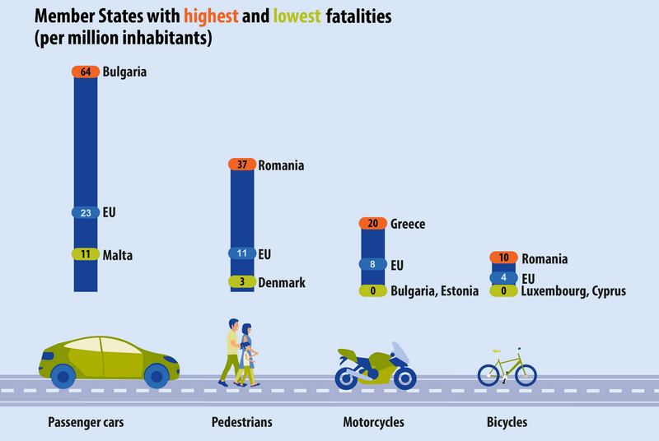
THE CONTEXT

Slide 7
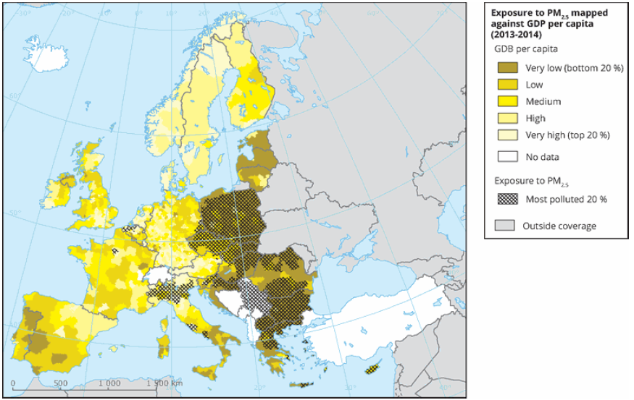
THE CONTEXT

Slide 8
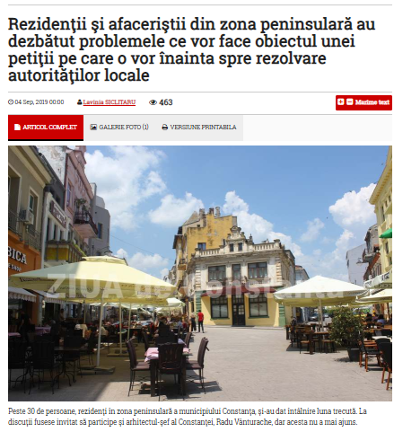
THE CONTEXT

Slide 9
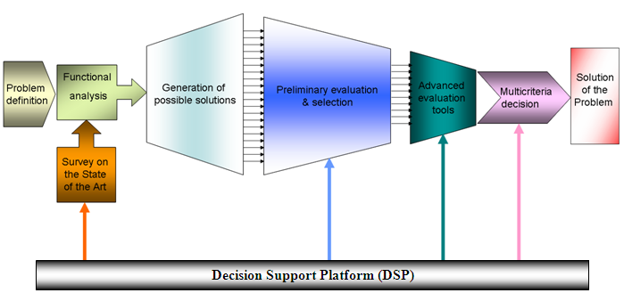
DECISION SUPPORT SYSTEMS FOR INNOVATION

Slide 10
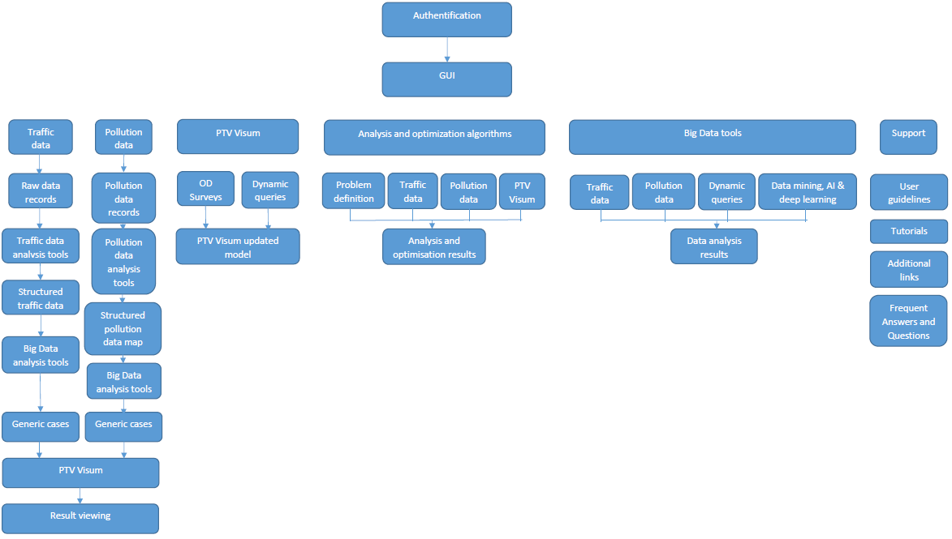
Architecture of the Decision Support System

Slide 11
PLATFORM FUNCTIONALITY
Traffic Data Analyses
Pollution Data Analyses
Modeling, Simulation & Optimization
Decision support
Scenario building
Simulation of alternative cases
Sensitivity analysis
Trip planning, step-by-step directions and schedules
Bus estimated time of arrival to bus stops, estimated time of arrival to destination, live bus locations and stops
Complete bus line information
Points of interest, display Points of Interest that can be visited with the public transport in a given time
Feedback inputs
EVALUATION !!!!

Slide 12
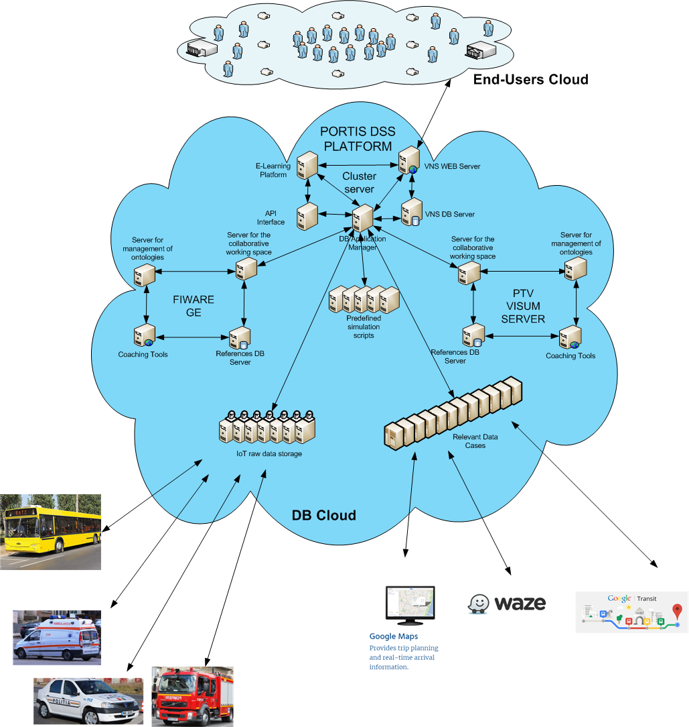
CONCEPT

Slide 13
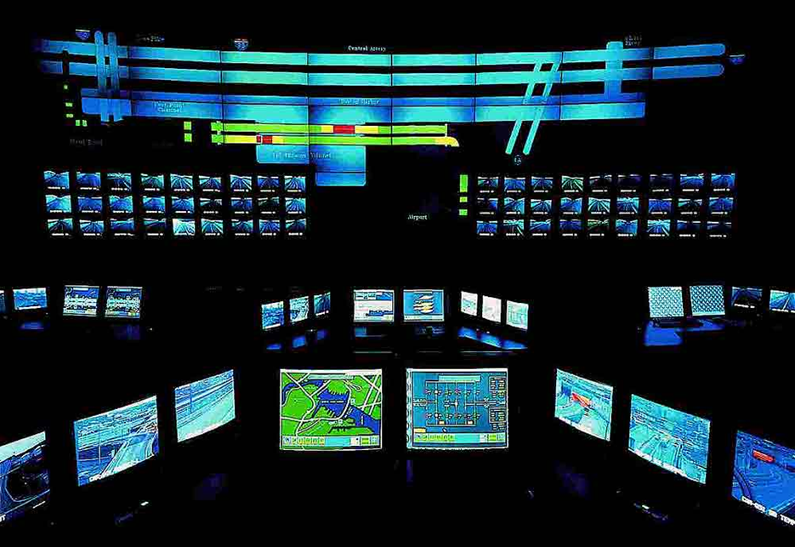
INTEGRATING PLATFORMS

Slide 14
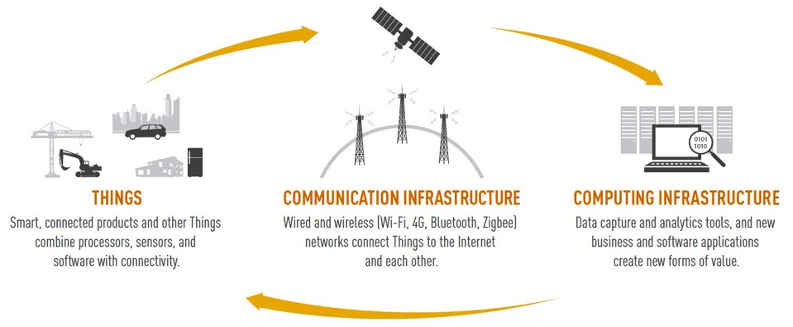
Internet of Things - IoT
Smart, connected objects, products, systems and other Things
connected through Internet-like communication infrastructure to a
computing infrastructure that are changing the world.

Slide 15


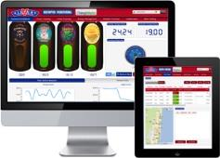
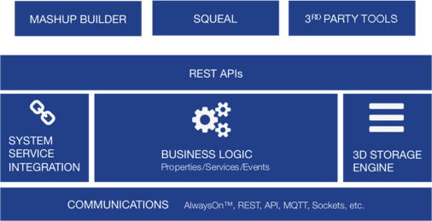







Internet of Things - IoT
Dynamic Applications
Rapid Application
Dev.
Platform
The Network
Sensors, Devices &
Equip.

Slide 16

DIGITAL ROBOTS

Slide 17
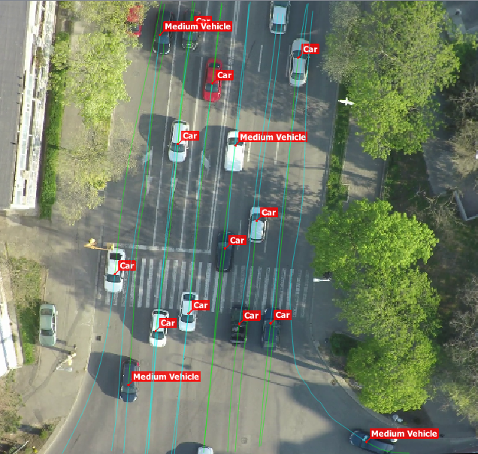
TRAFFIC DATA CAPTURING

Slide 18
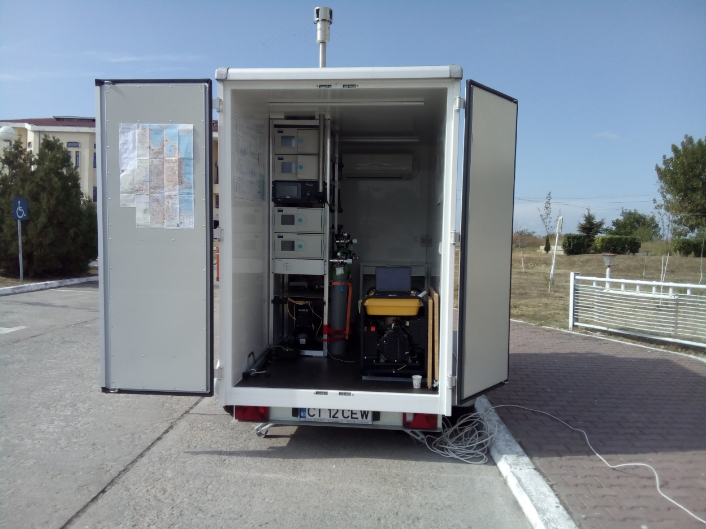
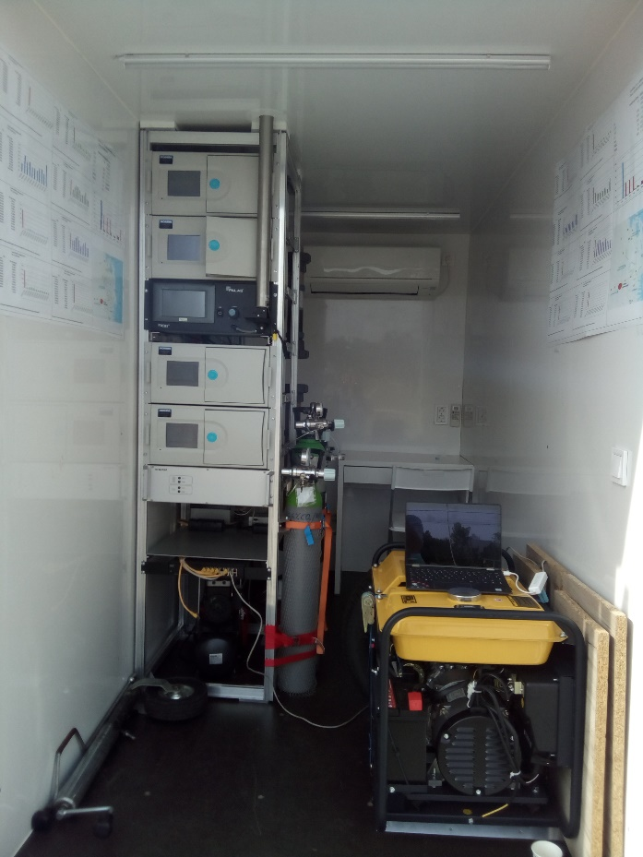
POLLUTION DATA CAPTURING

Slide 19


TOMYbot
www.tomy.ro
TOMYbot – robot digital pentru asistență, evaluare și suport de decizie pentru implementarea măsurilor de mobilitate durabilă în orașe porturi

Slide 20
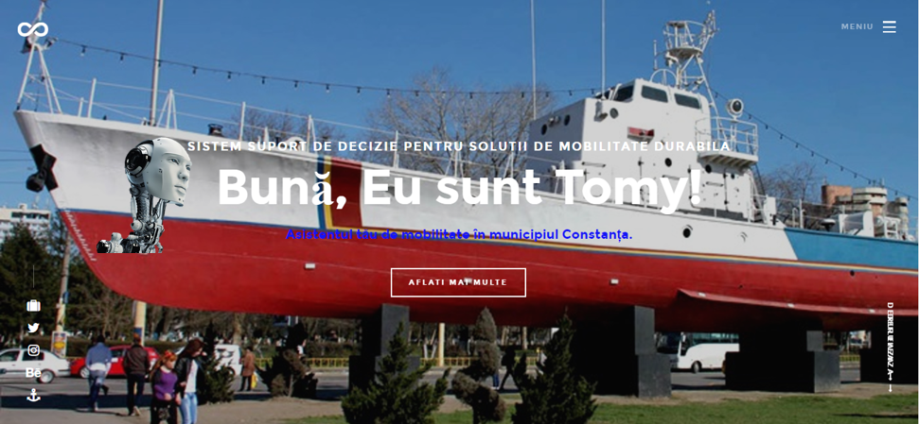
TOMYbot

Slide 21
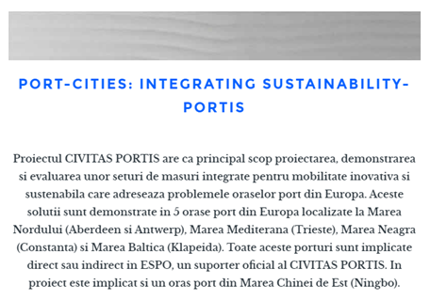
TOMYbot

Slide 22
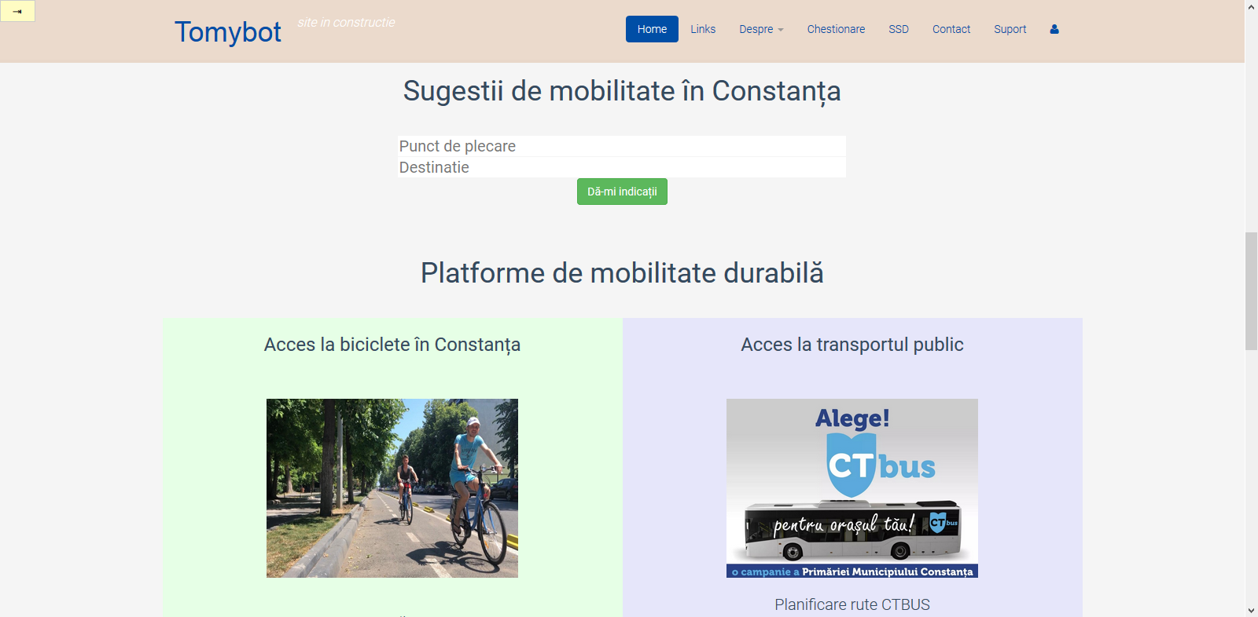
TOMYbot

Slide 23
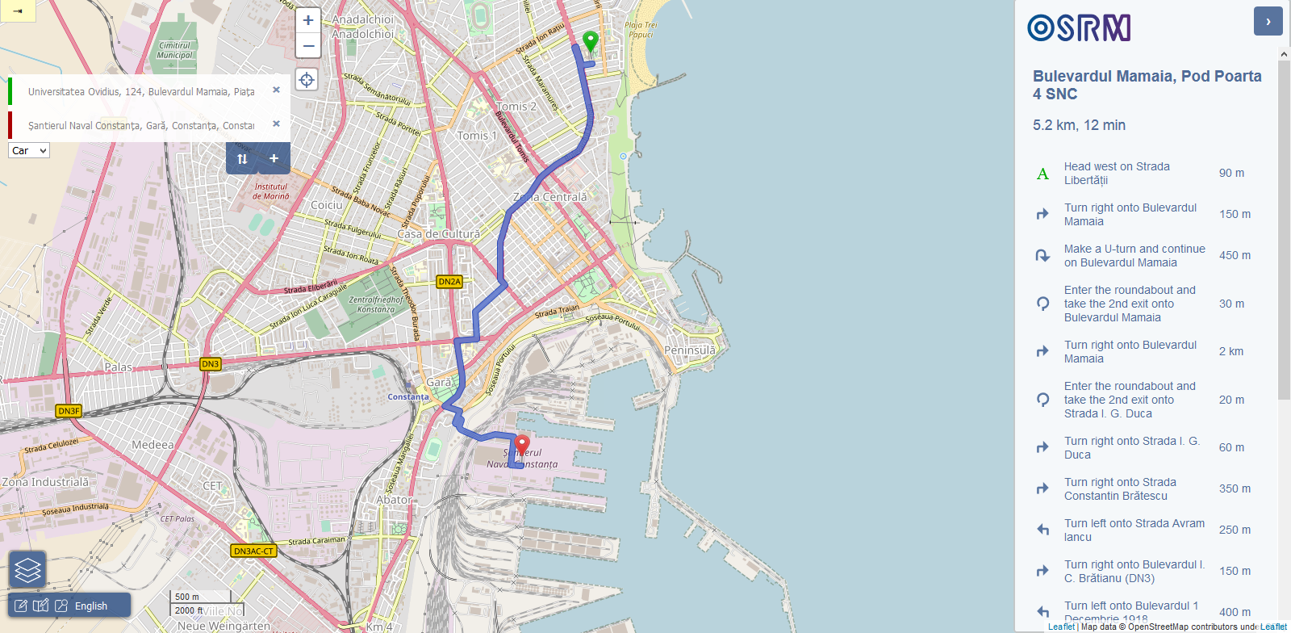
TOMYbot

Slide 24
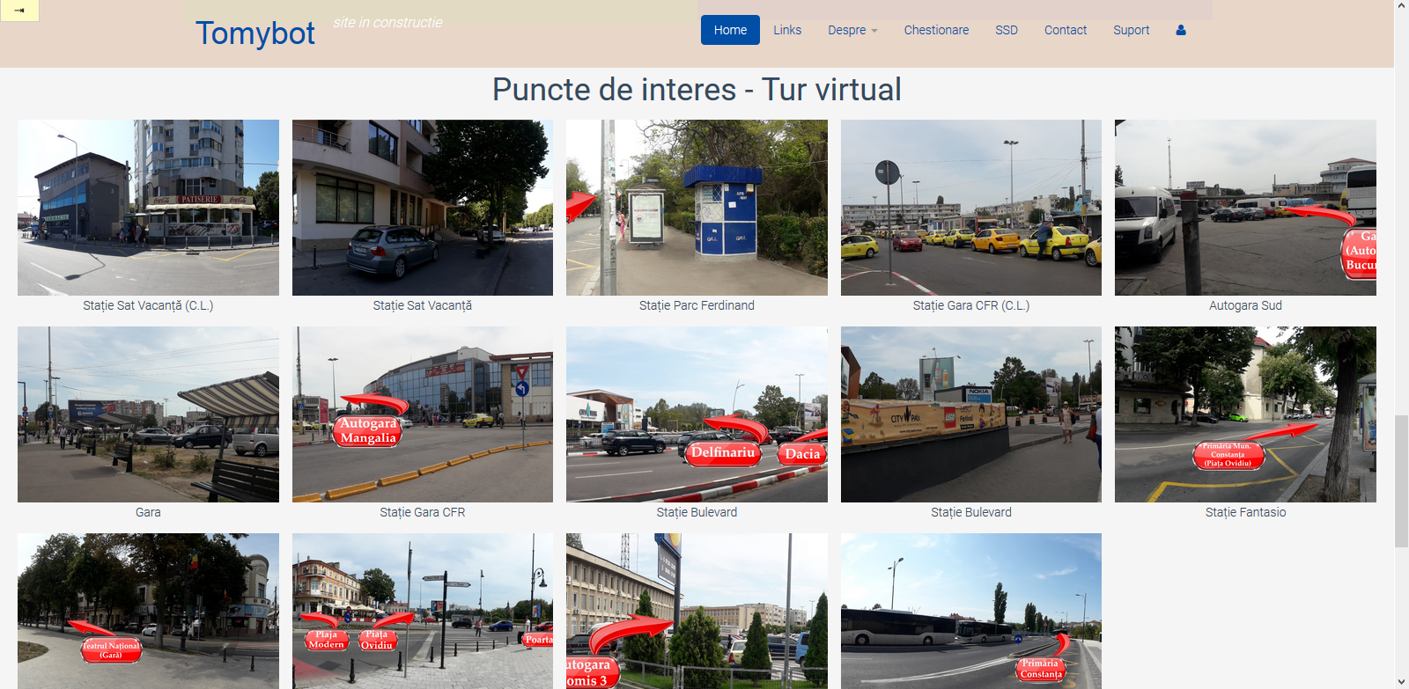
TOMYbot

Slide 25
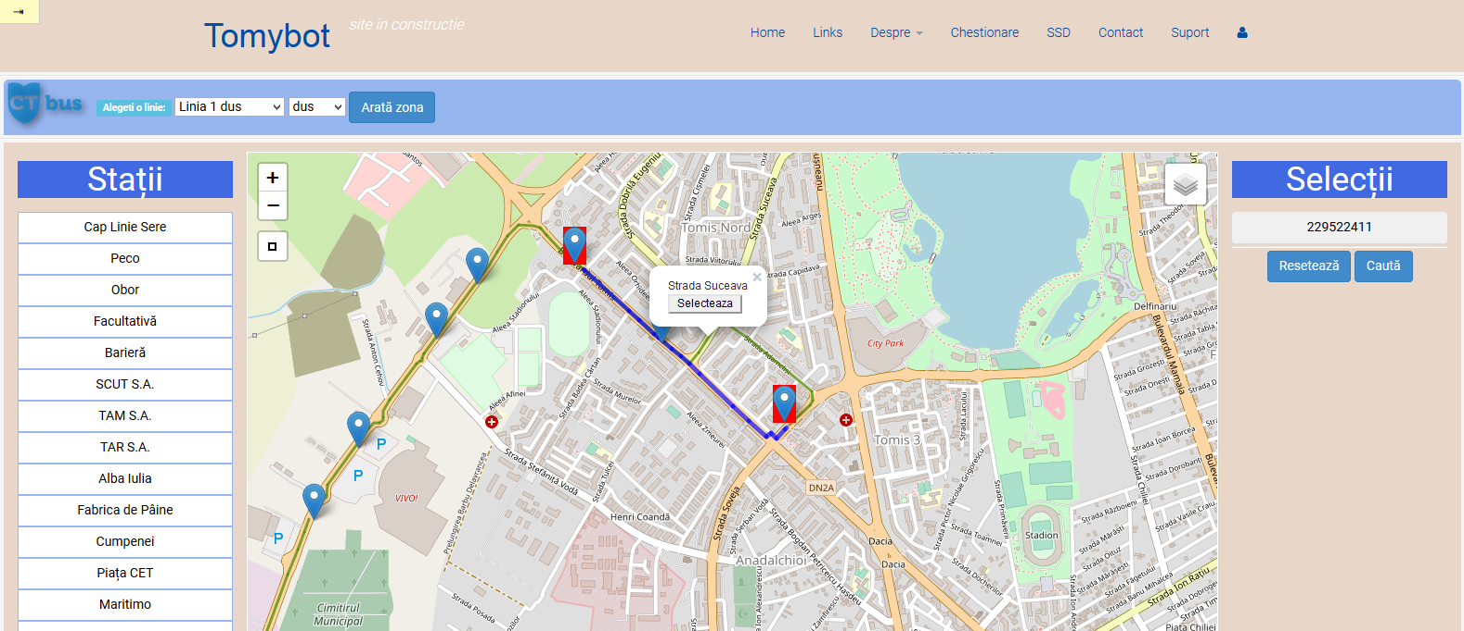
TOMYbot

Slide 26
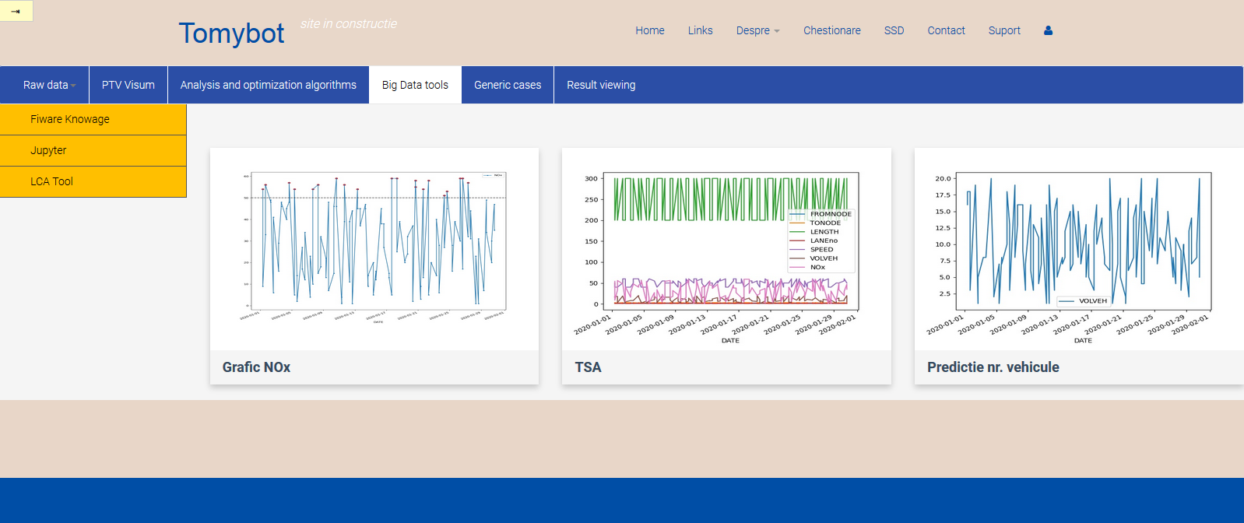
TOMYbot

Slide 27
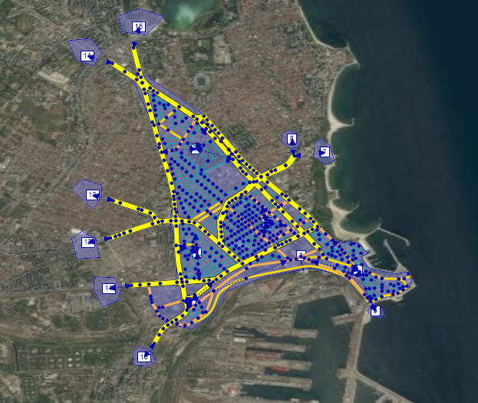
VISUM MODELING

Slide 28
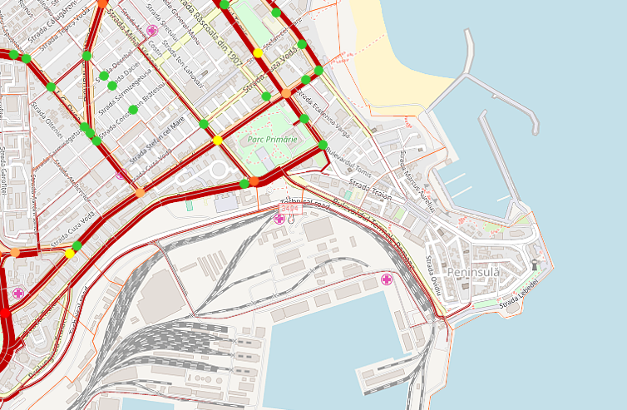
VISUM MODELING

Slide 29
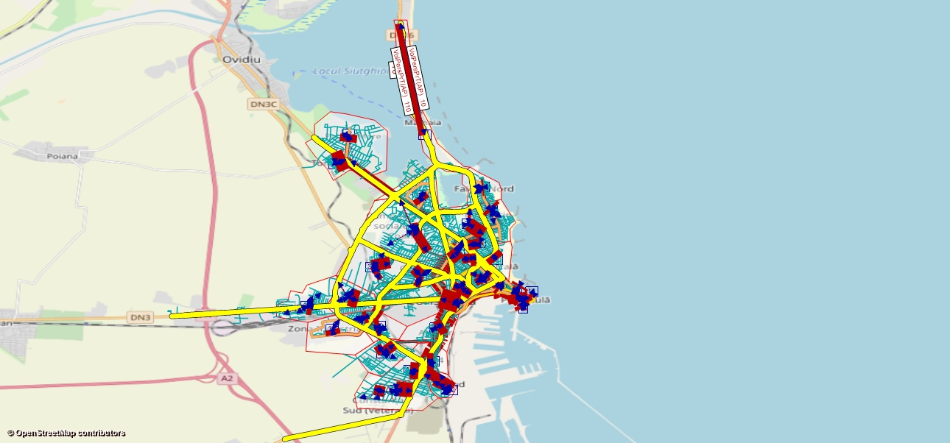
VISUM MODELING

Slide 30
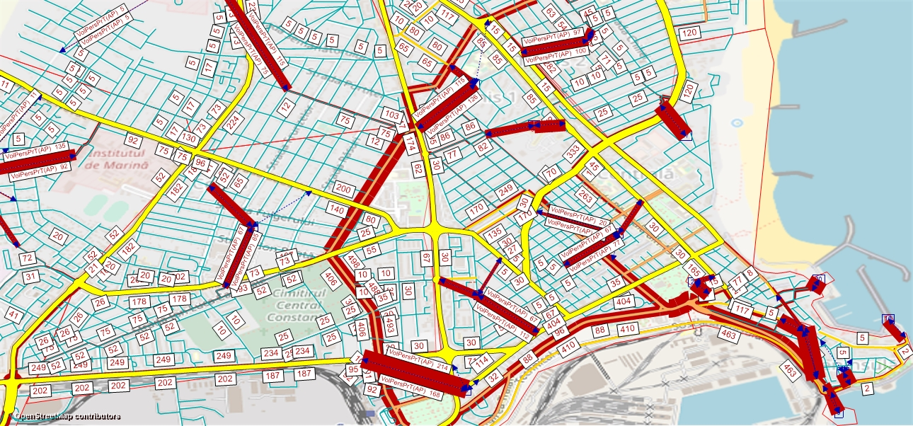
VISUM MODELING

Slide 31
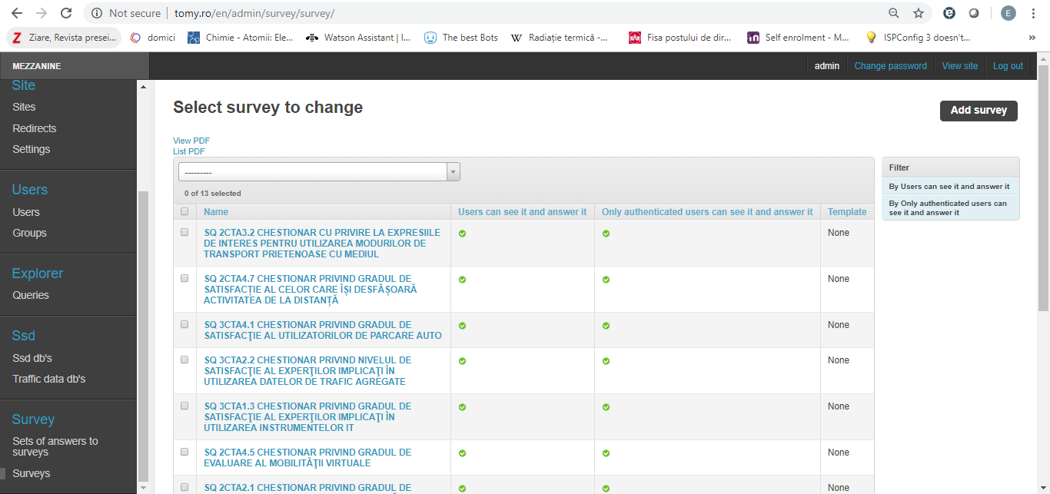
Evaluation toolbox

Slide 32
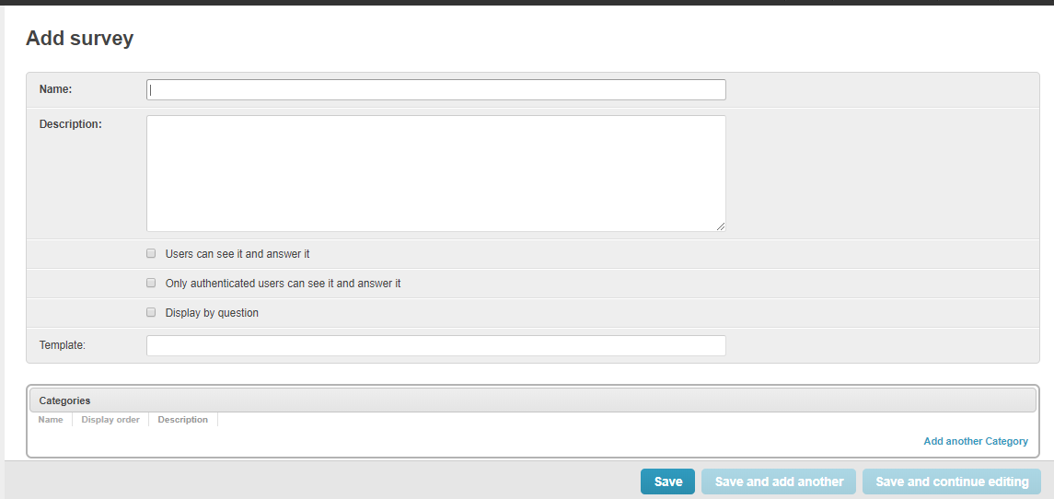
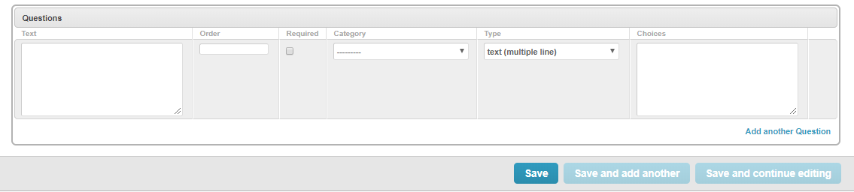
Evaluation toolbox

Slide 33
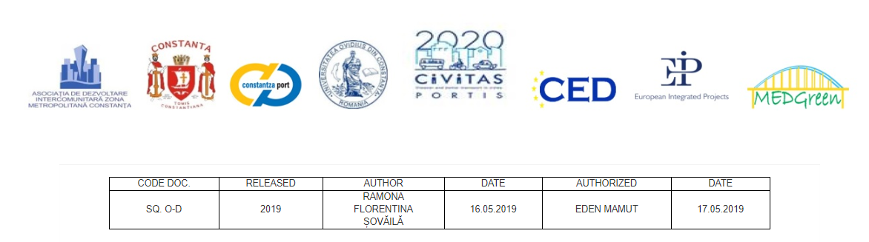
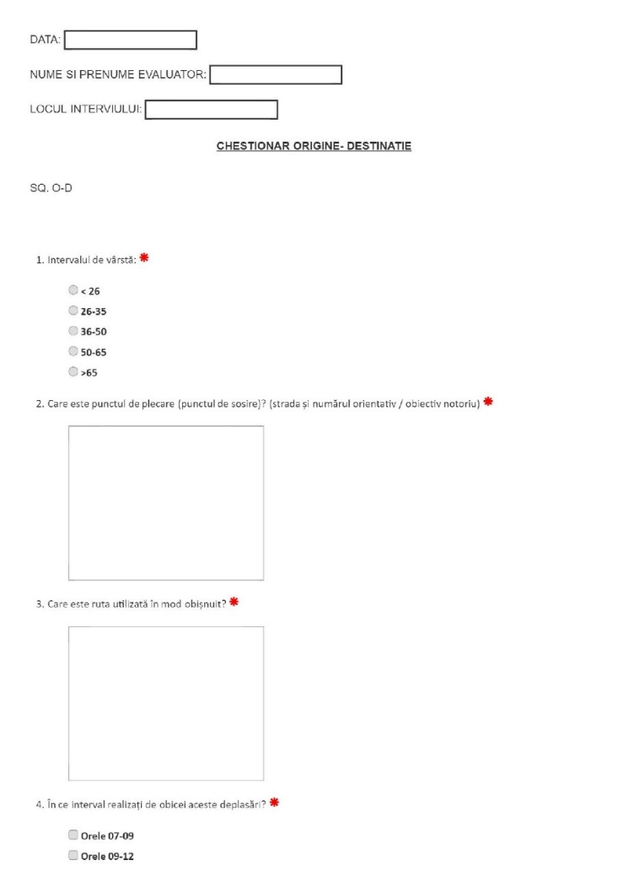
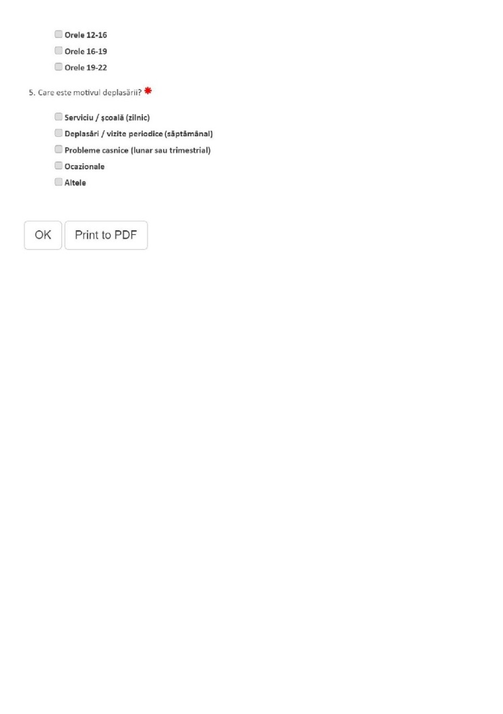
Evaluation toolbox

Slide 34
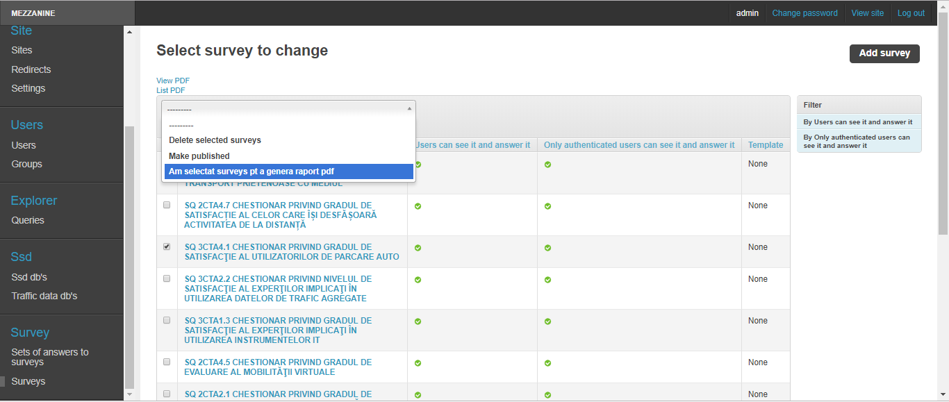
Evaluation toolbox

Slide 35
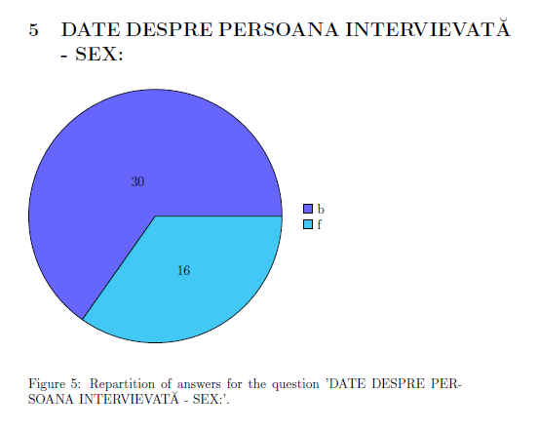
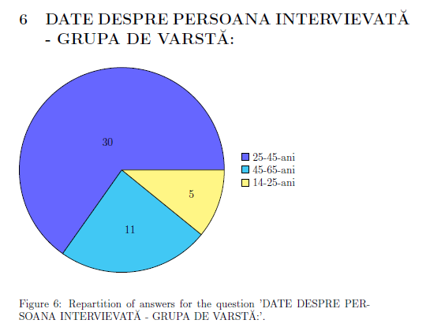
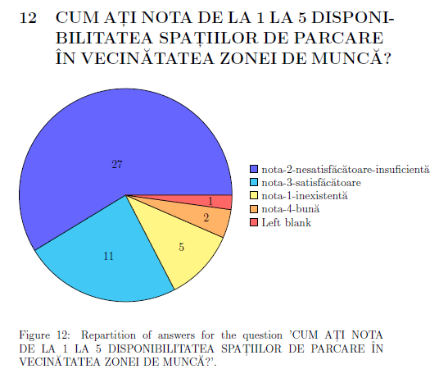
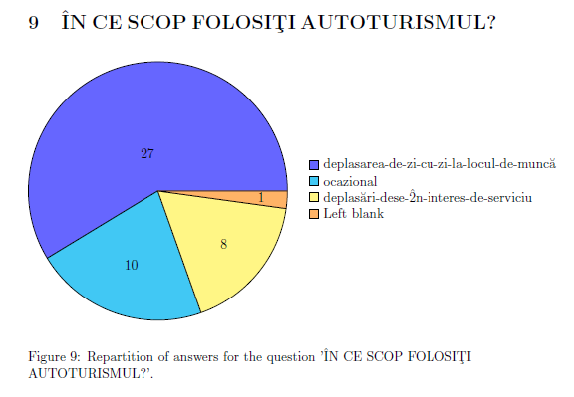
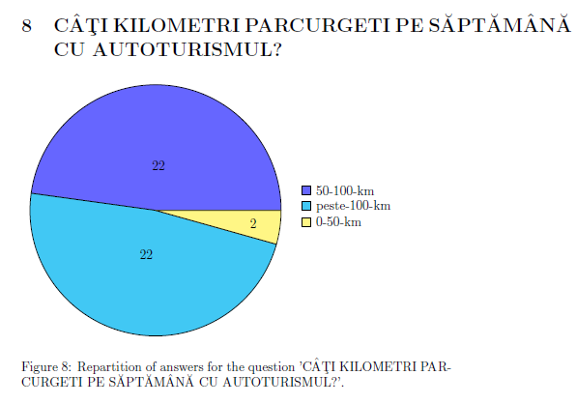
Evaluation toolbox

Slide 36
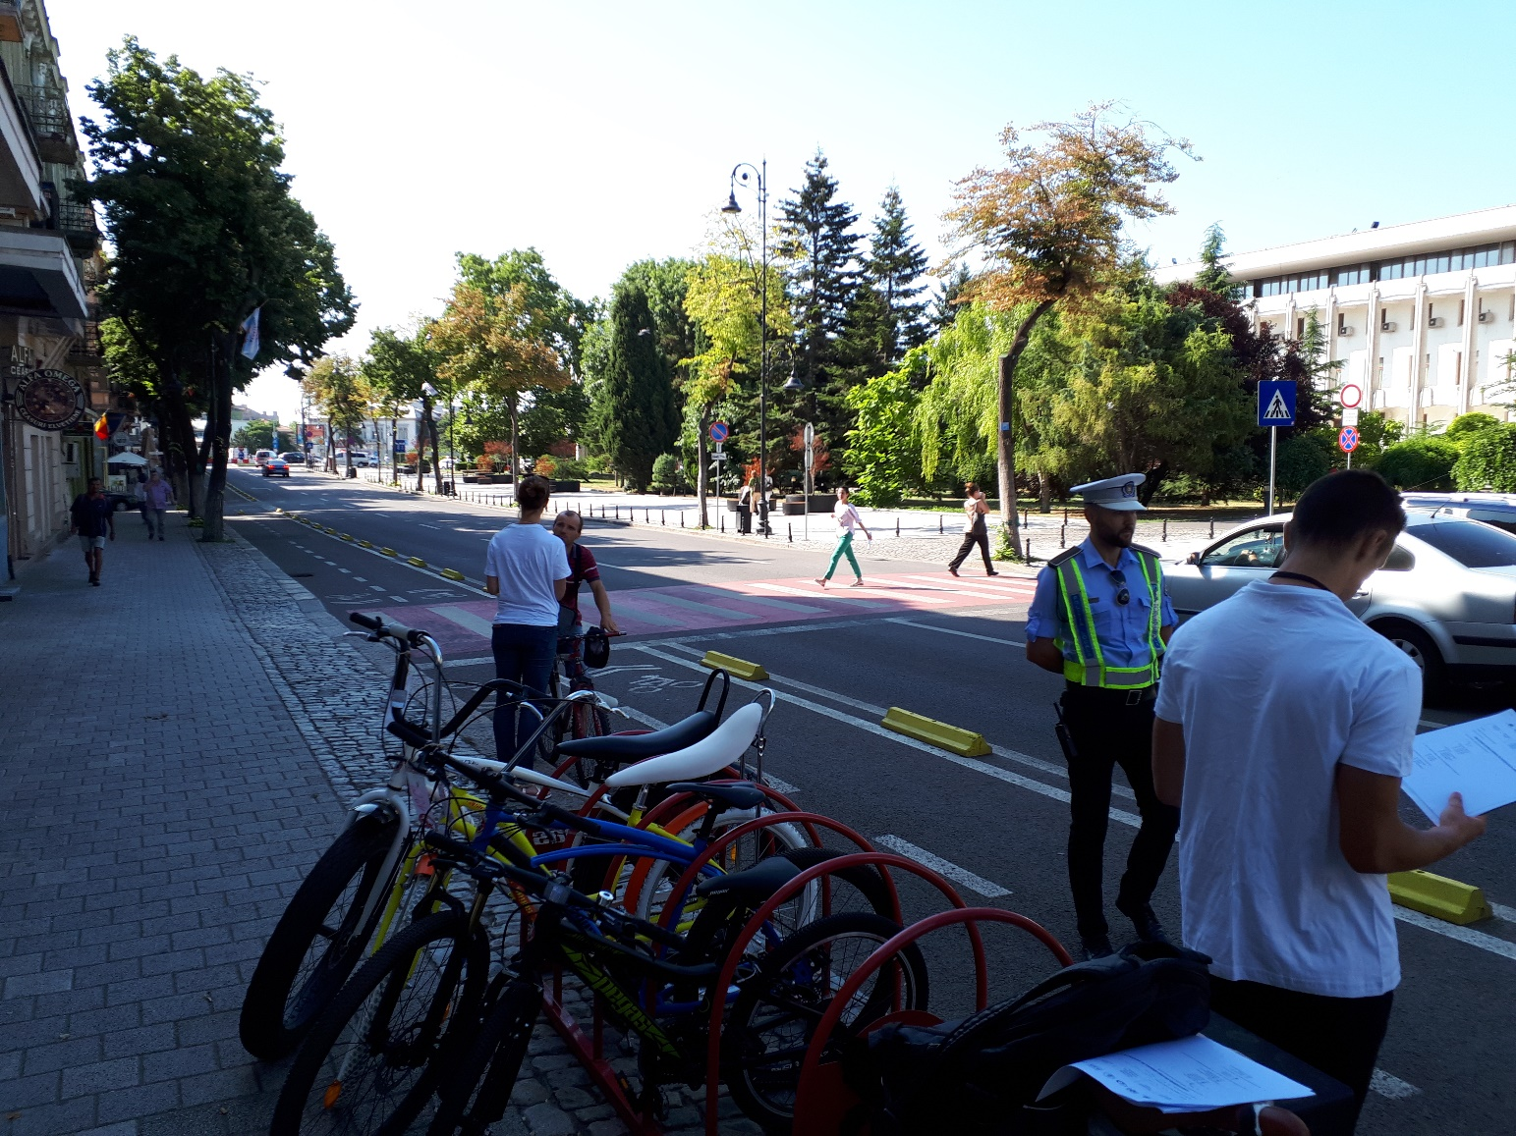
Collecting data from the ground

Slide 37
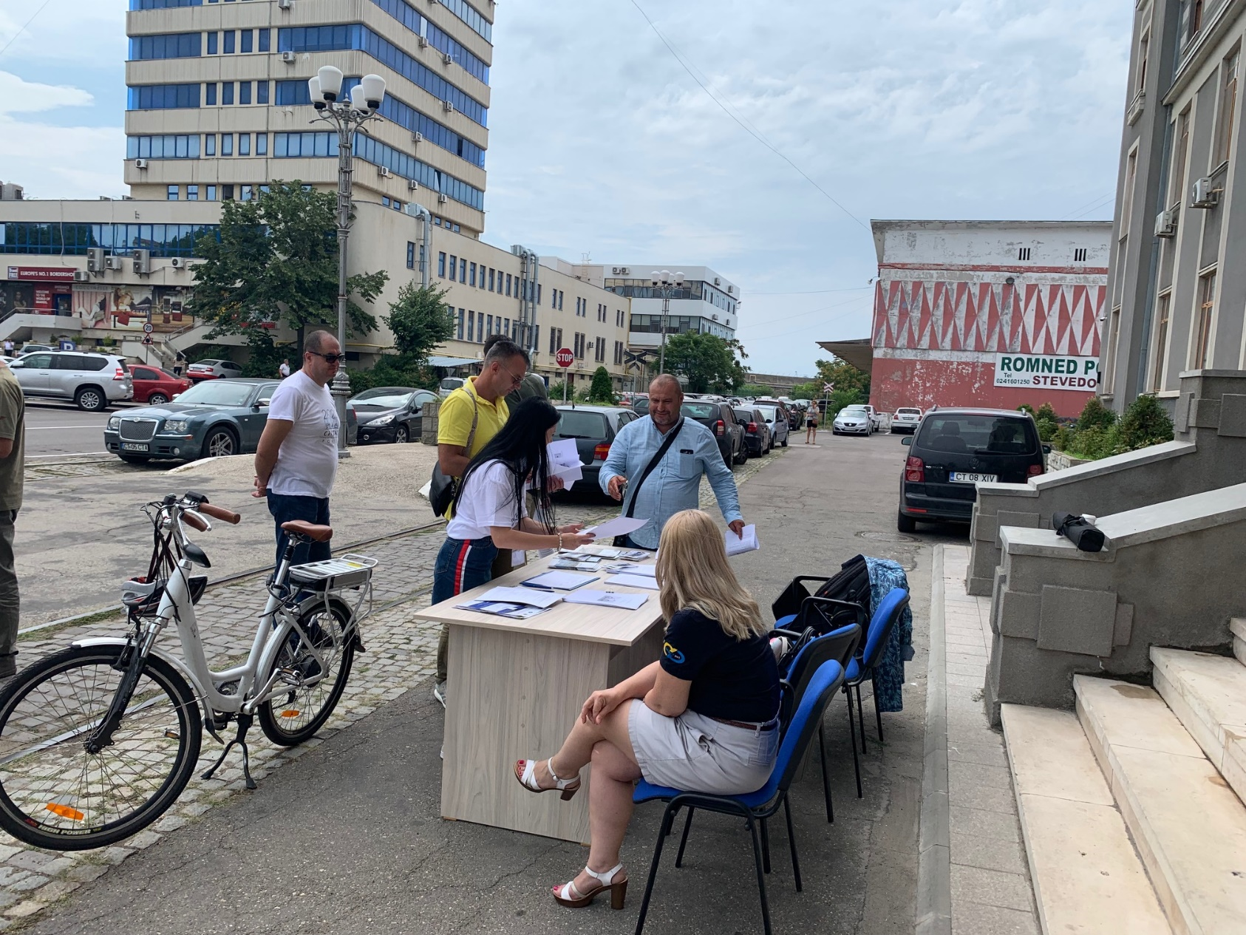
Collecting data from the ground

Slide 38
Next steps: Ovidius Cyber Cloud
Project title: Development of the numerical computation infrastructure of the Ovidius University of Constanta for modeling, simulation and processing of massive data structures by the establishment of a Cloud Computing Data Center. Contract no. 252/29.05.2020, MySMIS code 124984, Operational Program Competitivity, Priority Axis – Scientific Research, Technology Development and Innovation in the support of economic competitivitness and business development, Project type: Cloud Computing and Massive Data Processing Infrastructures.
Implementing organization: Institute for Nanotechnologies and Alternative Energy Sources at “Ovidius” University of Constanta.
The aim of the project is the development of a data center for cloud computing consisting on the infrastructure, operation procedures, integration in the national network and in the EOSC.
Co-financed project by the European Regional Development Fund through the Competitiveness Operational Program

Slide 39
Conclusions
The implementation of the sustainable transport measures requires a very professional approach and for this purpose, a Decision Support System might be extremely useful;
The collection and processing of reliable data is the crucial element of the appropriate functioning of such a digital platform;
Building a system for data collection and processing is a very challenging process and it might be considered as a whole project on its own;
It is an iterative process and has a valuable impact also in the implementation of the sustainable transport measures;

Slide 40

Thank you for your attention!
&
Please, send me your comments at: emamut@univ-ovidius.ro

