Slide 1
Establishing a Membership Model for Industry
Sy Holsinger
Business Development Manager - EGI Foundation

Slide 2
Outline
Brief history
Value of working between industry and the public sector
Engagement results to date
Evolving landscape and opportunities
Industry Membership model (beta)
Actions and activities moving forward

Slide 3
Brief History
EGI and Business Engagement
EGEE Projects (2004-2009)
Dedicated Programme for Business
Business Forum and Business Associates
2004
EGI Business Model Development
Sustainability Planning
Evolving the EGI Business Model
2011
EGI Business Engagement Programme
Revised programme for Council adoption
Onboarding and use cases
2015
Digital Innovation Hubs
Emerging concept for public-private partnerships
2018
Membership Model for Industry
Evolving formal engagement
Testing fee-based mechanisms
2020

Slide 4
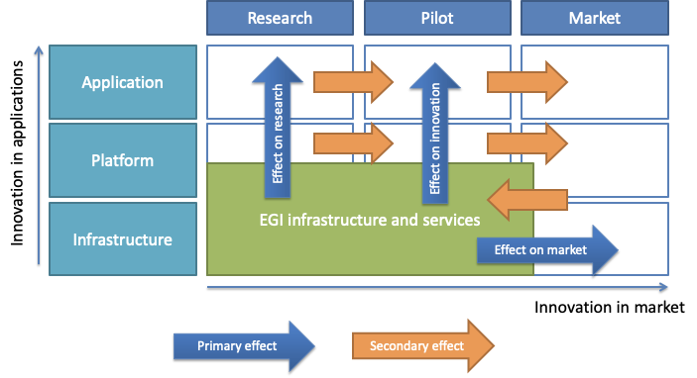
Engaging with the private sector
From research to market – value chain

Slide 5
Value of Working with Industry
For the EGI Federation
Knowledge
Acquire new knowledge and expertise Share skills and expertise Increase research innovation projects outputs Boost publications
Service
Add complementary resources Improve technical services offered Offer a wider range of tailor-made products, services or solutions
Business
Obtain free licenses or discounts Access new category of users Expand the base of business sector partners Lead to revenue generation
Policy
Support EC initiatives for supporting start-ups/SMEs Implement part of the EGI mission Demonstrate the value of the EGI services

Slide 6
Roles and Value for Industry
Working with the EGI Federation
Customer
Access existing EGI services
Adopt new and innovative technologies
Reuse open research data sets, tools and applications
Provider
Offer services to or part of EGI
Expand and strengthen the customer base
Participate in the procurement framework
Partner
Co-develop new products, services, solutions
Contribute as a partner to proposals for funded projects
Team up with experts on distributed computing systems and an array of research domains
Market
Increase visibility on a European and global scale
Network with an international community
Provide direct input to shape future services of EGI for business opportunities

Slide 7
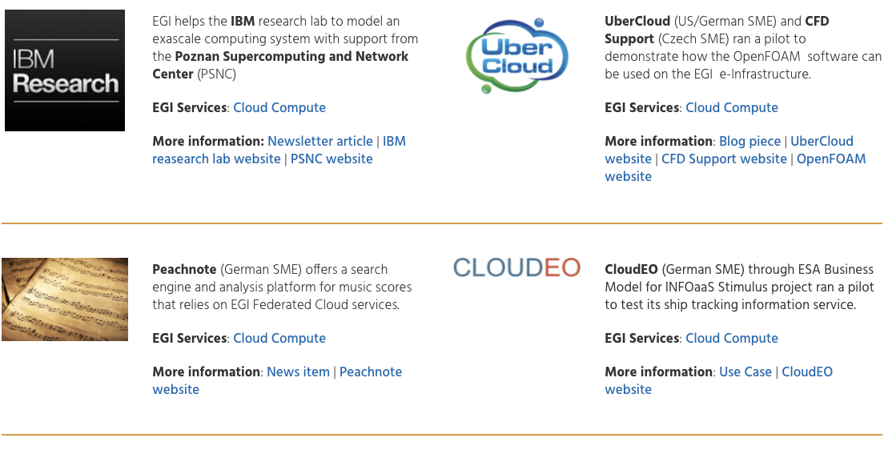
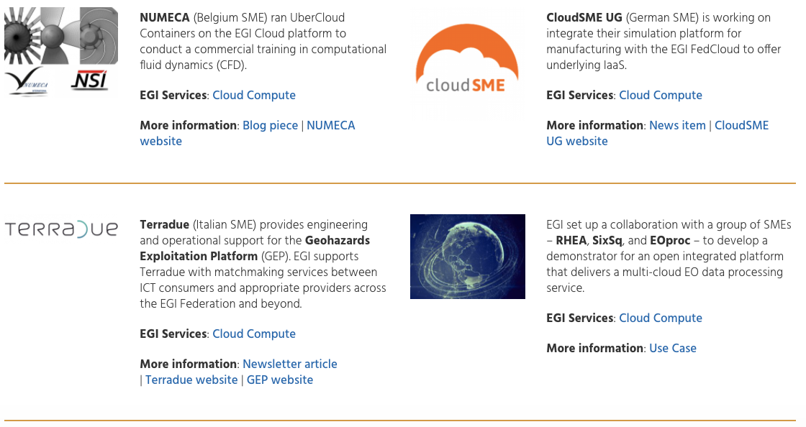
Business Engagement
Results to date
Use Cases and Pilots
Partnerships and Providers
Projects
*several others to start in 2021

Slide 8
Evolving Landscape
Digital Innovation Hubs and Paid Service Provisioning
The DIH concept/term is increasing in popularity as the means for describing public-private partnerships
Improves communications and marketing; also more concrete/tangible
Re-branding EGI Business Engagement Programme as an EGI DIH
Separate EGI business activities and the “EOSC DIH”
Clearer mechanism for industry to join EGI not connected to its governance
Funding opportunities
Future Financial Framework (2021-2027): European Digital Innovation Hubs in Digital Europe Programme + Country contact points established for EDIHs
No blocking issues to register in the EC DIH Catalogue
Apply for project funding for EGI under the DIH umbrella + increase local engagement
Paid service provisioning
Join pool of providers to support paid use cases

Slide 9
EGI Governance Bodies
Relations with EGI DIH
SIB
(Strategy and Innovation Board)
EGI Council
EGI Executive Board
Services & Solutions
Technology
Security
Operations
Users
Industry
DIH
(Digital Innovation Hub)
SSB
(Service and Solutions Board)
TCB
(Technology Coordination Board)
SPG
(Security Policy Group)
OMB
(Operations Management Board)
UCB
(User Community Board)

Slide 10
EGI Industry Membership Model
Criteria, Benefits and Fees
 | Member | Community
Access to basic testbed resources and support, open research datasets, tools and apps | ✔ | ✔
Establish Cooperation Agreements | ✔ | ✔
Presentation and promotion opportunities at EGI events | ✔ | ✔
Join EGI DIH Community i.e. mailing list, dedicated meetings and events | ✔ | ✔
Opportunity to participate in EC-funded projects with EGI and partners | ✔
Eligible for supporting pay-for-use use cases as an integrated EGI provider | ✔
Inclusion in marketing material/presentations/website | ✔
Eligible for invitation to selected EGI Council Meetings and contribute to strategies | ✔
Reserved allocation of resources and specialized consultancy | ✔
Membership Fees
Type | Criteria |  |  | Annual Fee Subject to VAT
 | Staff | Turnover | Balance Sheet
Large | ≥250 | >€50M | >€43M | €24,000
Medium | 50-249 | ≤€50M | ≤€43M | €12,000
Small | 10-49 | ≤€10M | ≤€10M | €6,000
Micro | <10 | ≤€2M | ≤€2M | €1,500
Startup/Spinoff <3 years | ≤5 | ≤€350K | ≤€300K | Free
For each fee tier, the applicant needs to meet at least 2 of the 3 defined criteria.
Fees not applicable to any private entity already financially contributing as part of an EGI Full Participant (i.e. NGI)

Slide 11
Moving forward
Feedback, Interest, Activity Plan
Membership model feedback
Suggestions for improvement
Expressions of interest
EGI Council feedback/endorsement (5 Nov)
EGI Digital Innovation Hub
Register in the EC Smart Specialitation Platform https://s3platform.jrc.ec.europa.eu/digital-innovation-hubs
Update website pages and promotional material
Launch and Activities (Jan 2021)
Mailing list population
Monthly community meetings
Bi-monthly member only meetings
Quarterly newsletter
Annual F2F meeting (co-location where possible)
Annual success story/impact publication

Slide 12
Are you interested in joining
the EGI Digital Innovation Hub? Send your expression of interest to: business@egi.eu
Thank you :) Contacts: sy.holsinger@egi.eu
@syholsinger

