Slide 1
GENERAL HOUSEKEEPING
Please make sure your microphone and video are deactivated unless the (co)host gives permission.
Use the function to ask to speak, you find the option in the “participants” list
All presentations will be available on
Indico (see session via Timetable).
If you do not see all the Zoom buttons
at the bottom of the Zoom window, move your mouse on that window and buttons will appear.
Share your impressions and experiences on Twitter using #EGI2020 and mention @EGI_eInfra.

Slide 2
Data Analytics services in EGI
Giuseppe La Rocca
Community Support Team Lead.

Slide 3
Outline
Overview of the EGI Data Analytics services 25’
The EGI Notebooks
The EGI Workload Manager
The Elastic Cloud Compute Cluster (EC3)
The Science Software on Demand (SSoD)
The EGI VMOps dashboard
The Chipster suite
Experience/Feedback from the EGI communities:
D4Science experience with the EGI Notebooks service 15’
EISCAT_3D report with the EGI Workload Manager 15’
Q&A 10’

Slide 4
Overview of the EGI Data Analytics services
WeNMR portals
DIRAC
agInfra notebooks
DIRAC
...
EC3
Notebooks
Science Software on Demand
VMOps dashboard
...
Community allocations (IaaS / HTC Federation)
Applications on Demand (cloud resources for the long-tail)

Slide 5
List of the EGI Data Analytics services
EGI Notebooks: Create interactive documents with live code, visualisations and text
EGI Workload Manager: Manage computing workloads in an efficient way
Elastic Cloud Compute Cluster (EC3): Deploy virtual elastic clusters on top of Infrastructure as a Service (IaaS) providers
Science Software on Demand (SSoD): Science Gateway for general purpose scientific applications
EGI VMOps: deploy and manage VMs and VAs on the EGI Federated Cloud
Chipster: A user-friendly analysis software for next generation sequencing data

Slide 6
Clinic sessions and Zoom rooms
04 November, 15:30 - 16:45 CET All the clinic sessions will run in parallel!
Clinic session no.1:
The EGI Notebooks (Enol Fernandez, EGI Foundation)
The Elastic Cloud Compute Cluster (EC3) (Miguel Caballer, Amanda Calatrava Arroyo, UPV)
Room: http://go.egi.eu/zoom4
Clinic session no.2:
The EGI VMOps dashboard (Alexandros Nakos, IASA)
The Science Software on Demand (SSoD) (Riccardo Bruno, INFN)
Chipster (Kimmo Mattila, CSC)
Room: http://go.egi.eu/zoom5
Clinic session no.3:
The Workload Manager (Andrei Tsaregorodtsev, IN2P3)
Room: http://go.egi.eu/zoom2

Slide 7
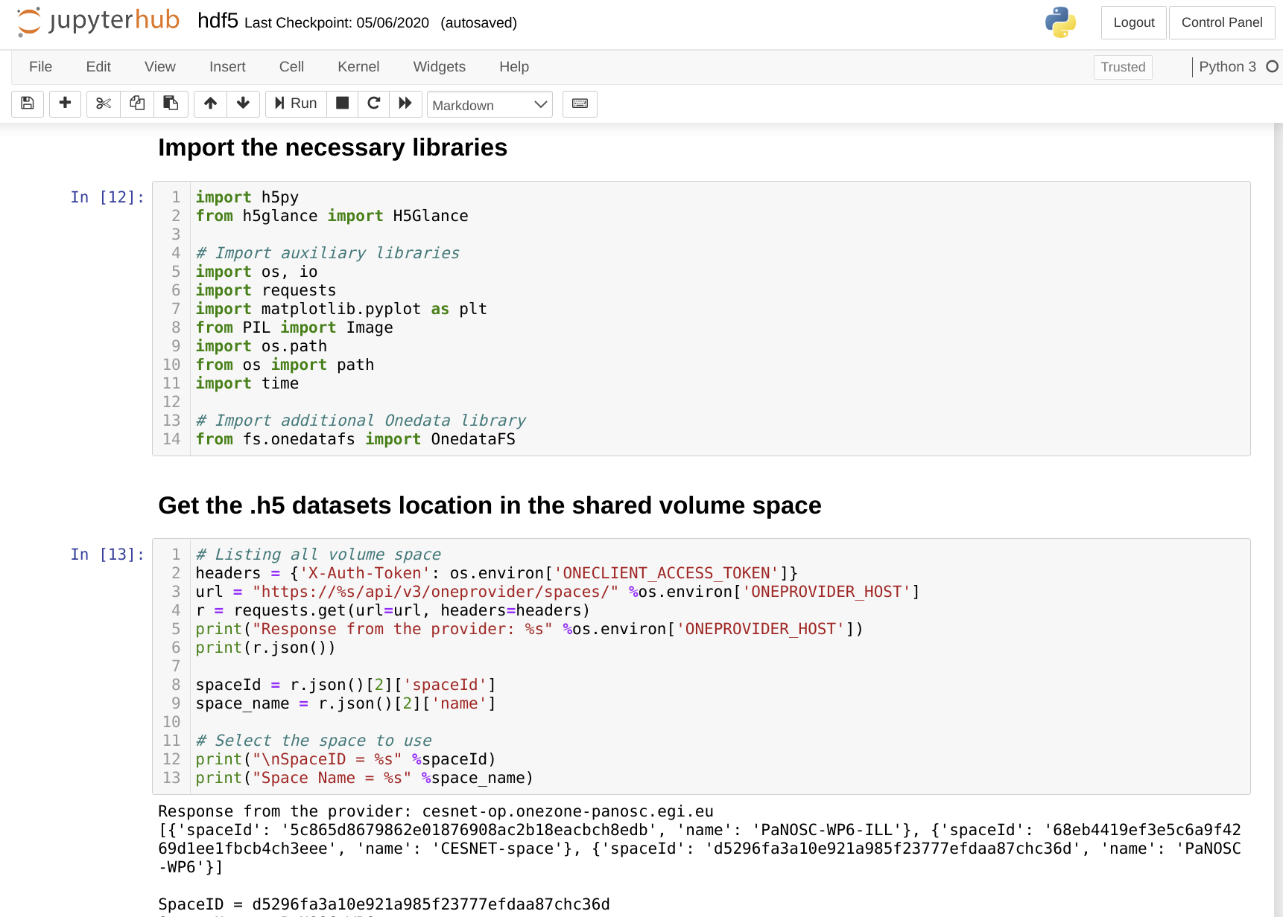
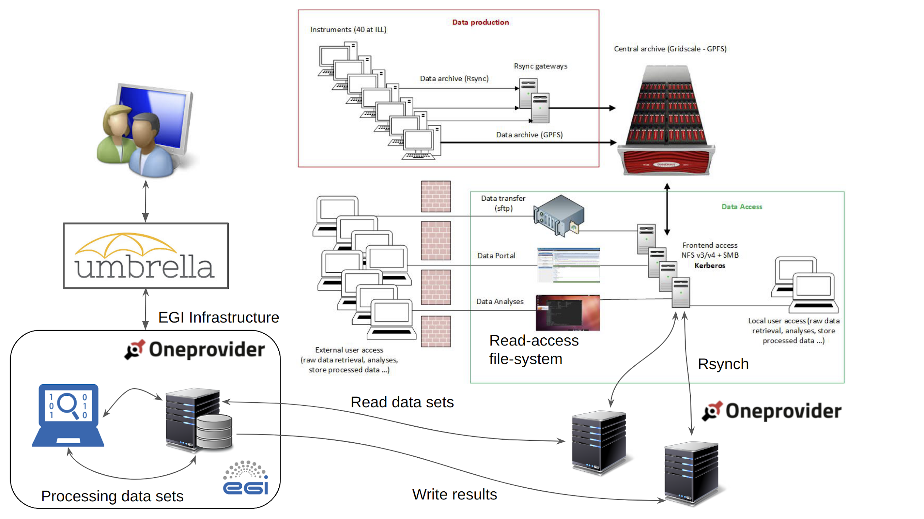
Jupyter notebooks

Slide 8
The EGI Notebooks: Overview
Create interactive documents with live code, visualisations and text
Service based on JupyterHub
JupyterHub hosted in the EGI Cloud:
Offers Jupyter notebooks ‘as Service’
One-click solution: login and start using
Extra EGI Features:
Login with the EGI AAI Check-In service
Persistent storage for notebooks
Use EGI computing and storage resources from your notebooks

Slide 9
The EGI Notebooks: Service Modes
Create interactive documents with live code, visualisations and text
Catch-all instance (https://notebooks.egi.eu)
Available via the Marketplace
Limited resources:
1 CPU, 1GB RAM and 10GB of persistent storage
Sponsored access (free for the users)
Kills notebooks after 1 hour of inactivity (Directories and files are permanent)
Community deployments
Tailored to specific community with custom computing/storage, e.g.:
Access to GPUs, fat nodes
Access to Spark, other BigData/ML environments
...
Clinic session: 04 November, 15:30 - 16:45 CET (http://go.egi.eu/zoom4)

Slide 10
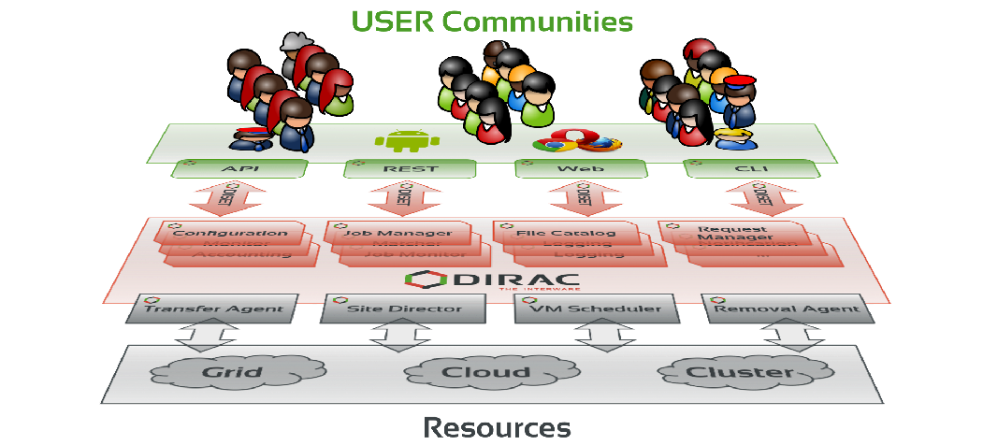
Workload Manager: Overview
Manage computing workloads in an efficient way
DIRAC provides:
a framework for building distributed computing systems aggregating multiple types of resources
an integrated solution with a reach set of ready to use services for managing computing resources, application workloads and data
A framework shared by multiple experiments, both inside HEP, astronomy, and life sciences

Slide 11
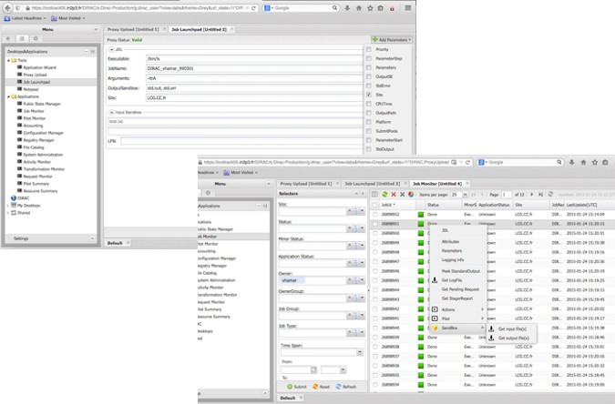
Workload Manager: Services
Manage computing workloads in an efficient way
DIRAC provides access to computing and storage resources
EGI grid and cloud resources, storage elements
User community provided resources (computing clusters, file servers)
User access DIRAC with :
Command line dsub /bin/echo “Hello world!”
Web Portal
Python and REST APIs
Jupyter notebooks (prototype)
Support for massive workload and data operations
Services customizable for the needs of particular communities
Webinar: DIRAC services for EGI 23 October 2020, 14:00 CET
Clinic session: 04 November, 15:30 - 16:45 CET (http://go.egi.eu/zoom2)

Slide 12
Elastic Cloud Computing Cluster (EC3) is a tool to deploy virtual elastic clusters on top of Infrastructure as a Service (IaaS) providers, either public (such as Amazon Web Services, Google Cloud or Microsoft Azure) or on-premises (such as OpenNebula, OpenStack, etc)
EC3 deploys and configures virtual elastic clusters. It relies on IM to deploy the machines and on CLUES to automatically manage the elasticity.
Offers a set of predefined templates to configure the resources through Ansible:
Kubernetes, Mesos, SLURM, Torque, SGE, HTCondor, Nomad.
IM
CLUES
Ansible recipes
Webinars: The Infrastructure Manager (IM), 24 June 2020 Create elastic virtual clusters in the EGI Cloud with the EC3/IM 01 July 2020

Slide 13
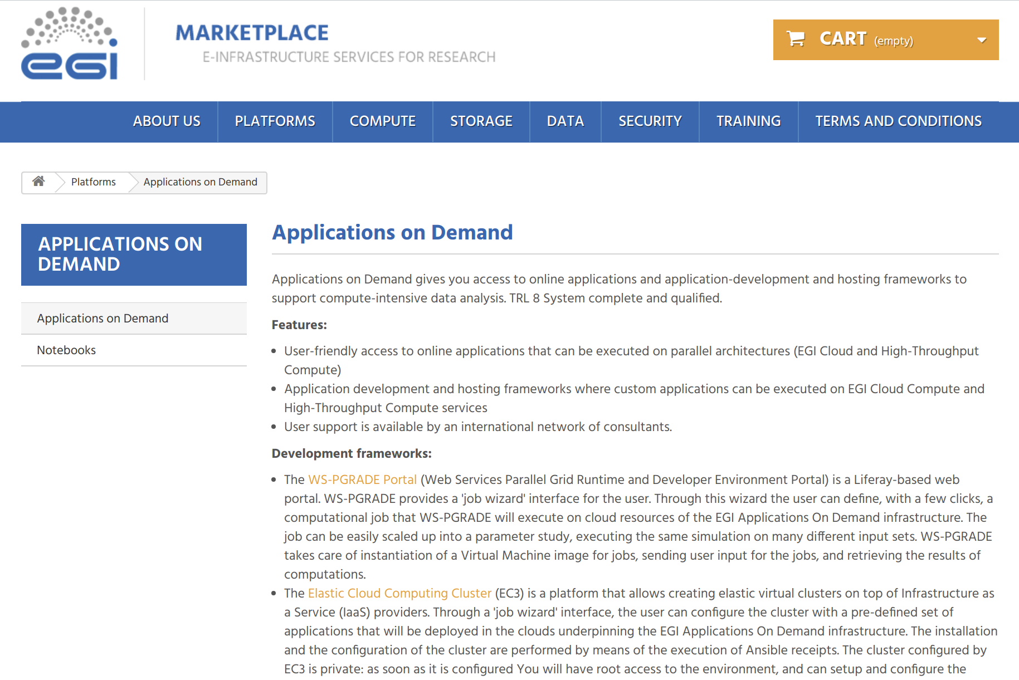
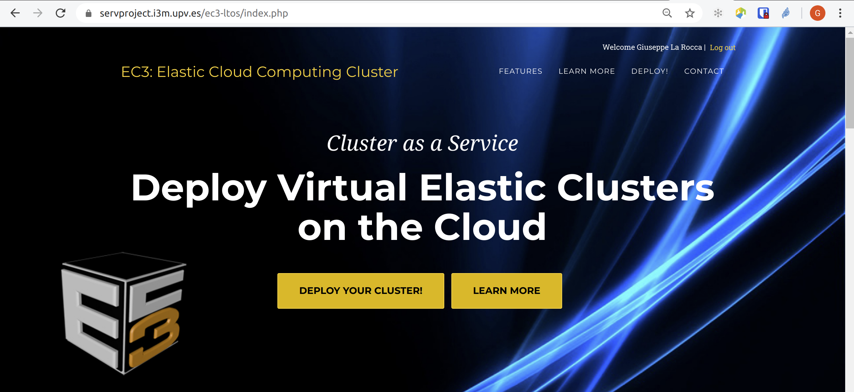
EC3 as a Service (EC3aaS)
EC3 as a Service (EC3aaS), is a web service offered to the community to facilitate the usage of EC3 to non-experienced users
Access link (through the EGI Marketplace)

Slide 14
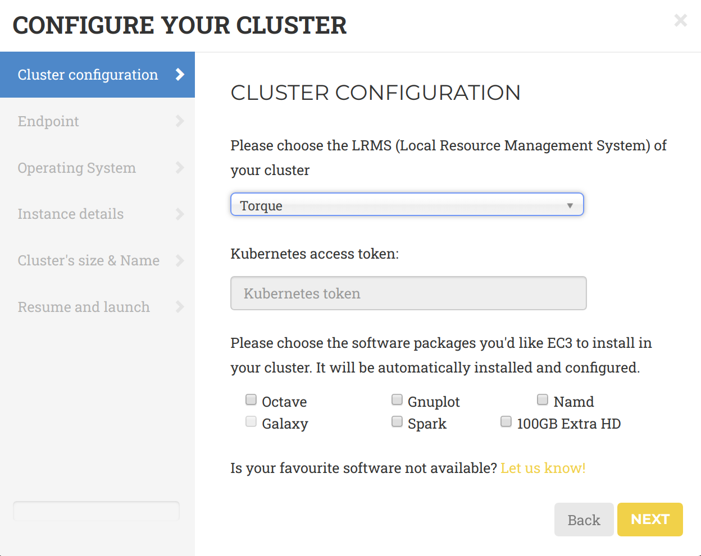
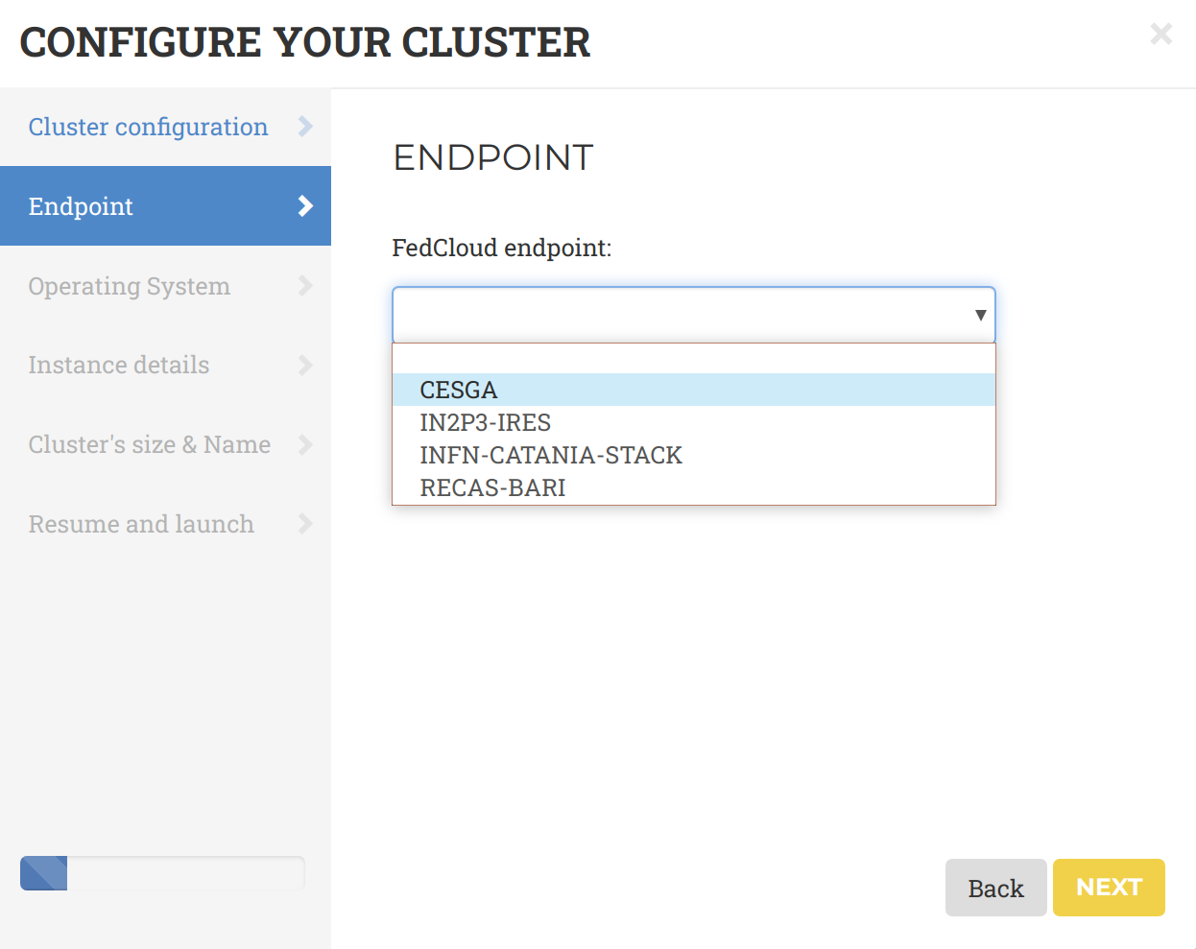
EC3 as a Service (EC3aaS)
A dedicated wizard will guide the user during the configuration process of the cluster
1.) Choose the Local Resource Management System that can be automatically installed and configured in the elastic virtual cluster
2.) Select from the list the endpoint of the providers where to deploy the elastic cluster

Slide 15
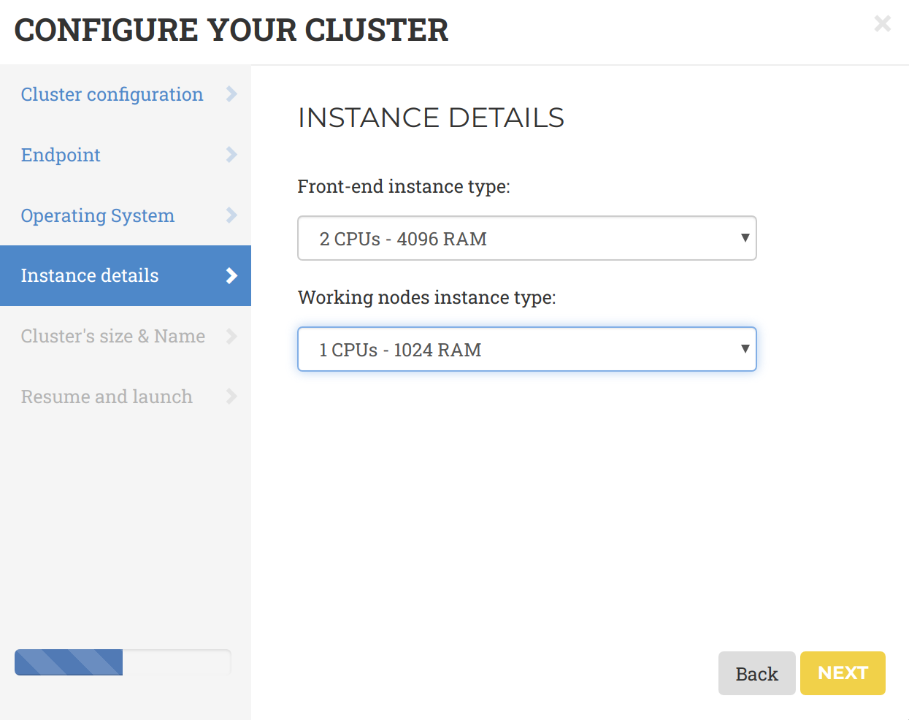
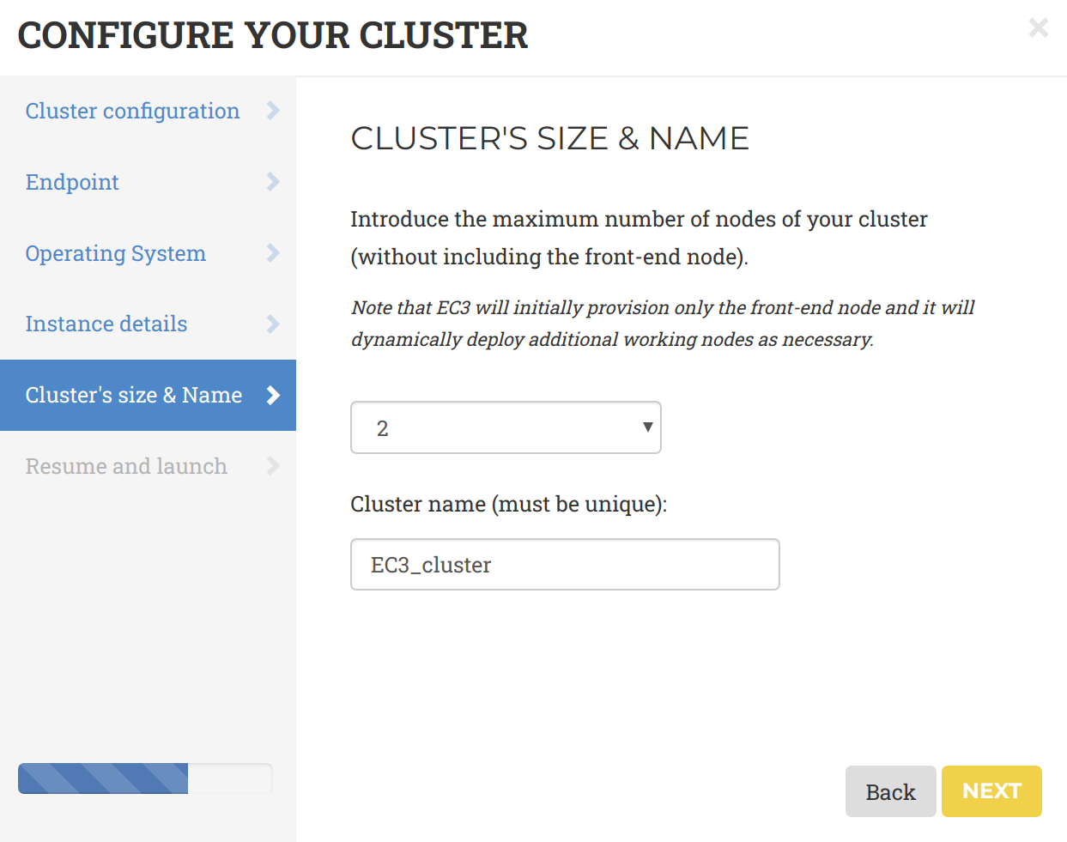
EC3 as a Service (EC3aaS)
A dedicated wizard will guide the user during the configuration process of the cluster
3.) Configure the cluster selecting the base OS images and in the vCPU cores and RAM to allocate for the front-end and the working nodes.
4.) Specify the cluster name and the maximum number of nodes of the cluster.
Clinic session: 04 November, 15:30 - 16:45 CET (http://go.egi.eu/zoom4)

Slide 16
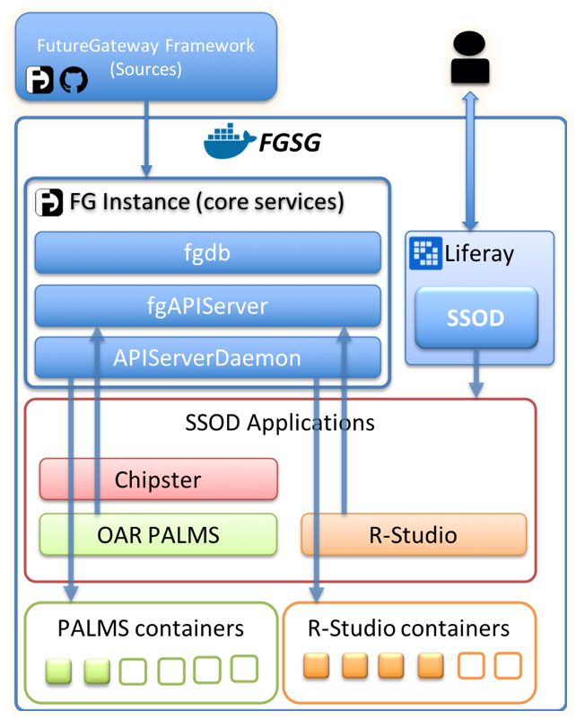
Science Software on Demand (SSoD)
https://fgsg.ct.infn.it/egissod/web/ssod
Science Gateway instance built on top of the FutureGateway Framework and the FGSG infrastructure aiming to improve the visibility of these environments in EOSC
FutureGateway ScienceGateway is a multi purpose platform designed to host one or more science gateways totally built on top of docker containers (Compose + Swarm). It also provides computational power exploiting docker containers
The FutureGateway Framework is a software suite aiming to build quickly and securely well structured Science Gateways. Its core component consists of a set of REST APIs

Slide 17
Science Software on Demand (SSoD)
https://fgsg.ct.infn.it/egissod/web/ssod
Liferay 7.1 portal
+ A customised third party Oauth2 module liferay-oidc-plugin
Federated Authentication
EGI Checkin support EGI federated Authentication and Authorization system
IAM legacy INDIGO-dc authentication module
User membership and user Authorisation are managed by both EGI and the FG
Contents
Welcome Provides general information about the portal
Applications Contains several applications made of different use cases:
RStudio SaaS cloud example, instantiating a personal RStudio instance
Optimal Design Sharing simulation information across researchers
FAIR Science Use cases for Reproducibility and Reusability
PALMS Physical Acrivity Lifelong Modeling & Simulation
Propose How to join FG community and create custom SGs.
Clinic session: 04 November, 15:30 - 16:45 CET (http://go.egi.eu/zoom5)

Slide 18
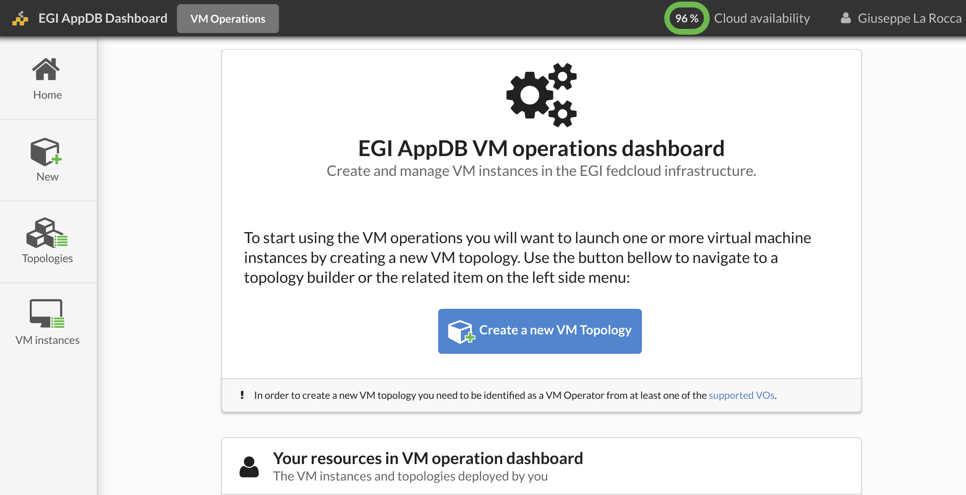
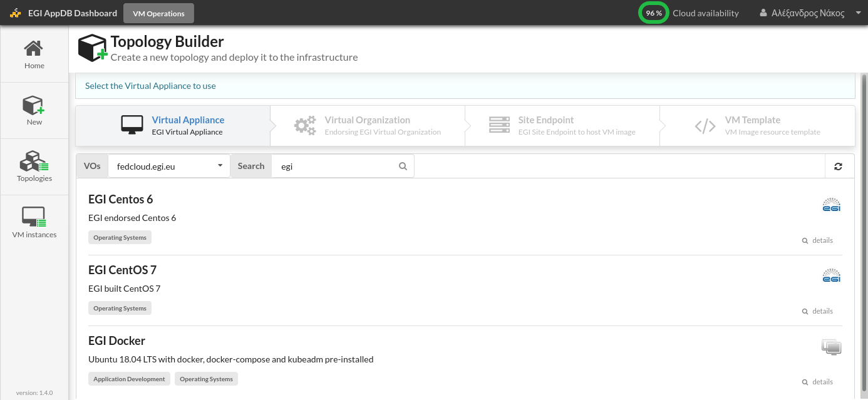
The EGI VMOps dashboard
https://dashboard.appdb.egi.eu/vmops
Provides a set of graphical interfaces to high-level services, in order to deploy and manage VAs and VAs on the EGI Federated Cloud
Easy VMs deployment with a wizard-like interface,
Helping users select, configure and deploy a VM in a few clicks
Perform ad-hoc operations on deployed VMs
Manage and monitor the deployed VMs in a single page

Slide 19
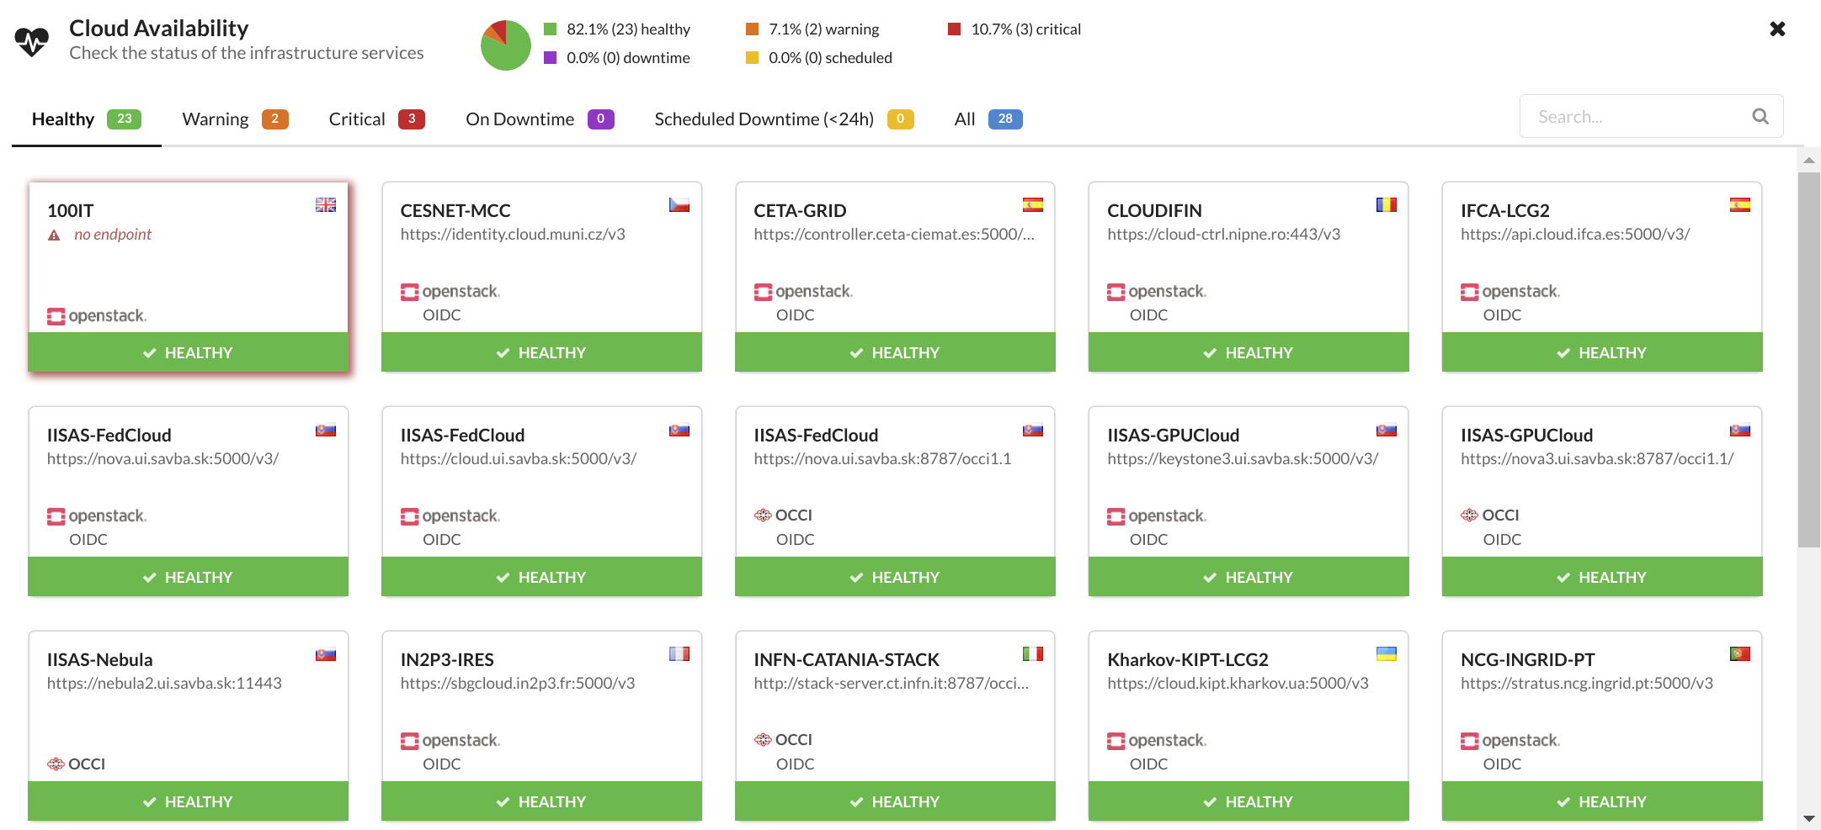
The EGI VMOps dashboard
https://dashboard.appdb.egi.eu/vmops
Enables users to contact cloud provider administrators for troubleshooting
Informs users about cloud provider availability to prevent invalid actions
Webinar: Accessing federated clouds in EGI with VMOps Dashboard, 25 November 2020, 14:00 CET
Clinic session: 04 November, 15:30 - 16:45 CET (http://go.egi.eu/zoom5)

Slide 20
Chipster is a user-friendly analysis software for next generation sequencing data such as scRNA-seq, RNA-seq, ChIP-seq, 16S, etc
Provides an easy access to over 450 analysis tools and reference data
Command line tools
R/Bioconductor packages
Free, open source software
Users don’t need to learn command line syntax of R and dozens of command line application
Chipster enables:
analyze high-throughput data
visualize data efficiently
share analysis sessions
A custom Chipster Web App is available for EGI users
Developed by CSC, Finland

Slide 21
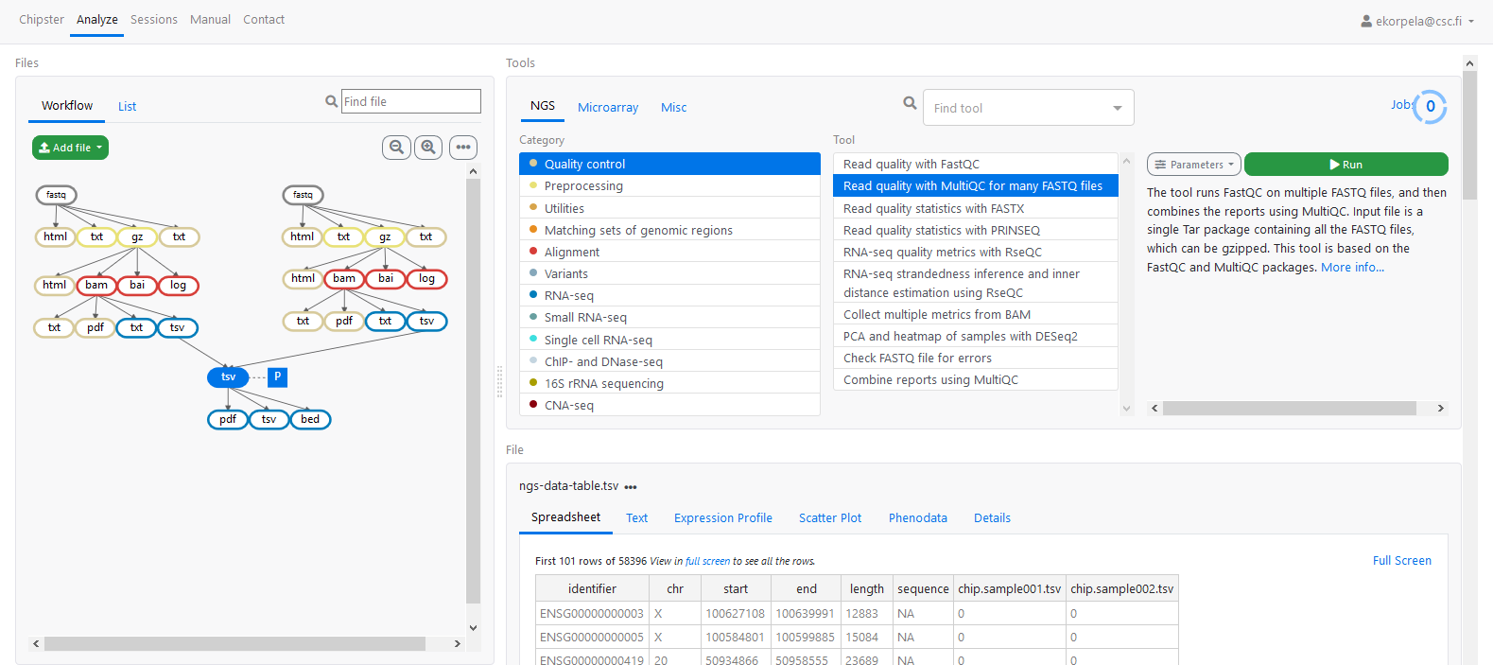
The Chipster web interface

Slide 22
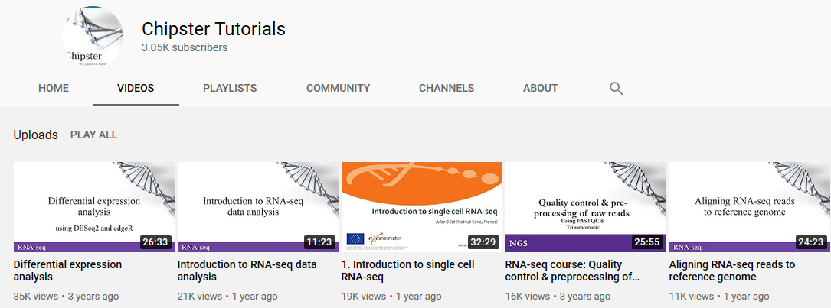
Chipster code base is open source:
Based on Kubernetes running on Ubuntu.
Recommended resources: at least 4 cores, 8GB RAM and 1TB Storage space
Easy to install your own Chipster server
Extensive set of training materials and tutorial videos available:
Webinar: Chipster - a user-friendly bioinformatics software for analyzing high-throughput data, 20 Nov. 2020, 14:00 CET
Clinic session: 04 November, 15:30 - 16:45 CET (http://go.egi.eu/zoom5)

Slide 23
References
The EGI Notebooks service:
https://www.egi.eu/services/notebooks/
https://notebooks.egi.eu
The EGI Workload Manager:
https://dirac.egi.eu/
EC3:
https://servproject.i3m.upv.es/ec3/
https://servproject.i3m.upv.es/ec3-ltos/index.php
The Science Software on Demand (SSoD):
https://fgsg.ct.infn.it/egissod/web/ssod
The EGI VMOps dashboard:
https://dashboard.appdb.egi.eu/vmops
Chipster:
https://chipster.csc.fi/
https://chipster.fedcloud-tf.fedcloud.eu/

Slide 24
Thank you!

