Slide 1
OPERAS’ use case
Clinic: Authentication-Authorisation services
Yoann Moranville (OPERAS/DARIAH)
EGI Conference - 02/11/2020

Slide 2
OPERAS
Open Scholarly Communication in the European Research Area for Social Sciences and Humanities
A distributed Research Infrastructure
Services are being provided and managed by OPERAS members (so flexibility is mandatory)
Making Open Science a reality for research in the SSH

Slide 3
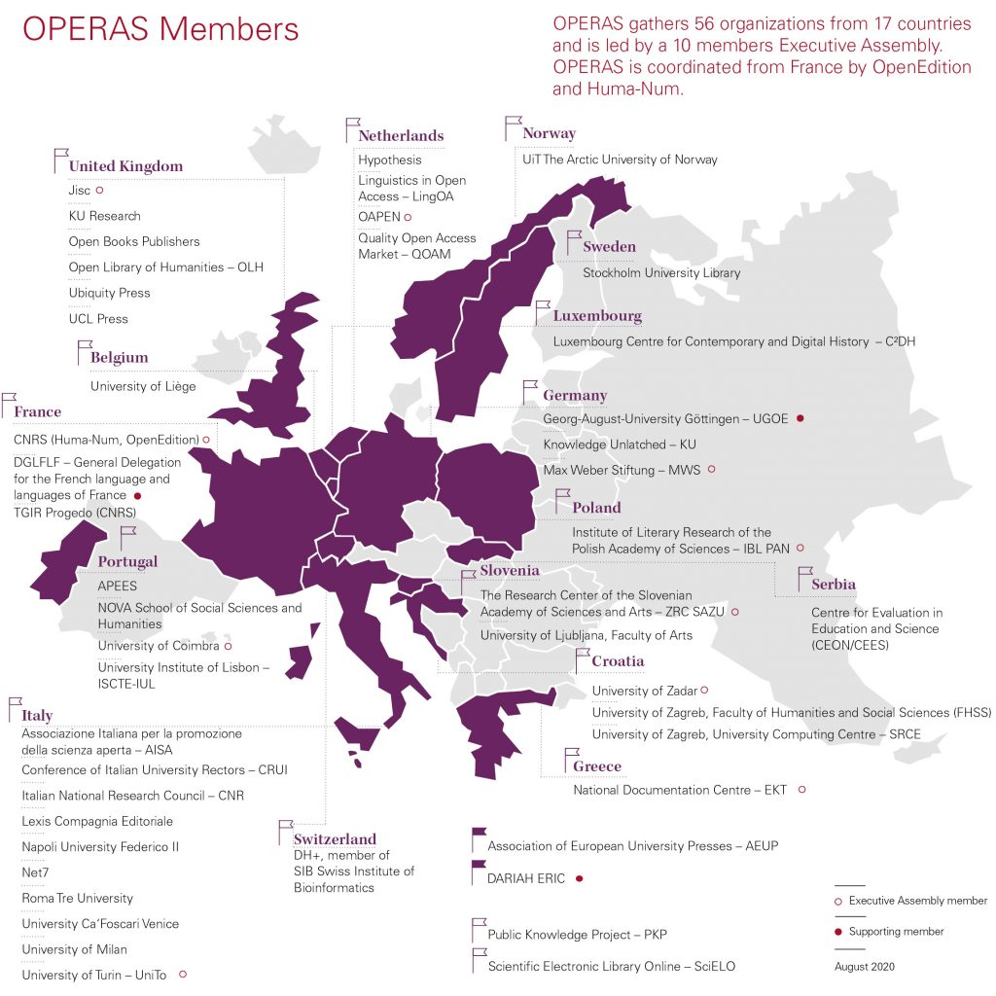

Slide 4
OPERAS Services in EGI Check-In
Currently 5 Core services existing or being built
Production
Research for Society
Beta
Metrics
Certification (DOAB)
In development
Discovery (GOTRIPLE)
Publication Service Portal (Pathfinder)

Slide 5
OPERAS Services in EGI Check-In
 | Integrated (dev)
 | Integration acted but work not finished
 | Later stage
OPERAS Publication Service Portal
OPERAS Discovery Service
OPERAS Certification Service
OPERAS Metrics Service
OPERAS Research for Society

Slide 6
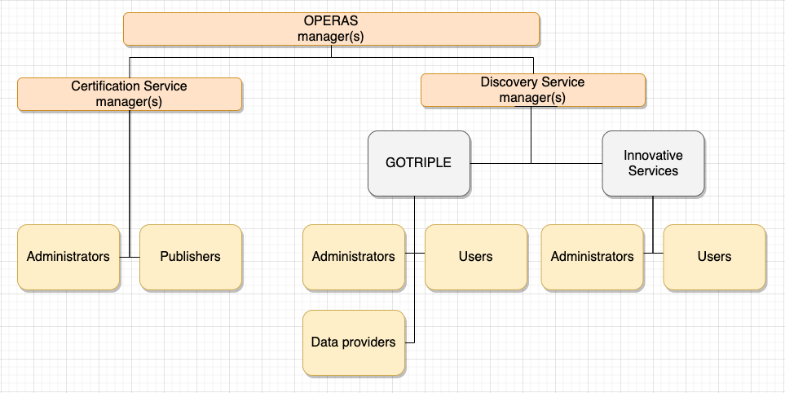
OPERAS Virtual Organisation
Check-in
Management

Slide 7
OPERAS Virtual Organisation
Check-in
Management
Entitlements
urn:mace:egi.eu:group:vo.operas-eu.org:DOAB:Admins.DOAB
urn:mace:egi.eu:group:vo.operas-eu.org:DOAB:Publishers.DOAB

Slide 8
Different scenarios / services
Publication Service Portal (Pathfinder)
Already integrated with Check-in (dev level)
Acted as Proof of Concept for us
OpenID Connect (PHP library)
Service is released
→ integration with production level AAI

Slide 9
Different scenarios / services
Certification Service (based on DOAB)
Currently being redesigned
Check-in integration for early 2021
SAML2.0 protocol with Shibboleth
DSpace already includes a plugin for Shibboleth

Slide 10
Different scenarios / services
Discovery Service (GOTRIPLE Platform)
Being developed and will be released in 2022
Check-in integration is being already started
Includes innovative services
integration at different levels
Info: Wednesday at 3:30pm (AAI session)

Slide 11
Different scenarios / services
Metrics Service
Pending integration, in discussion
Use of OAuth2 Device Authorization Grant?
API calls from scripts to a restricted API
User interaction once per 13 months
→ compromise?

Slide 12
Different scenarios / services
Research for Society
Already in production
→ already has its own authentication and authorisation internally
Discussions for integration with Check-in
Not yet started

Slide 13
Thanks!
www.operas-eu.org

