Slide 1


Global Open Science Cloud
Support and Lessons from the GREN
Erik Huizer
4th November 2020
www.geant.org

Slide 2
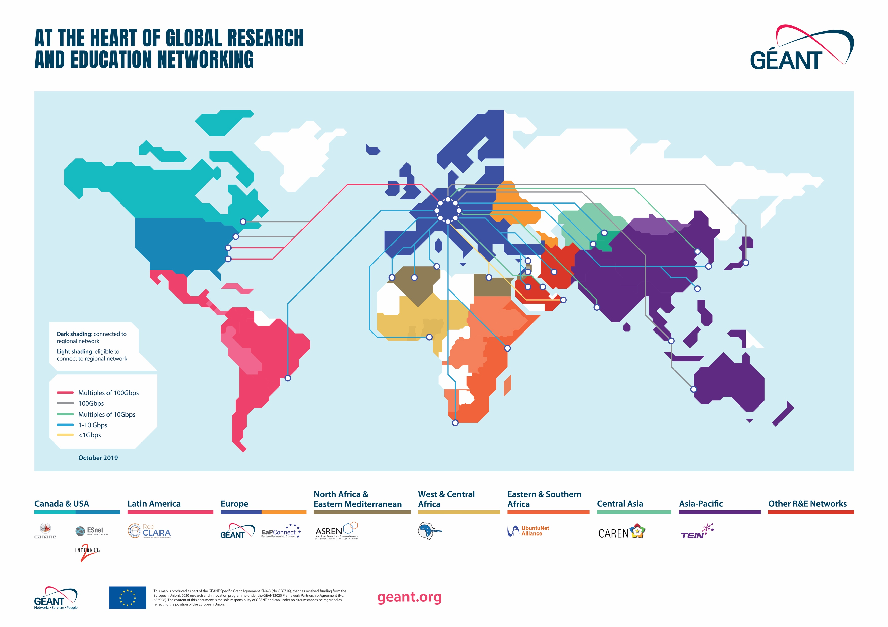

International Connectivity
Bella project

Slide 3
The Global REN

Slide 4
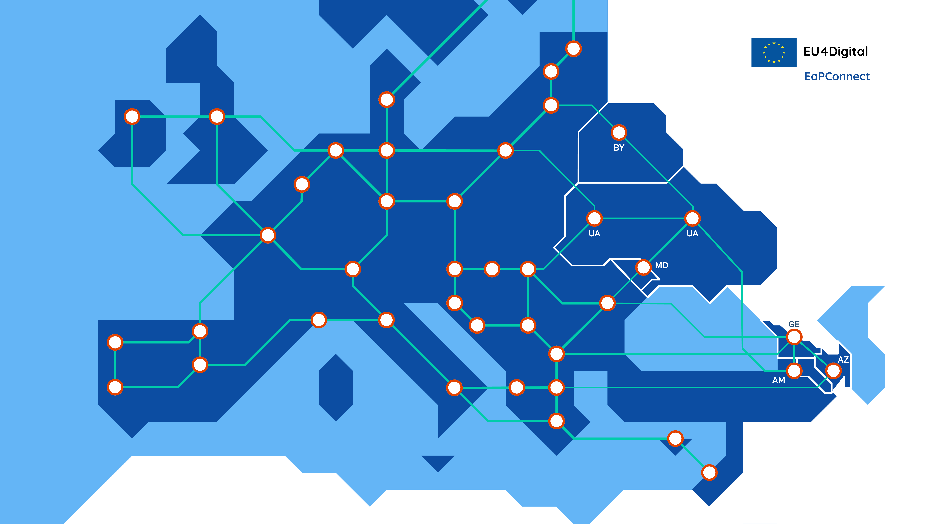
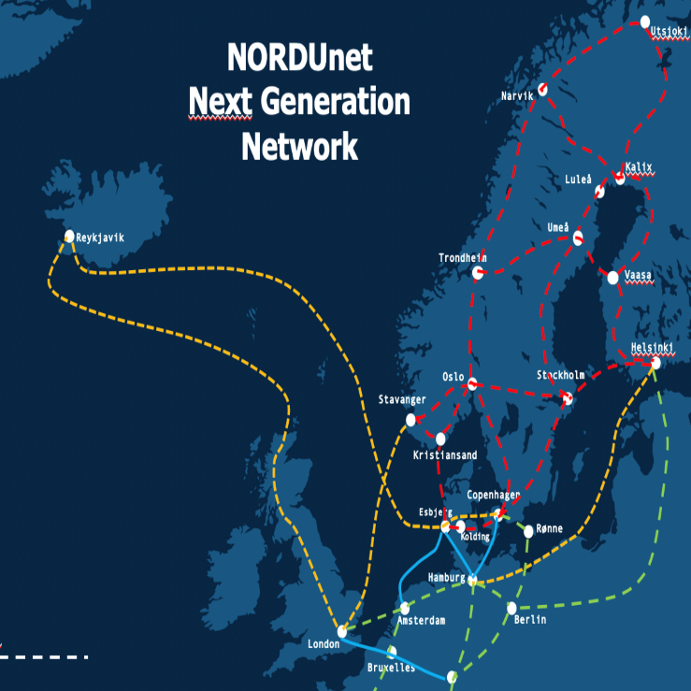

Slide 5
Swedish R&E Network SUNET
Notes:
This GREN is ready to support a global open science cloud – federation, interoperability, shared standards and close collaboration will be the key to success

Slide 6

Thank you
www.geant.org
© GEANT Limited on behalf of the GN4 Phase 2 project (GN4-2).
The research leading to these results has received funding from the European Union’s Horizon 2020 research and innovation programme under Grant Agreement No. 731122 (GN4-2).

