Slide 1
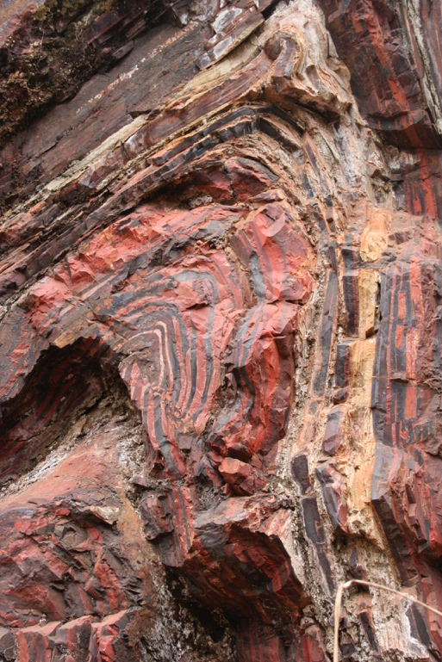
Supporting Global Open Science with Collaboration in Geoinformatics
Kerstin Lehnert, Columbia University, USA
Lesley Wyborn, Australian National University, Australia
Contact: LEHNERT@LDEO.COLUMBIA.EDU
Notes:
Lesson that

Slide 2
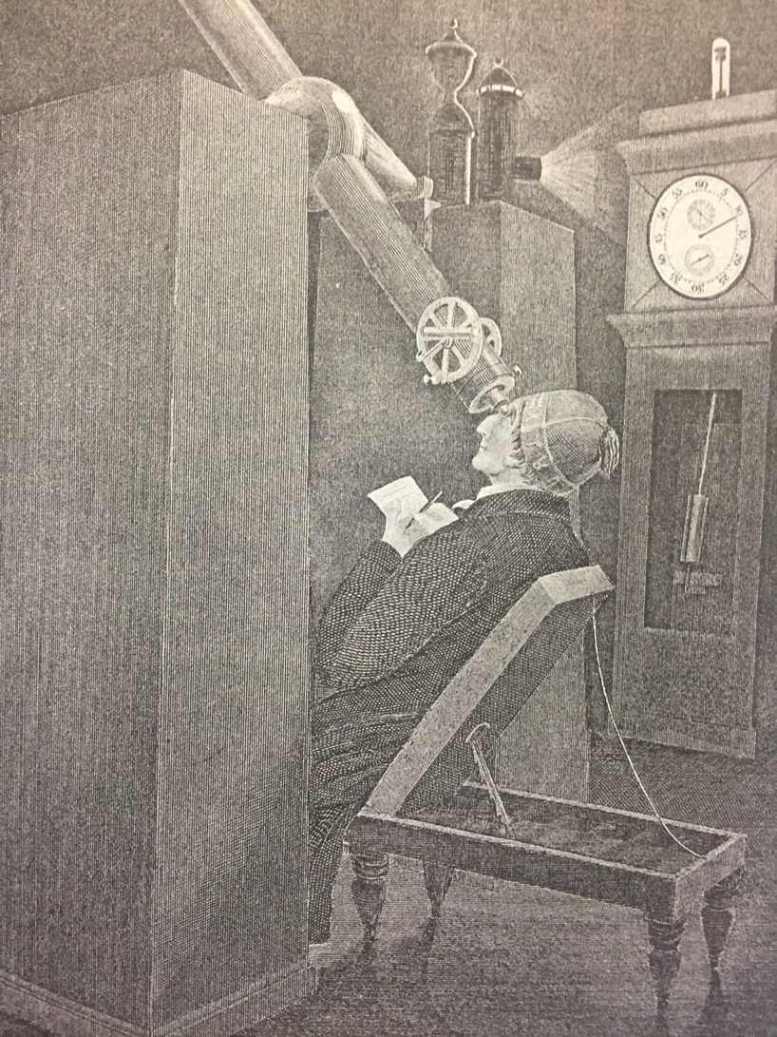
Global Sharing
In 1716 British astronomer Edmund Halley published a ten-page essay, which called upon scientists to unite in a project spanning the entire globe – one that would change the world of science forever. On 6 June 1761, Halley predicted, Venus would traverse the face of the sun....
... Through that observation, astronomers could calculate the size of the solar system – but only if they could compile data from many different points of the globe, all recorded during the short period of transit...
... And only if they combined these results could they achieve what had hitherto been almost unimaginable: a precise mathematical understanding of the dimensions of the solar system.
Andrea Wulf: Chasing Venus, The Race to Measure the Heavens (First Vintage Books Edition, Feb 2013)

Slide 3
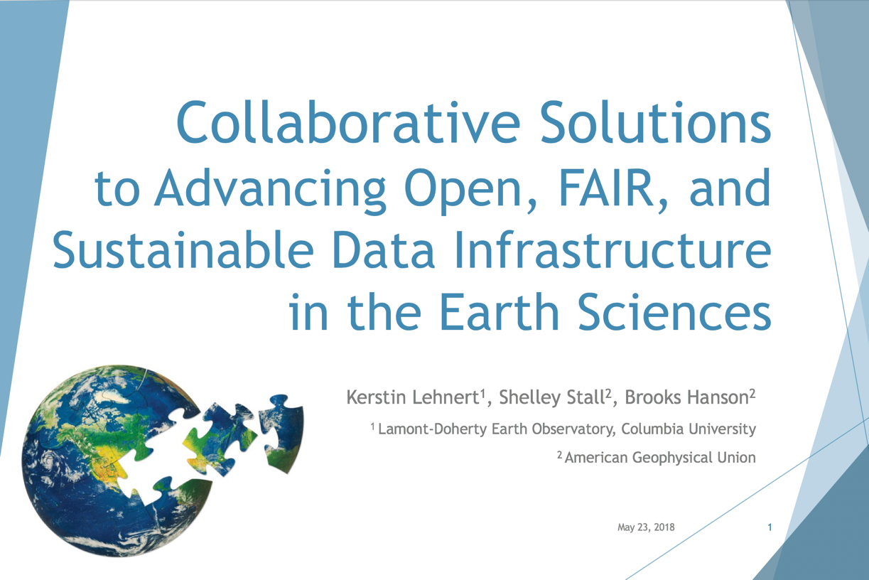
EGU 2018
JpGU 2018
Deep-time Digital Earth Forum 2019
AGU 2019 Town Hall

Slide 4
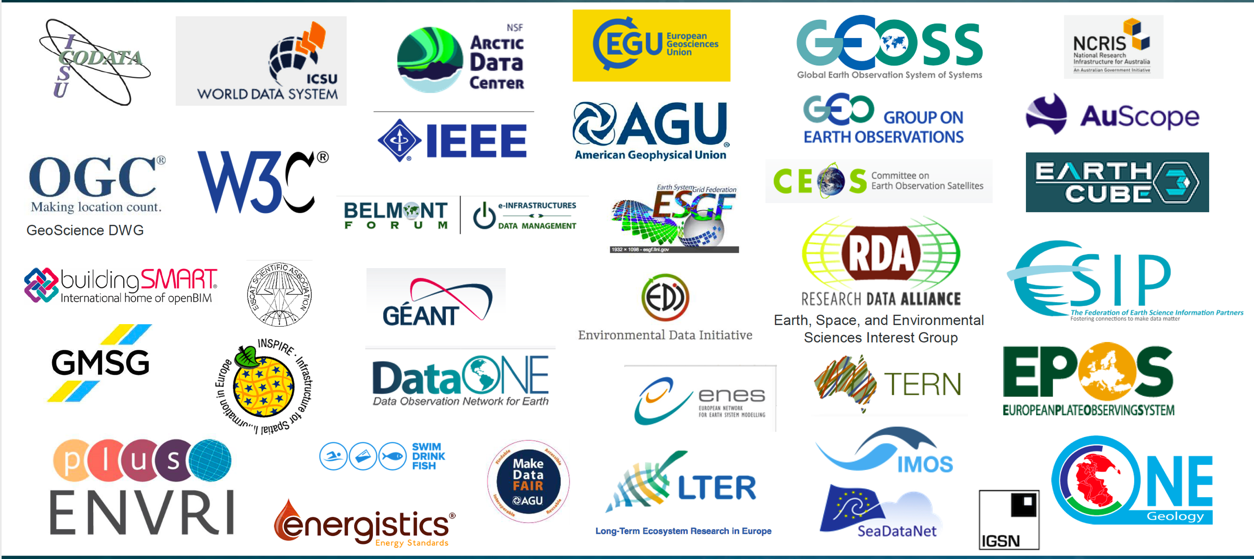
From: Wyborn et al., EGU 2018
Notes:
Many different types of collaboration, difficult ti navigate the landscape

Slide 5
Why We Need to Work Together
Converge on essential elements of data infrastructure development & operation
Stabilize solutions through common adoption (technical standards, best practices, policies, values)
Minimize confusion for users
Understand and appreciate each others capabilities, requirements, and constraints
Maximize use of limited resources
Avoid duplication of effort, leverage expertise
Create efficiencies of scale
Share infrastructure where possible

Slide 6
Driving Convergence: Collaborations in Geoinformatics (Examples)
Disciplinary – Best Practices - Global
Best Practices & Standards: OneGeochemistry
Policies & Procedures: COPDESS (Coalition for Publishing Data in the Earth & Space Sciences)
Cross-disciplinary – Infrastructure & Best Practices - Global
IGSN Global Sample Number
Disciplinary – Infrastructure - National
Council of Data Facilities (CDF): Shared Infrastructure Initiative

Slide 7
OneGeochemistry
“OneGeochemistry seeks to create a global geochemical data network that facilitates and promotes discovery and access of geochemical data through coordination and collaboration among international geochemical data providers.”
Opportunities for new research paradigms demand access to interoperable, ideally integrated global data resources.
Implementation of the FAIR data principles by publishers requires development, implementation, and governance of data best practices and standards by an international community.

Slide 8
OneGeochemistry Vision
A distributed architecture, where geochemical data are available globally using standard web services.
Generate standards for sustainability (and funding) of data repositories.
Requires that the international geochemistry community come together and agree on the standards (including vocabularies and ontologies) that will enable geochemical data from participating providers to be FAIR.
Partner with relevant professional societies such as the Geochemical Society and science unions (e.g. IUGS-CGI, IUPAC): Kick-off workshop planned with support from the Geochemical Society
Bring together large research infrastructure providers (AuScope/Australian Geochemistry Network, EPOS/Multi-scale Laboratories, EarthCube, EarthChem, etc.)

Slide 9
COPDESS
Coalition for Publishing Data in the Earth & Space Sciences
www.copdess.org
Connects and fosters international dialogue and coordination between publishers and data facilities.
Founded in 2014, now supported by the Earth Science Information Partners Federation (ESIP).
Created Statement of Commitment regarding supporting and following best practices around open data, signed by publishers and data repositories.
Became foundation for AGU’s Enabling FAIR Data Project that developed and promoted recommendations and guidelines for implementing the full research data ecosystem.

Slide 10
Current COPDESS Topics
Implementation of FAIR Data principles by publishers.
Need to address current lack of clear and detailed guidelines, workflows, and policies that help authors, editors, and data curators navigate new publishing requirements.
Development & governance of domain-specific data best practice. (OneGeochemistry!)
Coordination between publishers and repositories on domain-specific criteria for recommended data & software repositories.

Slide 11
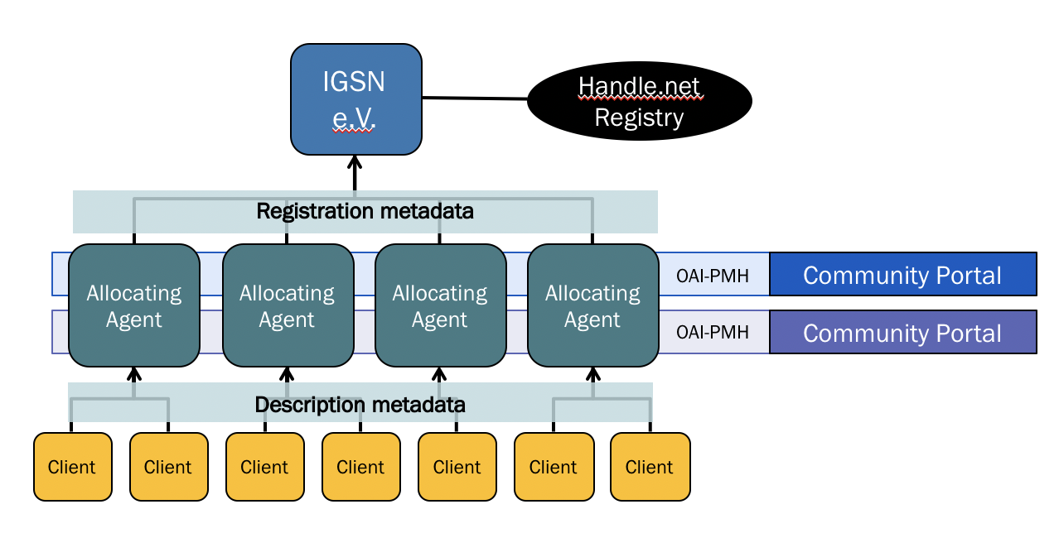
IGSN: International Collaboration to Make Samples FAIR
Globally unique & persistent identifier for physical specimens and samples.
Distributed architecture with local Agents (builds on the governance structure and technical architecture of DataCite).
Governed by an international organization with membership in 5 continents (IGSN e.V.);
8,362,375 samples registered globally.
Integrating scientific samples & collections into the research data ecosystem.

Slide 12
Ensuring a Sustainable Future: The IGSN 2040 Project
Funded by the Alfred P. Sloan Foundation
Develop business model and governance for sustainability, stability, and trustworthiness of registration services.
Partner with existing organizations
Build a “Community of communities”
Design a scalable and flexible architecture for rapidly growing number of IGSN & increasing diversity of specimen types, use cases, and stakeholder requirements.
Move IGSN Central Services to the cloud.
Transition from XML-based metadata to web architecture based on sitemaps.

Slide 13
Council of Data Facilities Shared Infrastructure Initiative
Improve capacity and capabilities of data facilities
Coordinate and converge on technology and operational procedures
Enhance sustainability and resiliency of data facilities
Notes:
Provide a collective voice on behalf of the member data facilities to the NSF and other foundations and associations, as appropriate
Identify, endorse, and promote standards and best or exemplary practices in the organization and operation of a data facility
Identify and support the development and utilization of shared infrastructure services, including computing services, professional staff development and training services, and related activities
Foster innovation through collaborative projects
Collaborate with standard-setting bodies with respect to standards for data sharing and interoperability, metadata, and related matters

Slide 14
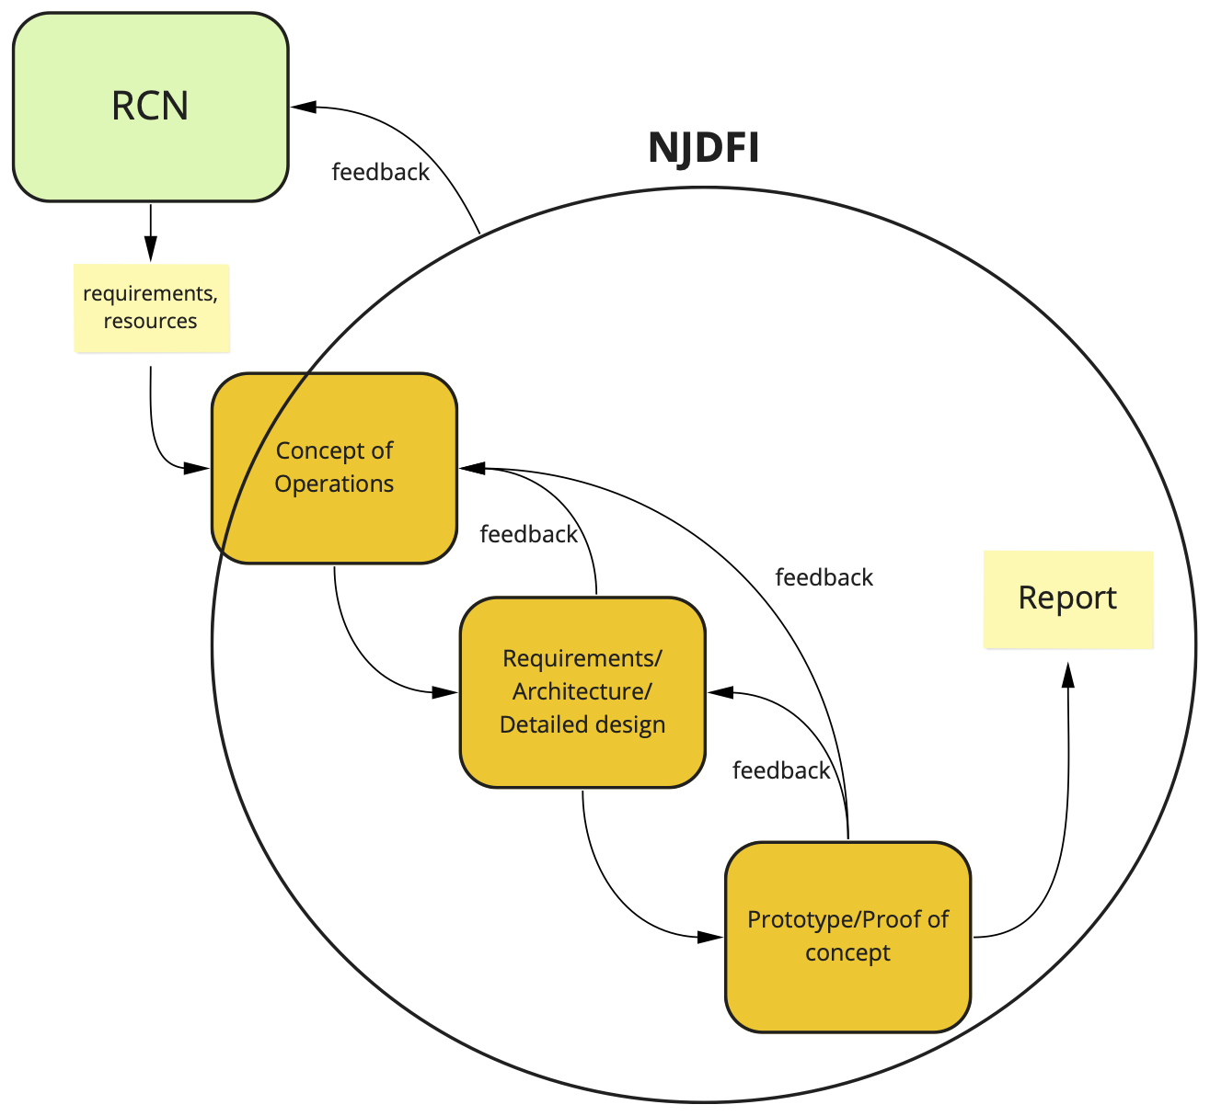
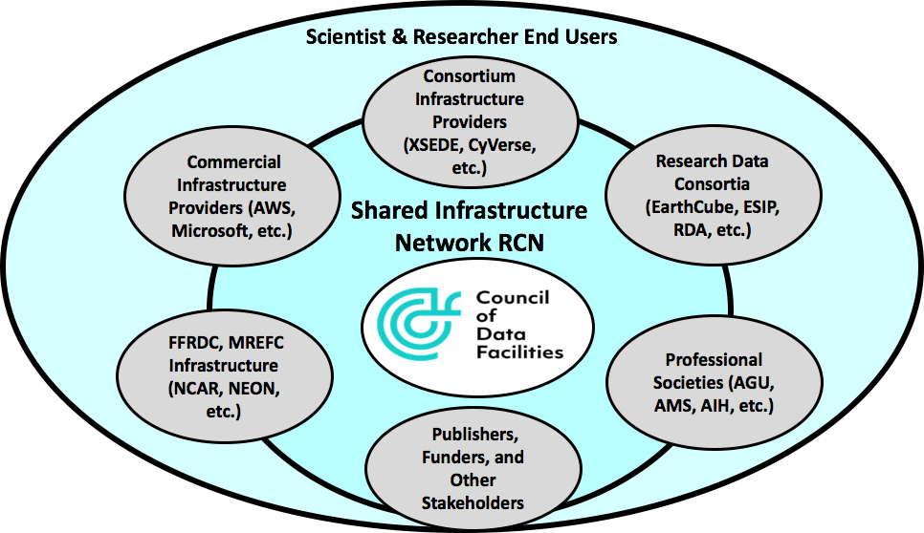
CDF Shared Infrastructure Initiative Proposed Activities
Sharing Infrastructure Across Data Facilities and Cyberinfrastructure Providers (RCN)
Next Generation Joint Data Facility Infrastructure Design and Prototyping

Slide 15
What we need to progress …
What we need are mechanisms to internationally link these major infrastructures to provide:
efficiencies in funding (stop reinventing the wheel!)
an environment where the research efforts can create globally interoperable networks of solid Earth science data, information systems, software and researchers.

Slide 16
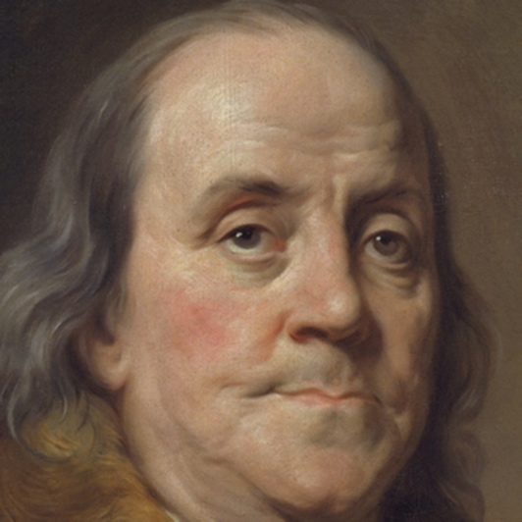
My Favorite Quote at the End:
“We must, indeed, all hang together or, most assuredly, we shall all hang separately”.
Benjamin Franklin

