Slide 1
EGI SMS, SPM process and current service offer
Matti Heikkurinen
Strategy and Innovation Officer

Slide 2
Outline
Short intro to the EGI SMS
Introduction to the SPM process
Basic SPM concepts
How to add new services in the EGI service portfolio
SDTP
The current EGI service portfolio

Slide 3
IMS, SMS, SPM?
Integrated Management System (IMS) - coherent set of processes to:
Turn strategy into executable, traceable actions - break a major challenge into manageable “chunks”
Ensures that the left hand knows what the right feet are doing
E.g. ISO 20k - from HR/Finance to IT Capacity planning
Service Management System (SMS)
Processes focused on consistent, predictable service delivery
Agree what it “says on the tin”, ensure delivered services match the descriptions
Service Portfolio Management (SPM)
Lifecycle of the service: from “business planning” to gracious “sundowning”
Service Portfolio contains detailed recipes for deploying services
Once reviewed and validated, they can be published and promoted to users

Slide 4
Formal IMS definition
Integrated management system is the framework of policies, processes and procedures used by EGI Foundation to ensure that it can fulfil all the tasks required to achieve its objectives.
The objective:
to ensure systematic and professional operation and delivery of EGI Foundation services.
to plan, implement, monitor and continually improve all business processes under the responsibility of EGI Foundation.
It integrates all of the distributed organization's systems and processes into one complete framework, enabling an organization to work as a single unit with unified objectives.

Slide 5
IMS: Core Processes
Risk management
The systematic and regular identification, assessment and treatment of risks of any type
Finance & administration
Effective management of finance, business and office administration
Human resources
Ensure effective management of human resources
Business development & stakeholders
Stakeholder management (including Council participants and funding agencies/policy makers), review the EGI Strategy and its implementation
Information security management
Manage information security to ensure confidentiality, integrity and accessibility of relevant information assets
Continual improvement
Identify, prioritize, plan, implement and review all improvements

Slide 6
IMS: General Processes
Service portfolio management
Manage the service portfolio; alignment of new or changed services with organisation strategy
Service level management
Maintain a service catalogue; define, agree and monitor relevant agreements (SLA, OLA, UA)
Service reporting management
Specify all service reports and ensure its production according to specifications in a timely manner to support decision-making
Customer relationship management
Identify, record and analyse customer opportunities; manage service orders and maintain a good relationship with customers
Supplier & federated members relationship management
Establish and maintain a healthy relations with suppliers supporting the services; ensure the required capacity and monitor performance
Budgeting & accounting management
Ensure effective management of budgeting, accounting for services

Slide 7
IMS: IT Processes
Capacity management
Ensures sufficient capacities to meet agreed service levels and monitor performance requirements for services
Service availability & continuity management
Ensure sufficient service availability to meet agreed requirements and adequate service continuity in case of exceptional situations
Incident & service request management
Restore normal / agreed service operation in case of an incident; respond to user service requests
Problem management
Investigate the root causes of (recurring) incidents in order to avoid future recurrence of incidents
Configuration management
Provide and maintain an information about logical model of service components and its configuration
Change management
Ensure changes are planned, approved, implemented and reviewed in a controlled manner
Release & deployment management
Manage releases, so that changes can be tested and deployed to the live environment

Slide 8
IMS: What benefits does it bring?
It puts in place standard processes, procedures and agreements for managing the infrastructure efficiently and effectively.
It increased clarity on expectations between EGI partners and also customers.
It made decision-making clearer between organisations and individual teams.
Knowledge and experience that can be reused by other e-infrastructures through consultancy, audits, workshops and trainings.

Slide 9
IMS: Quality Control
Management reviews
Internal audits
External audits

Slide 10
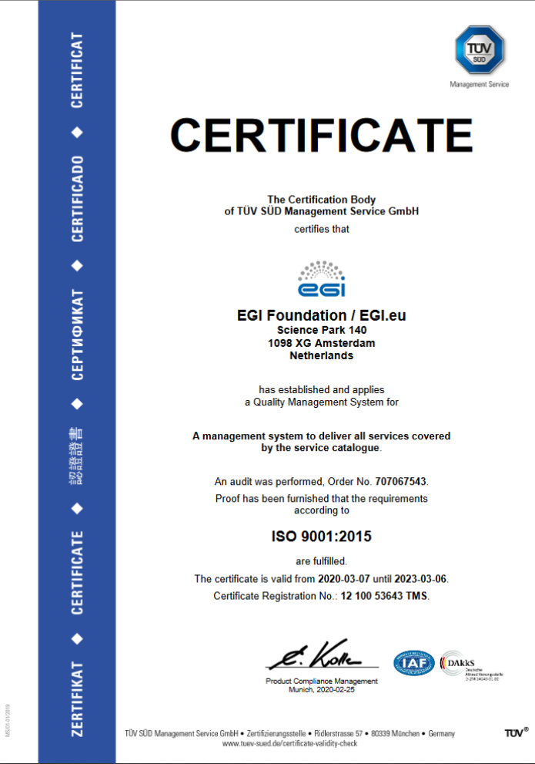
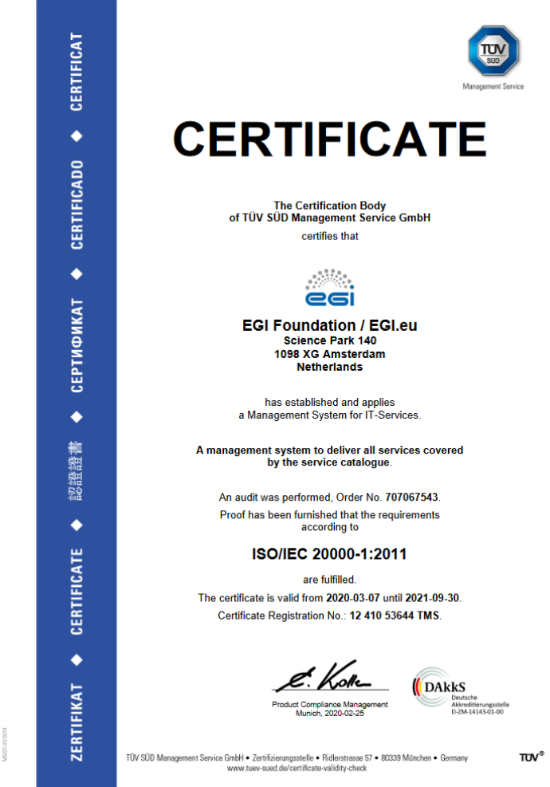
IMS: ISO Certifications
ISO 9001
ISO 20000

Slide 11
Questions/Comments Re. IMS?
Next up:
SMS process (or: how do we write the “service cookbook”?)

Slide 12
Service Portfolio management SPM
Layer 2: General Service Management
Goal: The goal of this process is to manage the service portfolio in order to ensure its regular review and to align new or changed services with business decisions as part of the overall organisation strategy. The process deals with major changes to services as defined in the Change management policy.
Process manager: Owen Appleton
Main outputs: Service portfolio (definition and planning of EGI service offer – past, future, current), SSB
Procedures and policies:
SPM1 Add, Change, Retire a service in the service portfolio

Slide 13
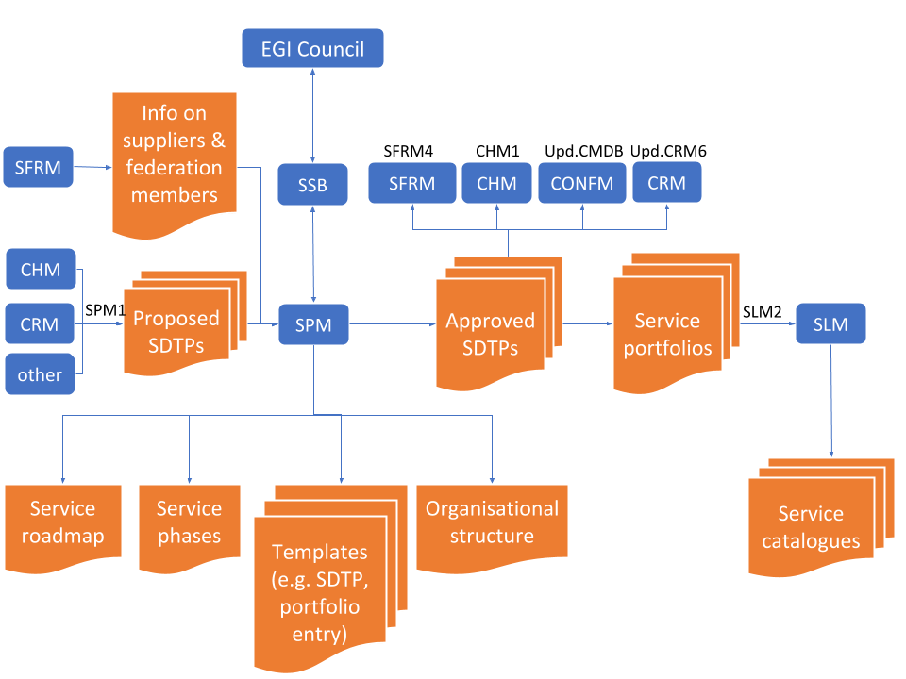
You’re here!
Notes:
Script/talking points:
This is complex, because reality is somewhat complex, too.
The diagram presents two things:
The link between the technical templates (that we’ll dive into in the follow-up session) and the strategic decision making o fEGI. This is the vertical dimension
SPM does technical evaluation of portfolio entry: would the service work?
SSB does strategic evaluation of the service: would the service support the goals of the organisation
The way services go from planning/proposal stage and eventually become active services supported through several IMS processes:
Supplier, Federation Member Relationship Management SFRM - “make sure we have virtual computers and disks”
Change Management: the “left hand/right foot” coordination (in IT, at least one limb is holding a knife!)
Configuration Management: prevent the issues that people consider “IT problems” - running out of disk space, memory,...
CRM: plan how to make sure customers are happy (we may provide perfect service according to a specification, but the customer won’t be happy if the service is not they really need: the needs and/or the users’ understanding of them evolves over time. Think of an optician - lenses might stay perfect, but eyes, amount of screen time, hobbies and professional tasks do.
SLM: publish the service, negotiate SLAs with users and OLAs with providers: basically: design the “hooks” that allow monitoring the performance of the service when it is running, trigger actions if the performance threatens to drop below the accepted level, do service recovery if things go wrong,...

Slide 14
Service Design and Transition Package
AKA SDTP, “SPM Fuel”
Formal definition
“Entirety of plans for the design and transition of a specific new or changed service”
Requirements (acceptance criteria), documents, plans etc.
Specific to the SMS system, but FitSM provides a template
EGI: FitSM-based (more comprehensive than e.g. EOSC one)
Value Proposition
User profile, Service categorisation, success criteria,...
Business case
Demand scenarios, cost/revenue projections,...
Service Design
Requirements, Architecture, Order workflow, Service Acceptance Criteria, cost structure,...
Transition plan
Detailed plan/checklist for launch
More details and concrete cases: next session!

Slide 15
Visible part of SPM: Service Catalogue
The list of services that EGI as a federation offers for research & innovation
Compute
Storage and Data
Training
Applications
Cloud Compute
Online Storage
FitSM Training
Applications on Demand
Cloud Container Compute
Archive Storage
ISO 27001 Training
Notebooks
High-Throughput
Compute
Data Transfer
Training Infrastructure
Security
Workload Manager
Check-in

Slide 16
The “invisible” parts of SPM
Processes used to manage service descriptions
Services that are
Not yet onboarded
Being retired
Internal (but managed as part of SPM)
Management reviews of the processes

Slide 17
Questions/comments re. SPM?
Next up: EGI Service Portfolio examples (mostly for reference)

Slide 18
EGI Internal Service Portfolio
The list of services delivered internally to the EGI federation to enable the EGI providers to work together
Coordination
Operations
Security
Communications
Accounting
Attribute Management
Project Management
and Planning
Collaboration Tools
Check-in
Strategy and Policy Development
Configuration Database
Community Coordination
Helpdesk
Operations and Support
Operational Tools
ITSM Coordination
Service Monitoring
Security Coordination
Validated Software and Repository
Technical Coordination
Marketplace

Slide 19
Compute services

Slide 20
EGI Cloud Federation
Multi-cloud IaaS with Single Sign-On
Federation features:
Common VM image catalogue
Discovery, accounting, SLA monitoring
Unified GUI dashboard
EGI Services powered by the Cloud Federation
Cloud Compute
Online Storage
Applications on Demand BETA
Cloud Container Compute BETA
Training Infrastructure
Notebooks BETA
Notes:
List of services of EGI powered by the EGI Cloud Federation

Slide 21
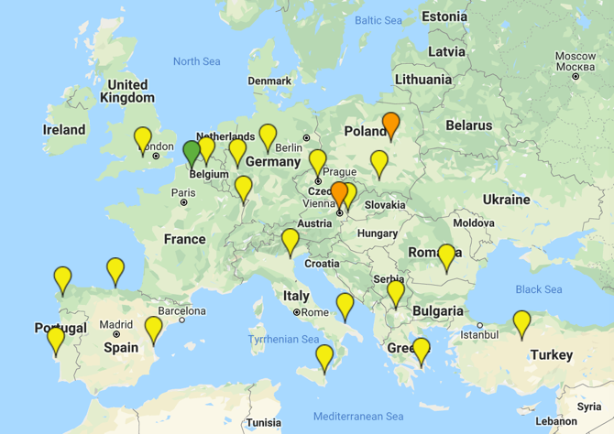
The infrastructure
New!
Finalising integration!

Slide 22
Cloud Compute
Deploy and scale virtual machines on-demand.
API-controlled computational resources in a secure and isolated environment without the overhead of managing physical servers.
Cloud Compute offers the possibility to select pre-configured virtual appliances (e.g. CPU, memory, disk, operating system or software) from a catalogue replicated across all EGI cloud providers. With Cloud Compute you can:
Execute compute- and data-intensive workloads (both batch and interactive)
Host long-running services (e.g. web servers, databases or applications servers)
Create disposable testing and development environments on virtual machines and scale your infrastructure needs
Select virtual machine configurations (CPU, memory, disk) and application environments to fit your requirements
Manage your resources in a flexible way with integrated monitoring and accounting capabilities

Slide 23
Cloud Container Compute
Deploy and scale Docker containers on-demand using Kubernetes technology
Cloud Container Compute offers users offers guaranteed computational resources in a secure and isolated environment with industry-standard Kubernetes container orchestration platform that:
Manages the nodes where to run the containers
Automates the deployment, management, scaling, networking, and availability of container-based applications running on that cluster.

Slide 24
High Throughput Computing
aka the grid
Execute thousands of computational tasks to analyse large datasets
Supported by a distributed network of computing centres:
>1,000,000 cores of installed capacity
> 1.6M computing jobs per day.
Integrated monitoring and accounting tools to provide information about the availability and resource consumption
Large amounts of processing capacity over long periods of time

Slide 25
EGI Compute Services
EGI Cloud Compute, Cloud Container Compute and HTC
 | Cloud Compute | Cloud Container Compute | High Throughput Compute
What is it? | Multi-cloud IaaS | Kubernetes on top of EGI Cloud Compute | The grid, a scalable batch system
What you run? | VMs | (Docker) Containers | Jobs
Typical workloads | Lift and shift existing applications Specific OS (kernel) requirements | Cloud-native containerised applications. | Execution of parallel computing tasks to analyse large datasets.
Pros / Cons | [+] Complete control on resources, run (almost) anything you’d like [-] Complex operation | [+] Industry standard [+] Hides complexity of Kubernetes setup [-] Kubernetes steep learning curve | [+] No management of resources, just submit jobs [-] Legacy interfaces [-] Porting of applications
Configurability
Abstraction

Slide 26
Workload Manager
Optimise the distribution of the computing jobs on HTC and Cloud
Workload Manager provides a DIRAC-based service for managing jobs on the EGI infrastructure with:
A user-friendly interface, web and CLI access
Support for both HTC and cloud resources of the federation: all resources perceived as a single large batch system

Slide 27
Data and storage services

Slide 28
Online storage
Store, share and access your files and metadata
A production service covering multiple data storage and access technologies
“Grid” Storage Elements
DPM, dCache, StoRM…
“Cloud” object-storage
OpenStack Swift
Providing data access to other services
Cloud Compute, Cloud Container Compute
High Throughput Compute
Workload Manger

Slide 29
Data Transfer
Transfer large sets of data from one place to another
A production service for managing data transfers reliably and efficiently
FTS- and WebFTS-based
Two providers have recently agreed an OLA with EGI
CERN – FTS and WebFTS
UKRI/RAL - FTS
Next steps
Integration of a with EGI Check-in and RCauth
OIDC
Online CA
Notes:
FTS: hide the implementation/optimisation details, retry if failure (form CERN). Third-party transfer possible
AAI: make things easier and more streamlined for the end users

Slide 30
DataHub
Data as a Service, distributed data management
A service for federated access, sharing, publishing, discovery of data
based on Onedata, operated by CYFRONET
EGI’s central Onezone: https://datahub.egi.eu
A reference/central Oneprovider connected to the DataHub
Providers at various sites can be federated
Integration with various other services
EGI: Check-in AAI, Cloud Compute, Cloud Container Compute, Online Storage, Notebooks,…
EOSC-hub: B2HANDLE, B2FIND,…
A long exploratory phase with various piloting activities was conducted
Lots of improvements on stability, performance
Lots of new features
Discoverability through the EGI Service Catalogue being finalized

Slide 31
The EGI notebooks in a nutshell
User guide
JupyterHub: a multi-user version of notebook
Manages Authentication
Spawns single-users notebooks servers on-demand
Gives each user a complete Jupyter server
EGI Notebooks: JupyterHub hosted on EGI Cloud
Integrated with Check-in (AAI proxy)
Persistent storage for notebooks
Bring your own environments/kernels
Access EGI computing and storage from the notebooks
Login

Slide 32
Service modes
Available via the Marketplace
Catch-all instance: https://notebooks.egi.eu
Limited resources: 1 CPU, 1GB RAM and 10GB of persistent storage
Sponsored access (free for the users)
One-click access: No need to Order it
Kills notebooks after 1 hour of inactivity (Use the persistent folder 🡪 Don’t loose your work!)
VO/Community deployments
Tailored to specific VO with custom computing/storage, e.g.:
access to GPUs, fat nodes
access to Spark, other BigData/ML environments
auto-mount filesystems on notebooks
…
Community deployment for training
1 CPU / 1GB RAM and 10GB storage / user

Slide 33
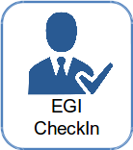
The EGI AAI Check-In architecture
Federated Identity Access Management (IAM) solution for research communities.
Combines multi-protocol federated access and flexible group/Virtual Organization management capabilities in one single platform.
Designed to enable users to transparently access distributed federated service providers.
Minimize overhead for end users, communities and service providers.
Implements the AARC blueprint
Identity
Providers
IdP (outside EGI)
Identity
Providers
IdP (from EGI)
Service Providers SP (from and outside EGI)

Slide 34
EGI Operations services
Making services robust
Accounting Monitoring
Helpdesk
Making problems resolvable
Authentication-Authorization Infrastructure
Service integration support and training
Making services accessible
Making services usable
Community specific e-Infrastructure
EGI Website and Marketplace
Engagement with new service providers
Making services discoverable
and orderable

Slide 35
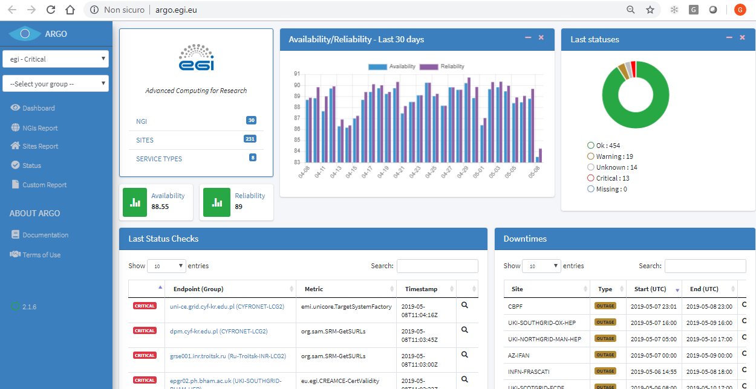
ARGO – The EGI Monitoring System
https://argo.egi.eu

Slide 36
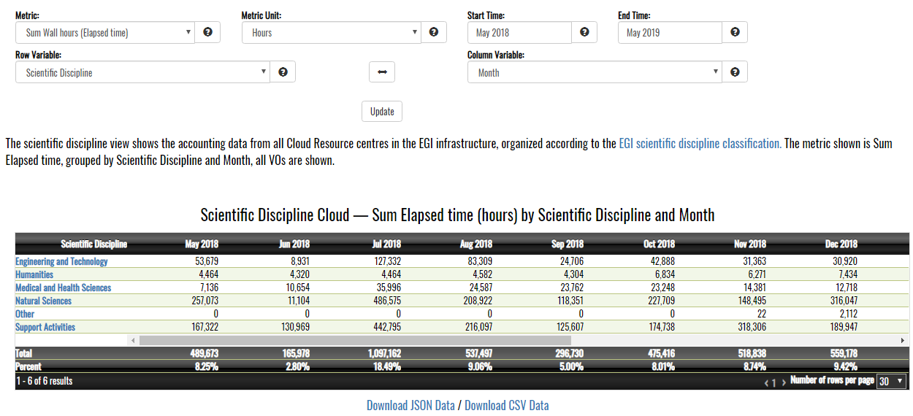
The EGI Accounting System
https://accounting.egi.eu

