Slide 1
EGI Service Design Workshop
Nuvla.io
Edge&App management platform as a service
Cristóvão Cordeiro, R&D Technical Project Manager @SixSq
https://www.linkedin.com/in/cristovaocordeiro/

Slide 2
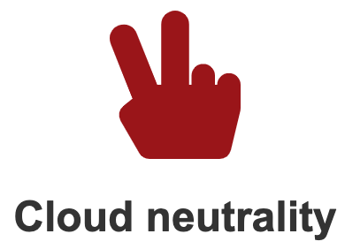
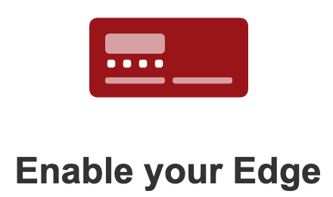
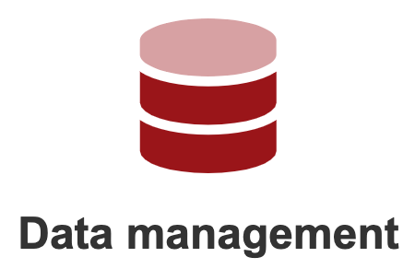
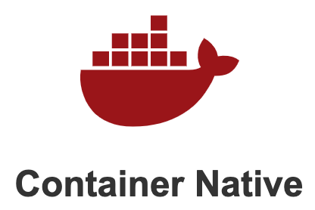
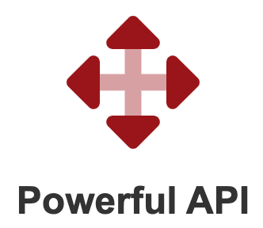
Nuvla.io
TRL 9
Nuvla.io is a technical and business edge management platform, as a service
NB
made for
App Vendors
Large Organisations
Monetize your software dev skills, by building apps for others to use
Build container apps
Drop them in the Marketplace
Nuvla.io users will deploy them
System Integrators
Get easier, faster and more secure access to data, without lock-in
Nuvla.io catalogues data access
Automatic pairing of data with apps
Process data from anywhere
Use Nuvla.io as the gluing agent to put together tailored solutions for your own customers
Exploit new & existing infrastructures
Onboard software to the Marketplace
Nuvla.io = your system’s control panel
Demystify the complexity of Edge-to-Cloud Computing, by providing ready-to-use technologies for streamlining infrastructure, data and application management @scale
Open source: https://github.com/nuvla
Notes:
Present your service
What are you offering?
What can you do with it?
What makes the use case interesting
why was the service developed, which gaps you’re filling
Value proposition (potential customers and users)
Who developed it and for whom?
When is it available?
Where is the service used now? Who in the EGI community should be interested in it?

Slide 3
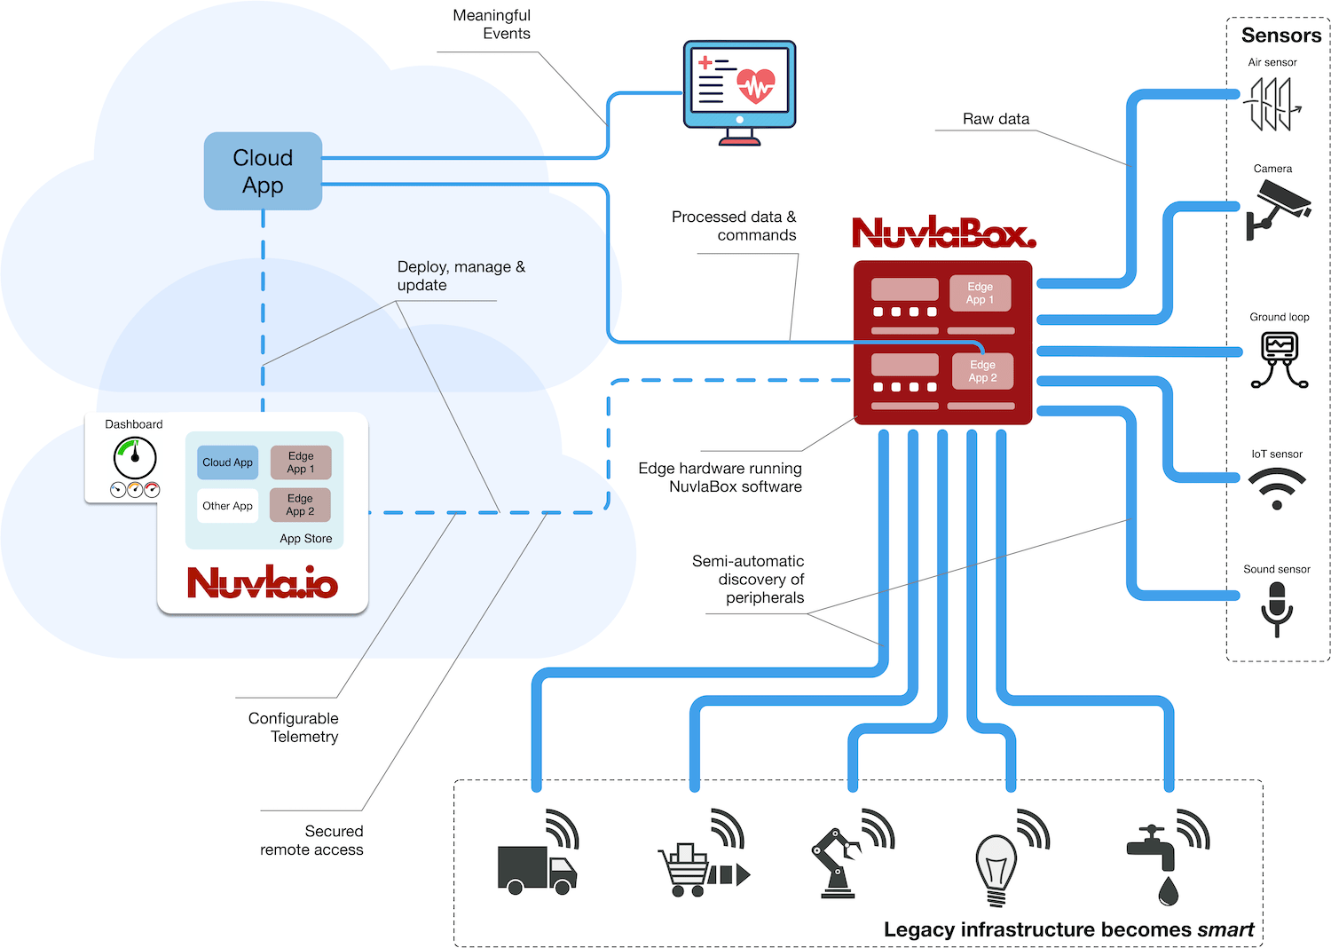
Nuvla.io: an Edge-to-Cloud Ecosystem
Create value for your citizens, with a
secure and data centric solution
Customers
Deploy AI, anywhere, anytime, without privacy intrusion

Slide 4
EGI integration plans
*As a potential Service Provider, the integration of Nuvla.io and/or NuvlaBox with existing EGI Services is only considered when deemed necessary for a proper integration of the Service Provider with the EGI Ecosystem
On a technical basis, the following EGI Services could potentially be integrated with Nuvla.io/NuvlaBox
EGI Service | How? | Priority
Cloud Compute | If standard IaaS Compute APIs are exposed within this service (i.e. OpenStack, Rackspace...) then the integration will make it possible to deploy CaaS cluster in EGI Federated Cloud Sites, from Nuvla.io | Medium
Check-in | This integration would give users IdP based access to the Nuvla.io EGI Service. | High
Applications on Demand | Since both Nuvla and NuvlaBox are open-source, these can be added as applications to be deployed by EGI users on demand | Medium
Notes:
Planned integration with EGI services
AAI, Ordering, SMS, Compute resources, Data mgmt. system, etc.
Try to identify which EGI services you should/may integrate with your service (e.g. AAI).
Assign a different priority
High/Medium/Low (e.g. AAI – High priority)

Slide 5
SDTP section: Business Case Design
*more support needed for Service Transition Plan
NOTE: to simplify, this case takes Nuvla.io & NuvlaBox as a single EGI Service. In practice, it is very likely for these technologies to be broken down to specific workflows, to be served as individual services (?)
 | Best case | Average case | Worst case
Demand Assessment | Vendors, systems integrators and researchers looking to exploit existing software and infrastructures, or simply scale case studies without lock-in | Users with edge computing use cases but no know-how on how to distribute and automate application and data management workflows | Users only looking for cloud brokerage.
Assumptions | High user friendliness; lack of Edge-to-Cloud competitors; ease of use; straightforward onboarding policies; simple terms | Increase demand by the community to enter the edge computing space; need to migrate legacy systems | Service provides off-the-shelf app and data management as a whole, plus multi-cloud management
Expected organisational impact on the SP | Additional staff; horizontal scaling of the infrastructures hosting the services | No impact | No impact
Expected cost | CAPEX: human effort from new staff. OPEX: human effort from support staff, plus additional compute costs to host the service | None | None
Expected revenue | Direct payment (subscription based) | Direct payment (pay as you go) | Funding
Risks | Scalability | Partial competitors are cheaper | None
Supplier Evaluation | N/A
Constraint/limiting factors | Only the risks above
Access Policy | Wide access (maybe ?)
Notes:
Choose one of the following section from the EGI SDTP template (PDF attached to the e-mail)
Business case design
Service design
Service transition plan
Summarise in the slides the expected information following the structure of the SDTP section
Put any relevant question to be discussed during the workshop
We suggest to select the section where you think more support is needed

Slide 6
Open issues
Future plans:
Explore service design
Discuss partners’ interest with potential service integrations
Issues to discuss/brainstorm about:
How to design the service? One uber platform vs specialized workflows?
How to get started with the Service Transition Plan?
Lessons learned (related to the initial EGI contact and the service in general):
A marketplace-driven EGI portfolio has the potential to open new doors and expose innovative and trending areas of computing to legacy communities

Slide 7
EGI Service Design Workshop
Nuvla.io
https://nuvla.io
Powered by SixSq
https://sixsq.com

