Slide 1
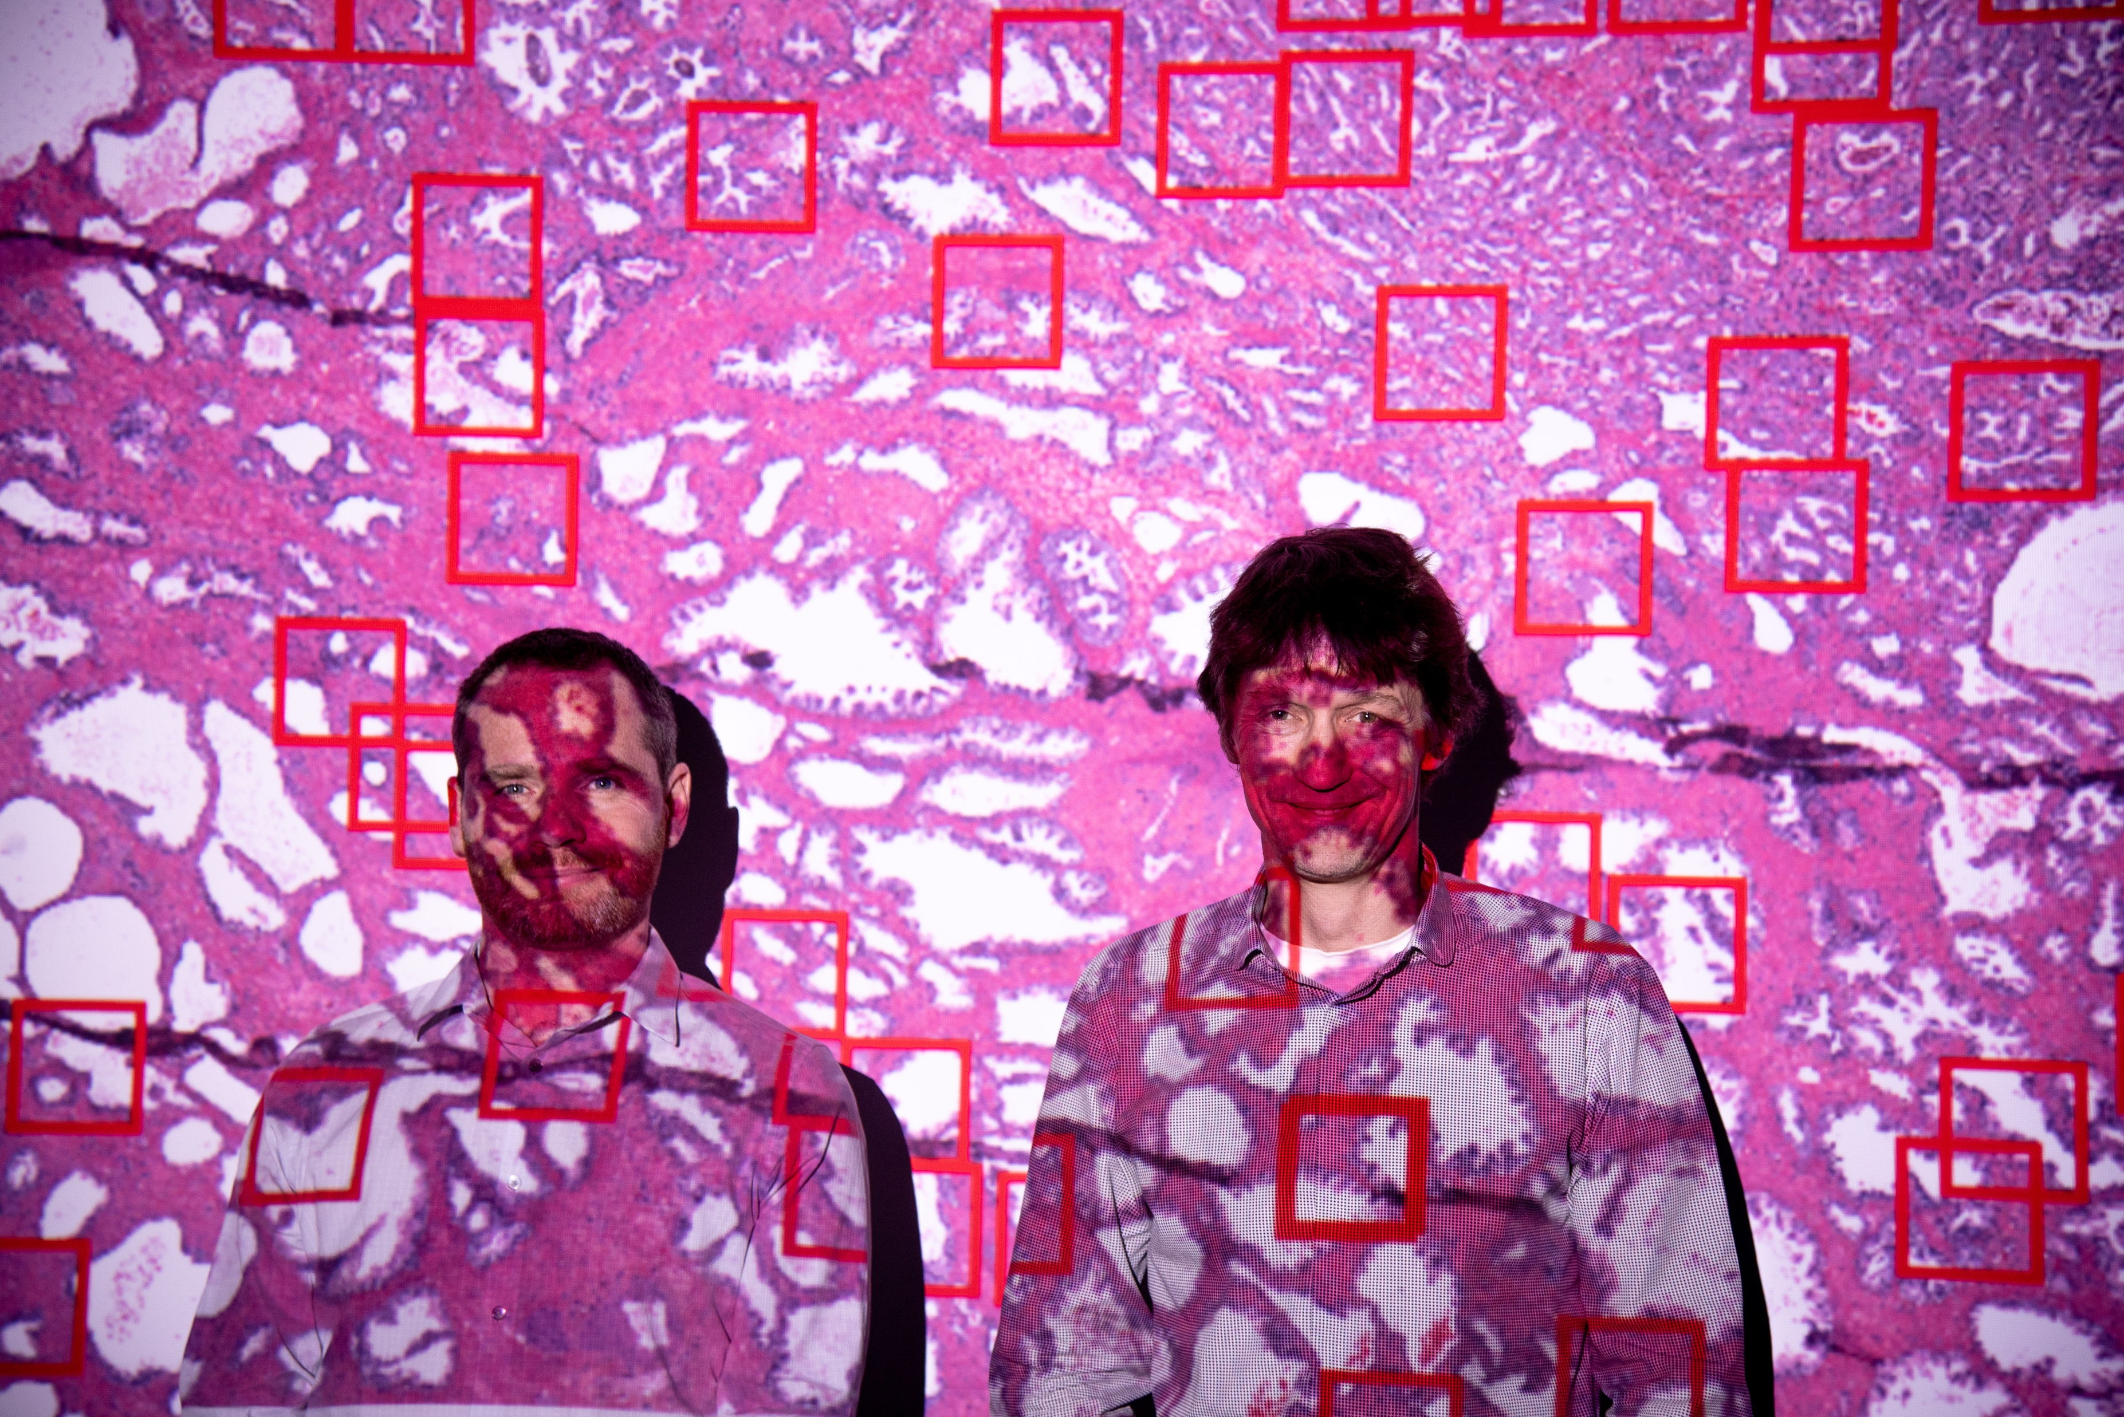
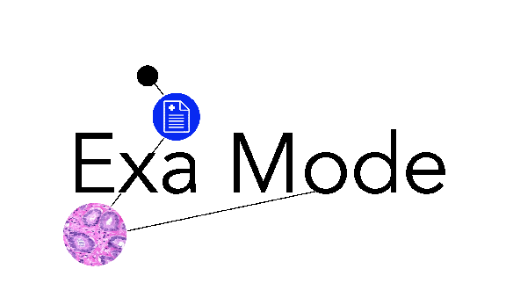
AI and ML in Health: Large resource requirements for medical image analysis
Henning Müller
HES-SO
EGI 2020
Notes:
Faire l’appel

Slide 2
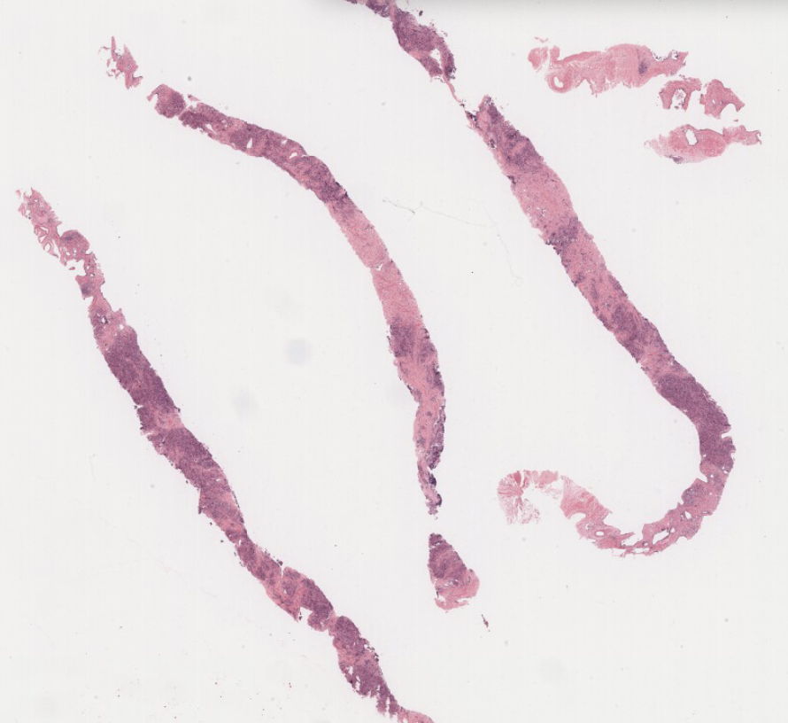
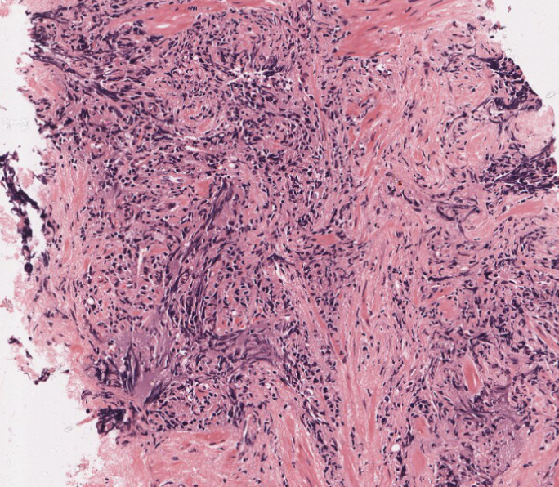
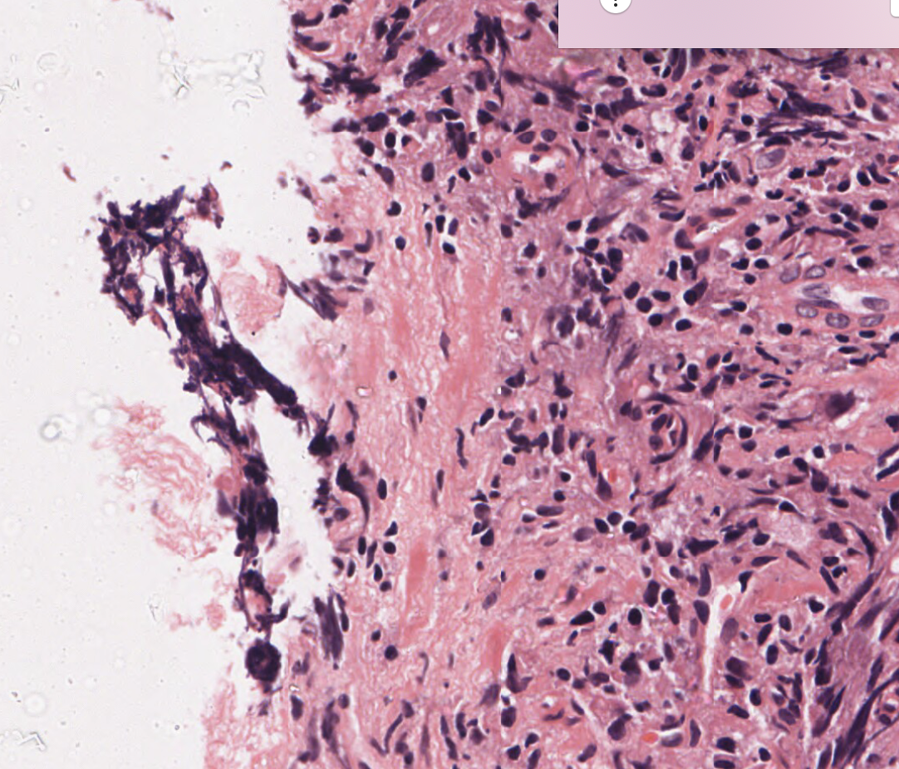
Histopathology imaging
Very large images
  ~100,000x100,000 pixels
    40x magnification
  Up to 10 GB in size
Cellular level
  Pixel size ~250 nm
Large variety

Slide 3
Workflow

Slide 4
Image volumes
30 GB uncompressed per image
4-5 images per biopsy to cover the entire tumor
  =150 GB per patient
Breast, colon, lung, cervix/uterus, prostate are part of screening programs
  Suspicious cases have a biopsy to detect any cancer early and with precision (relevant for treatment)
Thousands of biopsies in any University hospital
  Storage as frozen samples (tissue banks) and as glass slides in freezers
Histopathology is in the process of becoming digital

Slide 5
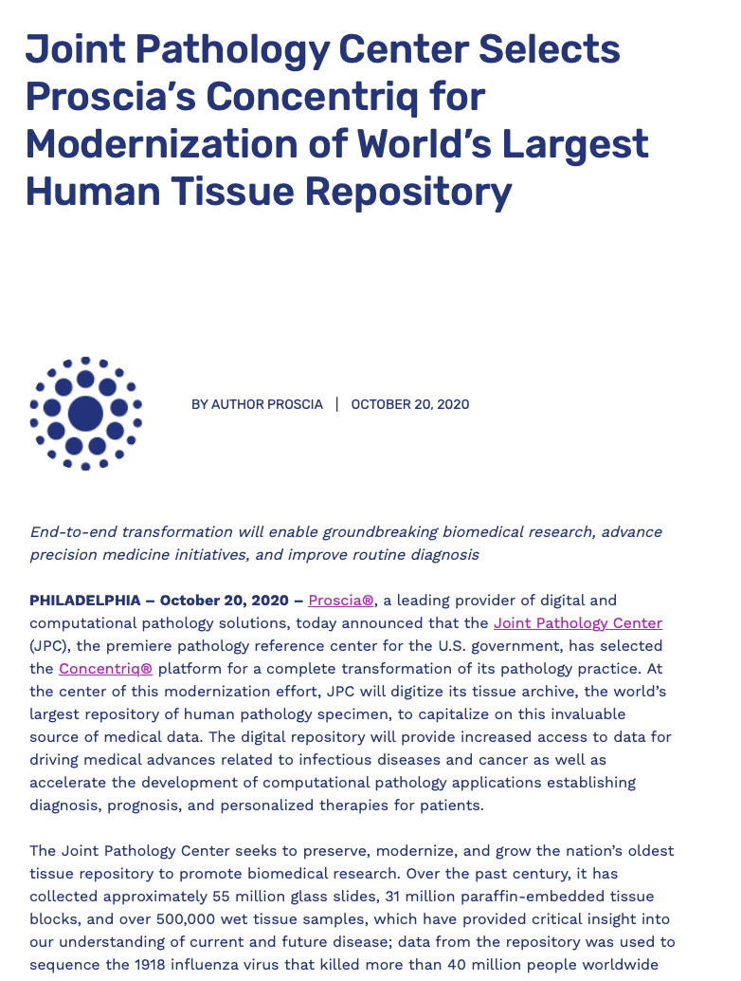
86’500’000x30’000’000’000
=2’595’000’000’000’000’000 Bytes

Slide 6
Specific computing requirements
Deep learning generally uses GPUs (detection)
  Massively parallel use is non-trivial
  Horovod is used, for example
  Data centers often do not have the fastest GPUs
Many steps require CPUs as well
  Transform image, create multi-scale representation
Communicating the data is extremely important
  Interconnection between servers and storage is essential
  Data centers have a clear advantage in this

Slide 7
H2020 Infrastructure project (2017-2020)
  Lead by LMU (Leibniz Rechenzentrum)
The objective is to develop exascale tools
  With several use cases as demonstrators
We run a use case on medical image analysis
  Decision support in histopathology
    With a focus on interpretability
  Compay data (breast cancer, >3TB compressed)
  Shows an increase in performance with more computational power
  Speed measurements in many scenarios

Slide 8

ExaMode
Extreme-scale Analytics via Multimodal Ontology Discovery & Enhancement
  Very large-scale data analysis
  Histopathology area that is becoming digital
    Large images, 100,000x100,000 pixels, often several per patient, up to 12 in prostate biopsies
EU Horizon 2020: ICT-12-2018-2020
  Acceptance rate: 6 of 78 submissions
Budget: ~5 Mio Euros
  7 partners: academic, commercial and hospital partners, plus a data center

Slide 9
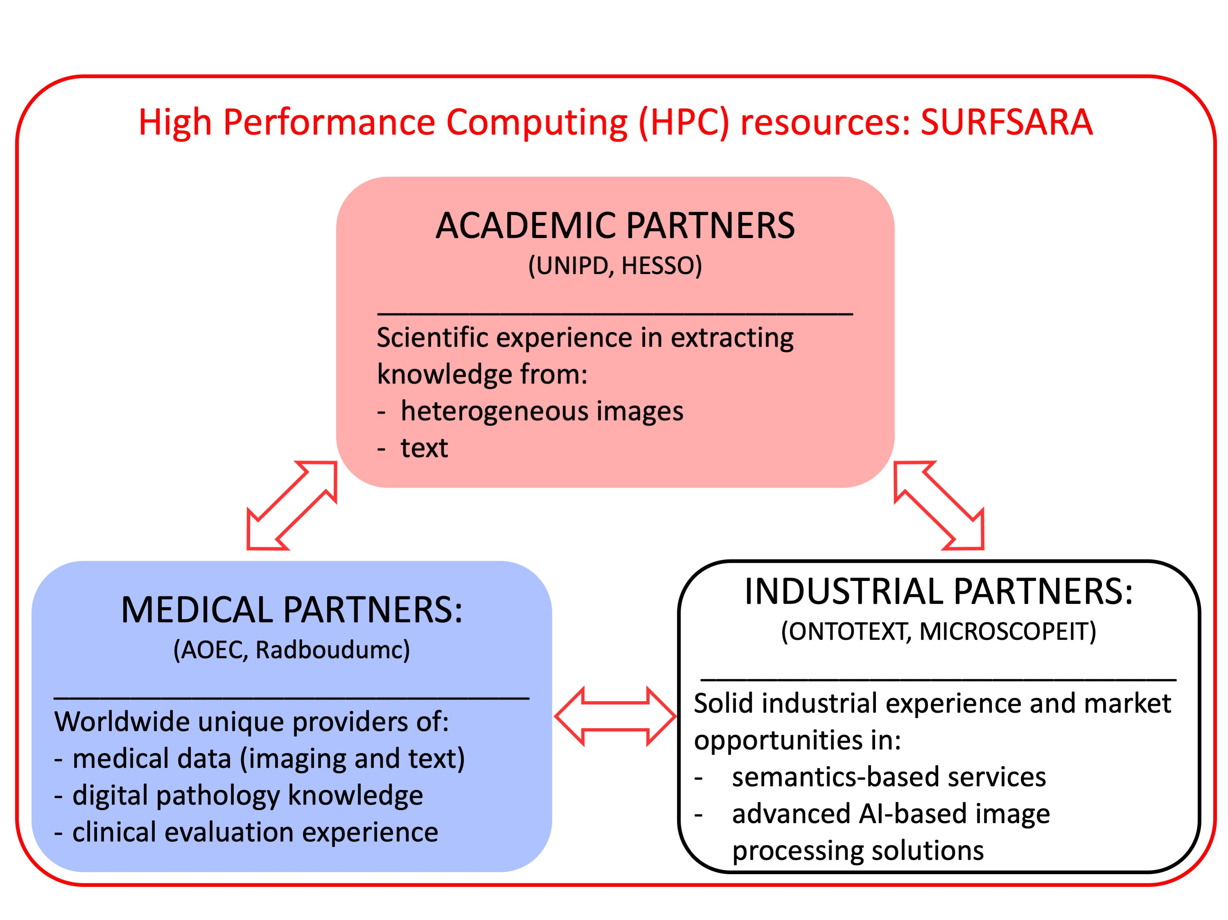
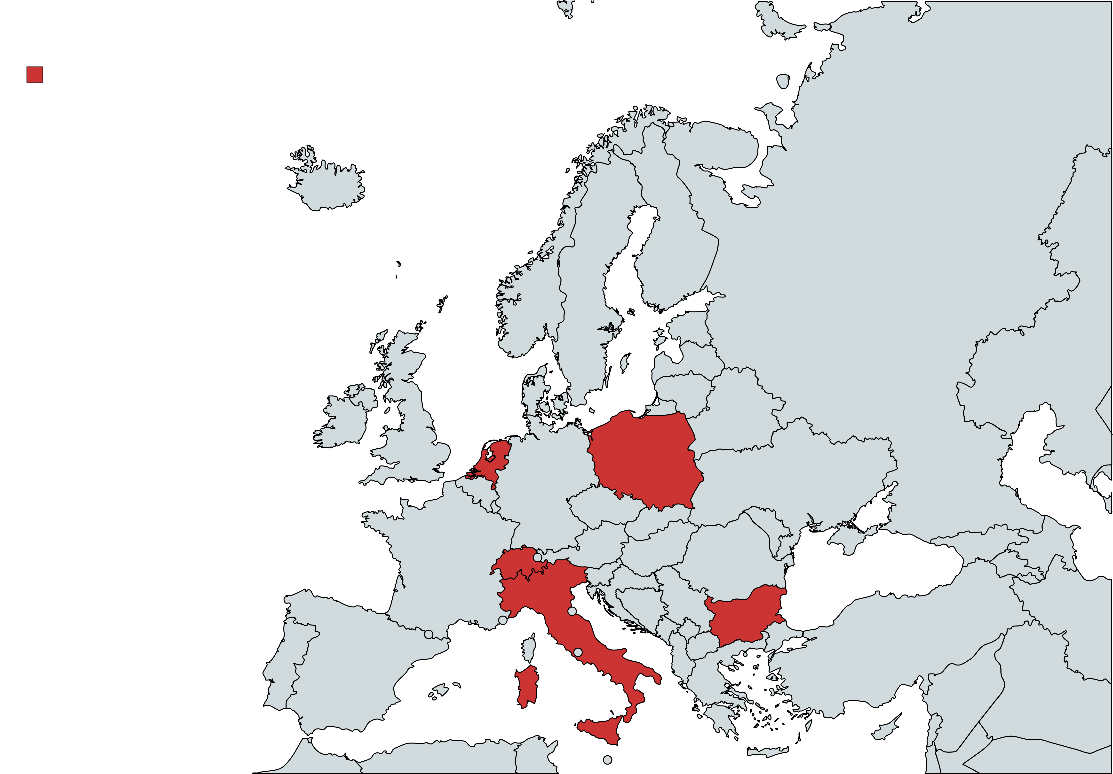
Introduction: consortium

Slide 10
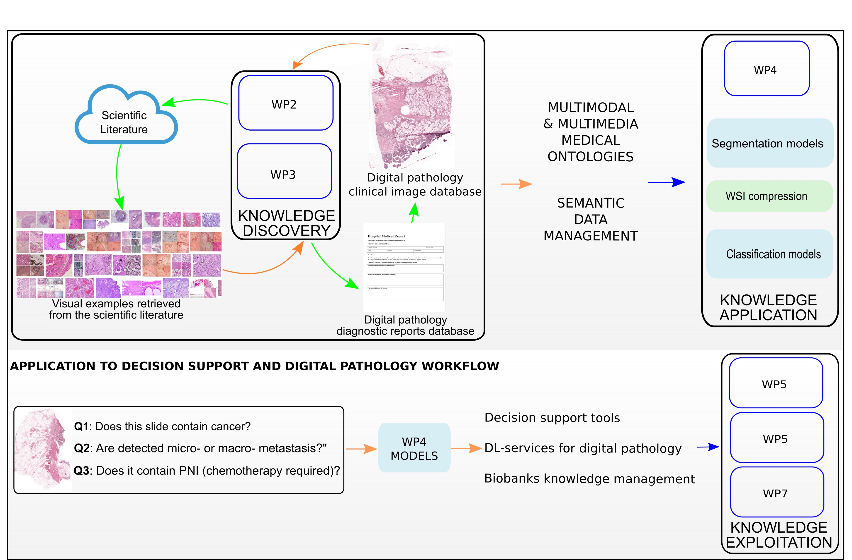
Decision support pipeline
6

Slide 11
Motivation
Deep learning has been a driving force for improving many applications of image analysis
  Networks require large amounts of training data
    Otherwise performance is limited
  Data diversity is important for generalizability
Most medical data sets have strong class imbalances, which creates classification problems
  Rare diseases require data from multiple centers making the organization complex
Many resources that include images have become available in the past few years
  PubMed Central, TCGA, TCIA, social networks, …

Slide 12
Objectives of our project part
Develop training deep learning models with weak labels, so not pixel level annotations
  And a combination of weak with strong labels
Combine semantic knowledge from pathology reports (UNIPD) with image data (multimodality)
  Development of domain ontologies
  Use this to generate weak labels for training
Make all this scalable to extremely large scales
Use images from the literature for training
  Combined with clinical images

Slide 13
Advantages of literature images
Rare images (unusual, untypical) are generally used for articles and case descriptions
  A few typical cases but mainly extreme cases to share the knowledge on them
  Creates critical mass for rare diseases
Images are from many laboratories and thus contain many image variations (staining, scanners)
  Increase generalizability of learned models thanks to this diversity
Exponentially increasing content
  Allows to improve models continuously based on latest imaging equipment

Slide 14
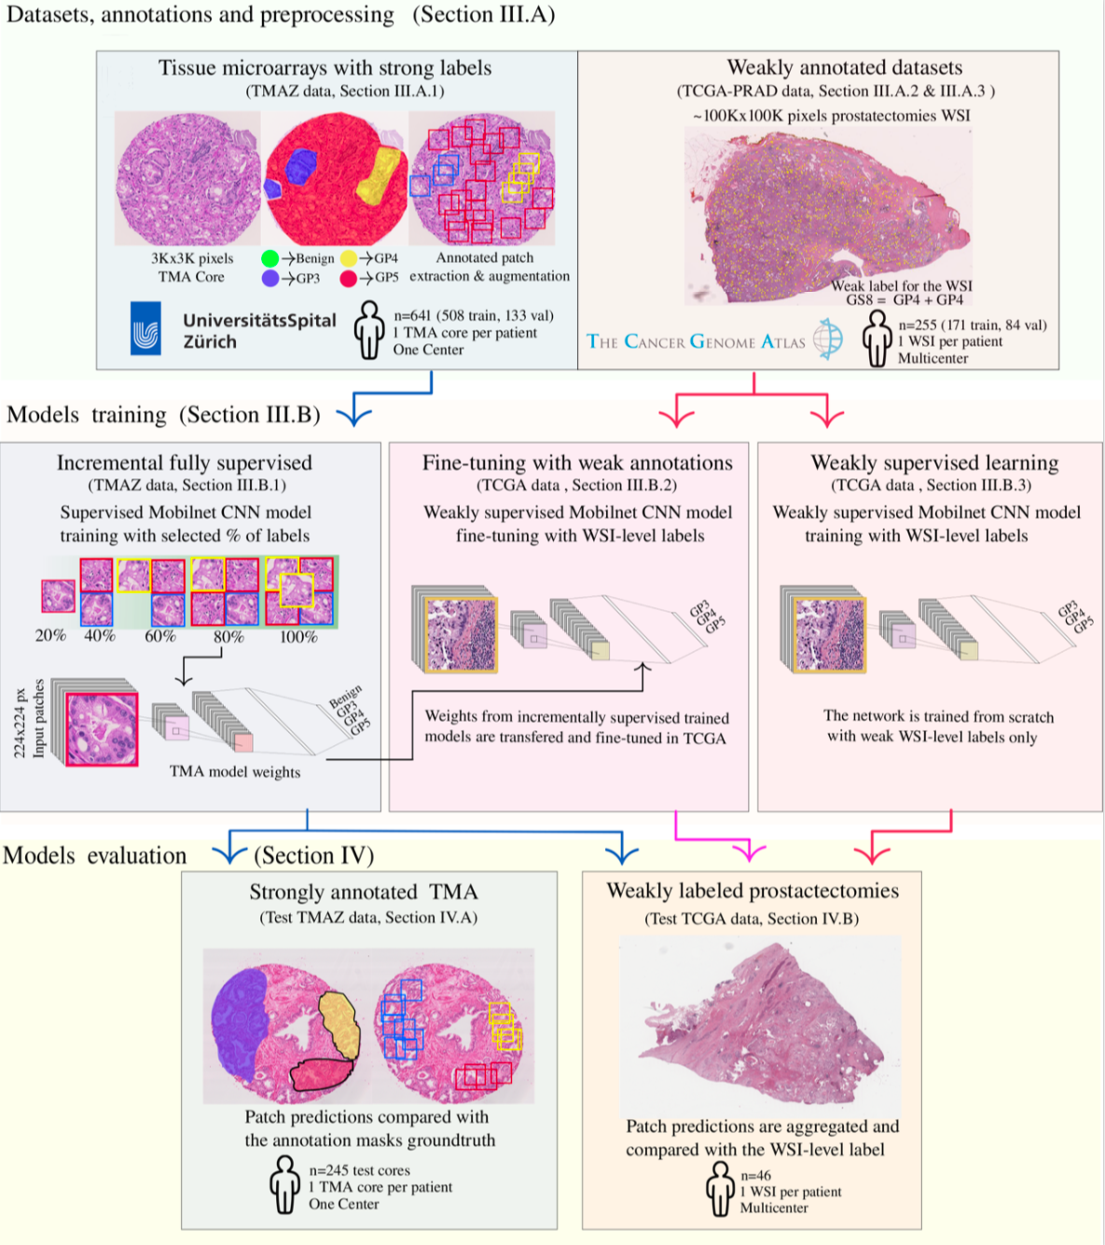

Slide 15
Performance

Slide 16
Conclusions
Current deep learning techniques have much potential in medical image analysis & classification
  Require much training data for good performance
Manually annotating images is expensive
  Plus specialists are often overloaded and not available
Learning from weak or global labels is possible
Strong computing infrastructures are required
  With a combination of GPU, CPU and particularly bandwidth
  Histopathology will require central infrastructures!

Slide 17
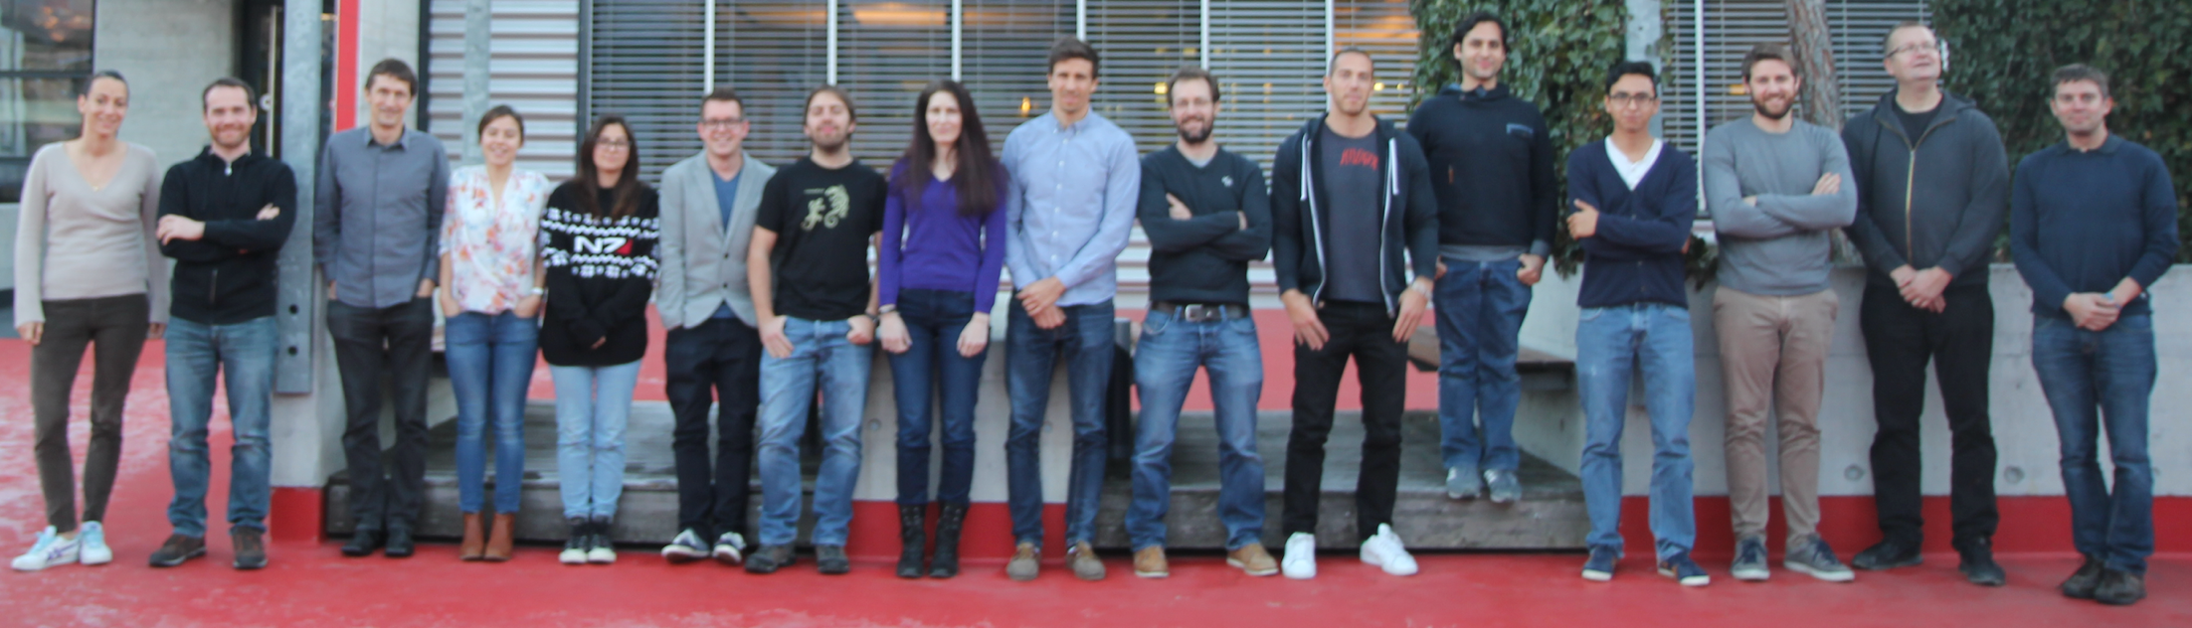
Contact
More information can be found at
  http://medgift.hevs.ch/
  http://publications.hevs.ch/
  http://www.examode.eu/
Contact:
  Henning.mueller@hevs.ch

