Slide 1
EOSC-hub T10.3
Diego Scardaci – T10.3 leader and AMB co-chair (EGI Foundation)
Dissemination level: Public/Confidential If confidential, please define:
Disclosing Party: (those disclosing confidential information)
Recipient Party: (to whom this information is disclosed, default: project consortium)

Slide 2
Outline
EOSC Early adopter programme Call 1
T10.3 involvement
EOSC Early adopter programme Call 2
Looking for 2 extra shepherds
EOSC-hub week
T10.3 deliverables

Slide 3
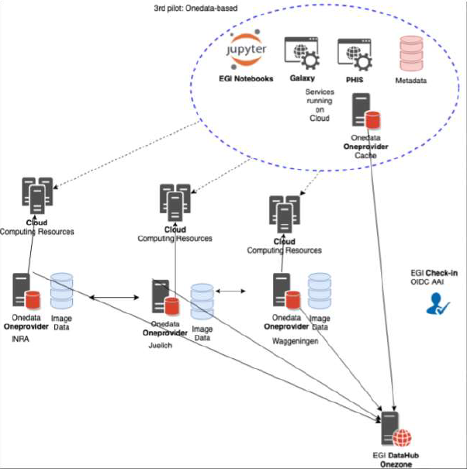
Project 1: Towards an e-infrastructure for plant phenotyping
High-throughput plant phenotyping platform “Phenotyping Hybrid Information System – PHIS” to be deployed in the EOSC-hub infrastructure
Three pilots proposed
Project factsheet
Title: Towards an e-infrastructure for plant phenotyping
Institution: INRA (France) - http://www.inra.fr/en/Scientists-Students
Principal investigator: Vincent Nègre, vincent.negre@inra.fr
Science areas: plant and agriculture
Shepherd: Nicolas Cazenave (CINES), cazenave@cines.fr
Workplan
Q1: first pilot based on the FranceGrilles service and EGI services
Q2: integrating EUDAT services
Q3: integrating EGI DataHub
Q4: assessing and choice

Slide 4
Project 1: Integration, providers, resources & costs
Service Integration | In-kind resources
EGI Cloud Compute & Cloud Container Compute | CESNET-MCC: 6x4CPUs with 6x32GB RAM (including support for a Oneprovider) IN2P3-IRES: 2VMs with 32GB RAM for pilot and Oneprovider VM with 8 vCPU, 32GB RAM with SSD
EGI Notebook | EGI: community-deployment for notebooks for 4 concurrent users (2 vCPUs cores, 4GB of RAM and 40GB of storage per notebook)
B2SAFE | 10 TB safe storage
EGI DataHub | 10 TB on DataHub Oneprovider, user support
Check-in
B2ACCESS
B2HANDLE

Slide 5
Project 2: Mapping the sensitivity of mitigation scenarios to societal choices
Project factsheet
Modeling studies to explore how future energy systems can evolve
quantify the tradeoffs, co-benefits, and interlinkages between different aspects of the global energy systems
international climate change policy and sustainable development
IAM MESSAGEix-GLOBIOM platform aimed at performing large scale (10-15k model runs) analyses
Title: Mapping the sensitivity of mitigation scenarios to societal choices
Institution: International Institute for Applied Systems Analysis (IIASA) (Austria) - https://www.iiasa.ac.at/
Principal investigator: Bas van Ruijven, vruijven@iiasa.ac.at
Science areas: Earth and related Environmental sciences, Economics and Business
Shepherd: Alessandro Costantini (INFN), alessandro.costantini@cnaf.infn.it
Workplan
Q1: infrastructure settings, enable federated identity, finalize and test containers
Q2: setup the IAM platform and perform initial model runs
Q3: tune the platform, increase scale of the tests in EOSC, analysis of results
Q4: IAM platform in the EOSC Portal, sustainability

Slide 6
Project 2: Integration, providers, resources & costs
Service Integration | In-kind resources
EOSC AAI
EGI Cloud Compute & Cloud Container Compute | INFN: 200 vCPUs cores, 800GB of RAM
EGI Online Storage | INFN: 6 TB

Slide 7
Project 3: STARS4ALL
Creation of a light pollution community in order to use resources such as datasets, presentations, source code, etc …
Publishing Light Pollution measurement data sets on relevant platforms (e.g. the GEOSS platform and B2FIND interdisciplinary metadata catalogues)
Project factsheet
Title: STARS4ALL
Institution: STARS4ALL Foundation (Spain) - https://stars4all.eu/
Principal investigator: Esteban Gonzalez, STARS4ALL Foundation patron, egonzalez@ciclope.info
Science areas: Light Pollution
Shepherd: Daan Broeder (KNAW/HuC DI), daan.broeder@di.huc.knaw.nl
Workplan
Q1: community metadata schema in B2SHARE, automatic creation of research objects, data analysis EGI Notebooks, testing PIDs
Q2: metadata harvesting by B2FIND and by GEOSS portal
Q2: creating research objects for all existing data-sets
Q3: setting up infrastructure components in EGI Cloud, testing infrastructure
Q4: Final checks/testing and publishing documentation

Slide 8
Project 3: Integration, providers, resources & costs
Service Integration | In-kind resources
B2SHARE
B2FIND
B2HANDLE
EGI Notebook | EGI: community-deployment for notebooks for 4 concurrent users (2 vCPUs cores, 4GB of RAM and 40GB of storage per notebook)
GEOSS Portal
EGI Cloud Compute & Cloud Container Compute | CESGA: 2x (1xCPUs, 8GB RAM, 10GB storage), 2x (1xCPU, 4GB RAM, 10GB storage)

Slide 9
Project 4: Transitioning EMSO ERIC Data Management Platform to production
The European Multidisciplinary Seafloor and water column Observatory (EMSO) aims to explore oceans to monitor climate change, risks of biodiversity loss, and natural hazards
The Data Management Platform (DMP) is a key component of the EMSO infrastructure
long-term, high-resolution, (near)-real-time monitoring data
coordinated approach for data capturing, archiving, management and delivery based on OGC standards
Project factsheet
Title: Transitioning EMSO ERIC Data Management Platform to production
Institution: EMSO ERIC (Italy) - http://emso.eu/
Principal investigator: Ivan Rodero, EMSO-ERIC Director, IT and data services, ivan.rodero@emso-eu.org
Science areas: Earth Sciences
Shepherd: Giuseppe La Rocca (EGI Foundation), giuseppe.larocca@egi.eu
Workplan
Q1: Scale-up the compute and storage resources. Redundancy: deploy in two cloud providers
Q2: Enabling federated identities, DMP scalability tests
Q3: Enabling EOSC monitoring and accounting in DMP, increase the scale of the tests
Q4: Agreed OLA with EOSC providers, publication in the EOSC Portal, Amnesia

Slide 10
Project 4: Integration, providers, resources & costs
Service Integration | In-kind resources
EGI Check-in
EOSC-hub Monitoring
EOSC-hub Accounting
EGI Cloud Compute & Cloud Container Compute | CESGA: 192 vCPU cores, 512GB of RAM, INFN: 300 vCPU cores, 1.2TB of RAM
EGI Online Storage | CESGA: 6.4 TB, INFN: 10 TB
OpenAIRE Amnesia

Slide 11
Project 5: Big Data Analytics for agricultural monitoring using Copernicus Sentinels and EU open data sets
Show how federated EOSC resources can facilitate a range of Sentinel data applications across agricultural user domains
Use of Big Data Analytics to multi-annual high resolution Copernicus Sentinel data and EU open access reference data sets
Agriculture use case: cross-border EU region of NL and Germany
Objectives:
(1) project EOSC as reference platform hosting permanent Sentinel data archive, (2) methods to handle a wide set of technical requirements for Sentinel data use
Project factsheet
Title: Big Data Analytics for agricultural monitoring using Copernicus Sentinels and EU open data sets
Institution: European Commission, Joint Research Centre - https://ec.europa.eu/jrc/en
Principal investigator: Guido Lemoine, Guido.lemoine@ec.europa.eu
Science areas: Earth ans Env. Sciences, Agriculture
Shepherd: Björn Backeberg (EGI Foundation), bjorn.backeberg@egi.eu
Workplan
Q1: Testbed setup, Jupyter notebook integration, data usage in policy context
Q2: Data formats for interactive analysis and visualization
Q2: Documents & tutorial
Q3: Review operational workflow, present results in WS
Q4: 2020 data processing & report on technical development and data use

Slide 12
Project 5: Integration, providers, resources & costs
Service Integration | In-kind resources
EODC Infrastructure | EODC: 8 vCPUs, 32GB of RAM, 100GB of storage
CloudFerro Infrastructure | CloudFerro: 24 vCPUs, 64GB of RAM, 100GB of storage
EGI Cloud Compute & Cloud Container Compute | CESNET: 16 vCPUs, 64GB of RAM, 100GB of storage
EGI Online Storage | CESNET: 10TB S3 type block storage

Slide 13
EAP Call 1
Are you interested on support one of the case?

Slide 14
EAP Call 2
8 short-listed proposals (see PDF attached to the agenda)
2 proposals looking for shepherds
Application 8: OpenBioMaps data management service for biological sciences and biodiversity conservation
Application 14: Integration of toxicology and risk assessment services into the EOSC marketplace
Any volunteer?

Slide 15
EAP Call 2 – other short-listed proposals
Supporting FAIR data discoverability in clinical research: providing a global metadata repository (MDR) of clinical study object (ECRIN). Shepherds: Stefano Nicotri and Hans Van Piggelen
Open AiiDA lab platform for cloud computing in Materials Science (EPFL). Shepherd: Enol Fernandez
VESPA-Cloud (OBSPM). Shepherd: Baptiste Grenier
AGINFRA+: Virtual Research Environments to Support Agriculture and Food Research Communities (CNR). Shepherd: Pablo Orviz
EOSC DevOps framework and virtual infrastructure for ENVRI-FAIR common FAIR data services (ENVRI-FAIR). Shepherd: Andrea Manzi
Towards a Global Federated Framework For Open Science Cloud: Three Use Cases (AASCT). Shepherd: Giuseppe La Rocca

Slide 16
EOSC-hub week
18-20 May Karlsruhe (Germany)

Slide 17
T10.3 Deliverable
D10.6 Requirements and gap analysis report v2
Apr 2020

