Slide 1
EAP background
STARS4ALL is a citizen science community working on measuring light pollution;
PI Esteban Gonzalez Guardia, UPM Madrid
STARS4ALL was a EU project that ended in 2018
currently works through STARS4ALL foundation
Offers home to related light pollution research initiatives
interesting web site; a tool to visualize data from photometer network; uses crowd funding to fund community
network of 100+ photometers expect to double near future
working infrastructure for aggregating light pollution observation data in place
currently CKAN is used to manage the data and primary observation data published in Zenodo

Slide 2
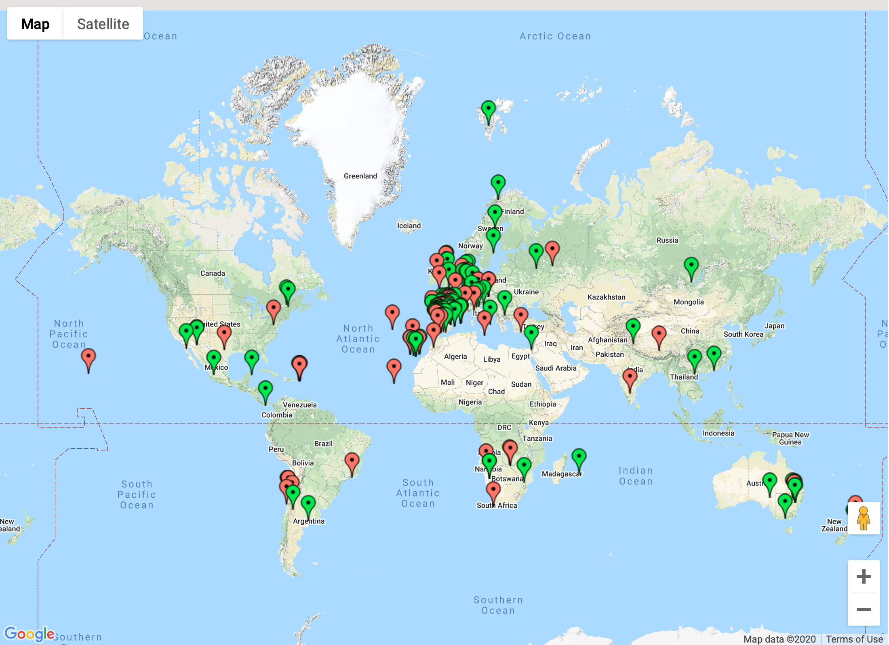
Photometer network
Coslada (Spain) - stars1
Hong Kong (China) - stars238
Collado Villalba (Spain) - stars 286

Slide 3
STARS4ALL and EOSC-Hub
Make their infrastructure more robust
Hosting services to mirror/backup the essential data aggregation and management components
Improve discoverability of their project & data via
B2FIND, B2SHARE
GEOSS platform
Improve data management practices
Deposit also secondary and tertiary data e.g. analysis, publications
Introduce Research Objects or Resource bundles for related primary, secondary and tertiary data combine and them with organizational information
Use of PIDs for sensors and Resource Objects
Improve usability of their data
Actionability of the research object links when displayed in B2FIND and B2SHARE
Use of Jupyter Notebooks for analyzing observation data directly from Zenodo and B2SHARE

Slide 4
STARS4ALL EAP Planning
Q1 | Metadata schema for data and research objects created and implement in B2SHARE data analysis JN with access to B2SHARE & Zenodo PIDs for RO and instruments | IP IP
Q2 | RO Metadata harvesting by B2FIND RO Metadata harvesting by GEOSS portal Conversion existing data-sets
Q3 | - HVA STARS4ALL data infrastructure by mirroring all components
Q4 | - checks & testing, writing documentation

Slide 5
STARS4ALL Research Object
RO-crate https://researchobject.github.io/ro-crate/1.0/
Community modelling using FOAF
B2SHARE team considering making RO metadata part of core metadata

Slide 6
Current status 20-2-2020
Current EAP workplan based also on discussions with the relevant service support teams; in total 5.5 PMs budgeted for a 12 month workplan
Description in the Community Requirements DB and design documents almost complete
Discussions with B2SHARE team ongoing, with B2HANDLE experts are planned on instrument metadata ; existing work from RDA PID4instruments WG seems highly relevant
Some service requests and service extension requests were issued but may need to be further discussed
B2SHARE, EGI Notebooks, B2HANDLE
Still technical aspects to clarify along the way:
STARS4ALL data integration in GEOSS platform using B2SHARE preferably as the data provider

Slide 7
Next Steps
Continue discussion with B2SHARE team:
schema for STARS4ALL metadata and Ros
Investigate harvesting by GEOSS platform
Discuss with B2HANDLE experts and RDA PID4instruments WG
Prepare other tasks, creating tickets and discuss with support teams
B2FIND, EGI Notebooks

Slide 8
STARS4ALL links
https://stars4all.eu
https://tess.stars4all.eu
https://wiki.eosc-hub.eu/display/EOSC/STARS4ALL

