Slide 1
Cloud Badge prototype report
23 April 2020
Valeria Ardizzone, Vincenzo Spinoso
EGI Operations team

Slide 2
Cloud Badge prototype
The main purpose of this system is advertising the quality of the EGI FedCloud, whose resources are consumed by many scientists.
http://90.147.102.22/badge98.html
Data source:
EGI Monitoring tool
EGI Configuration DB
EGI Accounting portal
23/04/2020
Notes:
<number>

Slide 3
Cloud Badge criteria
Criteria:
data are based over previous 3mo and there is an active SLA with a community (excluded dteam, ops and fedcloud)
For e.g.:
Report of January 2020 is based on data from October 2019 to December 2019
(Average Availability >= 98%)
AND
(Average Reliability >= 98%)
AND
(Accounting on user VOs > 0)
AND
Certification
Golden
(Average Availability >= 95%)
AND
(Average Reliability >= 95%)
AND
(Accounting on user VOs > 0)
AND
Certification
Silver
23/04/2020

Slide 4
March 2020 Cloud Badge report
(A/R and accounting data refers to December 2019-January 2020-February 2020)
N. Sites | GOLDEN | SILVER | NO BADGE
23 | 9 | 1 | 13
100IT
CESGA
CLOUDIFIN
DESY-HH
IISAS-FedCloud
IISAS-GPUCloud
IISAS-Nebula
IN2P3-IRES
UNIV-VILLE
RECAS-BARI
23/04/2020
Notes:
<number>

Slide 5
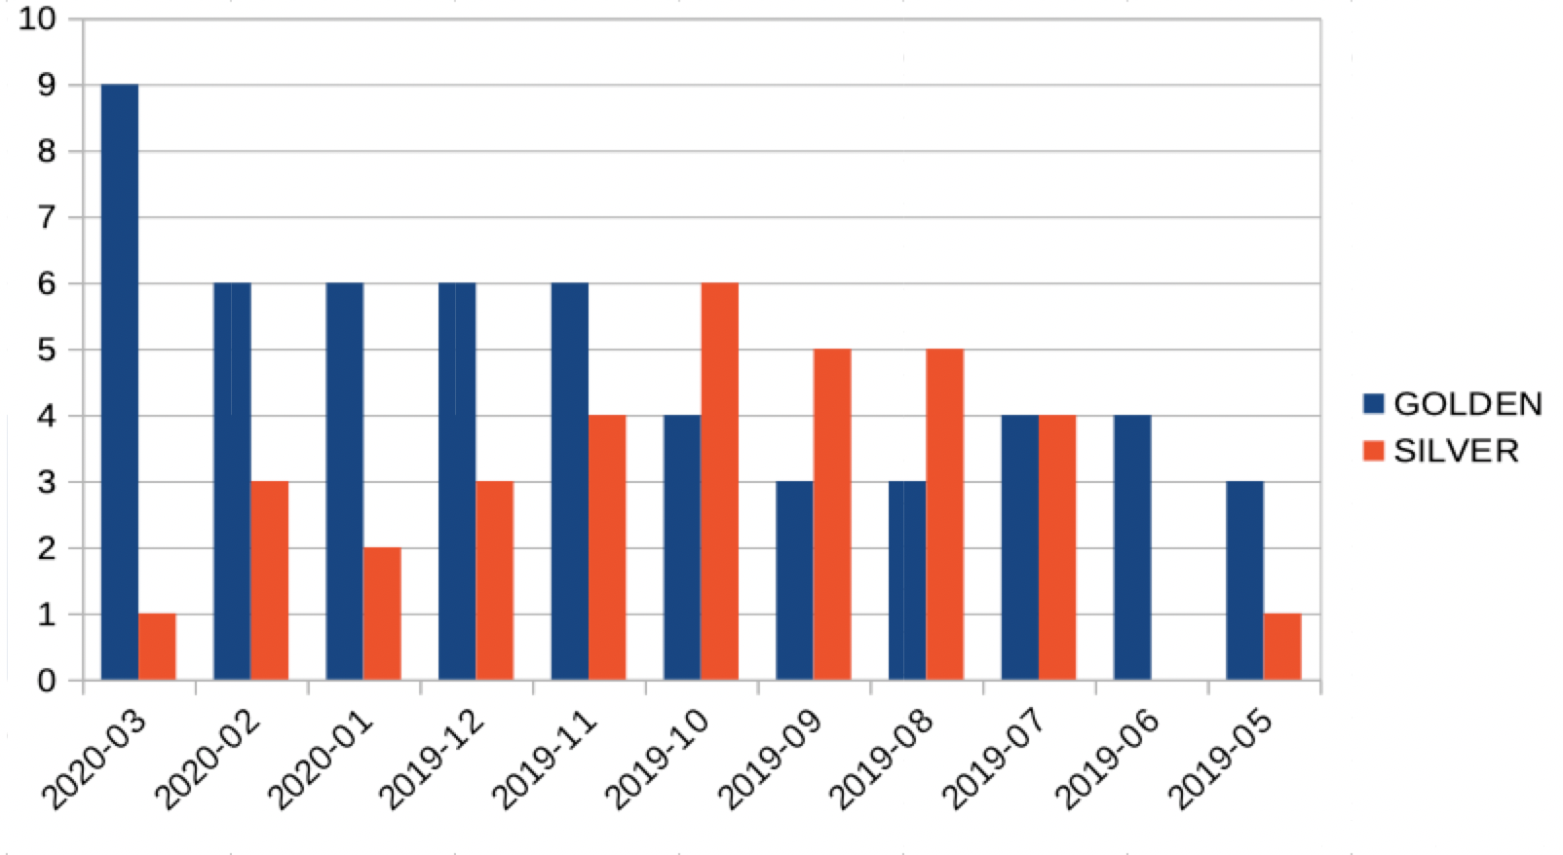
Cloud Badge Trend
23/04/2020

Slide 6
March 2020 Cloud Badge report
A/R and accounting data refers to December 2019-January 2020-February 2020
N. Sites | GOLDEN | SILVER | NO BADGE
23 | 9 | 1 | 13
February 2020 Cloud Badge report
A/R and accounting data refers to November 2019-December 2019-January 2020
N. Sites | GOLDEN | SILVER | NO BADGE
22 | 6 | 2 | 14
23/04/2020
Notes:
<number>

Slide 7
COMPARISON BETWEEN PERIODS
PREVIOUS PERIOD
CURRENT PERIOD
Golden
100IT
DESY-HH
IISAS-FedCloud
IISAS-GPUCloud
IISAS-Nebula
UNIV-VILLE
100IT
DESY-HH
IISAS-FedCloud
IISAS-GPUCloud
IISAS-Nebula
UNIV-VILLE
CONFIRMED
Silver
No Badge
CLOUDIFIN
CLOUDIFIN
CHANGED
RECAS-BARI
RECAS-BARI
CONFIRMED
INFN -STACK-PADOVA
INFN -STACK-PADOVA
CHANGED
CESGA
IN2P3-IRES
CESGA
IN2P3-IRES
CHANGED
23/04/2020

