Slide 1
ARCHITECTURE
SERVICE INTEGRATION
MOTIVATION
HOW IT WORKS
DOCS
BACKGROUND

Slide 2
BACKGROUND

Slide 3
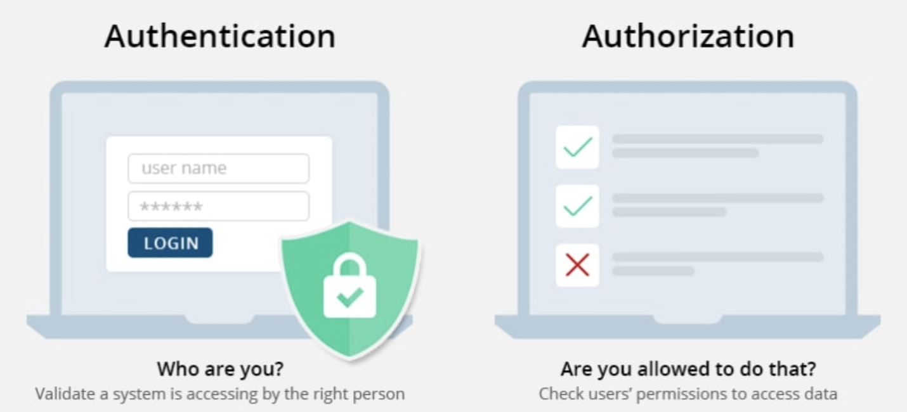
Authentication and Authorization

Slide 4
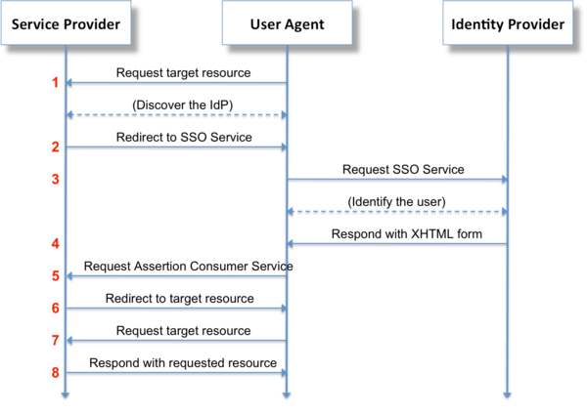
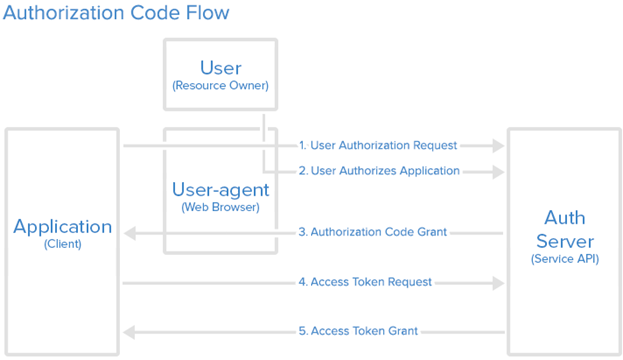
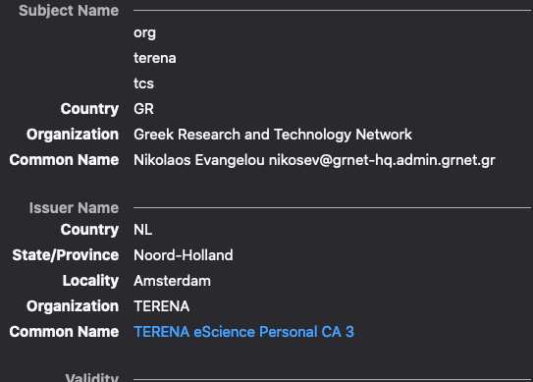
PROTOCOLS
X.509V3
SAML
OIDC
Open standard data format for exchanging AA data between parties, in particulat between
IDENTITY PROVIDER
and
SERVICE PROVIDER
OpenID Connect is a simple identity layer on top of the Oauth 2.0 protocol, which allows clients to verify the identity of a user based on the authentication performed by an authorization server
X.509 is a standard format for public key certificates, digital documents that securely associate cryptographic key pairs with identities such as websites, individuals, or organizations.

Slide 5
RIs are facilities that provide resources and services for research communities to conduct research and foster innovation. They can be used beyond research e.g. for education or public services and they may be single-sited, distributed, or virtual.
They include typically:
major scientific equipment or sets of instruments
collections, archives or scientific data
computing systems and communication networks
any other research and innovation infrastructure of a unique nature which is open to external users
RESEARCH Infrastructure
User Community A
RI 2
User Community B
RI 1

Slide 6
Motivation behind Check-in
Single sign-on to services through eduGAIN, social media and other institutional or community-managed identity providers
Only one account needed for federated access to multiple heterogeneous (web and non-web) service providers using different technologies (SAML, OpenID Connect, OAuth 2.0, X509)
Access to resources using different login credentials (institutional/social) via identity linking
Expressing the level of trust in the identity assertions
Aggregation and harmonisation of authorisation information (VOs/groups, roles, assurance) from multiple sources

Slide 7
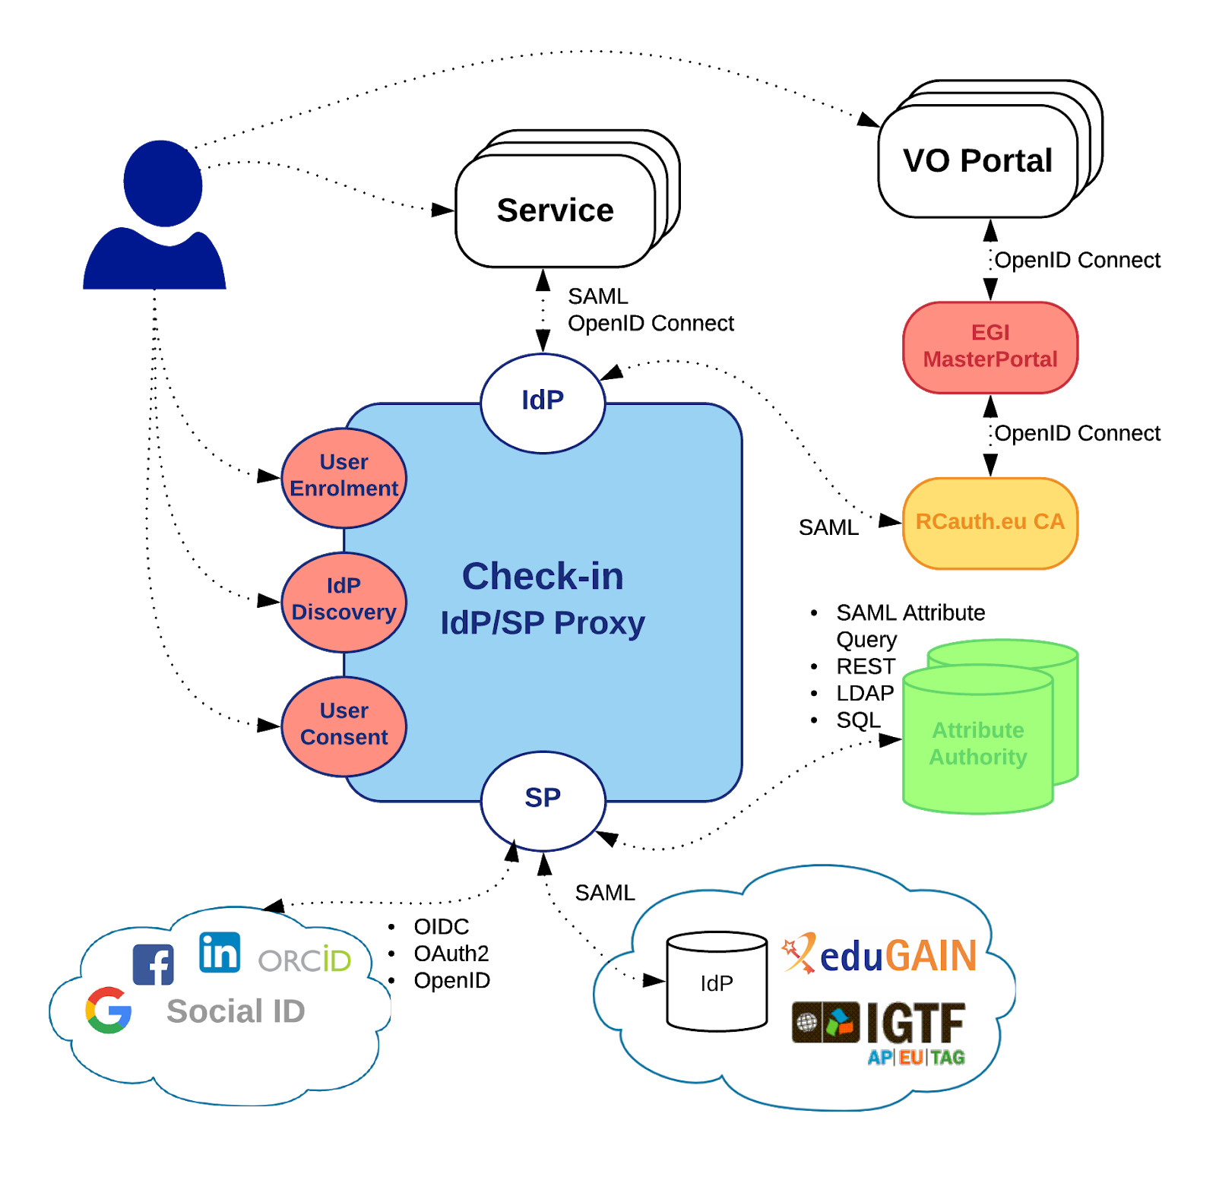
Check-in service architecture and interfaces
Implementation of the AARC blueprint architecture
Single point of integration for Identity Providers (IdPs) and Service Providers (SPs)
Registered in eduGAIN as an SP complying with REFEDS Research & Scholarship and Sirtfi security framework
All connected end-services can have one statically configured IdP
No need to run an IdP Discovery Service on each end-service
All connected SPs get harmonised user identifiers and accompanying authorization attribute sets from different IdPs that can be uniformly interpreted
Check-in service architecture and interfaces
Implementation of the AARC blueprint architecture
Single point of integration for Identity Providers (IdPs) and Service Providers (SPs)
Registered in eduGAIN as an SP complying with REFEDS Research & Scholarship and Sirtfi security framework
All connected end-services can have one statically configured IdP
No need to run an IdP Discovery Service on each end-service
All connected SPs get harmonised user identifiers and accompanying authorization attribute sets from different IdPs that can be uniformly interpreted

Slide 8
Use cases Community
HOW IT WORKS

Slide 9
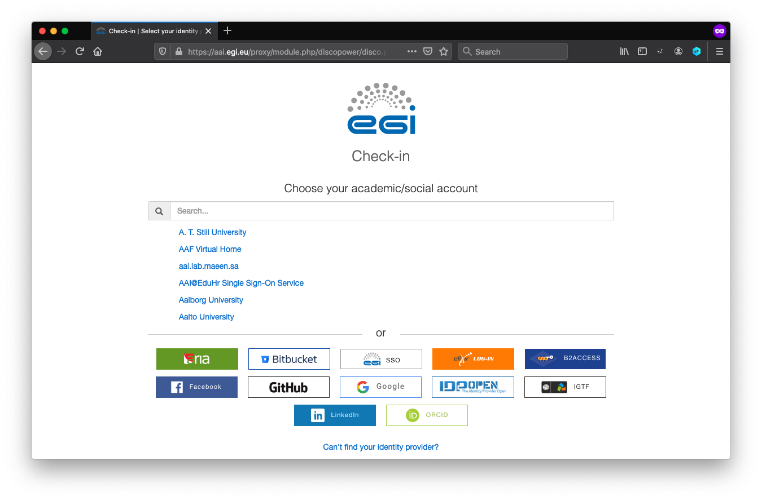
Identity Provider Discovery

Slide 10
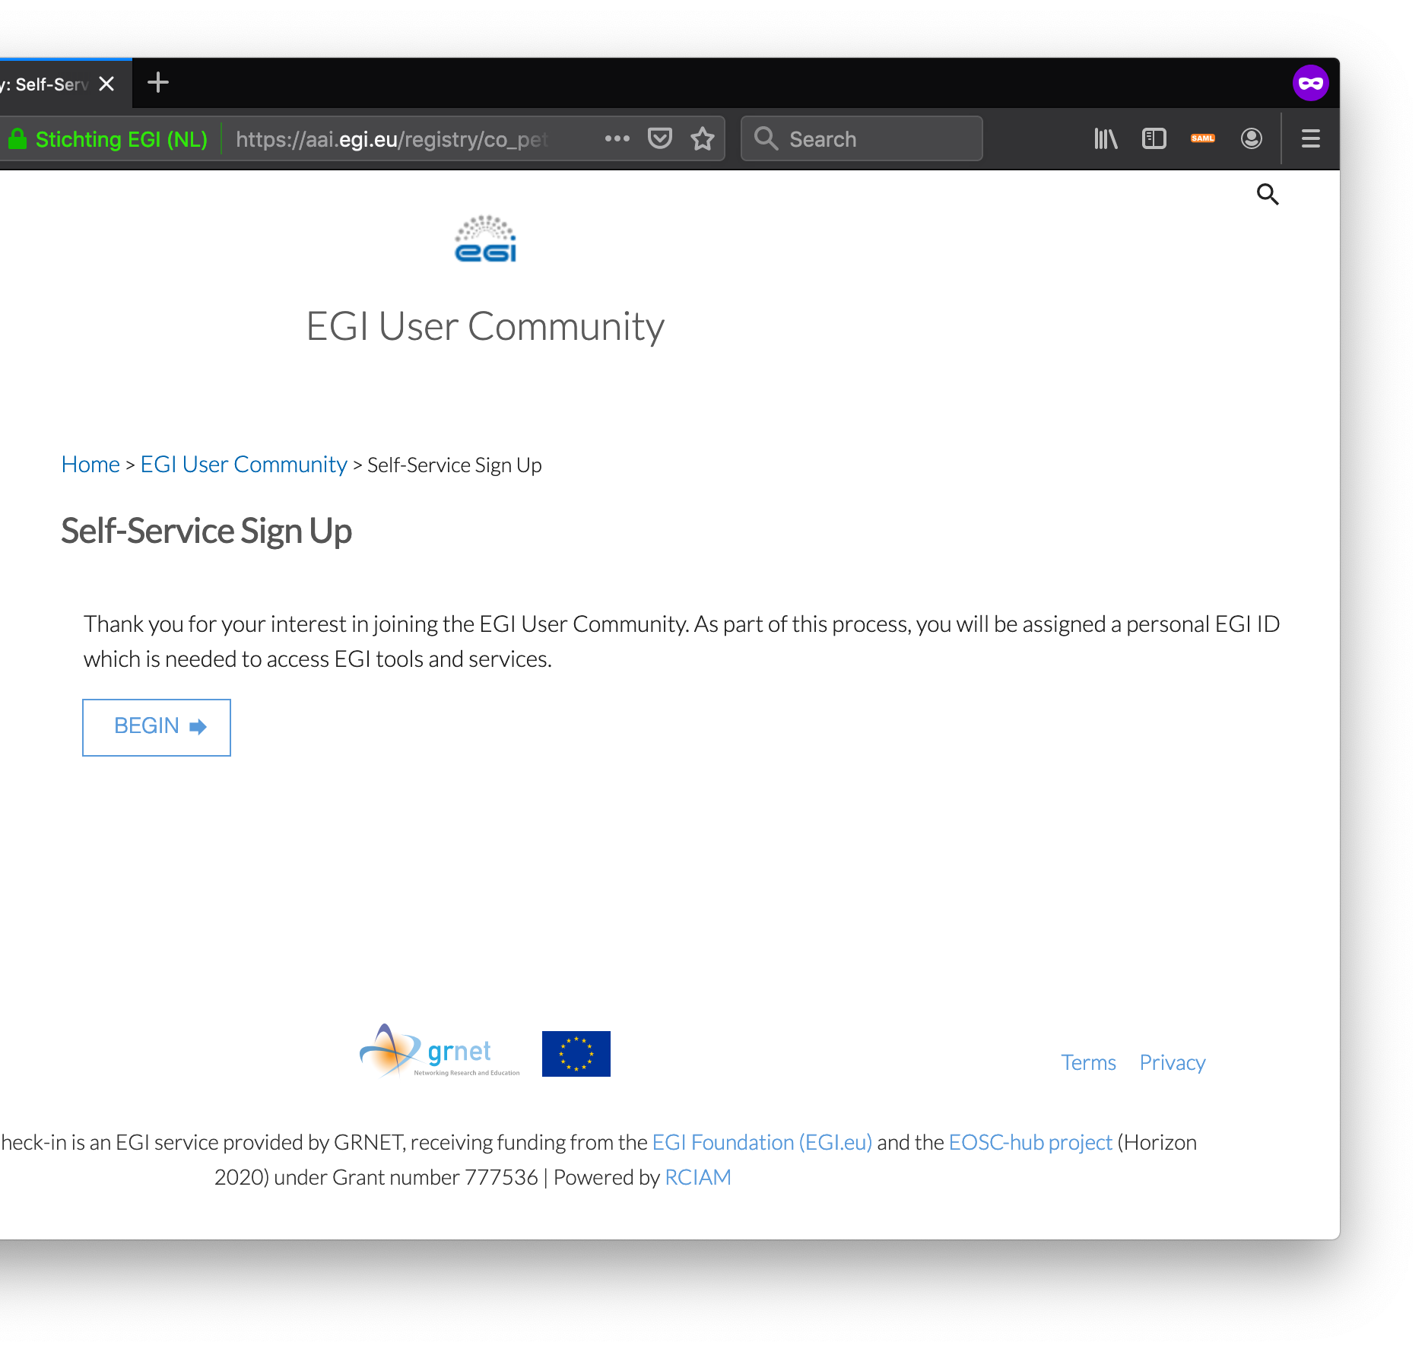
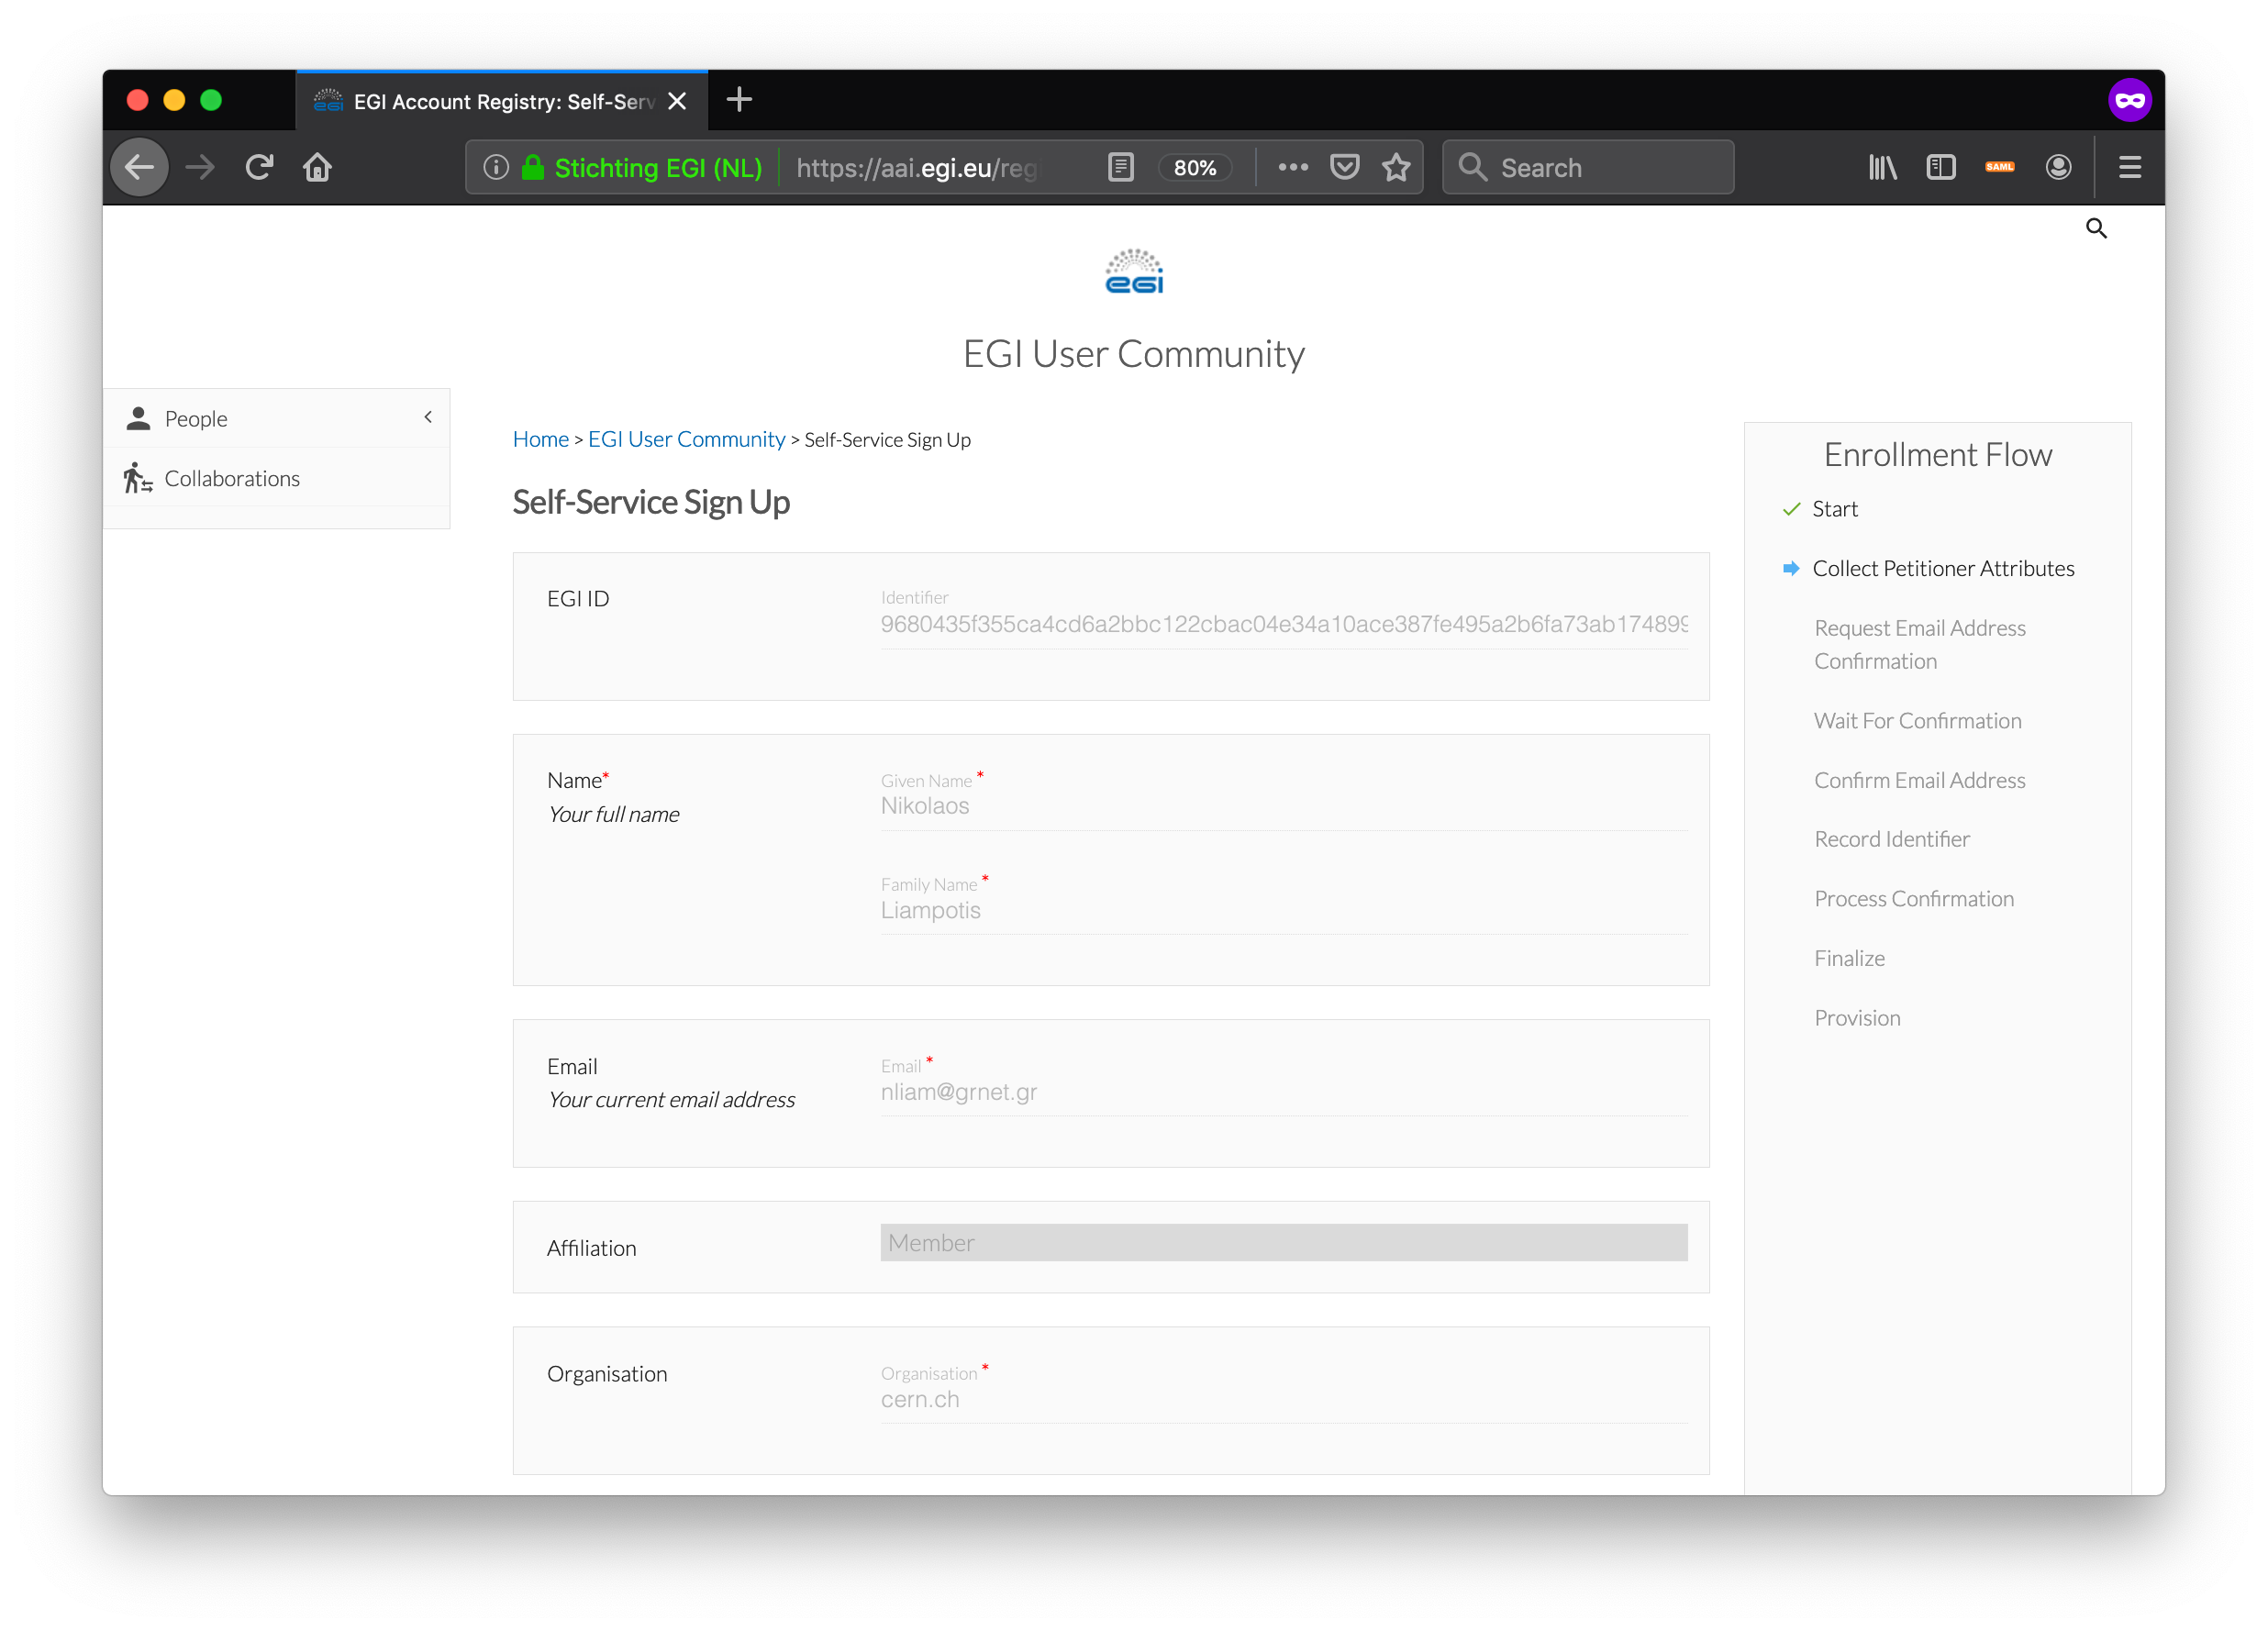
User enrollment

Slide 11
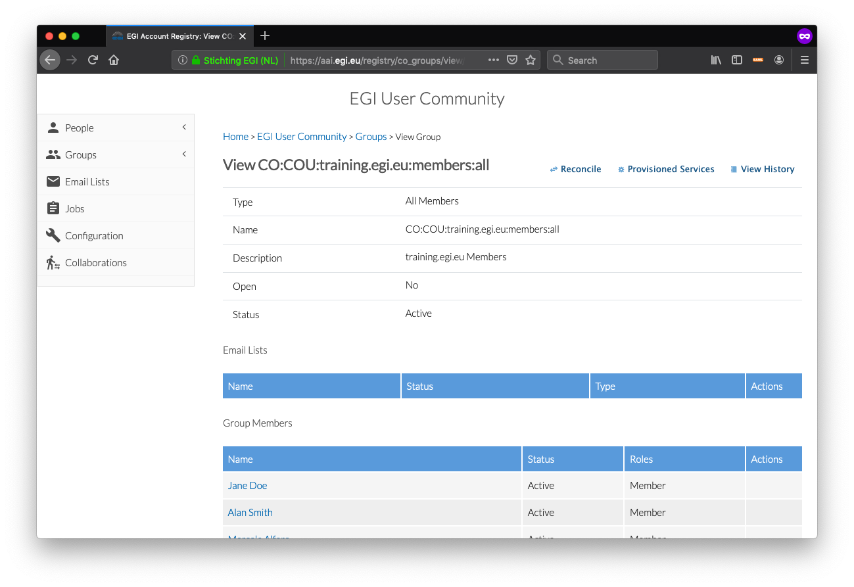
Group Management

Slide 12
Featured use case – For communities in need of a ready-to-use group management solution
eduGAIN
Social
Communities that do not operate their own group management service can leverage the group management capabilities of the Check-in platform to:
Avoid overhead of deploying a dedicated group management service
Allow authorised group admins to manage the information about their users independently
Enable easy and secure access to resources offered by EGI and other infrastructures participating in EOSC
EGI CheckIn
Virtual Organization
Service
EOSC Infrastructure
Service

Slide 13
Featured use case – For communities operating their own AAI
Social
eduGAIN
Community IdP
Community AAI connected to Check-in as an IdP Proxy to allow its users to access EGI services & resources
Community can access EGI services without changing their users’ authentication workflow
Community AAI
EGI Check-in
EGI Infrastructure
Service
Service

Slide 14
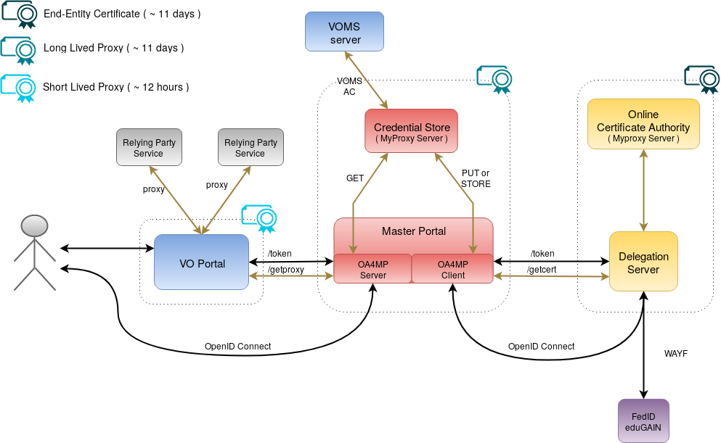
Non-web use cases & delegated access
RCauth.eu Online CA issued certificates
Check-in has been integrated with the production RCAuth.eu Online CA for allowing users to retrieve X.509 proxy certificates using their federated credentials
Master Portal retrieves end-entity certificate from RCauth.eu
Long-lived proxy certificate stored in backend MyProxy server
Short-lived proxies provided via:
Science Gateways via OIDC (so-called VO-portals)
users e.g. via SSH key authentication
EGI Check-in

Slide 15
Check-in Documentation
Usage guide
Integration guide for service providers
Integration guide for identity providers
Frequently Asked Questions

Slide 16
Connect your Service to EGI Check-in

