Slide 1
The EGI DataHub
Federate distributed data sets for data-intensive applications in the cloud
Andrea Manzi
Lucasz Dutka
EGI Foundation
Cyfronet

Slide 2
Outline
What is the EGI DataHub and the main use cases (Andrea)
  EGI DataHub and Onedata overview
  Main features
  Use cases
Demo on advanced use cases and new features (Lucasz)
  New GUI and tokens
  Harvesters
  QoS support
Q&A

Slide 3
EGI DataHub Overview
Service based on Onedata technology and co-funded by the EOSC-Hub project
It allows transparent data access under a common namespace regardless of the location
  open access
  access restricted to members of a Virtual Organization (VO)
Data can be accessed via a GUI or an API
Allows replication of data from data providers for resiliency and availability purposes. Replication may take place either on­ demand or automatically.
Easy integration with other EGI components and with user communities existing infrastructures thanks to integration with EGI Checkin service, the EGI Authentication and Authorization Infrastructure (AAI)

Slide 4

Components and concepts
Onezone, the federation and authentication service.
  SSO with all the connected storage providers (Oneprovider)
Oneprovider: data management component deployed in the data centres, provisioning data and managing transfers
  REST and CDMI APIs
Space: a virtual volume where users organize data. A space is supported by one or multiple Oneproviders
Oneclient: a client providing access to the spaces through a FUSE mount point (local POSIX access)

Slide 5




Architecture
DS.3
FUSE Client
Oneclient
EGI Checkin
Service
Data Space 1
HTTP GUI
REST / CDMI
FUSE Client
Oneclient
Onezone
FUSE Client
Oneclient
Data Space 2
HTTP GUI
REST / CDMI
FUSE Client
Oneclient
Credits : Bartosz Kryza

Slide 6

Service Status
EGI open service instance: https://datahub.egi.eu
  Onezone and default Oneprovider operated by Cyfronet
The Service is in the transition to Beta phase, so soon will be part of the EGI Service catalogue and Marketplace
  Already used by early adopters projects from EOSC-Hub
Integration with the EGI ecosystem is ongoing
  AAI
  Monitoring
  Helpdesk
  Accounting => To be completed before moving to production
Documentation available at https://docs.egi.eu/users/datahub/ and https://docs.egi.eu/providers/datahub/

Slide 7
Service Offering
Access to a PLAYGROUND public space is granted to anyone for testing and evaluation
  N.B. Limited and shared storage
Users are able to create private empty spaces and provide/ask for storage support via Oneprovider
  by installing Oneproviders on their infrastructure to store or expose existing datasets
  by contacting EGI support to request storage from EGI Federation providers
    According to SLA to be agreed with the providers
Communities may decide to have a customized and dedicated DataHub installation for their use cases
  e.g. PaNOSC https://onezone-panosc.egi.eu/
  by contacting EGI support to discuss the installation

Slide 8
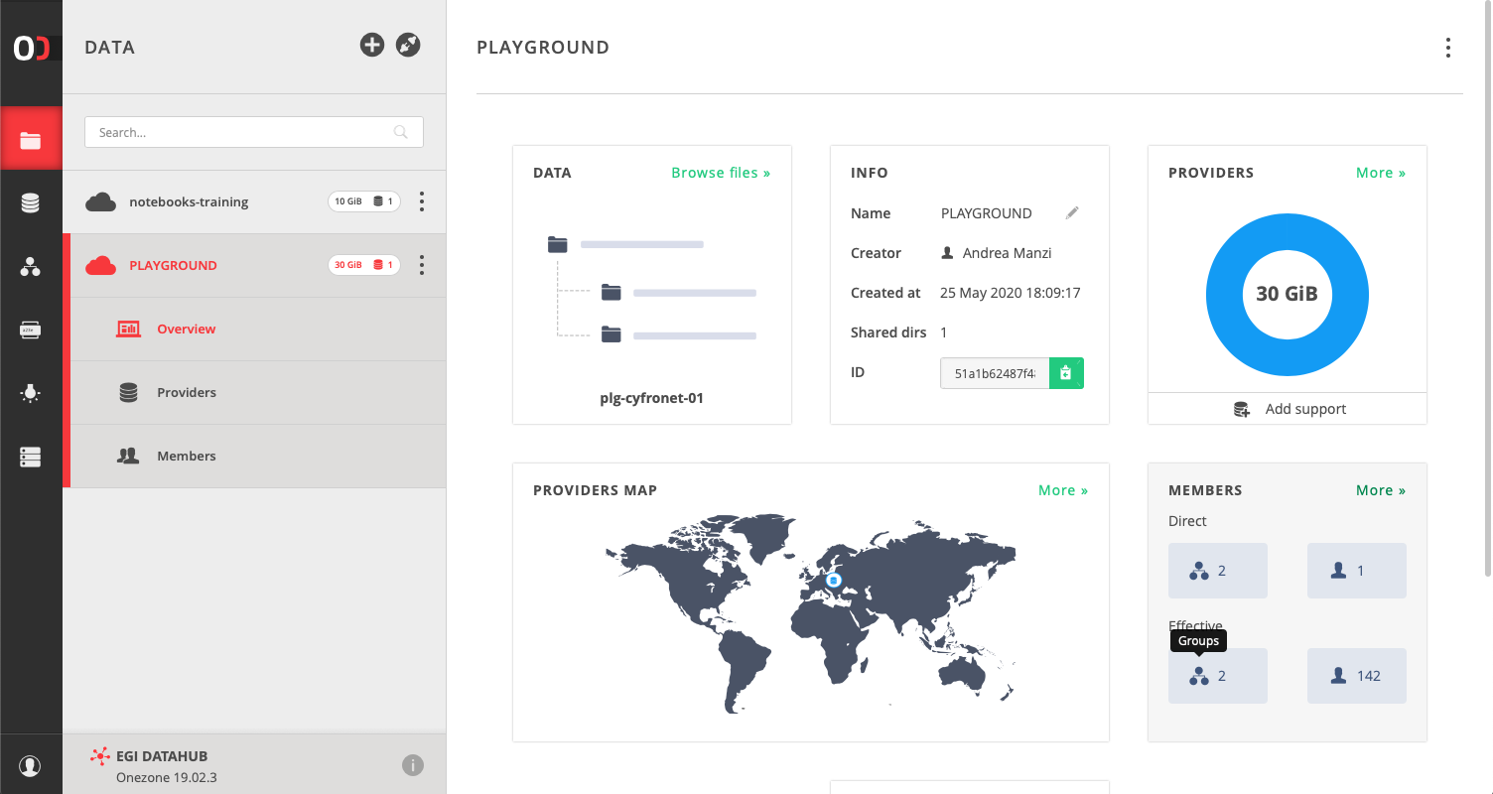
Space navigation/management

Slide 9
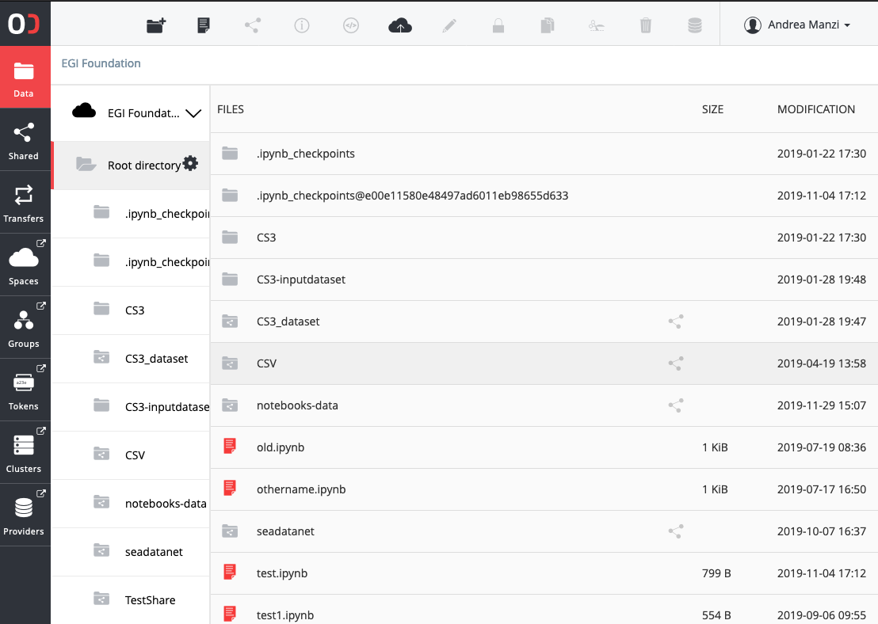
File / Share management
For each space, users can manage files stored at the OneProviders
  Usual file operations supported
Directory can be publicly shared
  https://datahub.egi.eu/share/8a7d0e1de074f8ab12cfdd8f2428f4b8ch6b7b
Shares can eventually be published via Handle services and have a PID assigned
  http://hdl.handle.net/21.T15999/QBFl7Pw

Slide 10
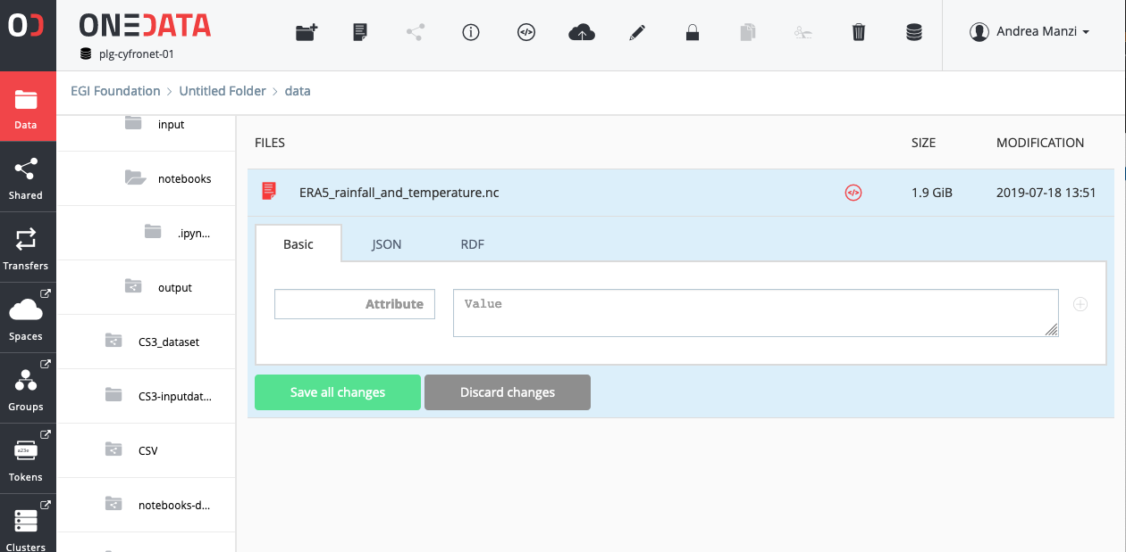
Metadata management
Metadata associated to files
  Key/value pairs
  Json
  RDF
Possibility to create indexes via REST API
Metadata harvesting via OAI-PMH interface
  http://datahub.egi.eu/oai_pmh?verb=ListRecords&metadataPrefix=oai_dc

Slide 11
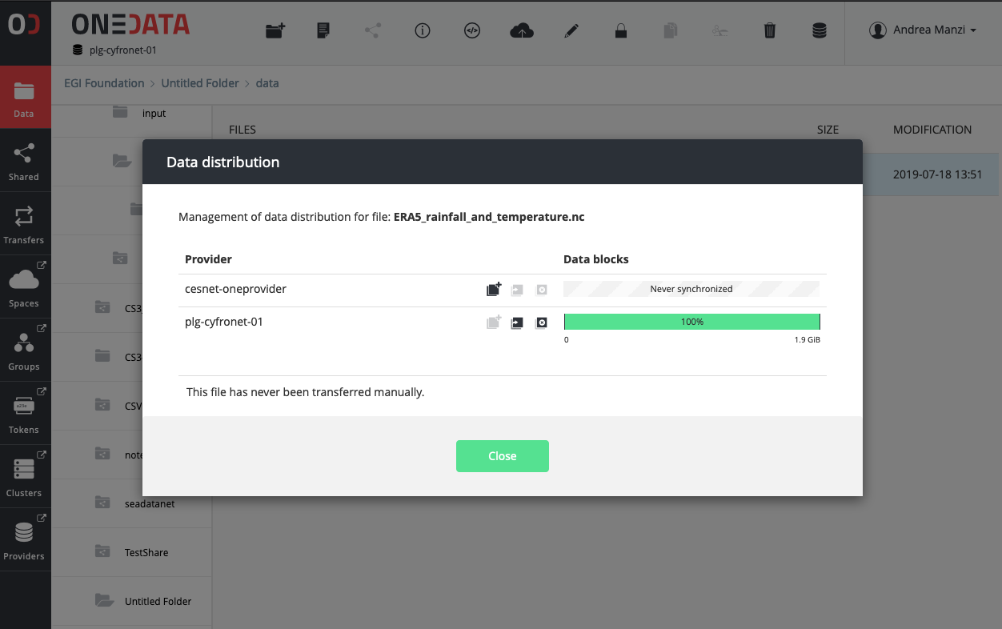
Replica / Transfer management
For spaces supported by multiple Oneproviders, the data distribution can be adjusted
  Data migration
  Data balancing
Transfers ca be scheduled, monitored and cancelled from the Web interface and REST API

Slide 12
Posix Access and Onedata Tokens
Oneproviders can be mounted via FUSE and accessed locally to a Linux system
Onedata Tokens are needed in order to authenticate user access
They can be generated either from the EGI DataHub Web interface, or via REST using a EGI-Checkin Access token ( which can be itself retrieved via CLI)
ONECLIENT_ACCESS_TOKEN=$(curl -H "X-Auth-Token: egi:$CHECKIN_ACCESS_TOKEN" -X POST \
-H 'Content-type: application/json' -d '{}' \
”https://datahub.egi.eu/api/v3/onezone/user/client_tokens" | jq -r .token)

Slide 13
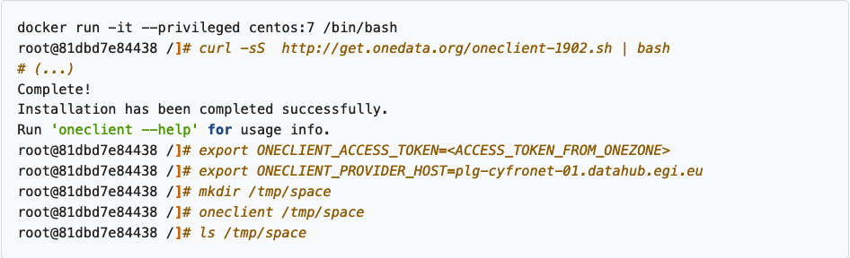
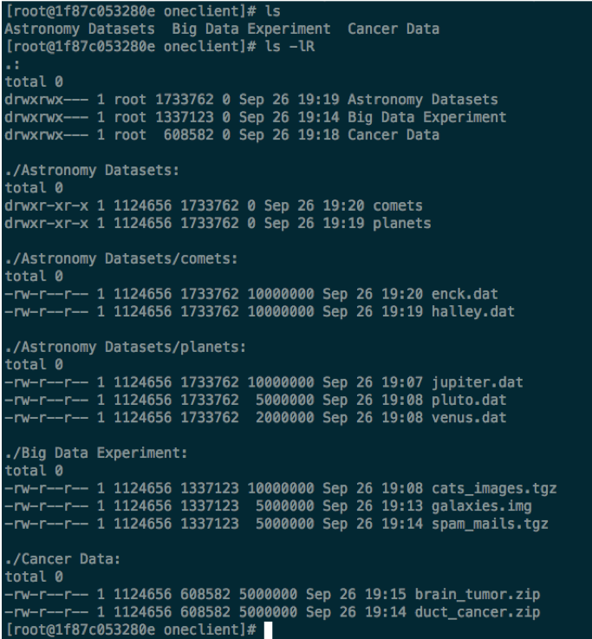
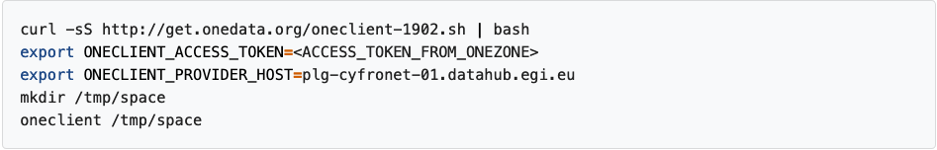
Posix Access via Oneclient
Files not available on the mounted Oneprovider, when accessed, are transparently transferred from other Oneproviders supporting the same space

Slide 14
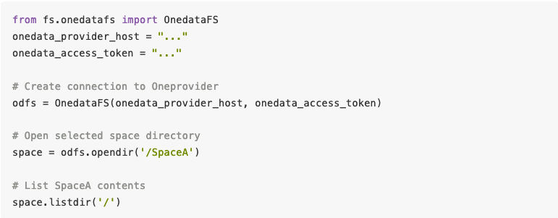
OnedataFS
OnedataFS is a PyFilesystem plugin to Onedata virtual file system. As a PyFilesystem concrete class, OnedataFS allows you to work with Onedata in the same way as any other supported filesystem
Available via Pypi and Anaconda
Particular useful in the case of data access via python Jupyter notebooks

Slide 15
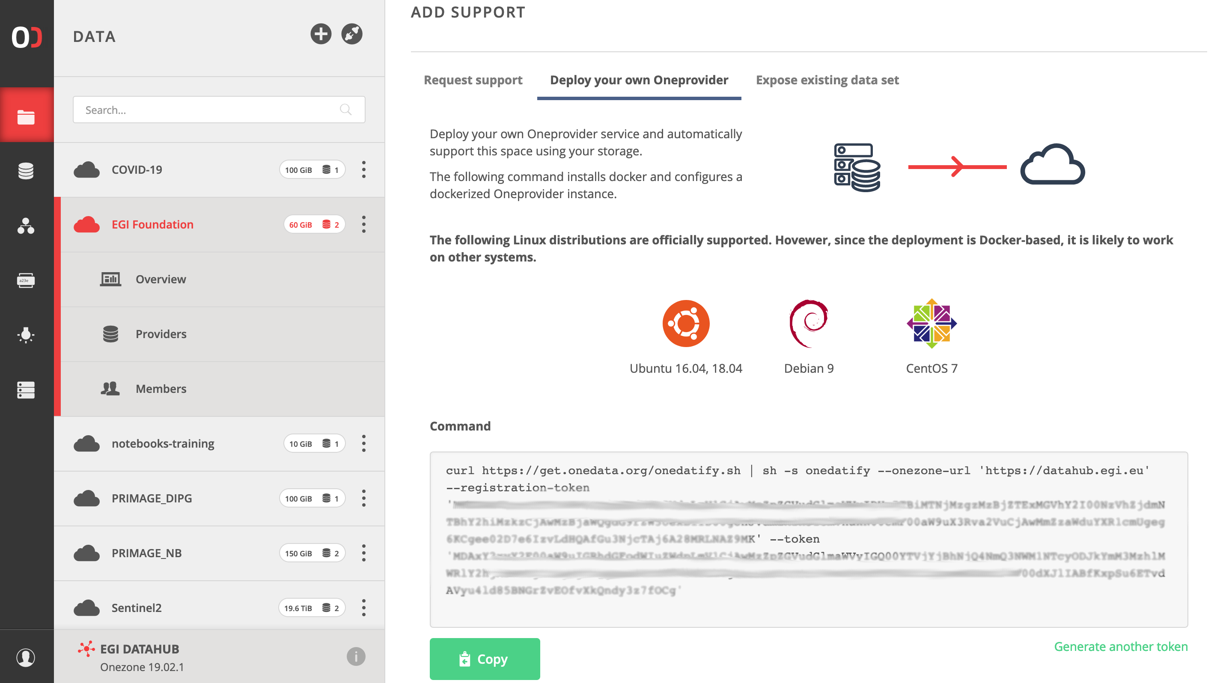
Install OneProvider to support EGI DataHub Spaces
Automatic SSL certificate installation via Let’s Encrypt
Supported backend
  Posix
  S3
  Swift
  CEPH
  GlusterFS
  NFS
  Webdav

Slide 16
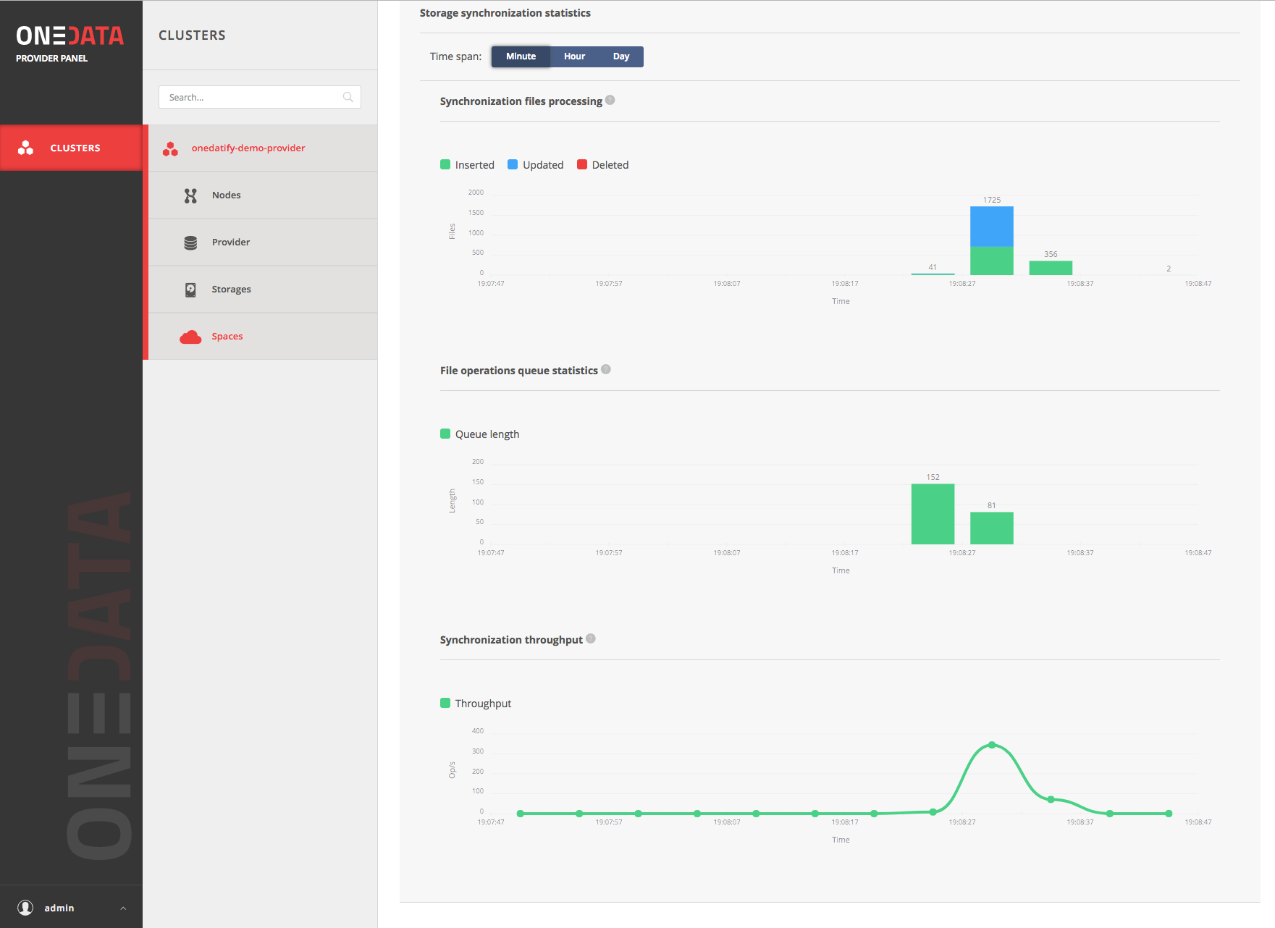
Install OneProvider and expose existing data
One time import
Continuous Synchronization
Statistics available from the Oneprovider admin panel

Slide 17
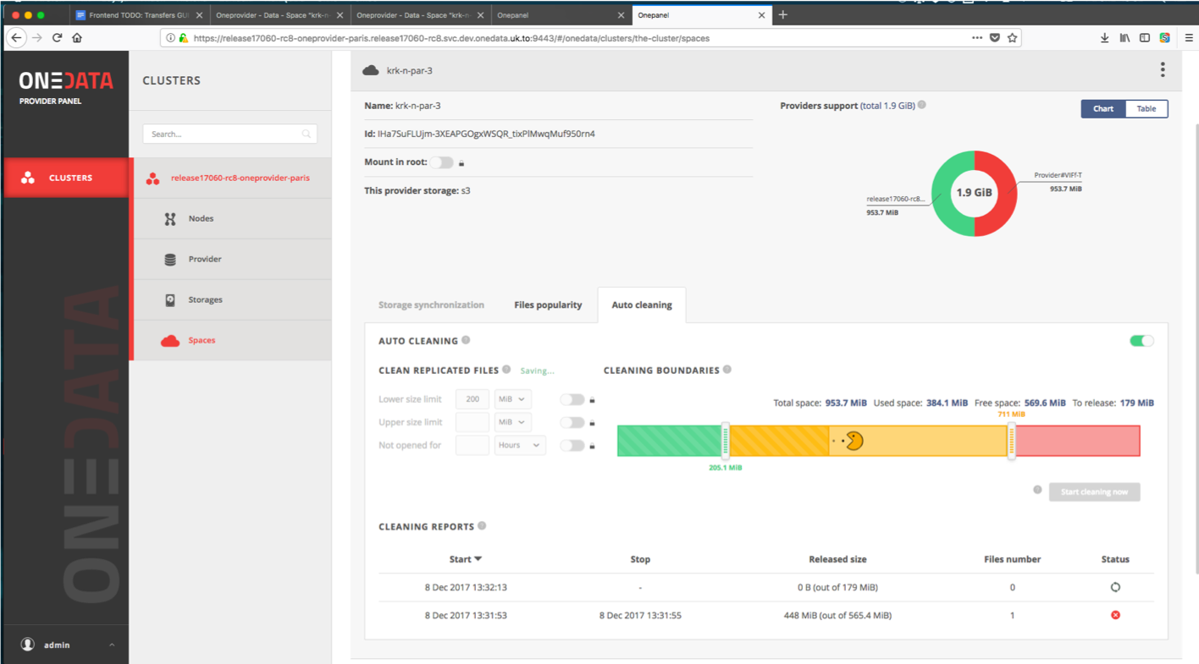
File Popularity, Caching and Autocleaning
File popularity can be enabled by admins
  Query popularity info via REST API
If the provider is used as a cache, autocleaning can be configured based on
  Free space
  File access time
  Number of file accesses

Slide 18
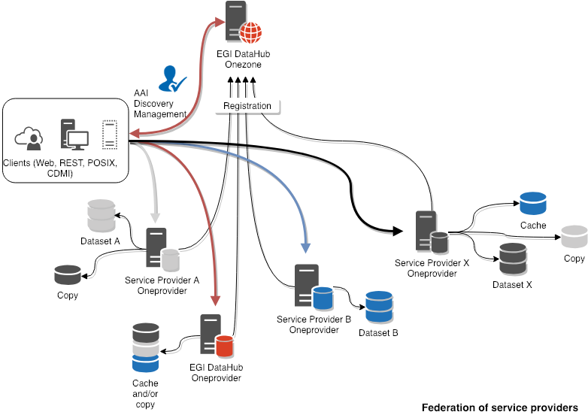
Use case: Federation of service providers
Possible heterogenous backend storages
Common interfaces (Web, REST, POSIX, CDMI)
Common AAI with Check-in
Discovery of Datasets in the EGI DataHub
  Optionally published with PID assigned
Community pilots
  MARIS, SeaDatanet files
  Emphasys, plant phenotyping images

Slide 19
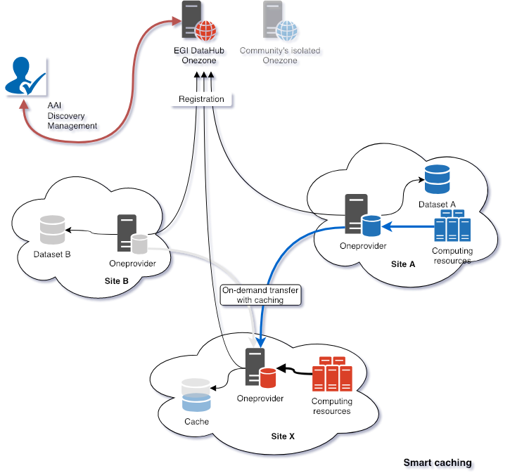
Use case: Smart caching of remote storage
Site A hosts data and computing resources
Site B hosts only data
Site X uses data from A and B without pre-staging
  Pre-staging can also be done using APIs
Data is accessed via POSIX with FUSE

Slide 20
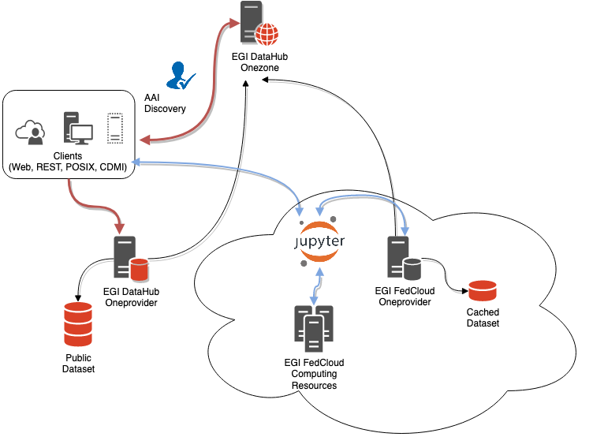
Use Case: EGI Notebooks and DataHub
Access to DataHub spaces from EGI Notebooks installations
Locally mounted spaces or accessed via OnedataFS API in case of Python
Storing Notebooks directly on Onedata spaces is also supported
Community pilots
  PaNOSC (see next)
  ECAS
  ENVRI-FAIR (under setup)

Slide 21
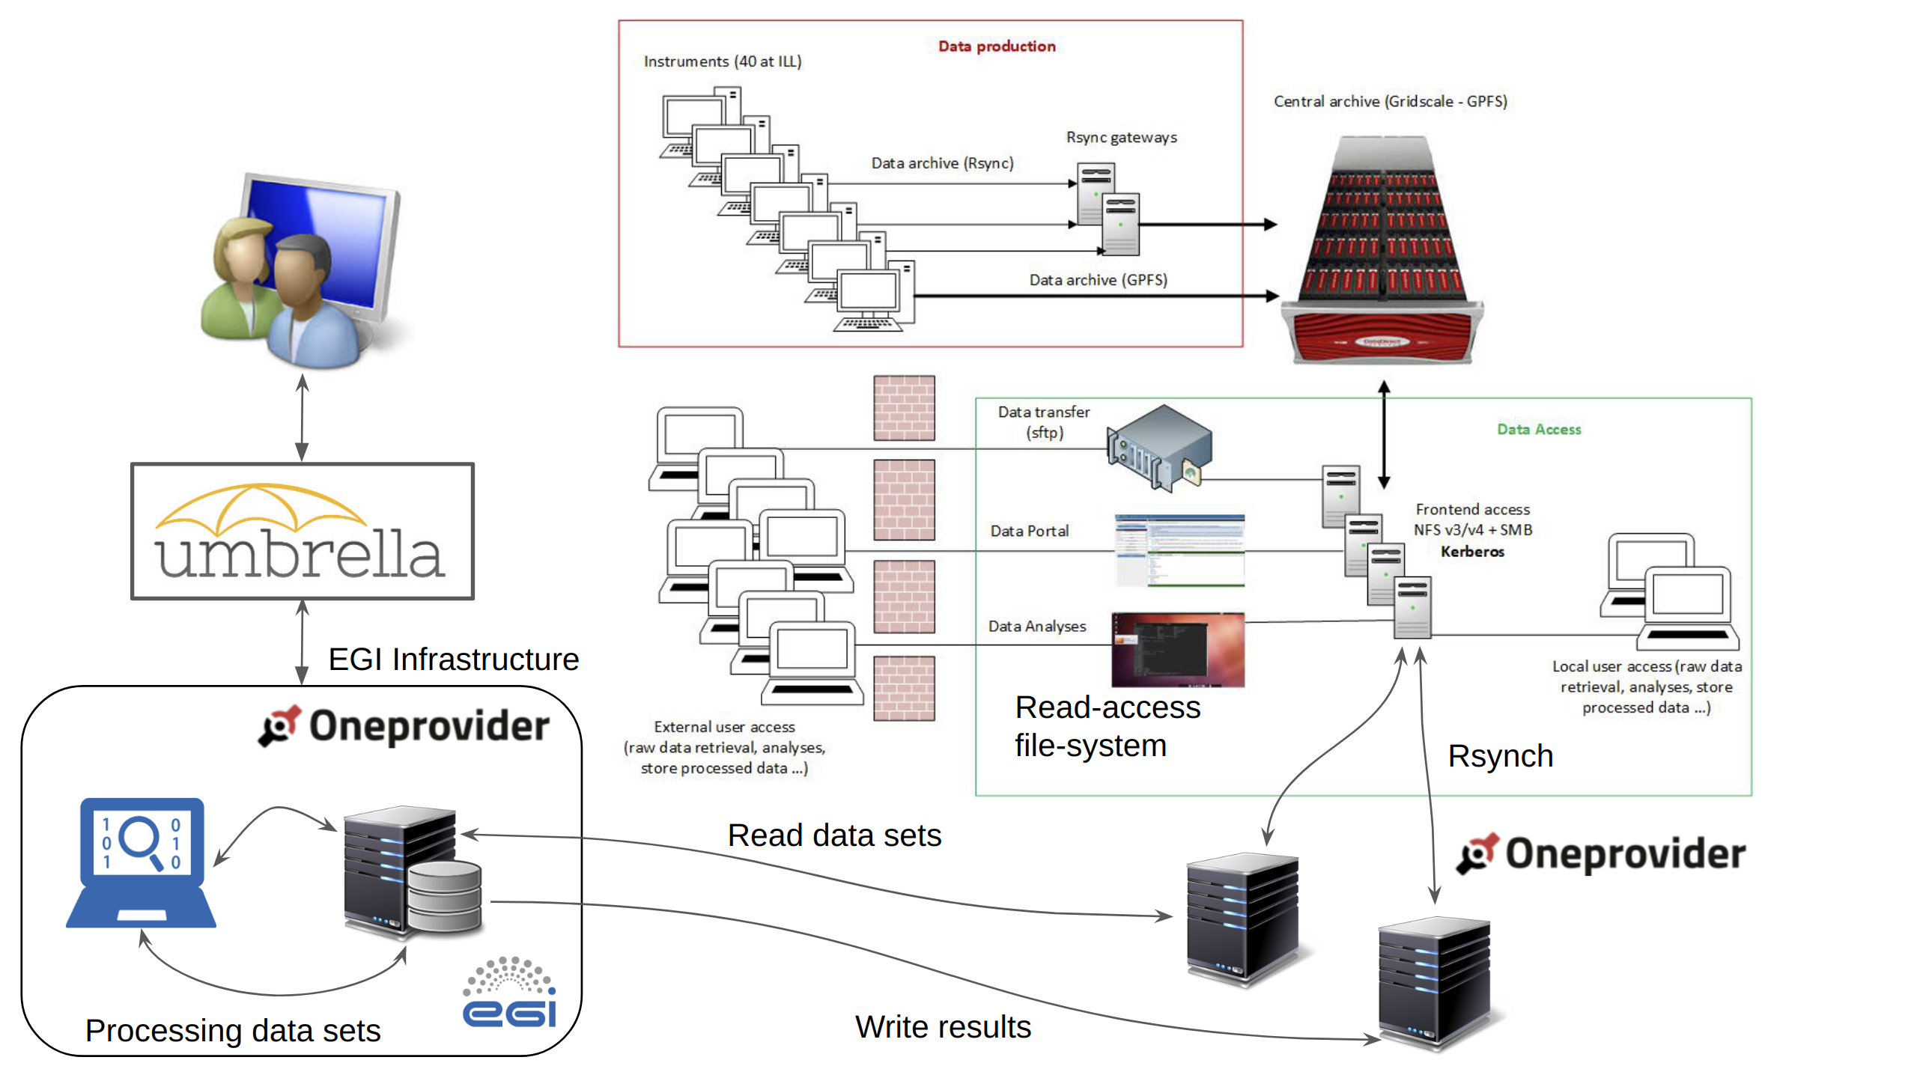
PaNOSC Pilot
Integration with UmbrellaID as community AAI for the PaNOSC project
Access to PaNOSC datasets from EGI notebooks through a dedicated DataHub installation
  Reading Hdf5 files and storing simulation results from/to Oneproviders on top of community NFS
https://github.com/EGI-Foundation/data-transfer-pilot/

Slide 22
DEMO

