Slide 1
Supporting FAIR data discoverability in clinical research: providing a global metadata repository (MDR) of clinical study object
Sergey Goryanin (ECRIN), Hans van Piggelen (SURFsara BV)
Stefano Nicotri (INFN)
Notes:
This is the cover page slide. Insert headings and titles as appropriate.

Slide 2
Background
Clinical research studies and data objects belonging to it are it often scattered around (e.g. website, publication, repository, registry).
Mechanisms for gaining access vary between different places and different data objects.
No agreed discovery metadata schemas implemented and used for discovery.
Findability of clinical studies and related data objects is a difficult, time-consuming process.

Slide 3
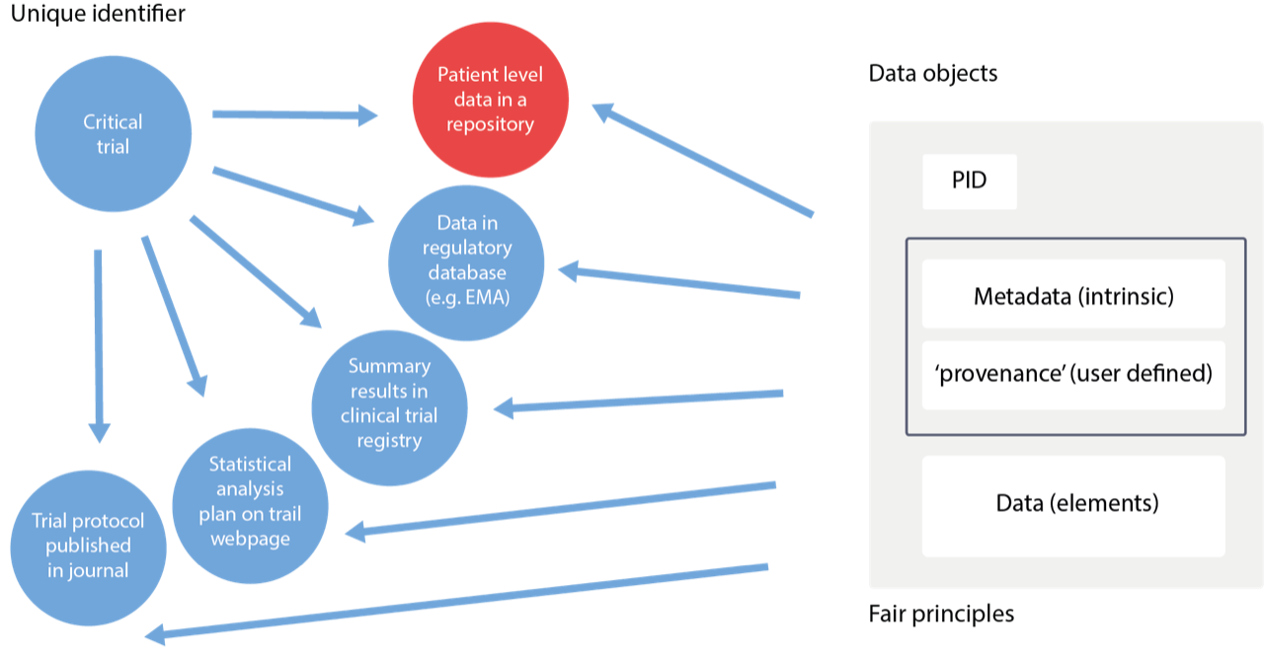
A study is any clinical research study with humans as study participants, and which is therefore subject to ethical approval, whether or not the study is interventional (a 'clinical trial'), or observational (including disease registry data), or a case study.
A data object is any information available in electronic form (a 'data stream') and may be a document (e.g. a pdf), a dataset in one of a variety of formats (spreadsheet, csv files, database file, XML etc.), a media (audio, video) file, an image (e.g. a conference poster) or simply a web page with useful text.
Fig. 1 – Structure of clinical trial (study, data object)

Slide 4
MDR… Why?
To maximize the discoverability of all these studies and related data objects, it is necessary to collect the metadata about them, including object provenance, location and access details, into a single system.
To that end ECRIN is currently developing an MDR (MetaData Repository) to standardize, assemble and display the metadata about clinical studies and the data objects generated by them, and provide access to them through a single system, accessed via a web portal.

Slide 5
MDR… Implementation
The web portal is developed in collaboration with ONEDATA (Cyfronet, Poland); functionality for discoverability of studies and related data objects is provided by INFN (Italy)*. So far metadata from 5 data sources have been collected using different modalities (e.g. XMLs processing, APIs, scraping of web pages) and stored as JSON objects/relational DB form on the test bed server at INFN. Data will be then ingested, uploaded and made available for the users.
The ONEDATA solution will implement the metadata collection and transport from multiple OneProvider to the central OneZone service; it will also deal with the ACLs management to implement the data protection.
* Within H2020 XDC project

Slide 6
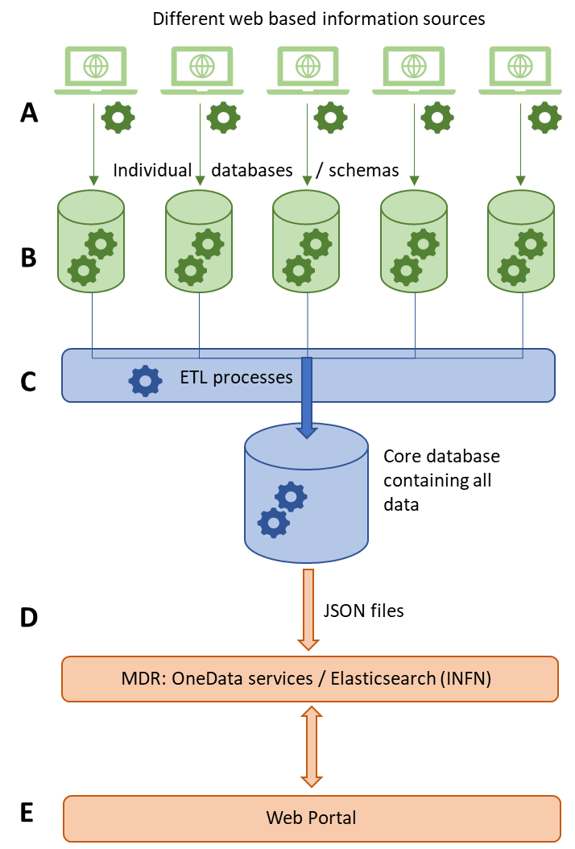

Slide 7
Current progress
5 data sources (PubMed, CT.gov, BioLINCC, Yoda, WHO ICTRP) are connected
Single and universal metadata schema was developed*
> 1.5 millions of studies and data objects uploaded (including COVID-19 related clinical trials)
JSON Schema - http://ecrin-mdr.online/index.php/JSON_Schemas
ECRIN Clinical Research Metadata Schema https://zenodo.org/record/3562911

Slide 8
Current cloud resources
Currently, ECRIN is using a cloud server, provided by INFN within the XDC project (16 VCPUs, 32GB RAM, 20GB of disk space + 1TB of external storage).
3 more VMs, provided by INFN as well, are used to prepare JSON files containing metadata, load and host them into a OneData environment (Oneprovider + Onezone).

Slide 9
Our data
Open, publicly available metadata;
(Meta)data are extracted from different sources and put in one place – our Core Database
Current number of records (files) is > 1.500.000
Files are represented in JSON format, 5-12 Kb each
Total size of Core Database is ~13Gb.

Slide 10
Tools and workflow
Metadata processing scripts are written on C#
APIs and back-end are on Django (v. 3.0.3), Python (v. 3.7.6)
Anaconda (v. 4.8.3) environment for the further ML and DL implementation
PostgreSQL (v. 12.2) database
ElasticSeach as the current search engine
Web-server: Nginx (v. 1.17)

Slide 11
Activities in EOSC-Hub
Revise web-portal
Investigate a new mechanism of ECRIN metadata ‘injection’ and upgrading on OneData platform;
Extend the MDR demonstrator to run in production in the EOSC environment
Make MDR demonstrator part of the EOSC catalogue
Developing ElasticSearch-based APIs
Collect data on user action and users feedbacks
Enable harvesting by EUDAT B2FIND

Slide 12
Q1
Investigate a new mechanism of ECRIN metadata ‘injection’ and upgrading on OneData environment.
Revision of the web-portal.
Investigate metadata schema and requirements for future harvesting by B2FIND

Slide 13
Q2
Continue the revision of current web-portal, developed within XDC project in collaboration with OneData (web-portal GUI + OneData Environment) and INFN (ElasticSearch + hardware support).
Testing and upgrading the web-portal with respect to updated ECRIN requirements.
Continued investigation on harvesting by B2FIND

Slide 14
Q3
Testing the work produced in Q1 and Q2
Start to develop ElasticSearch-based APIs in collaboration with INFN
Enable harvesting of a single MDR instance by B2FIND test instance

Slide 15
Q4
Finalizing the development and integration testing by users.
Support for potential users, including collecting metrics as well as feedback, and feeding back requests for change.
Enable harvesting of one or more MDR instance by B2FIND production instance

Slide 16
Requested technical services
Infrastructure: INFN cloud platform Cloud@ReCaS-Bari
Service: INFN ElasticSearch, OneData Environment (including OneProvider, OneSpaces, OneZone etc).

Slide 17
Goals to be achieved in 1 year
Running in production
ECRIN portal on EOSC OneData service
Elasticsearch backend
for the platform, running on EOSC services
scalability of the services
Improved and possibly automated metadata ingestion into ECRIN/OneData environment
Updated and integrated ECRIN portal in OneData environment
Revised ECRIN metadata schema
Automated metadata harvesting by EUDAT B2FIND
Support for potential users

Slide 18
More details?
Our wiki:
http://ecrin-mdr.online/index.php/Project_Overview

Slide 19
Thank you!
Any questions?

