Slide 1
EAP: Open AiiDA lab platform for cloud computing in Materials Science
PI: Giovanni Pizzi / Leopold Talirz; Sh: Enol Fernández
Dissemination level: Public/Confidential If confidential, please define:
Disclosing Party: (those disclosing confidential information)
Recipient Party: (to whom this information is disclosed, default: project consortium)

Slide 3
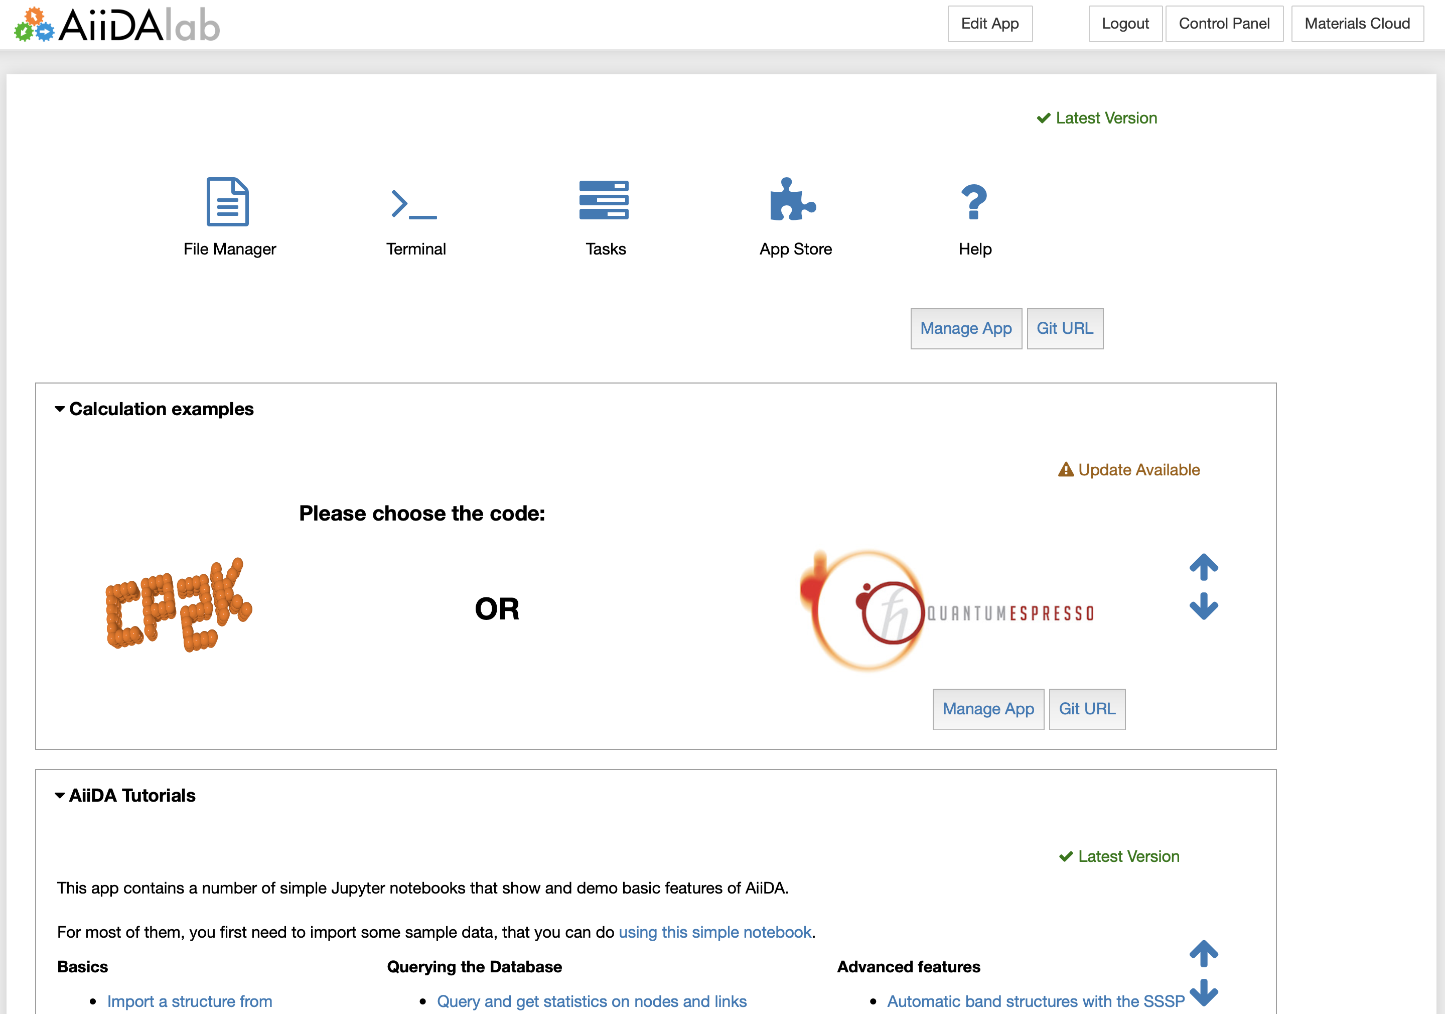
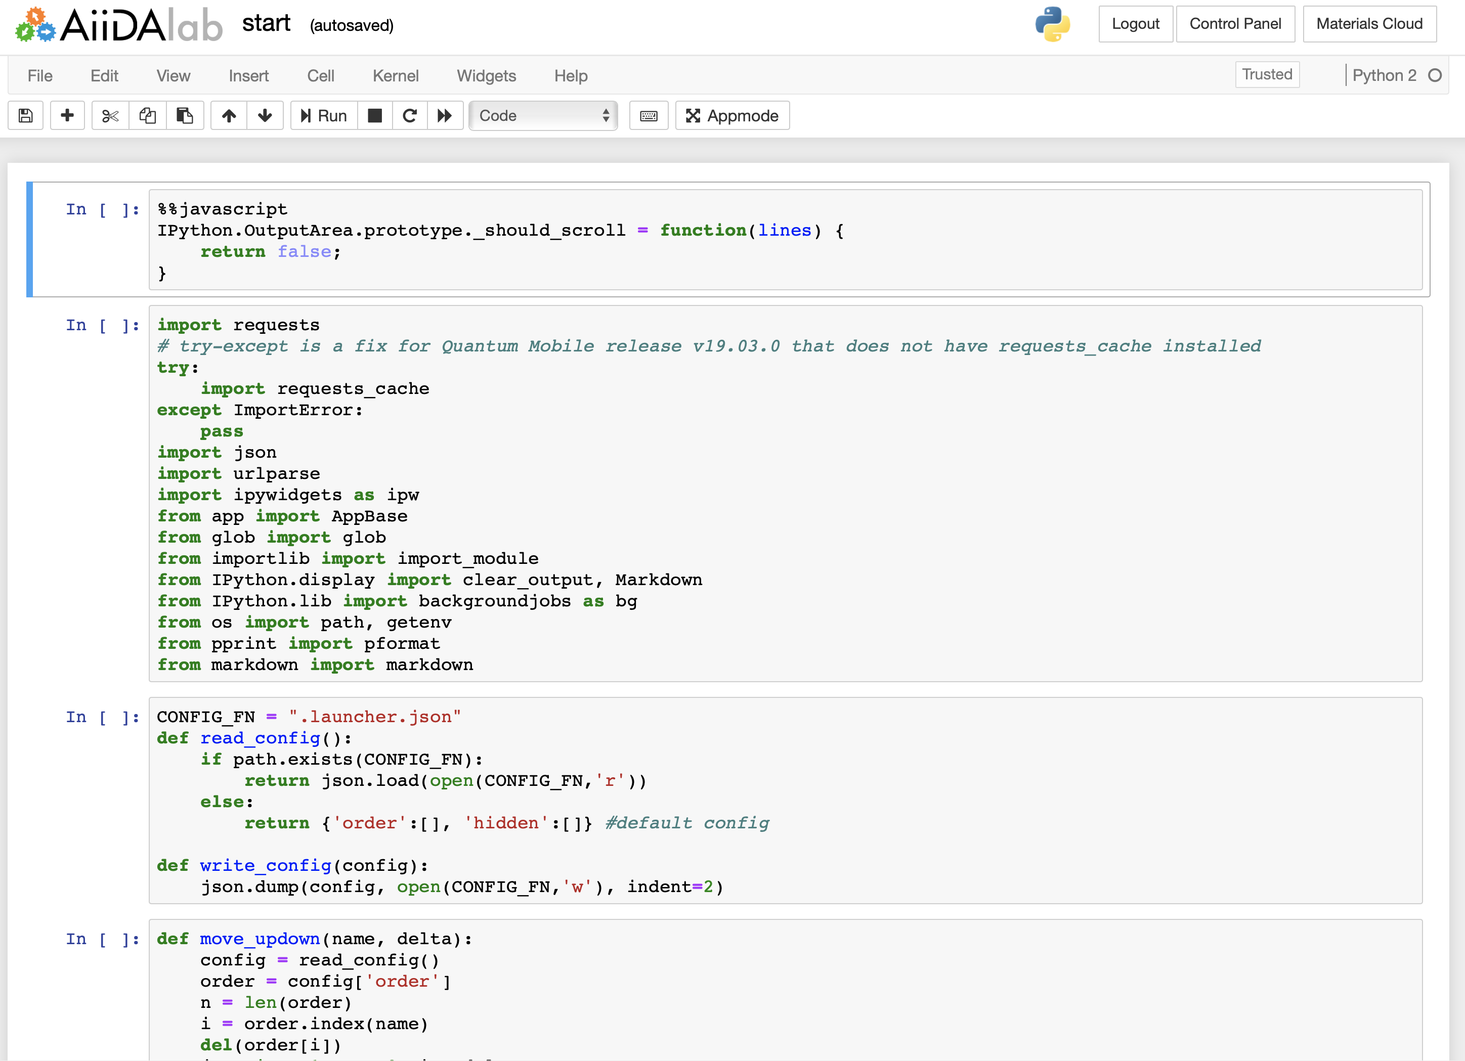
AiiDA lab
Our cloud data generation platform and data analysis platform
Based on AiiDA + Jupyter + App Mode
Custom Home view with “App store” and app management
Provide easy user interfaces to AiiDA (for theorists and experimentalists alike)
Click on “Edit app” to switch from “App mode” to the standard Jupyter interface
App Store to install new apps or manage existing ones
Check if the app is updated
Apps can be added, removed, reordered

Slide 4
Automatic DFT simulations

Slide 5
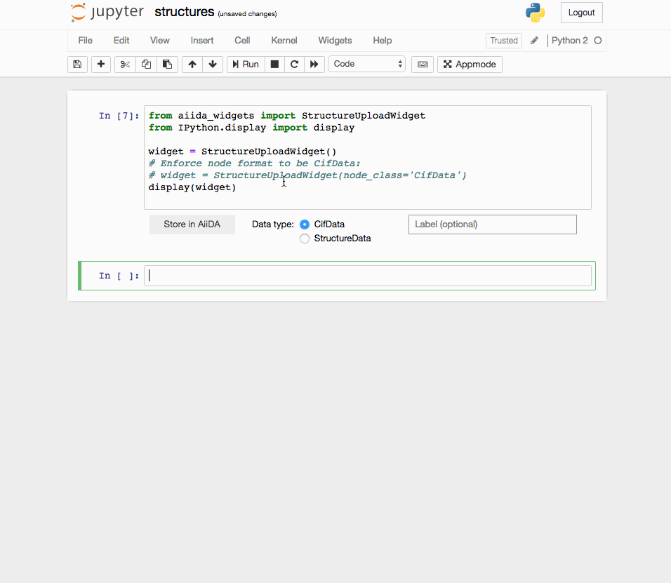
Resources to make your own app
Docs and wiki https://github.com/aiidalab/aiidalab-home/wiki/Intro
“Cookiecutter” recipe for scaffolding of new AiiDA lab apps https://github.com/aiidalab/aiidalab-app-cutter
Basic widgets for common functionality https://github.com/aiidalab/aiidalab-widgets-base
Advanced widgets for more specific usages in development https://github.com/aiidalab/aiidalab-widget-periodictable https://github.com/aiidalab/aiidalab-widget-graph

Slide 6
Kubernetes and scaling + hosting your own AiiDA lab
Kubernetes: Platform for managing containerized services, facilitating autoscaling, open-sourced by Google
Working on allowing easy re-deploy of AiiDA lab “on premises”, relevant for other data centres/universities, critical for industries
All the stack now open source (Both for single VM, or autoscaling with kubernetes)

Slide 7
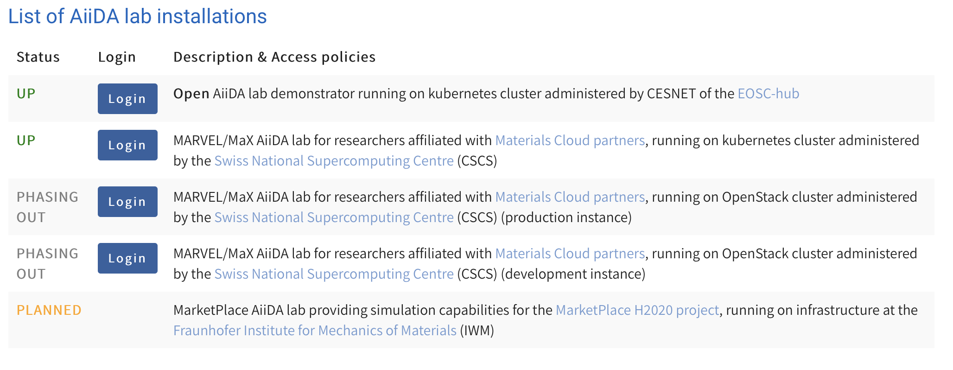
AiiDA lab deployment(s)

Slide 8
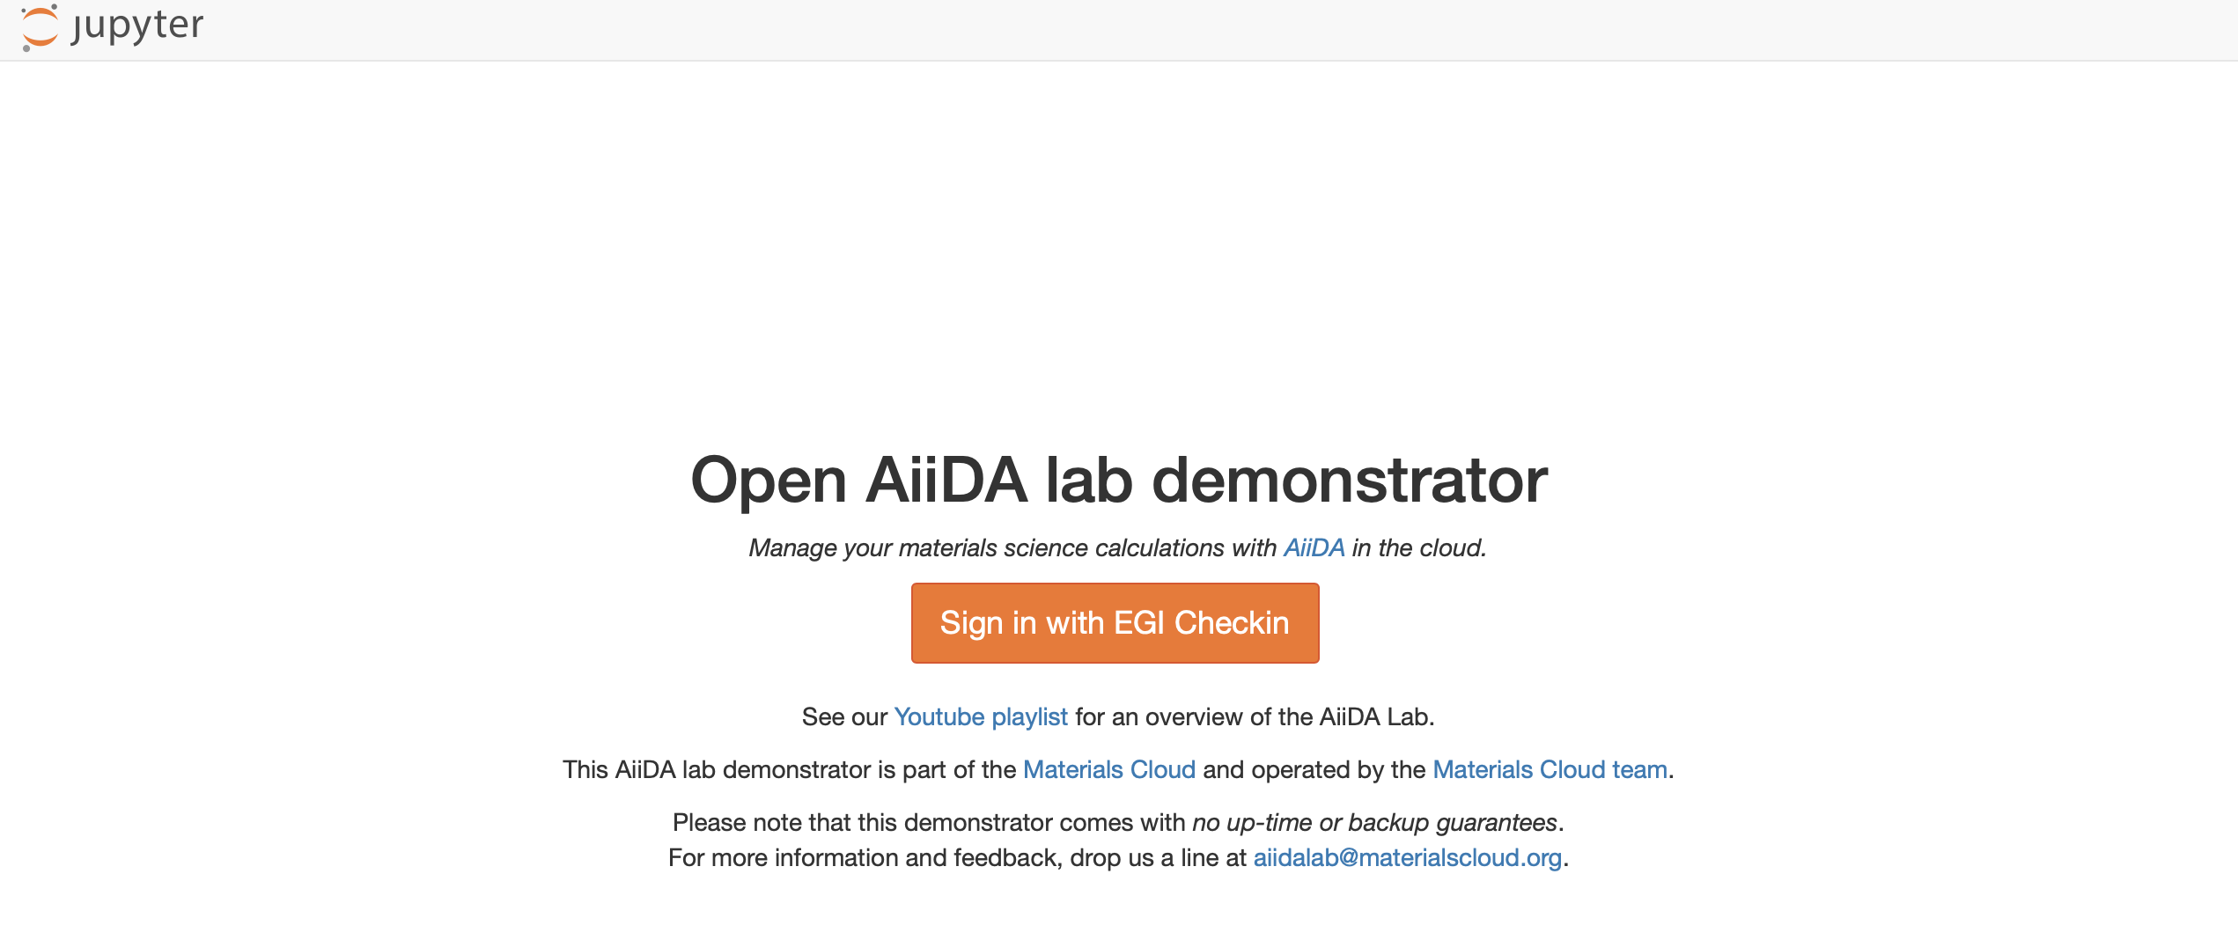
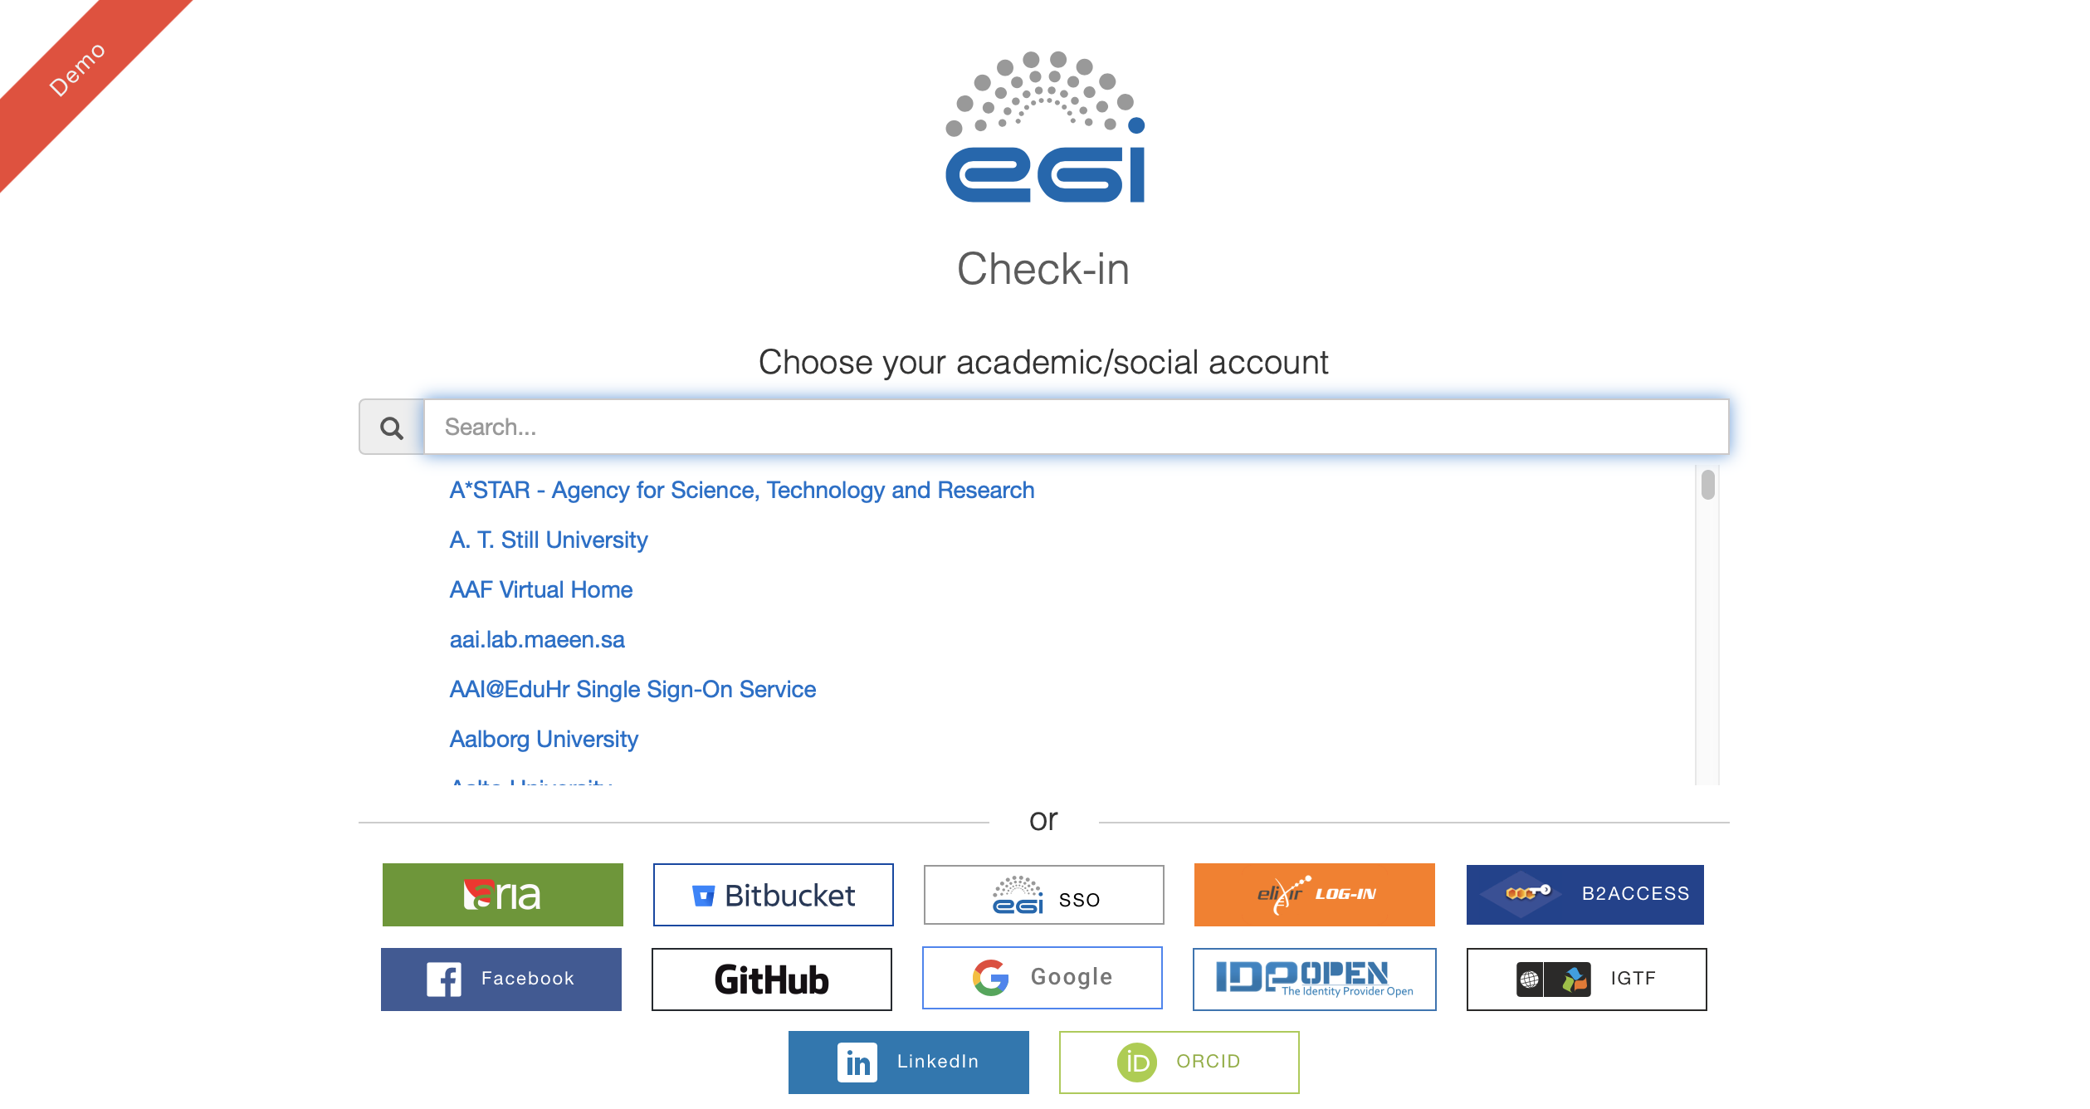
AiiDA lab on EOSC/CESNET

Slide 9
Goals
Provide an open AiiDA lab for researchers in Europe capable of supporting ~100 concurrent users
Support of the order of ~1000 users in the system
Test scalable kubernetes set-up so resources can be adjusted to the load as required
Explore S3-compatible object store for user data
Simplify access to the service as much as possible, avoiding complex registration processes

Slide 10
Work plan
Work planned for Q1 | Integration with EGI Check-in, set up the instance with support for AiiDA 1.1 (released in Feb 2020)
Work planned for Q2 | On-boarding of users (~50 expected) Deployment of an application to run Quantum ESPRESSO relaxation workflows in a fully automated fashion
Work planned for Q3 | Use of the AiiDA lab instance for a classroom/tutorial supporting at least 50 concurrent users (e.g. for the tutorial we’ll hold in Lithuania in July 2020: https://www.cecam.org/index.php/workshop-details/3 or a later one) Installation in the instance of updated apps, software stack and data as needed for the tutorial Support of at least 6 different simulation codes and the corresponding AiiDA plugins (e.g. among these: Quantum ESPRESSO, Siesta, Fleur, BigDFT, Yambo, Wannier90, CP2K)
Work planned for Q4 | On-boarding of users (>100 expected), and testing scaling to at least a few hundreds. Identification of issues (e.g. required disk/CPU/RAM quotas, speed and efficiency of the storage to support efficient database storage and querying) Provide straightforward apps to connect to HPC resources (for which the user has already credentials) Upgrade of the full software stack to the most recent available software (AiiDA version, AiiDA plugins, python libraries).

Slide 11
Services of EOSC-hub / integration
EOSC-hub AAI (Check-in):
support for integration, simplification of the registration process
EGI Cloud Container Compute (CESNET):
Support for deployment of scalable Kubernetes
Provisioning of resources
EGI Online Storage (CESNET):
10TB storage available as Kubernetes volumes
IM/EC3:
Auto-scaling Kubernetes setup
B2HANDLE/Zenodo:
Explore PID releasing services/Zenodo integration for the Materials Cloud Archive
EOSC-hub monitoring:
A/R monitoring of the service

Slide 12
Progress
Discussion of the technical plan with providers
2 PMs for CESNET for provision of resources
No effort needed for other services
Marketplace project created with the services requested

Slide 13
Next steps
Creation of wiki entries for requirements
Expand allocation at CESNET
Start integration activities
Elastic K8s with EC3
Move to production Check-in

