Slide 1
OMB Sept 2020
Matthew Viljoen, Operations Manager
EGI Foundation

Slide 2
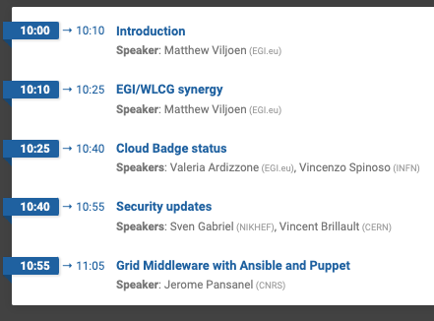
Agenda

Slide 3
EOSC-hub Project News
Service Provider documentation https://wiki.eosc-hub.eu/display/EOSC/Service+Provider+Documentation
onboarding information
TRL information
EOSC-hub Integration Handbook
EOSC-hub Operations Handbook (to be released)
Project extension (3 months) for UMD/CMD release related work
Remaining Operations and Service delivery work
Ensure smooth handover to follow-on project
Document/complete the SMS
Audit of Info Security Management and Configuration Management work

Slide 4
Plans for 2021 and 2023
New projects and service delivery
EOSC-Future and EGI-ACE evaluation results Oct/Nov
Phase IV core service tools delivery from Jan 2021
OLAs for core services to be renewed
Changes:
UMD Infrastructure IASA->Ibergrid
Collaboration tools CESNET->EGI Foundation

Slide 5
CREAM-CE decommission
https://wiki.egi.eu/wiki/PROC16_Decommissioning_of_unsupported_software
CREAM-CE end of life: 31st Dec 2020
Original broadcast: https://operations-portal.egi.eu/broadcast/archive/2293
Number of endpoints (certified, production and monitored): 147
Decommissioning start date: Oct 1st 2020
a probe detecting CREAM-CE endpoints will be run, returning WARNING status
https://ggus.eu/index.php?mode=ticket_info&ticket_id=148715
Nov 1st: probe returns CRITICAL status, alarms created on the ROD dashboard, ROD teams start to create tickets
1st Jan 2021: EGI Ops will start chasing the sites still providing CREAM-CE endpoints
By this time service end-points which couldn't be upgraded should be put into downtime by site admin or ROD:

Slide 6
RCs and RPs OLAs yearly review
New versions finalised
Resource Centre OLA v2.7 https://documents.egi.eu/document/31
Resource Infrastructure Provider OLA v2.7 https://documents.egi.eu/document/463

Slide 7
UMD news
UMD 4.11.3
emergency fix for Frontier, release on Sept 15th: https://repository.egi.eu/2020/09/15/release-umd-4-11-3/
UMD release cycle updates https://wiki.egi.eu/wiki/Next_middleware_release * CentOS8 released in September 2019 https://lists.centos.org/pipermail/centos-announce/2019-September/023449.html ** same life cycle as RHEL https://access.redhat.com/support/policy/updates/errata#Life_Cycle_Dates ** CentOS8 will be maintained until May 2029, CentOS7 will be maintained until June 2024 * UMD currently focuses on CentOS7 ** UMD5, under deployment, will support CentOS8 with new software already ready for CentOS8 ** UMD5/CentOS7 will also inherit software from UMD4/CentOS7 that provides support for the next years (unsupported software will be removed) ** UMD4/CentOS7 will be removed after sites have migrated to UMD5/CentOS7
SL6 will be maintained until November 2020 * sites are aware they need to move services away from SL6; no enforcement/procedure from EGI, but, in case unfixable software security issues come up, the site will be eligible for suspension as usual!

Slide 8
Future events
EGI Virtual Conference 2020 (2-4 Nov)
Programme being finalized
Registration opening in next few days
Realising the European Open Science Cloud (16-19 Nov)
https://www.eosc-hub.eu/events/realising-european-open-science-cloud
Registration opening in next few days
Notes:
in2p3
eosc-hub week – inc. archtecture, rop, spf & tech workshops

Slide 9
Upcoming EGI Webinars
https://www.egi.eu/webinars/
CernVM-FS for Containers (~14 Oct to be confirmed) Jakob Blomer
For: site admins, cluster admins, CVMFS power users
Intro, container distribution, using CVMFS with container runtimes, publishing, Q&A
Dirac services for EGI users (23 Oct) Andrei Tsaregorodtsev
For: users and application experts
Dirac framework overview, managing user jobs/computing resources/data, custom applications using DIRAC API, Q&A
Providing bioinformatics services with Chipster platform (11 Nov) Kimmo Mattila, Petri Klemelä
For: service providers, bioscientists
Structure of Chipster, setting up a new Chipster server, Q&A
Operational aspects of an NGI
For: new NGI managers

Slide 10
Next OMB
19 Nov 2020 (3rd Thursday of the month)
To be confirmed on ML

