Slide 1
Supporting FAIR data discoverability in clinical research: providing a global metadata repository (MDR) of clinical study object
Sergey Goryanin (ECRIN), Hans van Piggelen (SURFsara BV)
Stefano Nicotri (INFN)
Notes:
This is the cover page slide. Insert headings and titles as appropriate.

Slide 2
Revision of web portal (Q1; completed)
ECRIN provided additional requirements and small changes in the web-portal;
All those changes and requirements were implemented by ONEDATA team.

Slide 3
Investigate metadata schema and requirements for future harvesting by B2FIND (Q1 completed; Q2 ongoing)
The possible interactions seem to be problematic due to big differences between the MDR metadata schema and the B2FIND metadata schema.
Interaction seems to be possible on organisational level rather than the level of the content data.
A detailed report exploring the possible interactions between the MDR and B2FIND has been submitted.

Slide 4
Uploading and re-indexing the full dataset (Q1, Q2; ongoing)
The revision of the ECRIN metadata scheme was done;
The metadata scheme was updated (the current version is v. 4: link);
Data is now on the preparation stage.

Slide 5
Testing and upgrading the web-portal with respect to updated ECRIN requirements (Q2; ongoing)
Due to the updated metadata scheme and data; there will be a need to extend the web-portal filters’ options and adapt the MDR web-portal to the new metadata scheme in general.

Slide 6
Start to develop Elasticsearch-based APIs (Q3; completed)
The current APIs work with the ECRIN metadata scheme v. 3;
ES-based API supports 3 types of search:
Specific study search
Search by study characteristics
Via published paper search

Slide 7
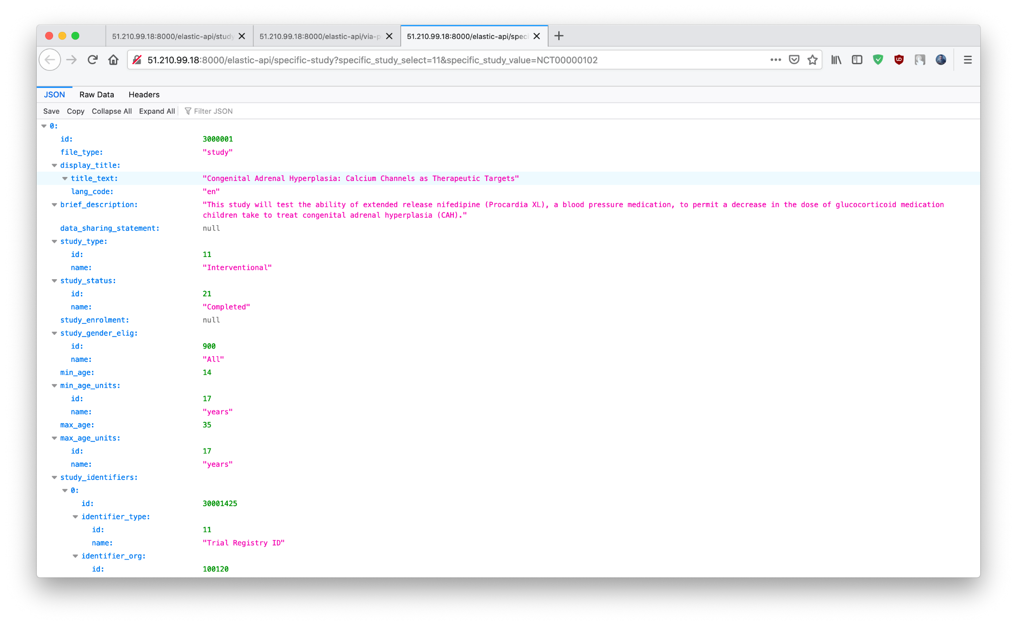

Slide 8
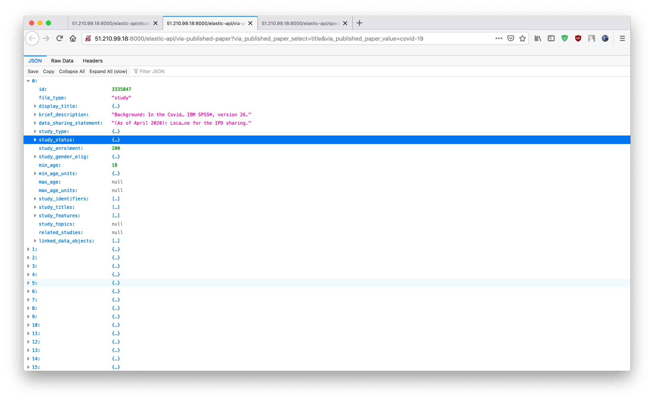

Slide 9
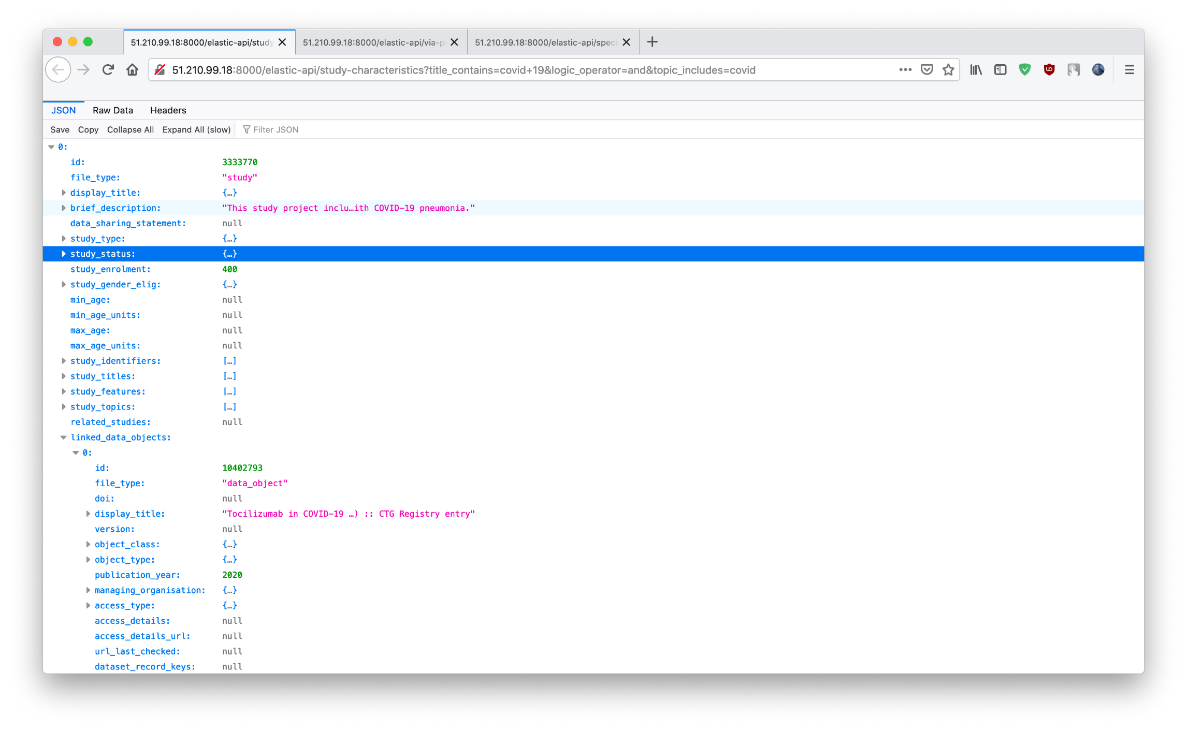

Slide 10
More details?
Confluence:
https://confluence.egi.eu/display/EOSC/Supporting+FAIR+data+discoverability+in+clinical+research:+providing+a+global+metadata+repository+(MDR)+of+clinical+study+object?show-miniview

Slide 11
Thank you!
Any questions?

