Slide 1
OpenBioMaps data management service for biological sciences and biodiversity conservation
PI: Miklós Bán
Shepherd: Miguel Caballer

Slide 2
Overview
The OpenBioMaps (OBM) is a free and open-source database framework for scientific and conservation purposes.
Science areas:
Biology, conservation biology, ecology, biodiversity
The OBM system is used for data management by nature conservation institutes, biodiversity research and citizen science projects.
OBM provides a number of services that make day-to-day work with data easier, but it does not yet provide tools for analyzing the data. Particularly for high computing tasks.
Current use cases:
https://openbiomaps.org/projects/

Slide 3
Current status
Status of access to the services and SLAs agreed with the providers (Created):
SLA agreed with IFCA site (https://documents.egi.eu/public/ShowDocument?docid=3565)
1-8 VM, 48 CPUs, 100 GB RAM, 2 TB HD. (It’s still not clear to me, the size of the allocated resources, because it does not match my two agreements…)
Added extension of 3 months till March the 31th.
Progress of the application:
OBM computation layer: in development
OBM as EOSC service: test node successfully deployed at IFCA manually with OpenStack interface.
Initial version of TOSCA Recipes and Ansible roles created to deploy the application automatically using IM.
Currently testing the automated deployment using Infrastructure Manager Dashboard:
https://appsgrycap.i3m.upv.es:31443/im-dashboard/

Slide 4
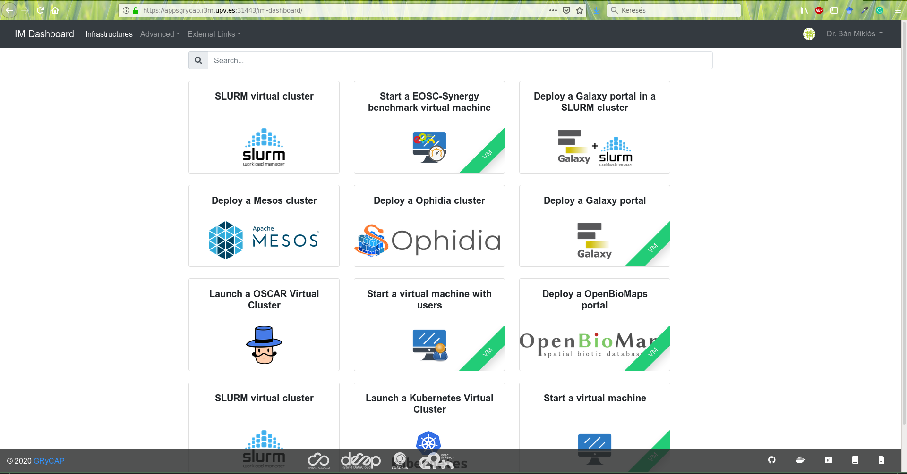
Current Status
TOSCA template and Ansible recipes has been created (with Miguel) to launch OpenBioMaps portal from IM dashboard

Slide 5
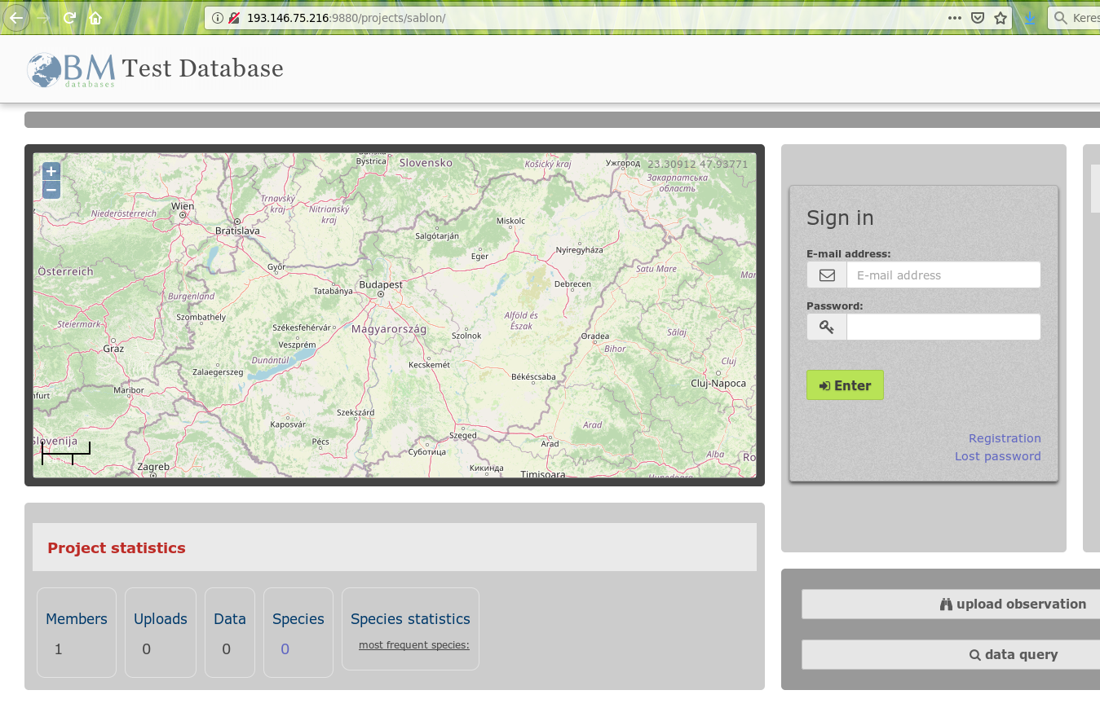
Current Status
OpenBiomaps deployed Successfully!

Slide 6
Background computational service for OpenBioMaps
Creating background computational service for OpenBioMaps projects to help researcher using OBM databases to apply particular computations.
These can be any R or python scripts.

Slide 7
Why do we need a dedicated computing capacity?
Because these are complex and complicated computations and because the data is mostly not generated where there would be capacity to process it. Anyone who would be able to perform these computations mostly doesn’t even know about the data or doesn’t have access to it.
This is because much of the biodiversity data is collected by conservationists and amateurs
Solution: If I can create a database background service that can be used to analyze data from the database without moving it (sharing, downloading or exporting), it is likely that a much larger proportion of biodiversity data will be processed and much more research collaboration will be created with conservation.

Slide 8
I have few early adopters in my remote data processing project
A research groups that performs analysis of a large number of environment factors on the state variables of mid-mountain forests.
National Parks which would like to perform automatic analysis of the spread of species (using drone and satellite images) or other maps

Slide 9
In both cases we have good result in the analysis part
(it is good news for me :D but maybe less interesting here.)
The interface between the OBM database server and the EOSC computational server is still under construction and cannot be published yet. I am currently busy with OBM side developments:
Service access management (who and how can access computation capacity) - It is in testing state/ rebuild a new version
Data management interface (which data selected and how send it the computational node) - It is in testing state/ rebuild a new version
Problem with large file transfers: integrating B2.. services. I don't know yet, how
Sharing data: B2Handle, B2Share - I will get help from our library to learn them..
Using Geoss / Geo DAB - not yet tested
Computational package interface - will be an interface to create/share/upload custom computational packages - we are working on it
Computational node's side developments:
Request processing and management: we are working on a new version
Generalized computation packages: we are working on a new version

Slide 10
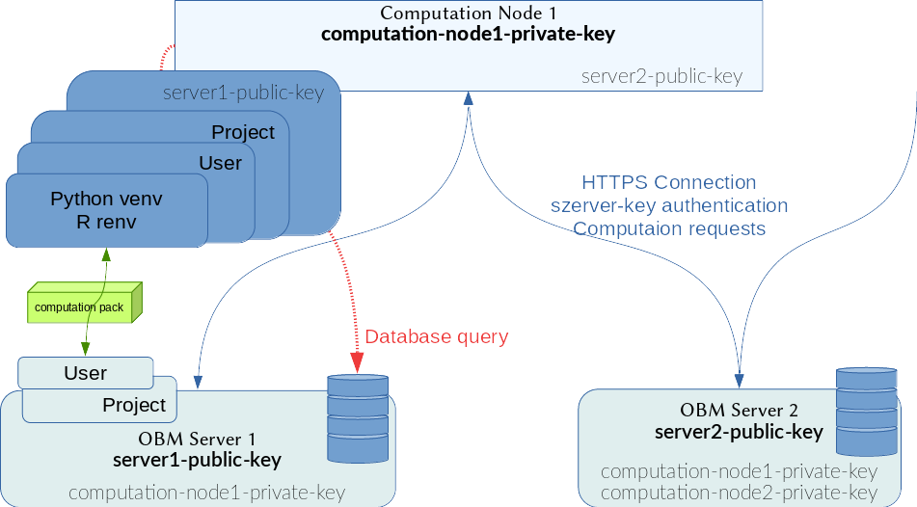
the new computation schema

Slide 11
Issues: At first, things don’t work, then not later...
E.g. on openstack interface:
Volumes still cannot be attached to VMs
Few days ago, our main VM collapsed due to some service level problem. I did not receive any notification about it. The machine could not be restored. Unfortunately, I was unable to create another virtual machine instead of the instance due to some unresolved errors.
Issues beyond the service provider: There is a lot of and diverse information, but it is often superficial. At first, the options always seem scary, but later when I search for the specifics, I don’t find enough information.

Slide 12
banm@vocs.unideb.hu
micafer1@upv.es

